Slide 1
Objectives:
ELECTRO MAGNETIC FIELDS
• To introduce the concepts of electric field, magnetic field.
• Applications of electric and magnetic fields in the development of the theory for power
transmission lines and electrical machines.
UNIT – I Electrostatics:
Electrostatic Fields – Coulomb’s Law – Electric Field Intensity (EFI) – EFI due to a line and a surface
charge – Work done in moving a point charge in an electrostatic field – Electric Potential – Properties of
potential function – Potential gradient – Gauss’s law – Application of Gauss’s Law – Maxwell’s first
law, div ( D )=ρv – Laplace’s and Poison’s equations . Electric dipole – Dipole moment – potential and
EFI due to an electric dipole.
UNIT – II Dielectrics & Capacitance:
Behavior of conductors in an electric field – Conductors and Insulators – Electric field inside a dielectric
material – polarization – Dielectric – Conductor and Dielectric – Dielectric boundary conditions –
Capacitance – Capacitance of parallel plates – spherical co‐axial capacitors. Current density –
conduction and Convection current densities – Ohm’s law in point form – Equation of continuity
UNIT – III Magneto Statics:
Static magnetic fields – Biot‐Savart’s law – Magnetic field intensity (MFI) – MFI due to a straight
current carrying filament – MFI due to circular, square and solenoid current Carrying wire – Relation
between magnetic flux and magnetic flux density – Maxwell’s second Equation, div(B)=0, Ampere’s
Law & Applications: Ampere’s circuital law and its applications viz. MFI due to an infinite sheet of
current and a long current carrying filament – Point form of Ampere’s circuital law – Maxwell’s third
equation, Curl (H)=Jc
UNIT – IV Force in Magnetic fields and Magnetic Potential:
Magnetic force Moving charges in a Magnetic field – Lorentz force equation – force on a current
element in a magnetic field – Force on a straight and a long current carrying conductor in a magnetic
field – Force between two straight long and parallel current carrying conductors – Magnetic dipole and
dipole moment – a differential current loop as a magnetic dipole . Magnetic potential and its limitations
– vector magnetic potential and its properties . Self and Mutual inductance – Neumann’s formulae –
determination of self‐inductance of a solenoid and toroid and mutual inductance between a straight long
wire and a square loop wire in the same plane – energy stored and density in a magnetic field.
UNIT – V Time Varying Fields:
Time varying fields – Faraday’s laws of electromagnetic induction – Its integral and point forms –
Maxwell’s fourth equation, Curl (E)=‐dB/dt – Statically and Dynamically induced EMFs – Simple
problems ‐Modification of Maxwell’s equations for time varying fields – Displacement current
TEXT BOOKS:

Slide 2
UNIT-I
Electrostatic Fields
•
•
•
•
•
•
•
•
•
•
•
Coulomb’s Law
Electric Field Intensity –Fields due to line and surface Charge Distributions
Work done in moving a point charge in an electrostatic field
Electrostatic Potential & Properties of potential function – Potential gradient
Gauss’s law – Application of Gauss’s Law
Maxwell’s first law
Divergence
Laplace’s and Poison’s equations – Solution of Laplace’s equation in one variable
Electric dipole – Dipole moment – potential and EFI due to an electric dipole
Torque on an Electric dipole in an electric field
Behavior of conductors in an electric field – Conductors and Insulators

Slide 3


Introduction:
The electric charge is a fundamental property of matter and charge exist in integral multiple of
electronic charge. Electrostatics can be defined as the study of electric charges at rest. Electric fields
have their sources in electric charges.
(Note: Almost all real electric fields vary to some extent with time. However, for many problems,
the field variation is slow and the field may be considered as static. For some other cases spatial
distribution is nearly same as for the static case even though the actual field may vary with time.
Such cases are termed as quasi-static.)
In this chapter we first study two fundamental laws governing the electrostatic fields, viz, (1)
Coulomb's Law and (2) Gauss's Law. Both these law have experimental basis. Coulomb's law is
applicable in finding electric field due to any charge distribution, Gauss's law is easier to use when
the distribution is symmetrical
.
Coulomb's Law :
Statement:
Coulomb's Law states that the force between two point charges Q1and Q2 is directly proportional to
the product of the charges and inversely proportional to the square of the distance between them.
Point charge is a hypothetical charge located at a single point in space. It is an idealized model of a
particle having an electric charge.
Mathematically,
Where k is the proportionality constant. And
, is called the permittivity of free space
In SI units, Q1 and Q2 are expressed in Coulombs(C) and R is in meters.
Force F is in Newton’s (N)
(We are assuming the charges are in free space. If the charges are any other dielectric medium, we
will use
instead where
is called the relative permittivity or the dielectric constant of the
medium).

Slide 4

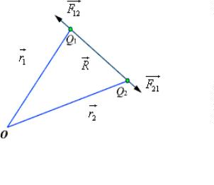




Therefore
....................... (1)
As shown in the Figure 1 let the position vectors of the point charges Q1and Q2 are given by and
. Let represent the force on Q1 due to charge Q2.
Fig 1: Coulomb's Law
The charges are separated by a distance of
. We define the unit vectors as
and
..................................(2)
can be defined as
.
Similarly the force on Q due to charge Q can be calculated and if
represents this force then we can
1
2
write
Force Due to ‘N ‘no.of point charges:
When we have a number of point charges, to determine the force on a particular charge due to all other
charges, we apply principle of superposition. If we have N number of charges Q ,Q ,.........Q located
1
2
N
respectively at the points represented by the position vectors , ,...... , the force experienced by a
charge Q located at is given by,

Slide 5






.................................(3)
Electric Field intensity:
The electric field intensity or the electric field strength at a point is defined as the force per unit charge.
That is
or,
.......................................(4)
The electric field intensity E at a point r (observation point) due a point charge Q located at (source
point) is given by:
..........................................(5)
For a collection of N point charges Q ,Q ,.........Q located at , ,...... , the electric field intensity at
1
2
N
point is obtained as
........................................(6)
The expression (6) can be modified suitably to compute the electric filed due to a continuous
distribution of charges.
In figure 2 we consider a continuous volume distribution of charge (t) in the region denoted as the
source region.
For an elementary charge
field expression as:
, i.e. considering this charge as point charge, we can write the
.............(7)

Slide 6
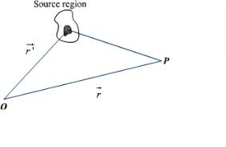




Fig 2: Continuous Volume Distribution of Charge
When this expression is integrated over the source region, we get the electric field at the point P due to
this distribution of charges. Thus the expression for the electric field at P can be written as:
..........................................(8)
Similar technique can be adopted when the charge distribution is in the form of a line charge density or a
surface charge density.
........................................(9)
........................................(10)
Electric flux density:
As stated earlier electric field intensity or simply ‘Electric field' gives the strength of the field at a
particular point. The electric field depends on the material media in which the field is being considered.
The flux density vector is defined to be independent of the material media (as we'll see that it relates to
the charge that is producing it).For a linear isotropic medium under consideration; the flux density
vector is defined as:
................................................(11)
We define the electric flux as
.....................................(12)

Slide 7
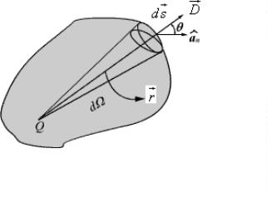





Gauss's Law:
Gauss's law is one of the fundamental laws of electromagnetism and it states that the total electric flux
through a closed surface is equal to the total charge enclosed by the surface.
Fig 3: Gauss's Law
Let us consider a point charge Q located in an isotropic homogeneous medium of dielectric constant .
The flux density at a distance r on a surface enclosing the charge is given by
...............................................(13)
If we consider an elementary area ds, the amount of flux passing through the elementary area is given by
.....................................(14)
But
, is the elementary solid angle subtended by the area
at the location of Q.
Therefore we can write
For a closed surface enclosing the charge, we can write
Which can seen to be same as what we have stated in the definition of Gauss's Law.
Application of Gauss's Law:
Gauss's law is particularly useful in computing
or
where the charge distribution has some

Slide 8

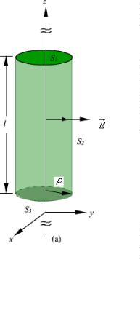
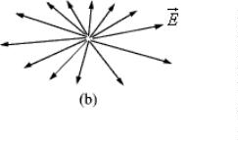
symmetry. We shall illustrate the application of Gauss's Law with some examples.
1. An infinite line charge
As the first example of illustration of use of Gauss's law, let consider the problem of determination of
the electric field produced by an infinite line charge of density LC/m. Let us consider a line charge
positioned along the z-axis as shown in Fig. 4(a) (next slide). Since the line charge is assumed to be
infinitely long, the electric field will be of the form as shown in Fig. 4(b) (next slide).
If we consider a close cylindrical surface as shown in Fig. 2.4(a), using Gauss's theorm we can write,
.....................................(15)
Considering the fact that the unit normal vector to areas S and S are perpendicular to the electric field,
1
3
the surface integrals for the top and bottom surfaces evaluates to zero. Hence we can write,
Fig 4: Infinite Line Charge

Slide 9

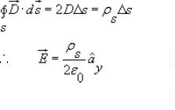
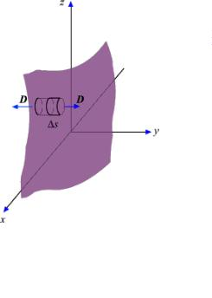
.....................................(16)
2. Infinite Sheet of Charge
As a second example of application of Gauss's theorem, we consider an infinite charged sheet covering
the x-z plane as shown in figure 5. Assuming a surface charge density of for the infinite surface
charge, if we consider a cylindrical volume having sides placed symmetrically as shown in figure 5,
we can write:
..............(17)
Fig 5: Infinite Sheet of Charge
It may be noted that the electric field strength is independent of distance. This is true for the infinite
plane of charge; electric lines of force on either side of the charge will be perpendicular to the sheet and
extend to infinity as parallel lines. As number of lines of force per unit area gives the strength of the
field, the field becomes independent of distance. For a finite charge sheet, the field will be a function of
distance.

Slide 10

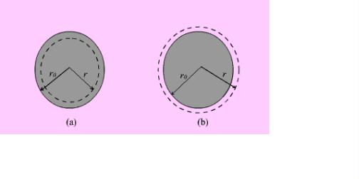




3. Uniformly Charged Sphere
Let us consider a sphere of radius r0 having a uniform volume charge density of rv C/m3. To determine
everywhere, inside and outside the sphere, we construct Gaussian surfaces of radius r < r0 and r > r0
as shown in Fig. 6 (a) and Fig. 6(b).
For the region
; the total enclosed charge will be
.........................(18)
Fig 6: Uniformly Charged Sphere
By applying Gauss's theorem,
............... (19)
Therefore
.............................................. (20)
; the total enclosed charge will be
For the region
........................................................... (21)
By applying Gauss's theorem,
....................................... (22)

Slide 11
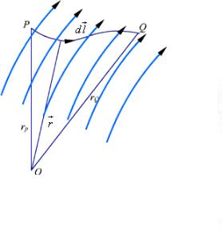


Electrostatic Potential:
In the previous sections we have seen how the electric field intensity due to a charge or a charge
distribution can be found using Coulomb's law or Gauss's law. Since a charge placed in the vicinity of
another charge (or in other words in the field of other charge) experiences a force, the movement of the
charge represents energy exchange. Electrostatic potential is related to the work done in carrying a
charge from one point to the other in the presence of an electric field. Let us suppose that we wish to
move a positive test charge
from a point P to another point Q as shown in the Fig. 8.The force at
any point along its path would cause the particle to accelerate and move it out of the region if
unconstrained. Since we are dealing with an electrostatic case, a force equal to the negative of that
acting on the charge is to be applied while moves from P to Q. The work done by this external
agent in moving the charge by a distance is given by:
............................. (23)
Fig 8: Movement of Test Charge in Electric Field
The negative sign accounts for the fact that work is done on the system by the external agent.
..................................... (24)
The potential difference between two points P and Q , VPQ, is defined as the work done per unit
charge, i.e.
............................... (25)

Slide 12
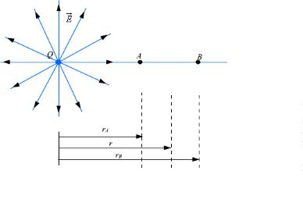


It may be noted that in moving a charge from the initial point to the final point if the potential difference
is positive, there is a gain in potential energy in the movement, external agent performs the work against
the field. If the sign of the potential difference is negative, work is done by the field.
We will see that the electrostatic system is conservative in that no net energy is exchanged if the test
charge is moved about a closed path, i.e. returning to its initial position. Further, the potential difference
between two points in an electrostatic field is a point function; it is independent of the path taken. The
potential difference is measured in Joules/Coulomb which is referred to as Volts.
Let us consider a point charge Q as shown in the Fig. 9.
Fig 9: Electrostatic Potential calculation for a point charge
Further consider the two points A and B as shown in the Fig. 9. Considering the movement of a unit
positive test charge from B to A , we can write an expression for the potential difference as:
...................(26)
It is customary to choose the potential to be zero at infinity. Thus potential at any point ( rA = r) due to a
point charge Q can be written as the amount of work done in bringing a unit positive charge from
infinity to that point (i.e. rB = 0).
.................................. (27)
Or, in other words,

Slide 13

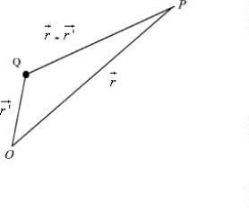



..................................(28)
Let us now consider a situation where the point charge Q is not located at the origin as shown in Fig. 10.
Fig 10: Electrostatic Potential due a Displaced Charge
The potential at a point P becomes
.................................. (29)
So far we have considered the potential due to point charges only. As any other type of charge
distribution can be considered to be consisting of point charges, the same basic ideas now can be
extended to other types of charge distribution also. Let us first consider N point charges Q1, Q2 ,..... QN
located at points with position vectors , , ....... . The potential at a point having position vector
can be written as:
.................................. (30a)
OR
...................................(30b)
For continuous charge distribution, we replace point charges Qn by corresponding charge elements
or
or
depending on whether the charge distribution is linear, surface or a volume
charge distribution and the summation is replaced by an integral. With these modifications we can write:

Slide 14






For line charge,
…………………(31)
For surface charge,
For volume charge,
................................. (32)
................................. (33)
It may be noted here that the primed coordinates represent the source coordinates and the unprimed
coordinates represent field point.
Further, in our discussion so far we have used the reference or zero potential at infinity. If any other
point is chosen as reference, we can write:
.................................(34)
where C is a constant. In the same manner when potential is computed from a known electric field we
can write:
……………….. (35)
The potential difference is however independent of the choice of reference.
.......................(36)
We have mentioned that electrostatic field is a conservative field; the work done in moving a charge
from one point to the other is independent of the path. Let us consider moving a charge from point P1 to
P2 in one path and then from point P2 back to P1 over a different path. If the work done on the two
paths were different, a net positive or negative amount of work would have been done when the body
returns to its original position P1. In a conservative field there is no mechanism for dissipating energy
corresponding to any positive work neither any source is present from which energy could be absorbed
in the case of negative work. Hence the question of different works in two paths is untenable; the work

Slide 15




must have to be independent of path and depends on the initial and final positions.
Since the potential difference is independent of the paths taken, VAB = - VBA , and over a closed path,
.................................(37)
Applying Stokes's theorem, we can write:
............................ (38)
from which it follows that for electrostatic field,
......................(39)
Any vector field that satisfies is called an irrotational field.
From our definition of potential, we can write
.................................(40)
from which we obtain,
.......................................... (41)
From the foregoing discussions we observe that the electric field strength at any point is the negative of
the potential gradient at any point, negative sign shows that
is directed from higher to lower values of
. This gives us another method of computing the electric field , i. e. if we know the potential function,
the electric field may be computed. We may note here that that one scalar function contain all the
information that three components of carry, the same is possible because of the fact that three
components of are interrelated by the relation
.
Equipotential Surfaces
An equipotential surface refers to a surface where the potential is constant. The intersection of an
equipotential surface with an plane surface results into a path called an equipotential line. No work is
done in moving a charge from one point to the other along an equipotential line or surface.

Slide 16
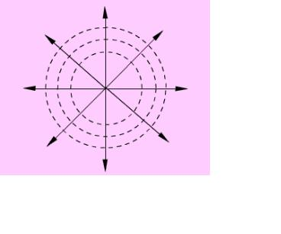

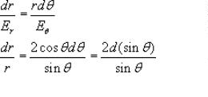
In figure 12, the dashes lines show the equipotential lines for a positive point charge. By symmetry, the
equipotential surfaces are spherical surfaces and the equipotential lines are circles. The solid lines show
the flux lines or electric lines of force.
Fig 12: Equipotential Lines for a Positive Point Charge
Michael Faraday as a way of visualizing electric fields introduced flux lines. It may be seen that the
electric flux lines and the equipotential lines are normal to each other. In order to plot the equipotential
lines for an electric dipole, we observe that for a given Q and d, a constant V requires that
is a
constant. From this we can write to be the equation for an equipotential surface and a
family of surfaces can be generated for various values of cv.When plotted in 2-D this would give
equipotential lines.
To determine the equation for the electric field lines, we note that field lines represent the direction of
in space. Therefore,
, k is a constant .............................................(42)
.................(43)
For the dipole under consideration =0 , and therefore we can write,
.................................. (44)

Slide 17




Work done in moving a point charge in an electrostatic field:
We have stated that the electric potential at a point in an electric field is the amount of work required to
bring a unit positive charge from infinity (reference of zero potential) to that point. To determine the
energy that is present in an assembly of charges, let us first determine the amount of work required to
assemble them. Let us consider a number of discrete charges Q1, Q2,......., QN are brought from infinity
to their present position one by one. Since initially there is no field present, the amount of work done in
bring Q1 is zero. Q2 is brought in the presence of the field of Q1, the work done W1= Q2V21 where
V21 is the potential at the location of Q2 due to Q1. Proceeding in this manner, we can write, the total
work done
Had
....................(45)
reverse
the
charges
been
brought
in
the
order,
................(46)
Therefore,
....
............(47)
Here VIJ represent voltage at the Ith charge location due to Jth charge. Therefore,
Or,
................(48)
If instead of discrete charges, we now have a distribution of charges over a volume v then we can write,
................(49)
where
Since,
is the volume charge density and V represents the potential function.
, we can write
.......................................(50)
Using the vector identity,

Slide 18
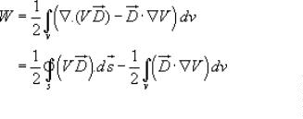






, we can write
................(51)
In the expression
varies as
, for point charges, since V varies as
and D varies as
, the term V
and the as
while the area varies as r2. Hence the integral term varies at least as
surface becomes large (i.e.
) the integral term tends to zero.
Thus the equation for W reduces to
................(52)
, is called the energy density in the electrostatic field.
Maxwell’s first law:
Statement:The following Electrostatic Field equations will be developed in this section:
Integral form Differential forms
Maxwell’s first equation is based on Gauss’ law of electrostatics published in 1832, wherein Gauss
established the relationship between static electric charges and their accompanying static fields.
The above integral equation states that the electric flux through a closed surface area is equal to the total
charge enclosed.

Slide 19

The differential form of the equation states that the divergence or outward flow of electric flux from a
point is equal to the volume charge density at that point.
Divergence:
The divergence represents the volume density of the outward fluxof a vector field from an infinitesimal
volume around a given point.
The following properties can all be derived from the ordinary differentiation rules of calculus. Most
importantly, the divergence is a linear operator, i.e.
for all vector fields F and G and all real numbers a and b.
There is a product rule of the following type: if φ is a scalar-valued function and F is a vector field, then
or in more suggestive notation
Another product rule for the cross product of two vector fields F and G in three dimensions involves
the curl and reads as follows:
or
The Laplacian of a scalar field is the divergence of the field's gradient:
The divergence of the curl of any vector field (in three dimensions) is equal to zero:
.
Poisson’s and Laplace’s Equations:
For electrostatic field, we have seen that
................................................................(53)
Form the above two equations we can write
................................................(54)

Slide 20




Using vector identity we can write,
................(55)
. Therefore,
For a simple homogeneous medium,
................(56)
is constant and
This equation is known as Poisson’s equation. Here we have introduced a new operator
, ( del
square), called the Laplacian operator. In Cartesian coordinates,
...............(57)
Therefore, in Cartesian coordinates, Poisson equation can be written as:
...............(58)
In cylindrical coordinates,
...............(59)
In spherical polar coordinate system,
...............(60)
At points in simple media, where no free charge is present, Poisson’s equation reduces to
...................................(61)
Which is known as Laplace’s equation.
Laplace’s and Poisson’s equation are very useful for solving many practical electrostatic field problems
where only the electrostatic conditions (potential and charge) at some boundaries are known and
solution of electric field and potential is to be found hroughout the volume. We shall consider such
applications in the section where we deal with boundary value problems.
Solutions to Laplace's Equation in CartesianCoordinates:
Having investigated some general properties of solutions to Poisson's equation, it is now appropriate to
study specific methods of solution to Laplace's equation subject to boundary conditions. Exemplified by
this and the next section are three standard steps often used in representing EQS fields. First, Laplace's
equation is set up in the coordinate system in which the boundary surfaces are coordinate surfaces. Then,

Slide 21




the partial differential equation is reduced to a set of ordinary differential equations by separation of
variables. In this way, an infinite set of solutions is generated. Finally, the boundary conditions are
satisfied by superimposing the solutions found by separation of variables.
In this section, solutions are derived that are natural if boundary conditions are stated along coordinate
surfaces of a Cartesian coordinate system. It is assumed that the fields depend on only two
coordinates, x and y, so that Laplace's equation is (Table I)
This is a partial differential equation in two independent variables. One time-honored method of
mathematics is to reduce a new problem to a problem previously solved. Here the process of finding
solutions to the partial differential equation is reduced to one of finding solutions to ordinary differential
equations. This is accomplished by the method of separation of variables. It consists of assuming
solutions with the special space dependence
In (2), X is assumed to be a function of x alone and Y is a function of y alone. If need be, a general space
dependence is then recovered by superposition of these special solutions. Substitution of (2) into (1) and
division by then gives
Total derivative symbols are used because the respective functions X and Y are by definition only
functions of x and y.
In (3) we now have on the left-hand side a function of x alone, on the right-hand side a function
of y alone. The equation can be satisfied independent of x and y only if each of these expressions is
constant. We denote this "separation" constant by k², and it follows that
and
These equations have the solutions

Slide 22
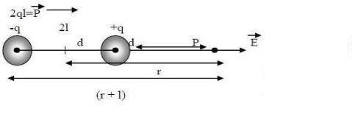
If k = 0, the solutions degenerate into
The product solutions, (2), are summarized in the first four rows of Table 5.4.1. Those in the right-hand
column are simply those of the middle column with the roles of x and y interchanged. Generally, we will
leave the prime off the k' in writing these solutions. Exponentials are also solutions to (7). These,
sometimes more convenient, solutions are summarized in the last four rows of the table.
Electric dipole:
The name given to two point charges of equal magnitude and opposite sign, separated by a distance
which is small compared to the distance to the point P, at which we want to know the electric and
potential fields
Dipole moment:
A stronger mathematical definition is to use vector algebra, since a quantity with magnitude and
direction, like the dipole moment of two point charges, can be expressed in vector form
W
h
e
r
e
d
i
s
t
h
e
d
i
s
p
l
a
c
e
m
e
n
t
v
e
c
t
o
r
p
o
i
n
t
i
n
g
f
r
o
m
t
h
e
n
e
g
a
t
i
v
e
c
h
a
r
g
e
t
o
t
h
e
p
o
s
i
t
i
v
e
c
h
a
r
g
e
.
T
h
e
e
l
e
c
t
r
i
dipole moment vector p also points from the negative charge to the positive charge.
c
EFI due to an electric dipole:
To calculate electric field created by a dipole on the axial line ( on the same line joining the two charges),
•
All the measurement of distances are to be taken from the centre(O).
•
•
Let the distance between O to +q and O to –q be‘l’.So, total length between +q and –q will be ‘2l’.
Take a point ‘p’on the axial line at the distance ‘r’from the centre as shown in figure.

Slide 23
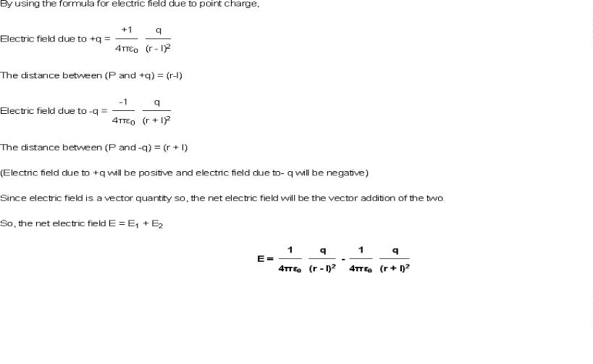
Now, we wish to calculate electric field at point ‘P’.

Slide 24
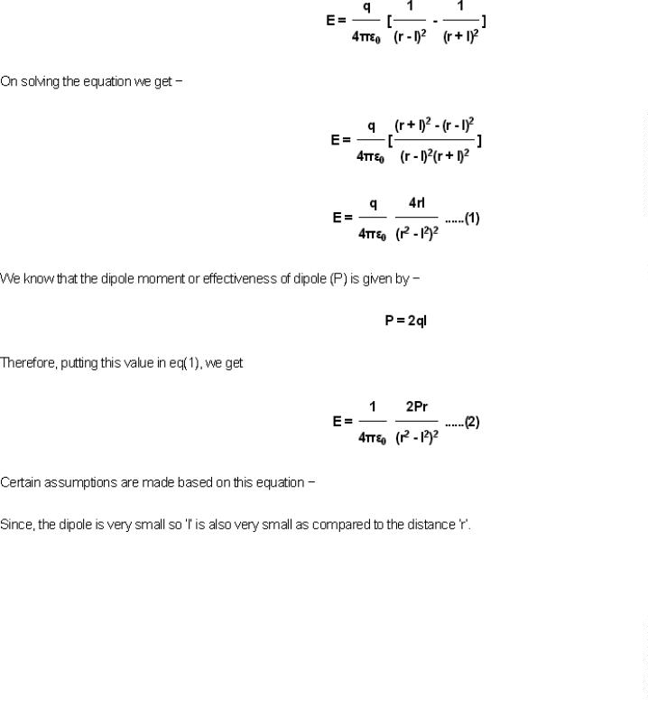

Slide 25
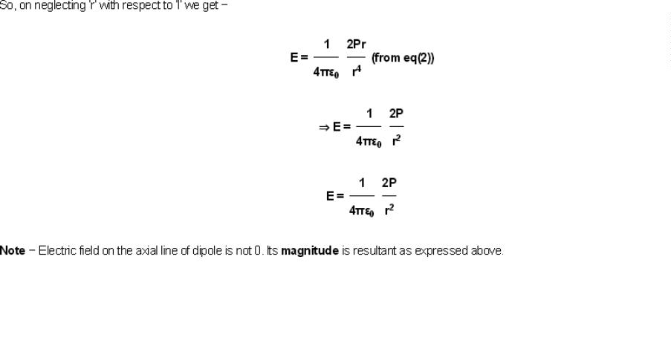
Torque:
An object with an electric dipole moment is subject to a torque τ when placed in an external electric
field. The torque tends to align the dipole with the field. A dipole aligned parallel to an electric field has
lower potential energy than a dipole making some angle with it. For a spatially uniform electric field E,
the torque is given by
where p is the dipole moment, and the symbol "×" refers to the vector cross product. The field vector and
the dipole vector define a plane, and the torque is directed normal to that plane with the direction given
by the right-hand rule.
A dipole oriented co- or anti-parallel to the direction in which a non-uniform electric field is increasing
(gradient of the field) will experience a torque, as well as a force in the direction of its dipole moment. It
can be shown that this force will always be parallel to the dipole moment regardless of co- or anti-
parallel orientation of the dipole.

Slide 26
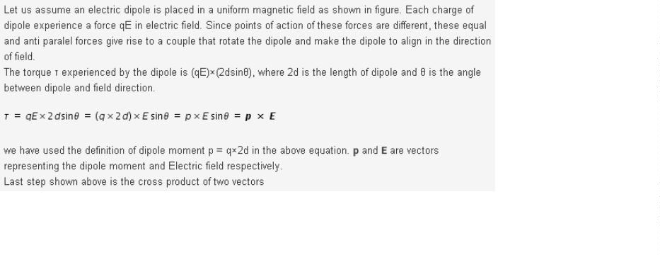
Torque on an Electric dipole in an electric field:

Slide 27
UNIT – II
Dielectrics & Capacitance
• Behavior of conductors in an electric field – Conductors and Insulators
• Electric field inside a dielectric material
• polarization
• Dielectric – Conductor boundary conditions
• Dielectric – Dielectric boundary conditions
• Capacitance-Capacitance of parallel plates – spherical co‐axial capacitors with composite
dielectrics
• Energy stored and energy density in a static electric field
• Current density
• conduction and Convection current densities
• Ohm’s law in point form
• Equation of continuity

Slide 28
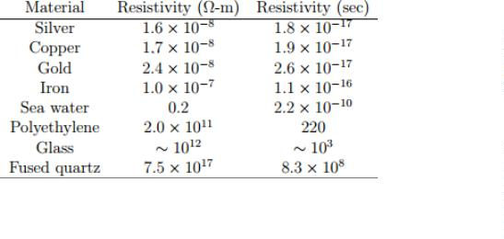
Behavior of conductors in an electric field:
Conductors:
Materials in which it is easy for charges to move around. We will discuss conductors in some depth
when we discuss currents; for now, we will just summarize a few of their properties. Among the best
conductors are metals — silver, gold, copper, aluminum, etc. The atoms of these metals form a
crystalline structure in which electrons can easily hop around from atom to atom. Although a chunk of
metal is neutral overall, we can visualize it as being made of lots of positive charges that are nailed in
place, paired up with lots of negative charges (electrons) that are free to move around. In isolation, the
negative charges will sit close to the positive charges, so that the metal is not only neutral overall, but
also largely neutral everywhere (no local excess of positive or negative charge). Under the influence of
some external field, the electrons are free to move around.
Electric fields and conductors For the rest of this lecture, we will assume that conductors are materials
that have an infinite supply of charges that are free to move around. (This of course just an idealization;
but, it turns out to be an extremely good one. Real conductors in fact behave very similar to this limit.)
From this, we can deduce a few important facts about conductors and electrostatic fields
• There is no electric field inside a conductor: Why? Suppose we bring a plus charge near a conductor.
For a very short moment, there will be an electric field inside the conductor. However, this field will act
on and move the electrons, which are free to move about. The electrons will move close to the plus
charge, leaving net positive charge behind. The conductor’s charges will continue to move until the
“external” E~ -field is cancelled out — at that point there is no longer an E~ -field to move them, so
they stay still.
• Net charge can only reside on the surface of a conductor:This is easily proved with Gauss’s law:
make a little Gaussian surface that is totally contained inside the conductor. Since there is no E~ -field
inside the conductor, H E~ · dA~ is clearly zero for your surface. Since that is equal to the charge the
surface contains, there can be no charge. We will discuss the charge on the conductor’s surface in a
moment.

Slide 29
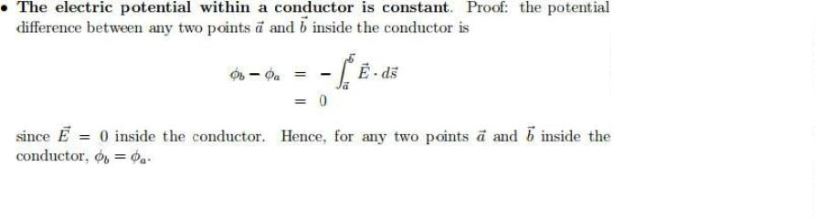
• Any external electric field lines are perpendicular to the surface: Another way to put this is that
there is no component of electric field that is tangent to the surface. We prove this by contradiction:
suppose that a component of the E~ -field were tangent to the surface. If that were the case, then charges
would flow along the surface. They would continue to flow until there was no longer any tangential
component to the E~ -field. Hence, this situation cannot exist: even if it exists momentarily, it will
rapidly (within 10−17 seconds or so) correct itself.
• The conductor’s surface is an equipotential: This follows from the fact that the E~ -field is
perpendicular to the surface. We do a line integral of E~ on the surface; the path is perpendicular to the
field; so the difference in potential between any two points on the surface is zero.
Insulators:
Insulators, on the other hand, are substances that have exactly the opposite effect on the flow of
electrons. These substances impede the free flow of electrons, thereby inhibiting the flow of electrical
current. Insulators contain atoms that hold on to their electrons tightly which restrict the flow of
electrons from one atom to another. Because of the tightly bound electrons, they are not able to roam
around freely. In simple terms, substances that prevent the flow of current are insulators. The materials
have such low conductivity that the flow of current is almost negligible, thus they are commonly used to
protect us from dangerous effects of electricity.
Some common examples of insulators are glass, plastic, ceramics, paper, rubber, etc. The flow of
current in electronic circuits is not static and voltage can be quite high at times, which makes it a little
vulnerable. Sometimes the voltage is high enough to cause electric current to flow through materials that
are not even considered as good conductors of electricity. This can cause electric shock because human
body is also a good conductor of electricity. Therefore, electric wires are coated with rubber which acts
as an insulator which in turn protects us from the conductor inside.

Slide 30
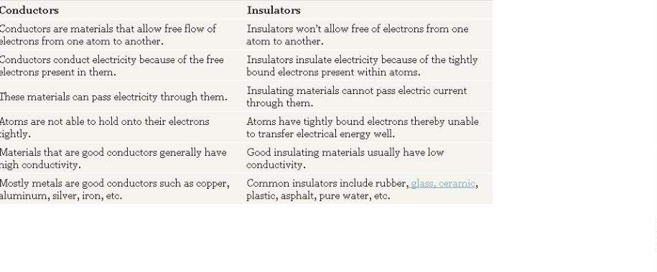
Conductors vs. Insulators: Comparison Chart

Slide 31
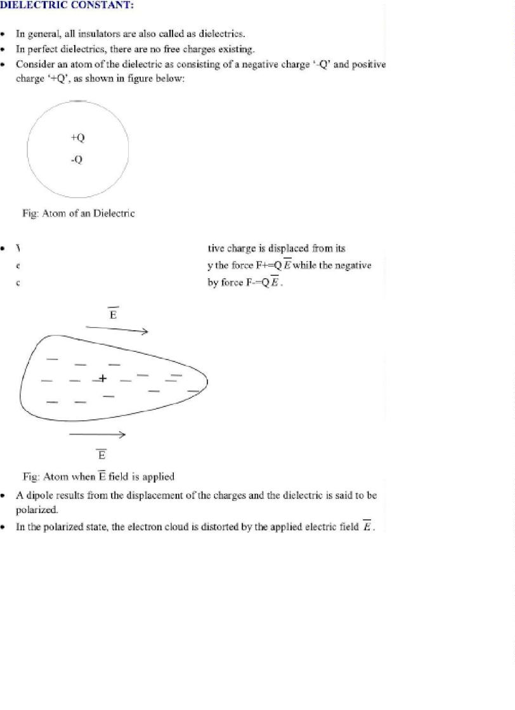
Electric field inside a dielectric material – polarization:

Slide 32
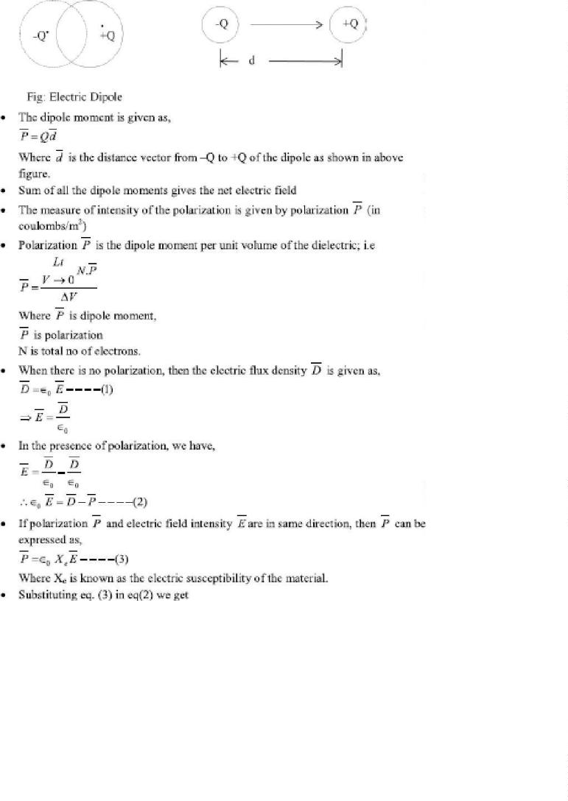

Slide 33
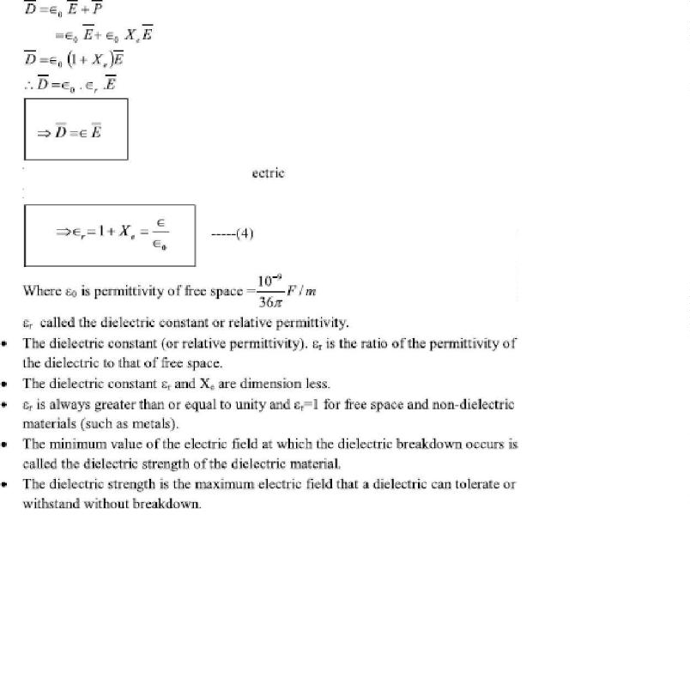


Boundary Conditions:
•
•
The boundary conditions at an interface separating:
– Dielectric and dielectric
– Conductor and dielectric
– Conductor and free space
To determine the boundary conditions, we need to use Maxwell’s equation:

Slide 34


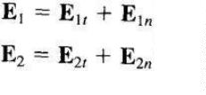
And
•
Decomposing the electric field intensity E into orthogonal components
where
and are, respectively, the tangential and normal components of E to the interface of interest
1.Dielectric – dielectric boundary conditions:
E and E in media 1 and 2 can be decomposed as
1
2
Applying Maxwell’s equation to the closed path ( abcda )
( 1 )

Slide 35

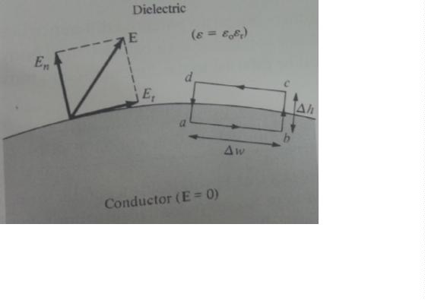




As ∆ℎ− > 0 , equation ( 1 ) becomes
( 2 )
is said to be continuous across the boundary
•
Since D = = + , eq. (2) can be written as
Or
is said to be discontinuous across the interface
Applying the Gauss’s law , we have
Allowing ∆ℎ−>gives

Slide 36
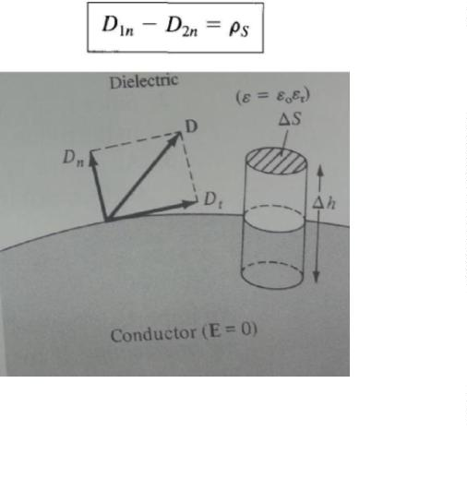


Or
If no free charges exist at the interface , so
(1)
is continuous across the interface , since = ,eq. ( 1 ) can be written as
The normal component of ( E ) is discontinuous at the boundary
2. Conductor – dielectric boundary conditions:
Applying Maxwell’s equation to the closed path ( abcda )

Slide 37
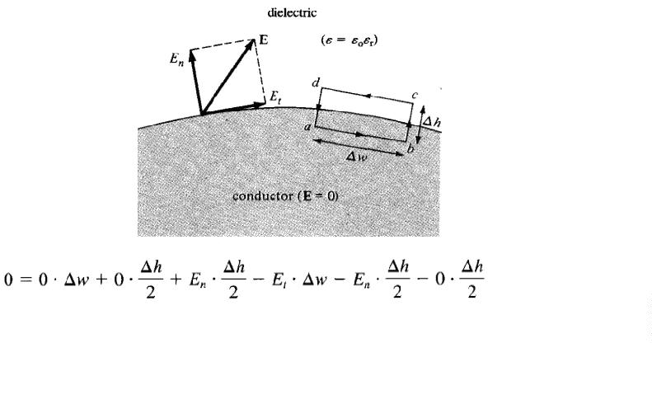

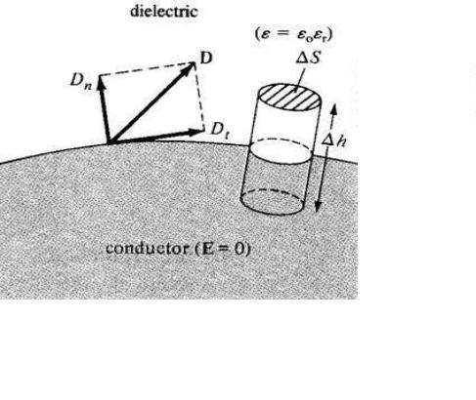

As∆ℎ-> 0,
Similarly, by applying the Gauss’s law to the pillbox and letting ∆ℎ → 0,we have

Slide 38




because D = = 0 inside the conductor, so
Or
Thus under static conditions, the following conclusions can be made about a perfect conductor:
1. No electric field may exist within a conductor
2. Since E = - _ = 0, there can be no potential difference any two points in theconductor
3. The electric field E can be external to the conductor and normal to its surface

Slide 39
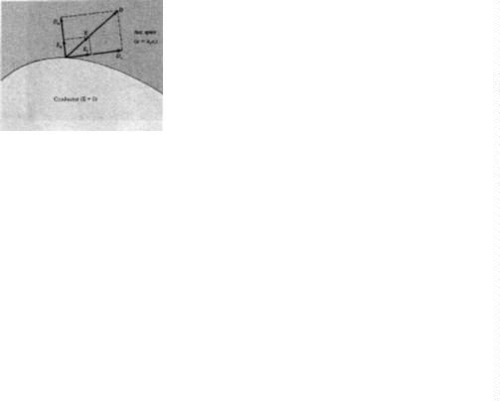



3. Conductor – free space boundary conditions:
This is a special case of the conductor – dielectric condition. Free space is a special dielectric
for which
Thus the boundary conditions are
Capacitance and Capacitors:
We have already stated that a conductor in an electrostatic field is an Equipotential body and any
charge given to such conductor will distribute themselves in such a manner that electric field
inside the conductor vanishes. If an additional amount of charge is supplied to an isolated
conductor at a given potential, this additional charge will increase the surface charge density
. Since the potential of the conductor is given by
, the potential of the

Slide 40

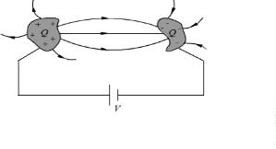


conductor will also increase maintaining the ratio same
. Thus we can write
where the
constant of proportionality C is called the capacitance of the isolated conductor. SI unit of
capacitance is Coulomb/ Volt also called Farad denoted by F. It can It can be seen that if V=1, C
= Q. Thus capacity of an isolated conductor can also be defined as the amount of charge in
Coulomb required to raise the potential of the conductor by 1 Volt.
Of considerable interest in practice is a capacitor that consists of two (or more) conductors
carrying equal and opposite charges and separated by some dielectric media or free space. The
conductors may have arbitrary shapes. A two-conductor capacitor is shown in figure below.
Fig : Capacitance and Capacitors
When a d-c voltage source is connected between the conductors, a charge transfer occurs which
results into a positive charge on one conductor and negative charge on the other conductor. The
conductors are equipotential surfaces and the field lines are perpendicular to the conductor
surface. If V is the mean potential difference between the conductors, the capacitance is given by
. Capacitance of a capacitor depends on the geometry of the conductor and the
permittivity of the medium between them and does not depend on the charge or potential
difference between conductors. The capacitance can be computed by assuming Q(at the same
time -Q on the other conductor), first determining
using Gauss’s theorem and then
determining
capacitor.
. We illustrate this procedure by taking the example of a parallel plate
Example: Parallel plate capacitor

Slide 41
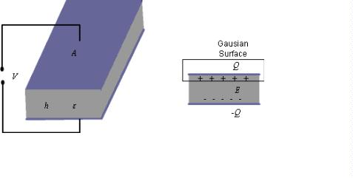




Fig : Parallel Plate Capacitor
For the parallel plate capacitor shown in the figure about, let each plate has area A and a distance
h separates the plates. A dielectric of permittivity fills the region between the plates. The
electric field lines are confined between the plates. We ignore the flux fringing at the edges of
the plates and charges are assumed to be uniformly distributed over the conducting plates with
densities
and -
,
.
By Gauss’s theorem we can write,
.......................(1)
As we have assumed to be uniform and fringing of field is neglected, we see that E is
constant in the region between the plates and therefore, we can write
parallel plate capacitor we have,
. Thus, for a
........................(2)
Series and parallel Connection of capacitors
Capacitors are connected in various manners in electrical circuits; series and parallel connections
are the two basic ways of connecting capacitors. We compute the equivalent capacitance for such
connections.
Series Case: Series connection of two capacitors is shown in the figure 1. For this case we can
write,

Slide 42
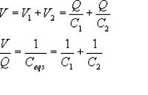
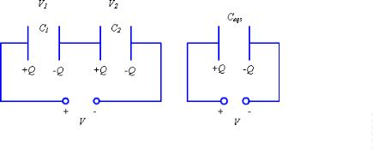
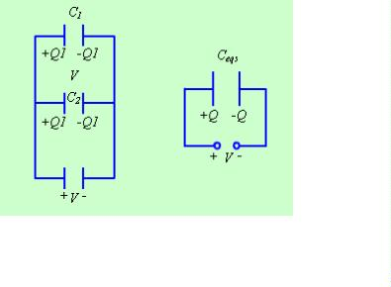

.......................(1)
Fig 1.: Series Connection of Capacitors
Fig 2: Parallel Connection of Capacitors
The same approach may be extended to more than two capacitors connected in series.
Parallel Case: For the parallel case, the voltages across the capacitors are the same.
The total charge
Therefore,
.......................(2)

Slide 43
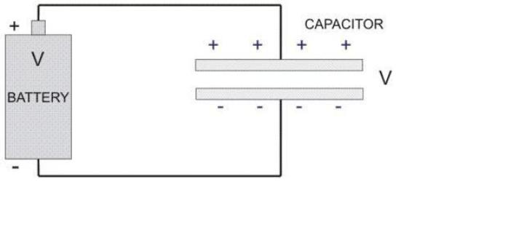

Energy Stored in Capacitor:
While capacitor is connected across a battery, charges come from the battery and get stored in
the capacitor plates. But this process of energy storing is step by step only.At the very beginning,
capacitor does not have any charge or potential. i.e. V = 0 volts and q = 0 C.
Now at the time of switching, full battery voltage will fall across the capacitor. A positive charge
(q) will come to the positive plate of the capacitor, but there is no work done for this first charge
(q) to come to the positive plate of the capacitor from the battery. It is because of the capacitor
does not have own voltage across its plates, rather the initial voltage is due to the battery. First
charge grows little amount of voltage across the capacitor plates, and then second positive charge
will come to the positive plate of the capacitor, but gets repealed by the first charge. As the
battery voltage is more than the capacitor voltage then this second charge will be stored in the
positive plate.
At that condition a little amount of work is to be done to store second charge in the
capacitor. Again for the third charge, same phenomenon will appear. Gradually charges will
come to be stored in the capacitor against pre-stored charges and their little amount of work done
grows up.

Slide 44
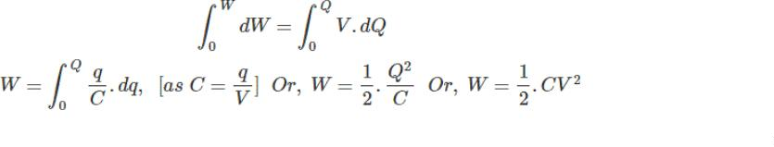





This half energy from total amount of energy goes to the capacitor and rest half of energy
automatically gets lost from the battery and it should be kept in mind always.
Continuity Equation and Kirchhoff’s Current Law
Let us consider a volume V bounded by a surface S. A net charge Q exists within this region. If a
net current I flows across the surface out of this region, from the principle of conservation of
charge this current can be equated to the time rate of decrease of charge within this volume.
Similarly, if a net current flows into the region, the charge in the volume must increase at a rate
equal to the current. Thus we can write,
.....................................(3)
or,
......................(4)
Applying divergence theorem we can write,
.....................(5)
It may be noted that, since in general may be a function of space and time, partial derivatives
are used. Further, the equation holds regardless of the choice of volume V , the integrands must
be equal.
Therefore we can write,
................(6)

Slide 45


The equation (6) is called the continuity equation, which relates the divergence of current density
vector to the rate of change of charge density at a point.
For steady current flowing in a region, we have
......................(7)
Considering a region bounded by a closed surface,
..................(8)
which can be written as,
......................(9)
when we consider the close surface essentially encloses a junction of an electrical circuit.
The above equation is the Kirchhoff’s current law of circuit theory, which states that
algebraicsum of all the currents flowing out of a junction in an electric circuit, is zero.

Slide 46
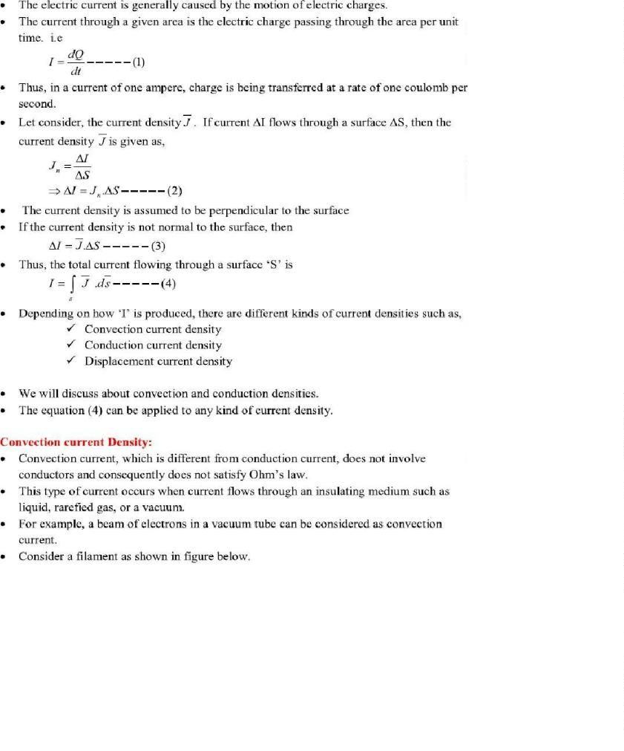
Convention and conduction current:

Slide 47
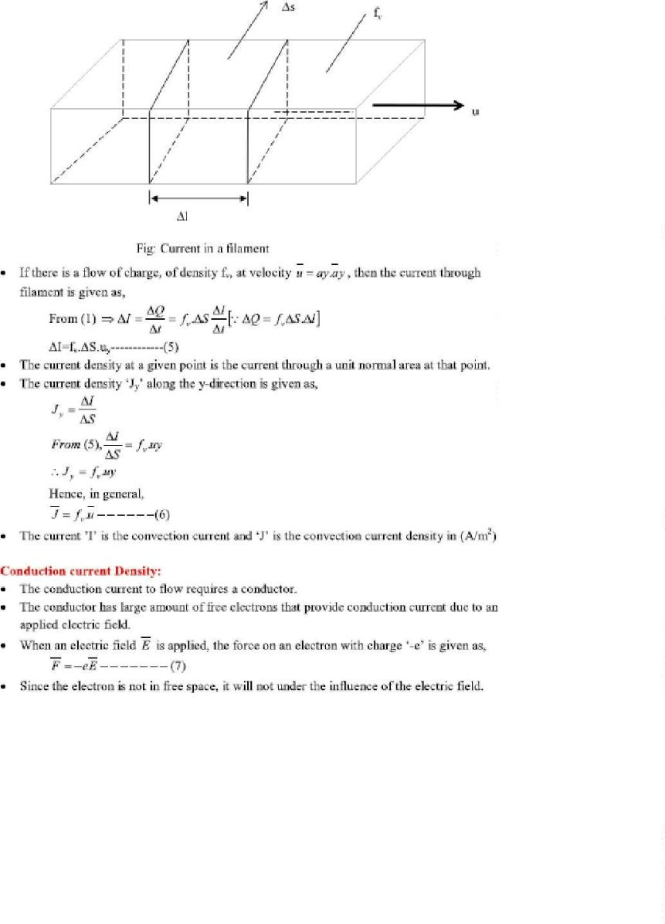

Slide 48
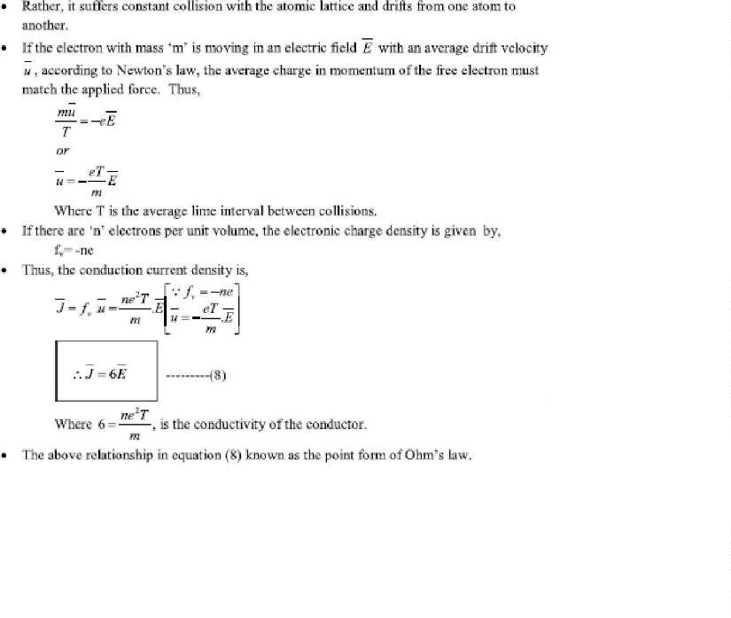
Ohm’s law in point form:

Slide 49

UNIT – III
Magneto Statics
• Biot‐Savart’s law
Magnetic field intensity (MFI)
MFI due to a straight current carrying filament
MFI due to circular, square and solenoid current Carrying wire
Relation between magnetic flux and magnetic flux density
• Maxwell’s second Equation, div(B)=0,
• Ampere’s circuital law and its applications viz. MFI due to an infinite sheet of
current and a long current carrying filament
• Point form of Ampere’s circuital law
• Maxwell’s third equation, Curl (H)=Jc

Slide 50
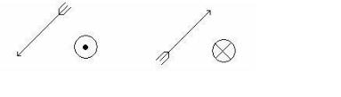
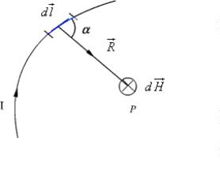
Introduction:
In previous chapters we have seen that an electrostatic field is produced by static or stationary
charges. The relationship of the steady magnetic field to its sources is much more complicated.
The source of steady magnetic field may be a permanent magnet, a direct current or an electric
field changing with time. In this chapter we shall mainly consider the magnetic field produced by
a direct current. The magnetic field produced due to time varying electric field will be discussed
later. Historically, the link between the electric and magnetic field was established Oersted in
1820. Ampere and others extended the investigation of magnetic effect of electricity . There are
two major laws governing the magneto static fields are:
Biot-Savart Law:
Usually, the magnetic field intensity is represented by the vector . It is customary to represent
the direction of the magnetic field intensity (or current) by a small circle with a dot or cross sign
depending on whether the field (or current) is out of or into the page as shown in Fig. 1.
Fig. 1: Representation of magnetic field (or current)
Biot- Savart Law
This law relates the magnetic field intensity dH produced at a point due to a differential current
element
as shown in Fig. 2.
Fig. 2: Magnetic field intensity due to a current element
The magnetic field intensity at P can be written as,

Slide 51



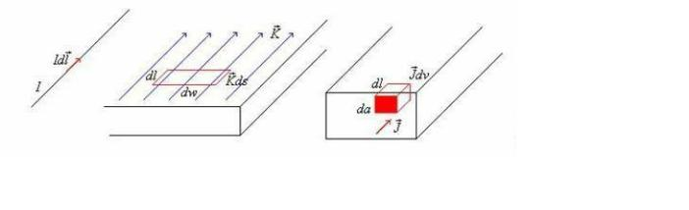



............................(1a)
..............................................(1b)
Where
is the distance of the current element from the point P.
Similar to different charge distributions, we can have different current distribution such as line
current, surface current and volume current. These different types of current densities are shown
in Fig. 3.
Fig. 3: Different types of current distributions
By denoting the surface current density as K (in amp/m) and volume current density as J (in
amp/m2) we can write:
......................................(2)
( It may be noted that
)
Employing Biot-Savart Law, we can now express the magnetic field intensity H. In terms of
these current distributions.
............................. for line current............................(3a)
........................ for surface current ....................(3b)
....................... for volume current......................(3c)

Slide 52

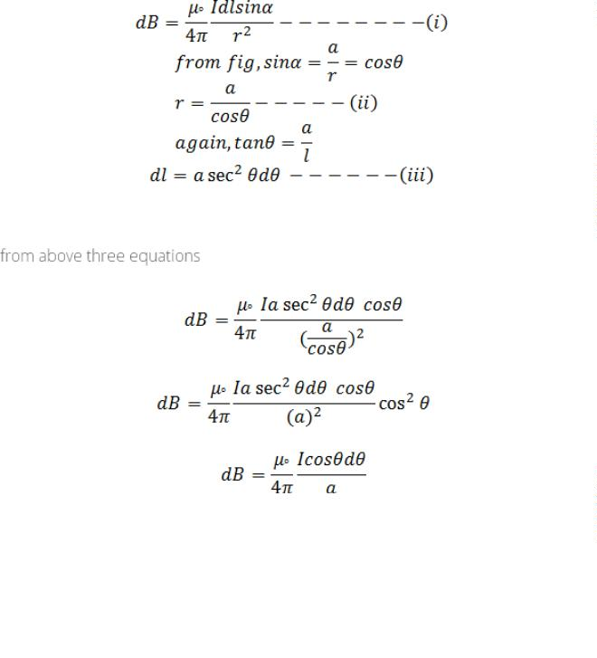
MFI due to a straight current carrying filament:
Consider an infinitely long conductor AB through which current I flows. Let P be any point at a
distance a from the centre of conductor. Consider dl be the small current carrying element at
point c at a distance r from point p. α be the angle between r and dl. l be the distance between
centre of the coil and elementary length dl. From biot-savart law, magnetic field due to current
carrying element dl at point P is

Slide 53
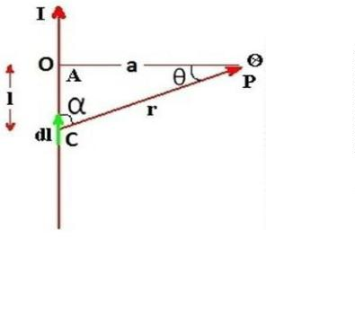
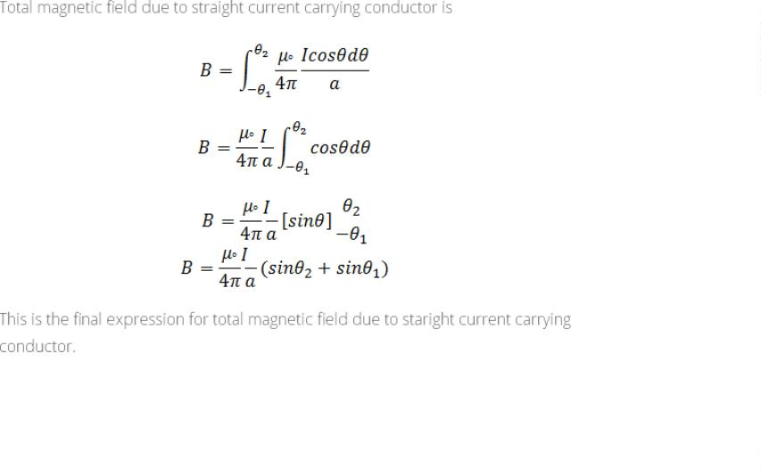

Slide 54
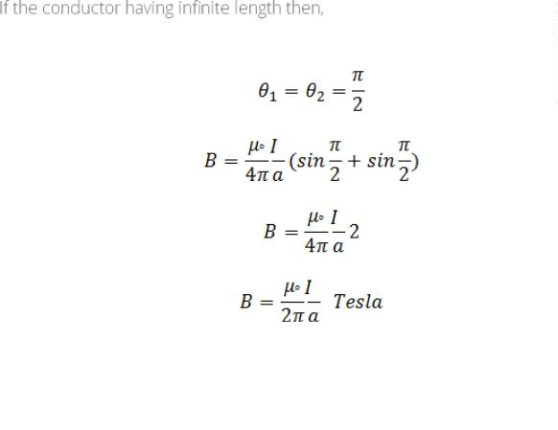
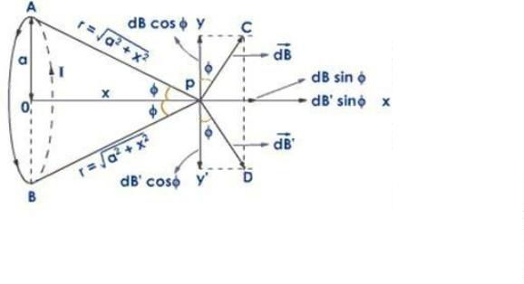

MFI due to circular current Carrying wire:
Consider a circular coil having radius a and centre O from which current I flows in anticlockwise
direction. The coil is placed at YZ plane so that the centre of the coil coincide along X-axis. P be
the any point at a distance x from the centre of the coil where we have to calculate the magnetic
field. let dl be the small current carrying element at any point A at a distance r from the point P
where
The angle between r and dl is 90°. Then fron biot-savart law, the magnetic field due to current
carrying element dl is

Slide 55



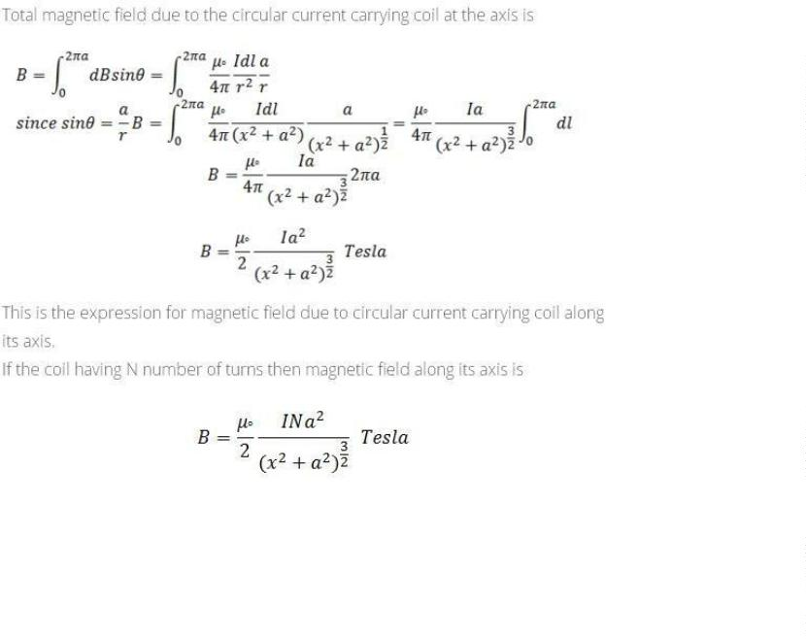
The direction of magnetic field is perpendicular to the plane containing dl and r. So the magnetic
field dB has two components
Similarly, consider another current carrying element dl’ which is diametrically opposite to the
point A. The magnetic field due to this current carrying element dB’ also has two components
Here both dBcosθ and dB’cosθ are equal in magnitude and opposite in direction. So they cancle
each other. Similarly, the components dBsinθ and dB’sinθ are equal in magnitude and in same
direction so they adds up
Total magnetic field due to the circular current carrying coil at the axis is

Slide 56


Magnetic Flux Density:
In simple matter, the magnetic flux density
related to the magnetic field intensity
as
where
called the permeability. In particular when we consider the free space
where
H/m is the permeability of the free space. Magnetic flux density is
measured in terms of Wb/m 2 .
The magnetic flux density through a surface is given by:
Wb
......................................(15)
In the case of electrostatic field, we have seen that if the surface is a closed surface, the net flux
passing through the surface is equal to the charge enclosed by the surface. In case of magnetic
field isolated magnetic charge (i. e. pole) does not exist. Magnetic poles always occur in pair (as
N-S). For example, if we desire to have an isolated magnetic pole by dividing the magnetic bar
successively into two, we end up with pieces each having north (N) and south (S) pole as shown
in Fig. 6 (a). This process could be continued until the magnets are of atomic dimensions; still
we will have N-S pair occurring together. This means that the magnetic poles cannot be isolated.
Fig. 6: (a) Subdivision of a magnet (b) Magnetic field/ flux lines of a
straight current carrying conductor
Similarly if we consider the field/flux lines of a current carrying conductor as shown in Fig. 6
(b), we find that these lines are closed lines, that is, if we consider a closed surface, the number
of flux lines that would leave the surface would be same as the number of flux lines that would

Slide 57





enter the surface.
Maxwell’s second Equation, div(B)=0:
From our discussions above, it is evident that for magnetic field,
......................................(16)
which is the Gauss's law for the magnetic field.
By applying divergence theorem, we can write:
Hence,
......................................(17)
Which is the Gauss's law for the magnetic fields in point form.
Ampere's Circuital Law:
Ampere's circuital law states that the line integral of the magnetic field
around a closed path is the net current enclosed by this path. Mathematically,
(circulation of H )
......................................(4)
The total current I enc can be written as,
......................................(5)
By applying Stoke's theorem, we can write
......................................(6)
Which is the Ampere's law in the point form.
Applications of Ampere's law:
We illustrate the application of Ampere's Law with some examples.
Example1 : MFI due to an infinite sheet of current and a long current carrying filament:

Slide 58







We compute magnetic field due to an infinitely long thin current carrying conductor as shown in
Fig. 4. Using Ampere's Law, we consider the close path to be a circle of radius as shown in
the Fig. 4.
If we consider a small current element
,
is perpendicular to the plane
containing both
,i.e.,
and
. Therefore only component of that will be present is
.
By applying Ampere's law we can write,
......................................(7)
Therefore,
which is same as equation (8)
Fig. 4.:Magnetic field due to an infinite thin current carrying conductor
Example2: MFI due to infinitely long coaxial conductor:
We consider the cross section of an infinitely long coaxial conductor, the inner conductor
carrying a current I and outer conductor carrying current - I as shown in figure 4.6. We compute
the magnetic field as a function of as follows:
In the region
......................................(9)
............................(10)
In the region

Slide 59




......................................(11)
Fig. 5: Coaxial conductor carrying equal and opposite currents
In the region
......................................(12)
........................................(13)
......................................(14)
In the region

Slide 60
UNIT – IV
Force in Magnetic fields and Magnetic Potential
• Magnetic force Moving charges in a Magnetic field – Lorentz force equation
Force on a current element in a magnetic field
Force on a straight and a long current carrying conductor in a magnetic field
Force between two straight long and parallel current carrying conductors
Magnetic dipole and dipole moment
a differential current loop as a magnetic dipole
Torque on a current loop placed in a magnetic field.
Scalar Magnetic potential and its limitations
Vector magnetic potential and its properties
Vector magnetic potential due to simple configurations
• Vector Poisson’s equations.
• Self and Mutual inductance – Neumann’s formulae
• Determination of self‐inductance of a solenoid and toroid
Mutual inductance between a straight long wire and a square loop wire in the same plane
Energy stored and density in a magnetic field.
Introduction to permanent magnets, their characteristics and applications.

Slide 61

Magnetic forces:

Slide 62


Scalar Magnetic Potential and its limitations:
In studying electric field problems, we introduced the concept of electric potential that simplified
the computation of electric fields for certain types of problems. In the same manner let us relate
the magnetic field intensity to a scalar magnetic potential and write:
...................................(18)
From Ampere's law , we know that
......................................(19)
Therefore,
............................(20)
we find that
But using vector identity,
is valid only where
. Thus
the scalar magnetic potential is defined only in the region where
general is not a single valued function of position.
. Moreover, Vm in
This point can be illustrated as follows. Let us consider the cross section of a
coaxial line as shown in fig 7.

Slide 63








In the region
,
and
Fig. 7: Cross Section of a Coaxial Line
If Vm is the magnetic potential then,
If we set Vm = 0 at
then c=0 and
We observe that as we make a complete lap around the current carrying conductor , we reach
again but Vm this time becomes
We observe that value of Vm keeps changing as we complete additional laps to pass through the
same point. We introduced Vm analogous to electostatic potential V. But for static electric fields,
and
, whereas for steady magnetic field
along the path of integration.
wherever
but
even if

Slide 64



Vector magnetic potential due to simple configurations:
We now introduce the vector magnetic potential which can be used in regions where
current density may be zero or nonzero and the same can be easily extended to time varying
cases. The use of vector magnetic potential provides elegant ways of solving EM field problems.
Since
and we have the vector identity that for any vector
,
, we
can write
.
Here, the vector field
is called the vector magnetic potential. Its SI unit is Wb/m.
Thus if can find
of a given current distribution,
can be found from
through a curl
operation. We have introduced the vector function
and related its curl to . A vector
function is defined fully in terms of its curl as well as divergence. The choice of
follows.
is made as
...........................................(23)
By using vector identity,
.........................................(25)
Great deal of simplification can be achieved if we choose
Putting , we get which is vector poisson equation.
...........................................(24)
.
In Cartesian coordinates, the above equation can be written in terms of the components as
......................................(26a)
......................................(26b)
......................................(26c)
The form of all the above equation is same as that of
..........................................(27)
for which the solution is
..................(28)

Slide 65






In case of time varying fields we shall see that
, which is known as Lorentz
condition, V being the electric potential. Here we are dealing with static magnetic field,
so
.
By comparison, we can write the solution for Ax as
...................................(30)
Computing similar solutions for other two components of the vector potential, the vector
potential can be written as
......................................(31)
This equation enables us to find the vector potential at a given point because of a volume current
density . Similarly for line or surface current density we can write
...................................................(32)
respectively.
..............................(33)
The magnetic flux
Substituting
through a given area S is given by
.............................................(34)
.........................................(35)
Vector potential thus have the physical significance that its integral around any closed path is
equal to the magnetic flux passing through that path.

Slide 66



Self and Mutual inductance – Neumann’s formulae:
Resistance, capacitance and inductance are the three familiar parameters from circuit theory. We
have already discussed about the parameters resistance and capacitance in the earlier chapters. In
this section, we discuss about the parameter inductance. Before we start our discussion, let us
first introduce the concept of flux linkage. If in a coil with N closely wound turns around where a
current I produces a flux
and this flux links or encircles each of the N turns, the flux linkage
is defined as . In alinear medium
, where the flux is proportional to the current, we
define the self inductance L as the ratio of the total flux linkage to the current which they link.
i.e.,
...................................(36)
To further illustrate the concept of inductance, let us consider two closed
loops C1 and C2 as shown in the figure 8, S1 and S2 are respectively the areas of C1 and C2 .
Fig:8
If a current I1 flows in C1 , the magnetic flux B1 will be created part of which will be linked to
C2 as shown in Figure 8:
...................................(37)
In a linear medium,
is proportional to I 1. Therefore, we can write
...................................(38)
where L12 is the mutual inductance. For a more general case, if C2 has N2 turns then
...................................(39)
and

Slide 67





or
...................................(40)
., the mutual inductance can be defined as the ratio of the total flux linkage of the second
circuit to the current flowing in the first circuit.
As we have already stated, the magnetic flux produced in C1 gets linked to itself and if C1 has
N1 turns then
, where
is the flux linkage per turn.
Therefore, self inductance
=
...................................(41)
As some of the flux produced by I1 links only to C1 & not C2.
...................................(42)
Further in general, in a linear medium,
and

Slide 68




Energy stored and density in a magnetic field.
Energy stored in Magnetic Field:
So far we have discussed the inductance in static forms. In earlier chapter we discussed
the fact that work is required to be expended to assemble a group of charges and this work is
stated as electric energy. In the same manner energy needs to be expended in sending currents
through coils and it is stored as magnetic energy. Let us consider a scenario where we consider a
coil in which the current is increased from 0 to a value I. As mentioned earlier, the self
inductance of a coil in general can be written as
..................................(43a)
or
..................................(43b)
If we consider a time varying scenario,
..................................(44)
We will later see that
is an induced voltage.

Slide 69








is the voltage drop that appears across the coil and thus voltage opposes the
change of current.
Therefore in order to maintain the increase of current, the electric source must do an work
against this induced voltage.
.
.................................(45)
(Joule)...................................(46)
which is the energy stored in the magnetic circuit.
We can also express the energy stored in the coil in term of field quantities.
For linear magnetic circuit
...................................(47)
...................................(48)
Now,
where A is the area of cross section of the coil. If l is the length of the coil
...................................(49)
Al is the volume of the coil. Therefore the magnetic energy density i.e., magnetic energy/unit
volume is given by
...................................(50)
In vector form
J/mt3 ...................................(51)
is the energy density in the magnetic field.

Slide 70
UNIT – V
Time Varying Fields
• Faraday’s laws of electromagnetic induction – Its integral and point forms
• Maxwell’s fourth equation, Curl (E)=‐dB/dt
• Statically and dynamically induced EMFs – Simple problems
• Displacement current
• Modification of Maxwell’s equations for time varying fields

Slide 71
Introduction:
In our study of static fields so far, we have observed that static electric fields are produced by
electric charges, static magnetic fields are produced by charges in motion or by steady current.
Further, static electric field is a conservative field and has no curl, the static magnetic field is
continuous and its divergence is zero. The fundamental relationships for static electric fields
among the field quantities can be summarized as:
(1)
(2)
For a linear and isotropic medium,
(3)
Similarly for the magnetostatic case
(4)
(5)
(6)
It can be seen that for static case, the electric field vectors and and magnetic field
vectors and form separatepairs.
In this chapter we will consider the time varying scenario. In the time varying case we
will observe that a changing magnetic field will produce a changing electric field and vice versa.
We begin our discussion with Faraday's Law of electromagnetic induction and then
present the Maxwell's equations which form the foundation for the electromagnetic theory.
Faraday's Law of electromagnetic Induction:
Michael Faraday, in 1831 discovered experimentally that a current was induced in a
conducting loop when the magnetic flux linking the loop changed. In terms of fields, we can say
that a time varying magnetic field produces an electromotive force (emf) which causes a current
in a closed circuit. The quantitative relation between the induced emf (the voltage that arises
from conductors moving in a magnetic field or from changing magnetic fields) and the rate of
change of flux linkage developed based on experimental observation is known as Faraday's law.
Mathematically, the induced emf can be written as

Slide 72





Emf =
Volts
(7)
where is the flux linkage over the closed path.
A non zero
may result due to any of the following:
(a) time changing flux linkage a stationary closed path.
(b) relative motion between a steady flux a closed path.
(c) a combination of the above two cases.
The negative sign in equation (7) was introduced by Lenz in order to comply with the
polarity of the induced emf. The negative sign implies that the induced emf will cause a current
flow in the closed loop in such a direction so as to oppose the change in the linking magnetic
flux which produces it. (It may be noted that as far as the induced emf is concerned, the closed
path forming a loop does not necessarily have to be conductive).
If the closed path is in the form of N tightly wound turns of a coil, the change in the
magnetic flux linking the coil induces an emf in each turn of the coil and total emf is the sum of
the induced emfs of the individual turns, i.e.,
Emf =
Volts
(8)
By defining the total flux linkage as
(9)
The emf can be written as
Emf =
(10)
Continuing with equation (3), over a closed contour 'C' we can write
Emf =
where
(11)
is the induced electric field on the conductor to sustain the current.
Further, total flux enclosed by the contour 'C ' is given by
(12)
Where S is the surface for which 'C' is the contour.

Slide 73




From (11) and using (12) in (3) we can write
(13)
By applying stokes theorem
(14)
Therefore, we can write
(15)
which is the Faraday's law in the point form
We have said that non zero can be produced in a several ways. One particular case is when a
time varying flux linking a stationary closed path induces an emf. The emf induced in a
stationary closed path by a time varying magnetic field is called a transformer emf .
Statically and dynamically induced EMFs:
Motional EMF:
Let us consider a conductor moving in a steady magnetic field as shown in the fig 2.
Fig 2
If a charge Q moves in a magnetic field , it experiences a force
(16)
This force will cause the electrons in the conductor to drift towards one end and leave the other
end positively charged, thus creating a field and charge separation continuous until electric and
magnetic forces balance and an equilibrium is reached very quickly, the net force on the moving
conductor is zero.

Slide 74


can be interpreted as an induced electric field which is called the motional electric
(17)
field
If the moving conductor is a part of the closed circuit C, the generated emf around the circuit is
. This emf is called the motional emf.

Slide 75

Modification of Maxwell’s equations for time varying fields :

Slide 76


Slide 77



Slide 78


Slide 79

Concept of displacementcurrent

Slide 80


Slide 81




Maxwell’s fourth equation, Curl (E)=‐ dB/dt:
Equation (5.1) and (5.2) gives the relationship among the field quantities in the static field. For
time varying case, the relationship among the field vectors written as
(1)
…………..(2)
(3)
(4)
In addition, from the principle of conservation of charges we get the equation of continuity
The equation must be consistent with equation of continuity
We observe that
(
5
)
Since
Thus
is zero for any vector
.
applies only for the static case i.e., for the scenario when
.
A
c
l
a
s
s
i
c
e
x
a
m
p
l
e
f
o
r
t
h
i
s
i
s
g
i
v
e
n
b
e
l
o
w
.
Suppose we are in the process of charging up a capacitor as shown in fig 3.
Fig 3
Let us apply the Ampere's Law for the Amperian loop shown in fig 3. Ienc = I is the total current
passing through the loop. But if we draw a baloon shaped surface as in fig 5.3, no current passes
through this surface and hence Ienc = 0. But for non steady currents such as this one, the concept
of current enclosed by a loop is ill-defined since it depends on what surface you use. In fact

Slide 82








Ampere's Law should also hold true for time varying case as well, then comes the idea of
displacement current which will be introduced in the next few slides.
We can write for time varying case,
………….(1)
…………….(2)
………… (3)
The equation (3) is valid for static as well as for time varying case.Equation (3) indicates that a
time varying electric field will give rise to a magnetic field even in the absence of The term
has a dimension of current densities
and is called the displacement current density.
Introduction of
in
equation is one of the major contributions of Jame's Clerk
Maxwell. The modified set of equations
(4)
(5)
(6)
(7)
is known as the Maxwell's equation and this set of equations apply in the time varying scenario,
static fields are being a particular case
In the integral form
.

Slide 83




(8)
………… (9)
(10)
(11)
The modification of Ampere's law by Maxwell has led to the development of a unified
electromagnetic field theory. By introducing the displacement current term, Maxwell could
predict the propagation of EM waves. Existence of EM waves was later demonstrated by Hertz
experimentally which led to the new era of radio communication.

