Slide 1

UNIT-I
Single Stage BJT Amplifier
Based on number of stages
Depending upon the number of stages of Amplification, there are Single-stage amplifiers
and Multi-stage amplifiers.
•
Single-stage Amplifiers −This has only one transistor circuit, which is a single stage
amplification.
•
Multi-stage Amplifiers −This has multiple transistor circuit, which provides multi-
stage amplification.
Based on its output
Depending upon the parameter that is amplified at the output, there are voltage and
power amplifiers.
•
Voltage Amplifiers −The amplifier circuit that increases the voltage level of the input
signal, is called as Voltage amplifier.
•
Power Amplifiers −The amplifier circuit that increases the power level of the input
signal, is called as Power amplifier.
Based on the input signals
Depending upon the magnitude of the input signal applied, they can be categorized as
Small signal and large signal amplifiers.
•
•
Small signal Amplifiers −When the input signal is so weak so as to produce small
fluctuations in the collector current compared to its quiescent value, the amplifier is
known as Small signal amplifier.
Large signal amplifiers −When the fluctuations in collector current are large i.e.
beyond the linear portion of the characteristics, the amplifier is known as large
signal amplifier.
Based on the frequency range
Depending upon the frequency range of the signals being used, there are audio and radio
amplifiers.
•
Audio Amplifiers −The amplifier circuit that amplifies the signals that lie in the audio
frequency range i.e. from 20Hz to 20 KHz frequency range, is called as audio
amplifier.
Page 1

Slide 2
•
Power Amplifiers −The amplifier circuit that amplifies the signals that lie in a very
high frequency range, is called as Power amplifier.
Based on Biasing Conditions
Depending upon their mode of operation, there are class A, class B and class C amplifiers.
•
•
•
•
Class A amplifier − The biasing conditions in class A power amplifier are such that
the collector current flows for the entire AC signal applied.
Class B amplifier − The biasing conditions in class B power amplifier are such that
the collector current flows for half-cycle of input AC signal applied.
Class C amplifier − The biasing conditions in class C power amplifier are such that
the collector current flows for less than half cycle of input AC signal applied.
Class AB amplifier − The class AB power amplifier is one which is created by
combining both class A and class B in order to have all the advantages of both the
classes and to minimize the problems they have.
Based on the Coupling method
Depending upon the method of coupling one stage to the other, there are RC coupled,
Transformer coupled and direct coupled amplifier.
•
•
•
RC Coupled amplifier − A Multi-stage amplifier circuit that is coupled to the next
stage using resistor and capacitor (RC) combination can be called as a RC coupled
amplifier.
Transformer Coupled amplifier − A Multi-stage amplifier circuit that is coupled to
the next stage, with the help of a transformer, can be called as a Transformer
coupled amplifier.
Direct Coupled amplifier − A Multi-stage amplifier circuit that is coupled to the next
stage directly, can be called as a direct coupled amplifier.
Based on the Transistor Configuration
Depending upon the type of transistor configuration, there are CE CB and CC amplifiers.
•
•
CE amplifier − The amplifier circuit that is formed using a CE configured transistor
combination is called as CE amplifier.
CB amplifier − The amplifier circuit that is formed using a CB configured transistor
combination is called as CB amplifier.
Page 2

Slide 3
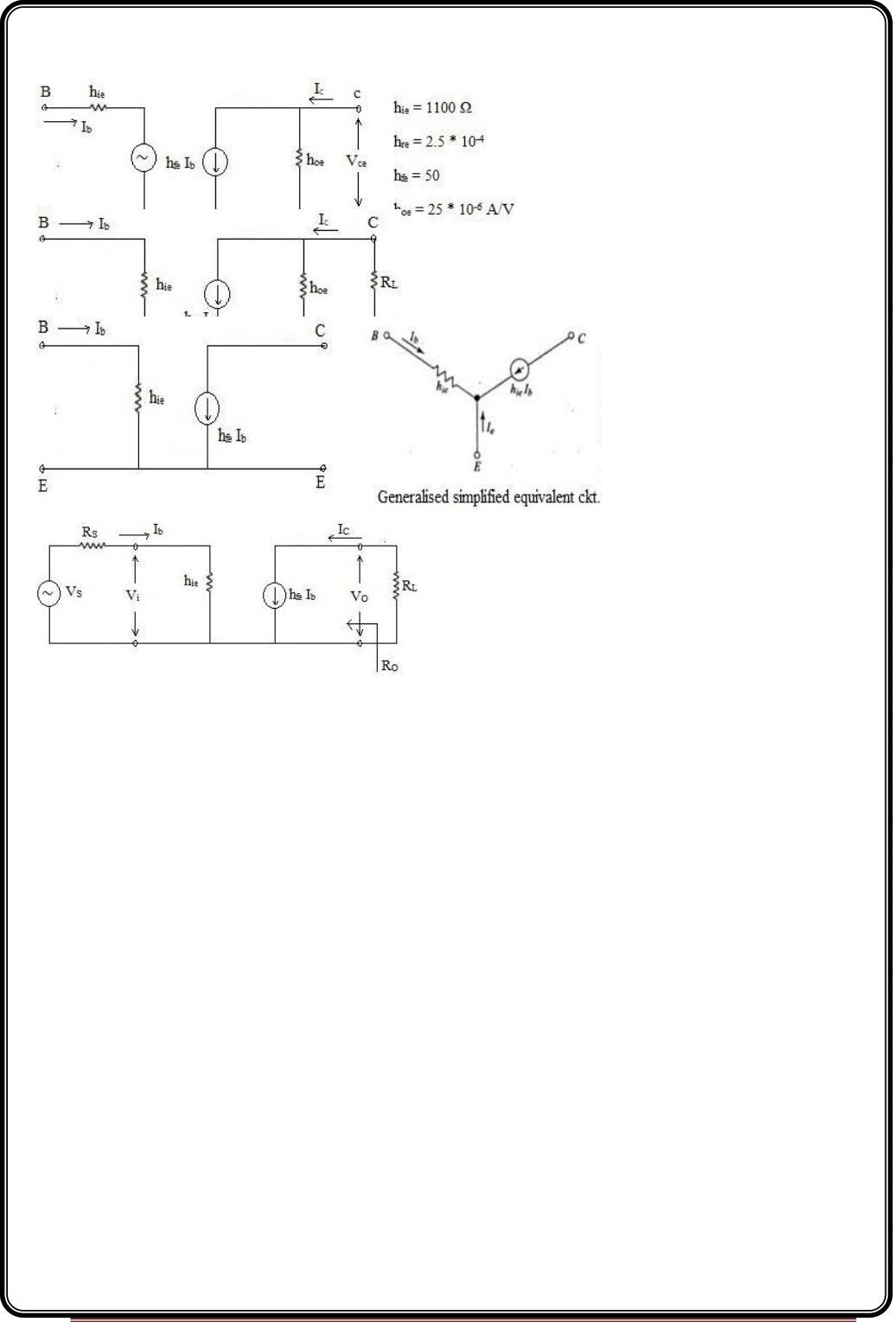
•
CC amplifier − The amplifier circuit that is formed using a CC configured transistor
combination is called as CC amplifier.
Simplified Common Emitter (CE) hybrid model
h and h is very small they can be neglected.
re
oe
Analysis of Common Emitter (CE) amplifier using simplified equivalent ckt
Page 3

Slide 4
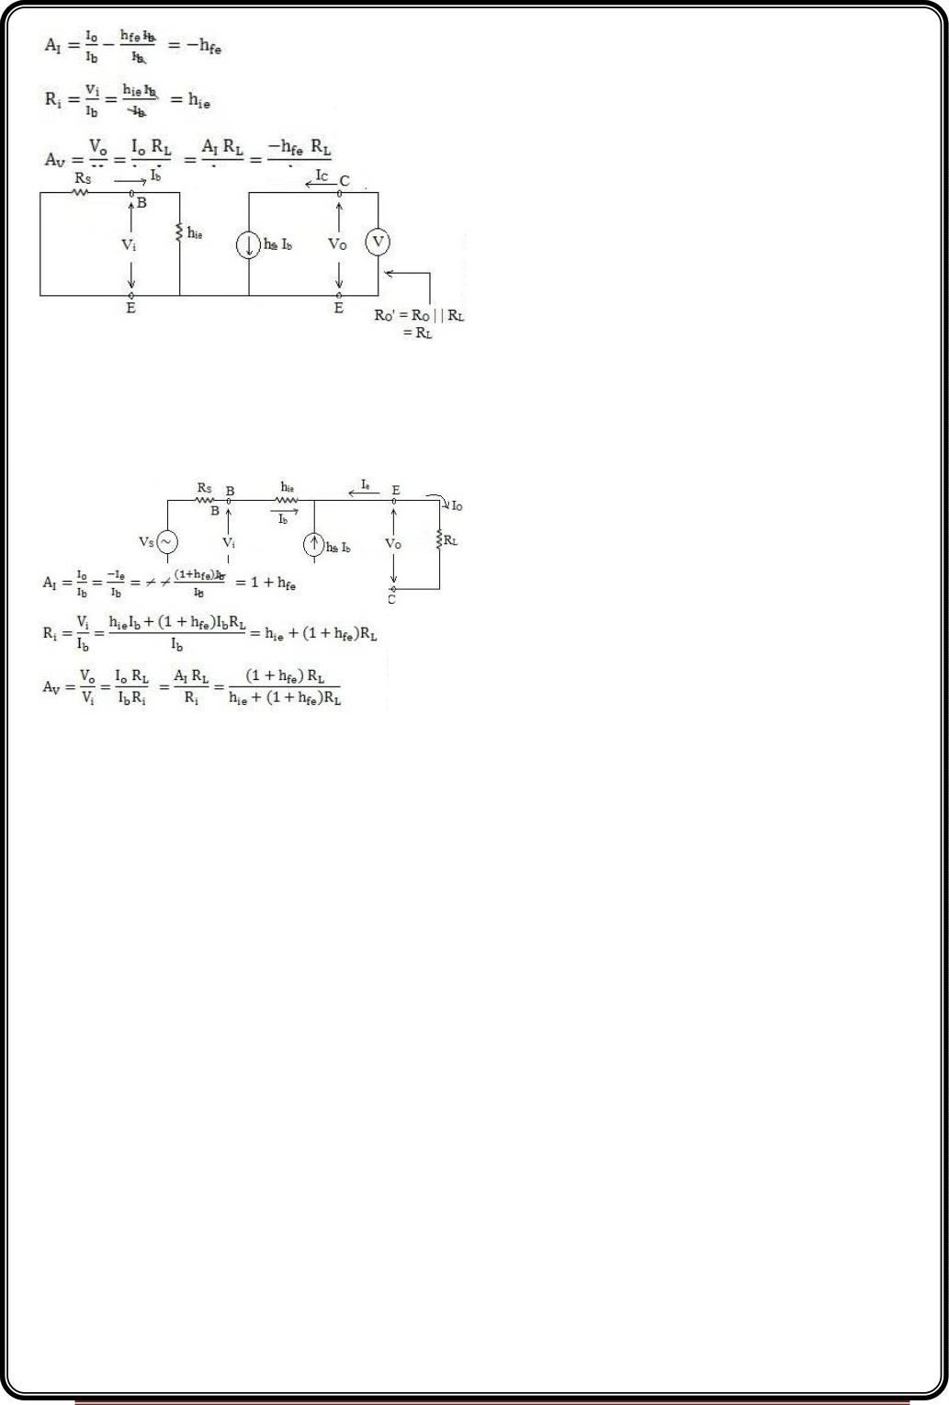
R =
o
V
I
C
I =h I
c
fe b
Apply KVL input side
R I +h I =0 => (R +hie)I =0
s b
ie b
s
b
It is possible only when I =0 =>I =h I =0
b
c
fe b
Ro=∞
Response of BJT amplifier in Common Collector (CC) configuration using simplified hybrid
model in CE configuration
Page 4

Slide 5
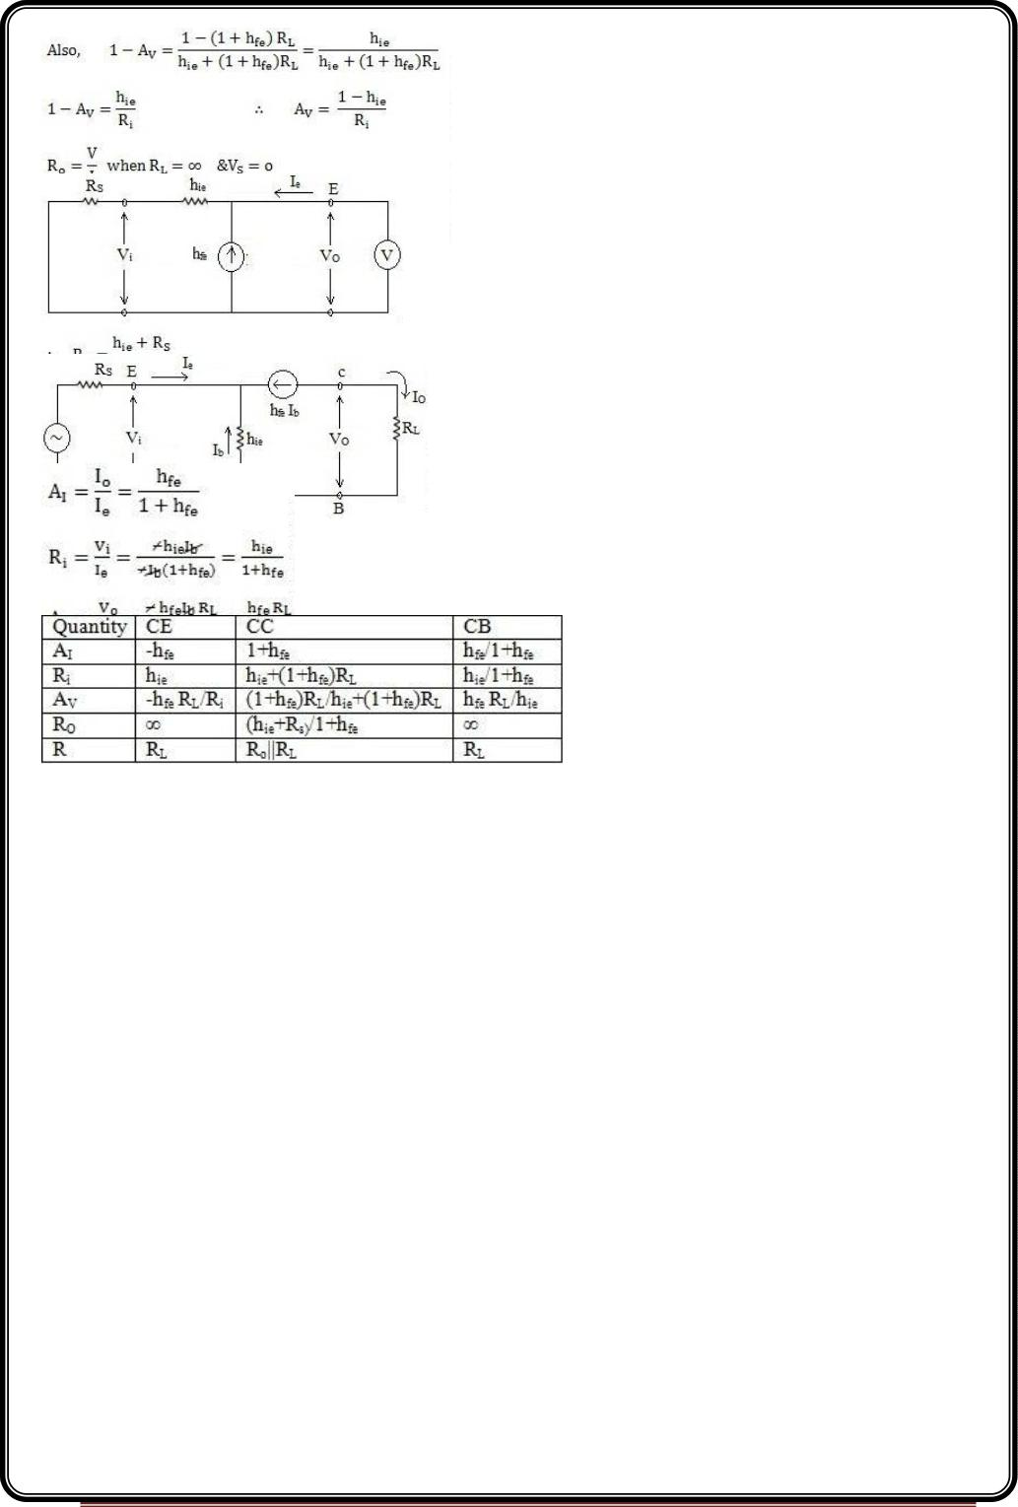
Common Base (CB) Configuration
Comparison of CE,CC and CB
Page 5

Slide 6
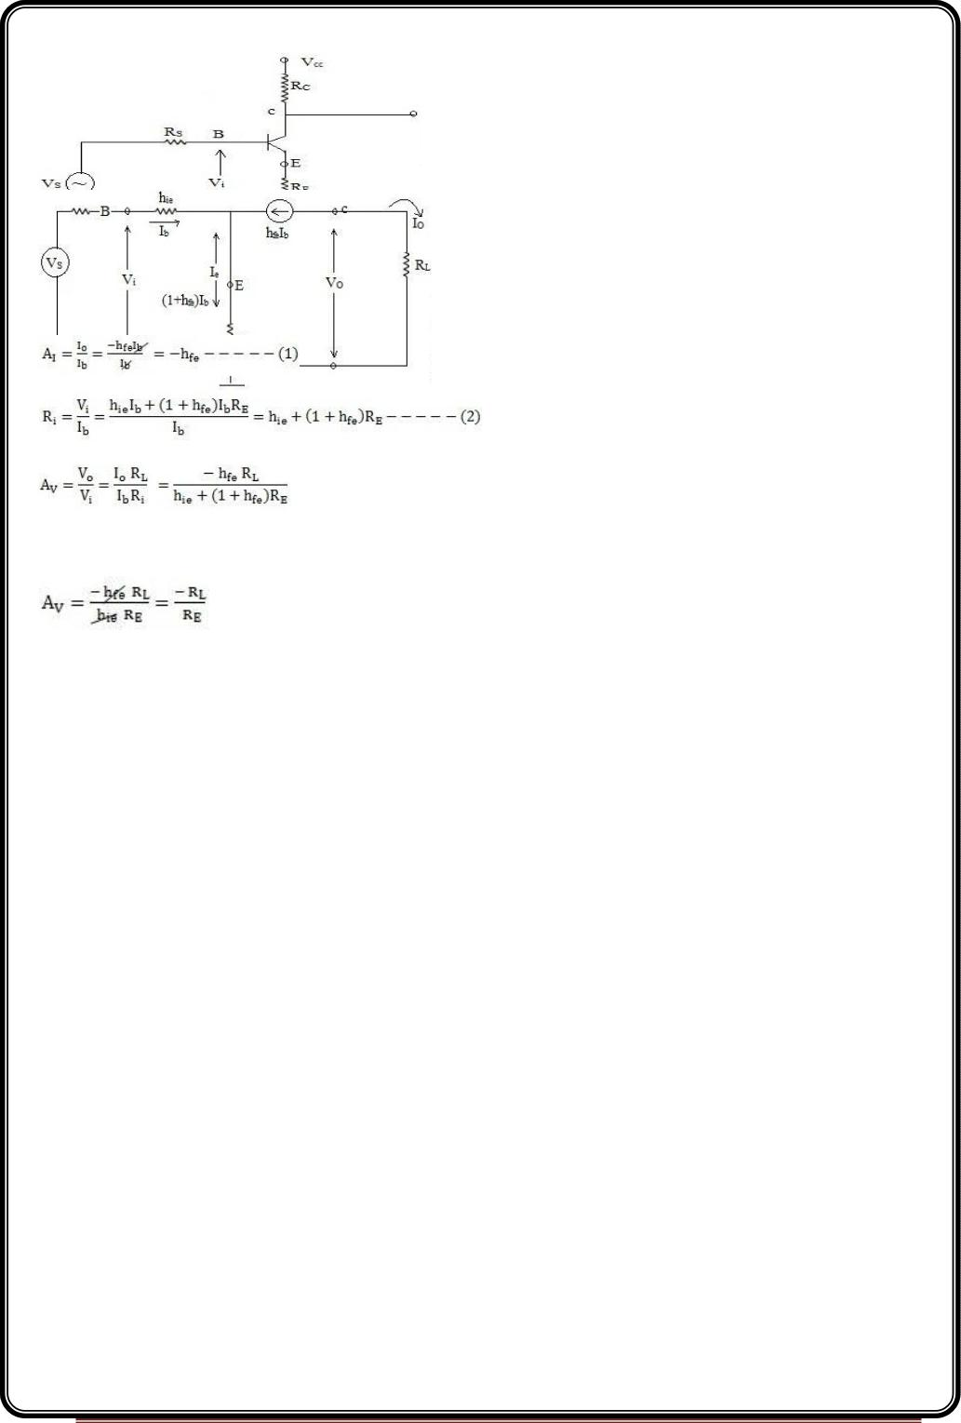
CE amplifier with emitter resistance RE
AI without R = -h ------------(1 a)
E
fe
Current gain is unaltered by one addition of amplifier resistance.
R without R = h ----------(2a)
i
E
ie
This is a desirable effect produced by the addition of resistance RE i.e. the input resistance is
higher.
Normally,
(1+h ) R >>h
fe
E
ie
Also hfe>> 1
Then,
So, the gain of the amplifier becomes the radio of two resistances, and hence the gain is
stabilized
Page 6

Slide 7
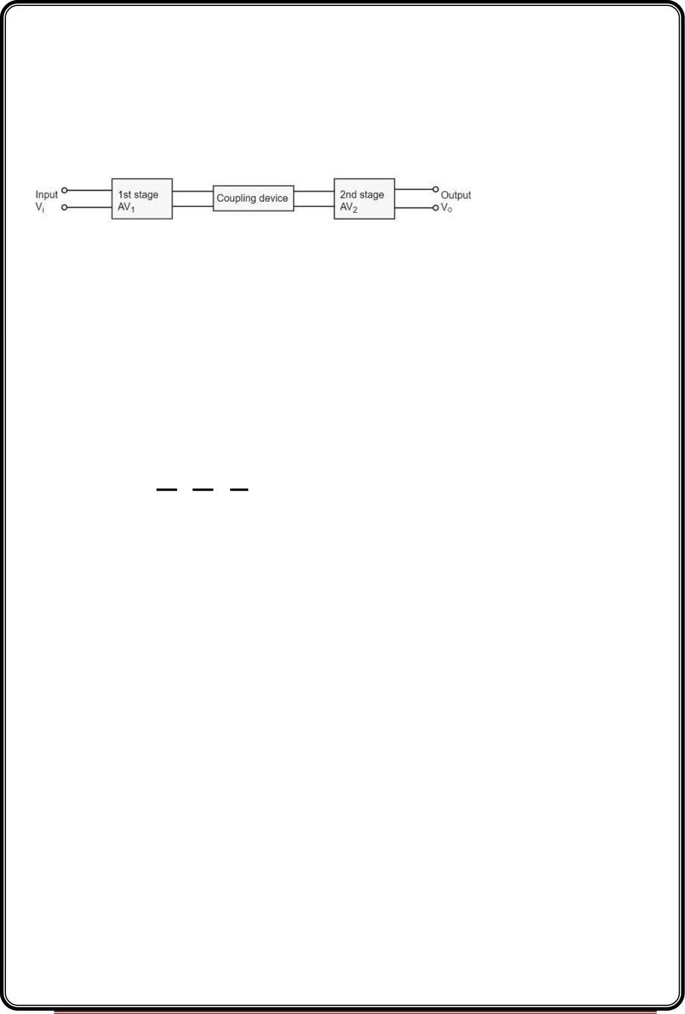
Multi-stage amplifiers
In practical applications, the output of a single state amplifier is usually insufficient, though
it is a voltage or power amplifier. Hence they are replaced by Multi-stage transistor
amplifiers.
In Multi-stage amplifiers, the output of first stage is coupled to the input of next stage
using a coupling device. These coupling devices can usually be a capacitor or a transformer.
This process of joining two amplifier stages using a coupling device can be called
asCascading.
The
following
figure
shows
a
two-stage
amplifier
connected
in
cascade.
The overall gain is the product of voltage gain of individual stages.
V 2 Vo Vo
AV=AV1×AV2=


V1 V 2 V1
Where AV = Overall gain, AV1 = Voltage gain of 1st stage, and AV2= Voltage gain of 2nd stage.
If there is n number of stages, the product of voltage gains of those n stages will be the
overall gain of that multistage amplifier circuit.
Purpose of coupling device
The basic purposes of a coupling device are
•
•
To transfer the AC from the output of one stage to the input of next stage.
To block the DC to pass from the output of one stage to the input of next stage,
which means to isolate the DC conditions.
Types of Coupling
Joining one amplifier stage with the other in cascade, using coupling devices form a Multi-
stage amplifier circuit. There are four basic methods of coupling, using these coupling
devices such as resistors, capacitors, transformers etc. Let us have an idea about them.
Resistance-Capacitance Coupling
Page 7

Slide 8
This is the mostly used method of coupling, formed using simple resistor-
capacitor combination. The capacitor which allows AC and blocks DC is the main coupling
element used here.
The coupling capacitor passes the AC from the output of one stage to the input of its next
stage. While blocking the DC components from DC bias voltages to effect the next stage.
Let us get into the details of this method of coupling in the coming chapters.
Impedance Coupling
The coupling network that uses inductance and capacitance as coupling elements can be
called as Impedance coupling network.
In this impedance coupling method, the impedance of coupling coil depends on its
inductance and signal frequency which is jwL. This method is not so popular and is seldom
employed.
Transformer Coupling
The coupling method that uses a transformer as the coupling device can be called as
Transformer coupling. There is no capacitor used in this method of coupling because the
transformer itself conveys the AC component directly to the base of second stage.
The secondary winding of the transformer provides a base return path and hence there is
no need of base resistance. This coupling is popular for its efficiency and its impedance
matching and hence it is mostly used.
Direct Coupling
If the previous amplifier stage is connected to the next amplifier stage directly, it is called
as direct coupling. The individual amplifier stage bias conditions are so designed that the
stages can be directly connected without DC isolation.
The direct coupling method is mostly used when the load is connected in series, with the
output terminal of the active circuit element. For example, head-phones, loud speakers etc.
Role of Capacitors in Amplifiers
Other than the coupling purpose, there are other purposes for which few capacitors are
especially employed in amplifiers. To understand this, let us know about the role of
capacitors in Amplifiers.
Page 8

Slide 9
The Input Capacitor Cin
The input capacitor Cin present at the initial stage of the amplifier, couples AC signal to the
base of the transistor. This capacitor Cin if not present, the signal source will be in parallel
to resistor R2 and the bias voltage of the transistor base will be changed.
Hence Cin allows, the AC signal from source to flow into input circuit, without affecting the
bias conditions.
The Emitter By-pass Capacitor Ce
The emitter by-pass capacitor Ce is connected in parallel to the emitter resistor. It offers a
low reactance path to the amplified AC signal.
In the absence of this capacitor, the voltage developed across RE will feedback to the input
side thereby reducing the output voltage. Thus in the presence of Ce the amplified AC will
pass through this.
Coupling Capacitor CC
The capacitor CC is the coupling capacitor that connects two stages and prevents DC
interference between the stages and controls the operating point from shifting. This is also
called as blocking capacitor because it does not allow the DC voltage to pass through it.
In the absence of this capacitor, R will come in parallel with the resistance R of the biasing
C
1
network of the next stage and thereby changing the biasing conditions of the next stage.
AmplifierConsideration
For an amplifier circuit, the overall gain of the amplifier is an important consideration. To
achieve maximum voltage gain, let us find the most suitable transistor configuration for
cascading.
CC Amplifier
•
•
Its voltage gain is less than unity.
It is not suitable for intermediate stages.
CB Amplifier
•
•
Its voltage gain is less than unity.
Hence not suitable for cascading.
Page 9

Slide 10
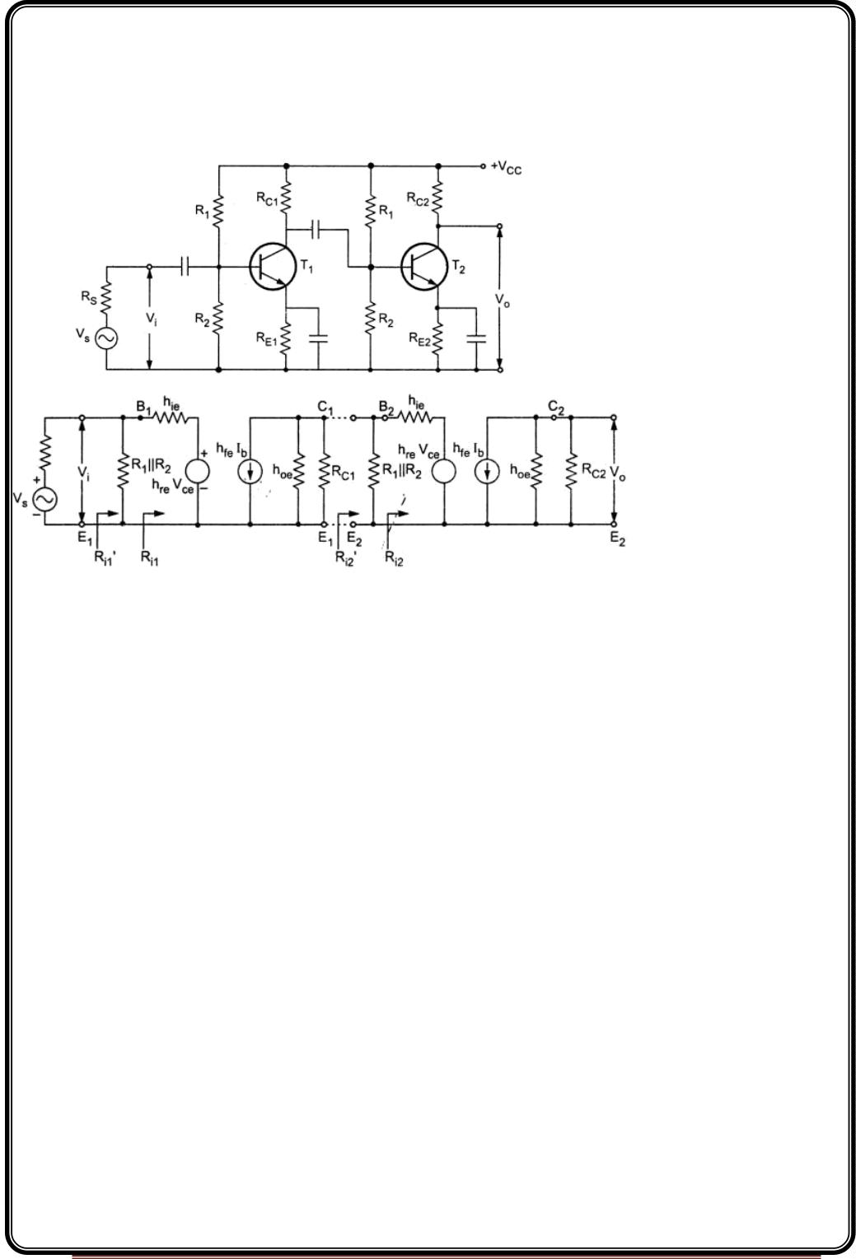
CE Amplifier
•
•
Its voltage gain is greater than unity.
Voltage gain is further increased by cascading.
The characteristics of CE amplifier are such that, this configuration is very suitable for
cascading in amplifier circuits. Hence most of the amplifier circuits use CE configuration.
Two Stage CE-CE Cascade Amplifier
h-parameter equivalent circuit
Page 10

Slide 11
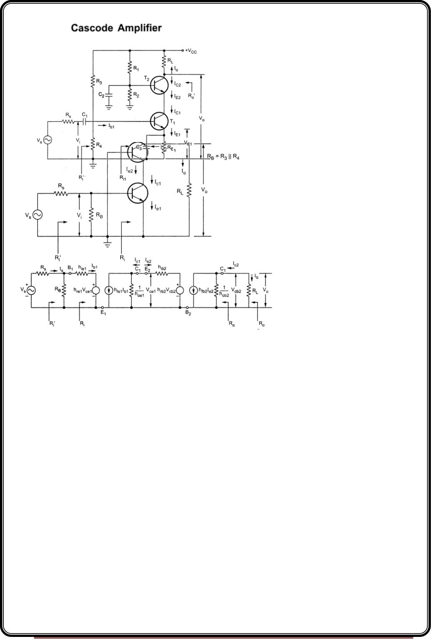
Cascode Amplifier
AC equivalent circuit
h-parameter equivalent circuit
Page 11

Slide 12
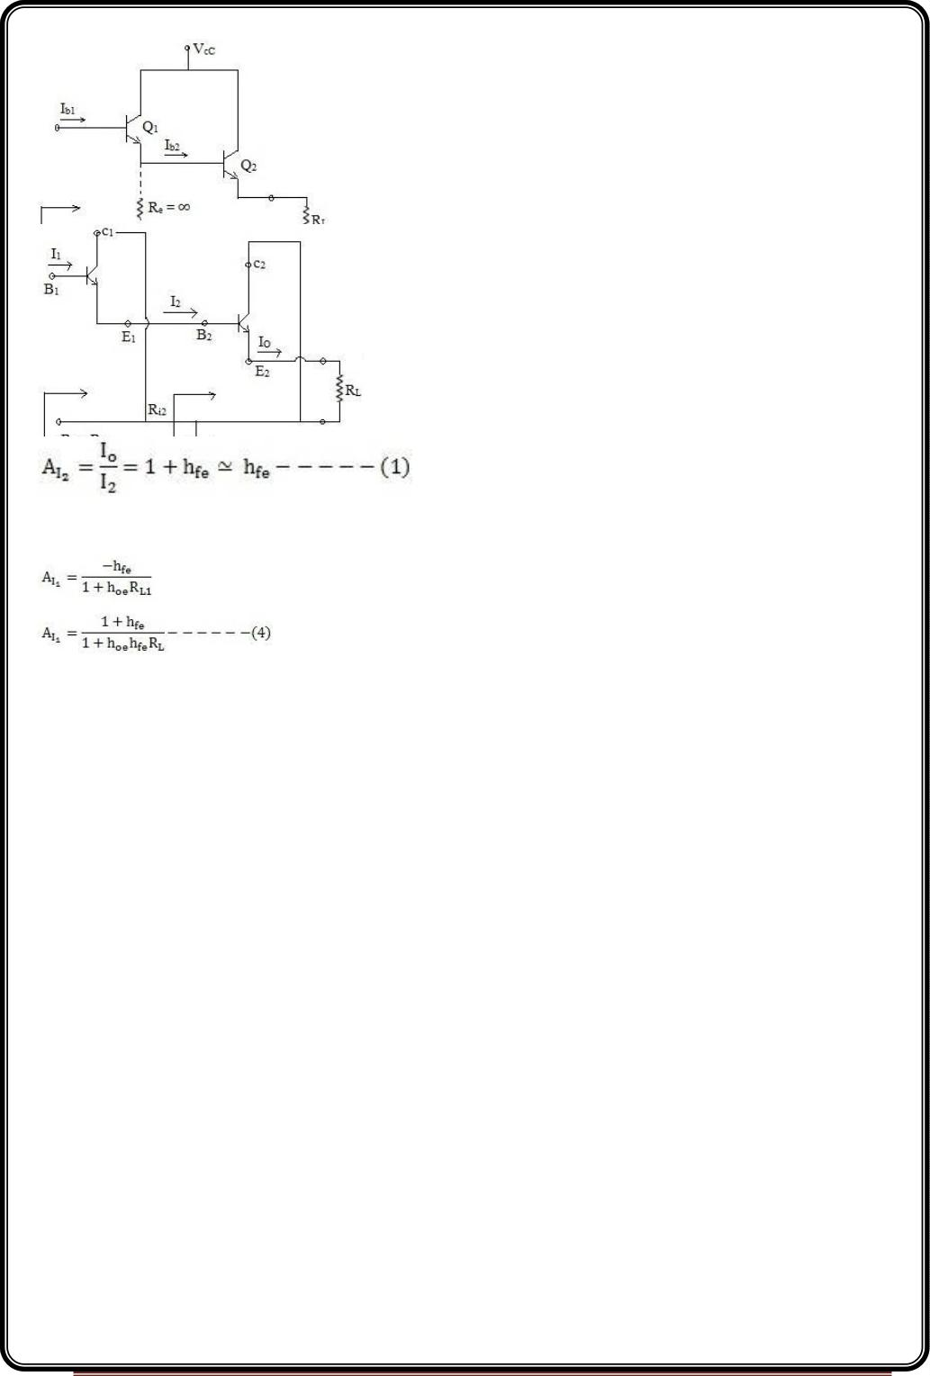
Darlington pair
Darlington pair 1- Two emitter follower stages in cascade with infinite emitter resistance in
the first stage constitute a Darlington circuit.
Second Stage
Let us assume , h R < 0.1
Also
oe
L
hfe>> 1
R = h + (1+h ) R ~ h + h R h R -----------(2)
i2
ie
fe
L
ie
fe
L
fe
L
R = R = h R ---------(3)
L1
i2
fe
L
First Stage
h R = h h R < 0.1 . If this inequality is satisfied, then we can use simplified equivalent ckt
oe L1
oe fe
L
in the first stage.Using exact solution
R = h + h A R
rc I1 L1
i1
ie
Page 12

Slide 13
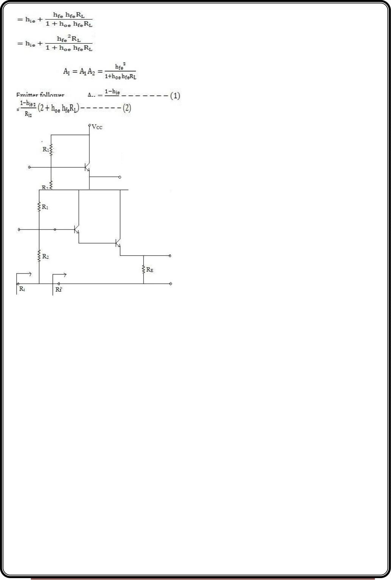
For emitter follower
R = h + (1+h ) R
i
ie
fe
L
=h + h R
ie
fe
L
Overall current gain
Darlington ckt , AV = A A
V1 V2
Effect of biasing network on the input resistance of emitter follower or Darlington ckt.
Page 13

Slide 14
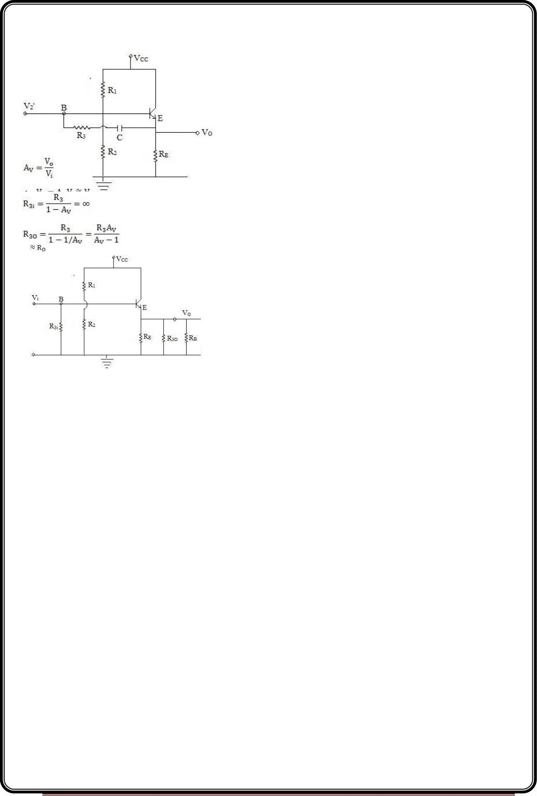
Effective input resistance R = R | | R | | R ’ where R ’ is a large input resistance of emitter
follower or Darlington ckt.
i
1
2
i
i
R = R | | R ’
i
B
i
~ RB
Emitter follower with Boot Strap Biasing
The reactance offered by the capacitor is very low for all frequencies.
R3 can be replaced by Miller’s theorem
Effective output resistance
R = R | | R | | R
L
O
3O
B
Page 14

Slide 15
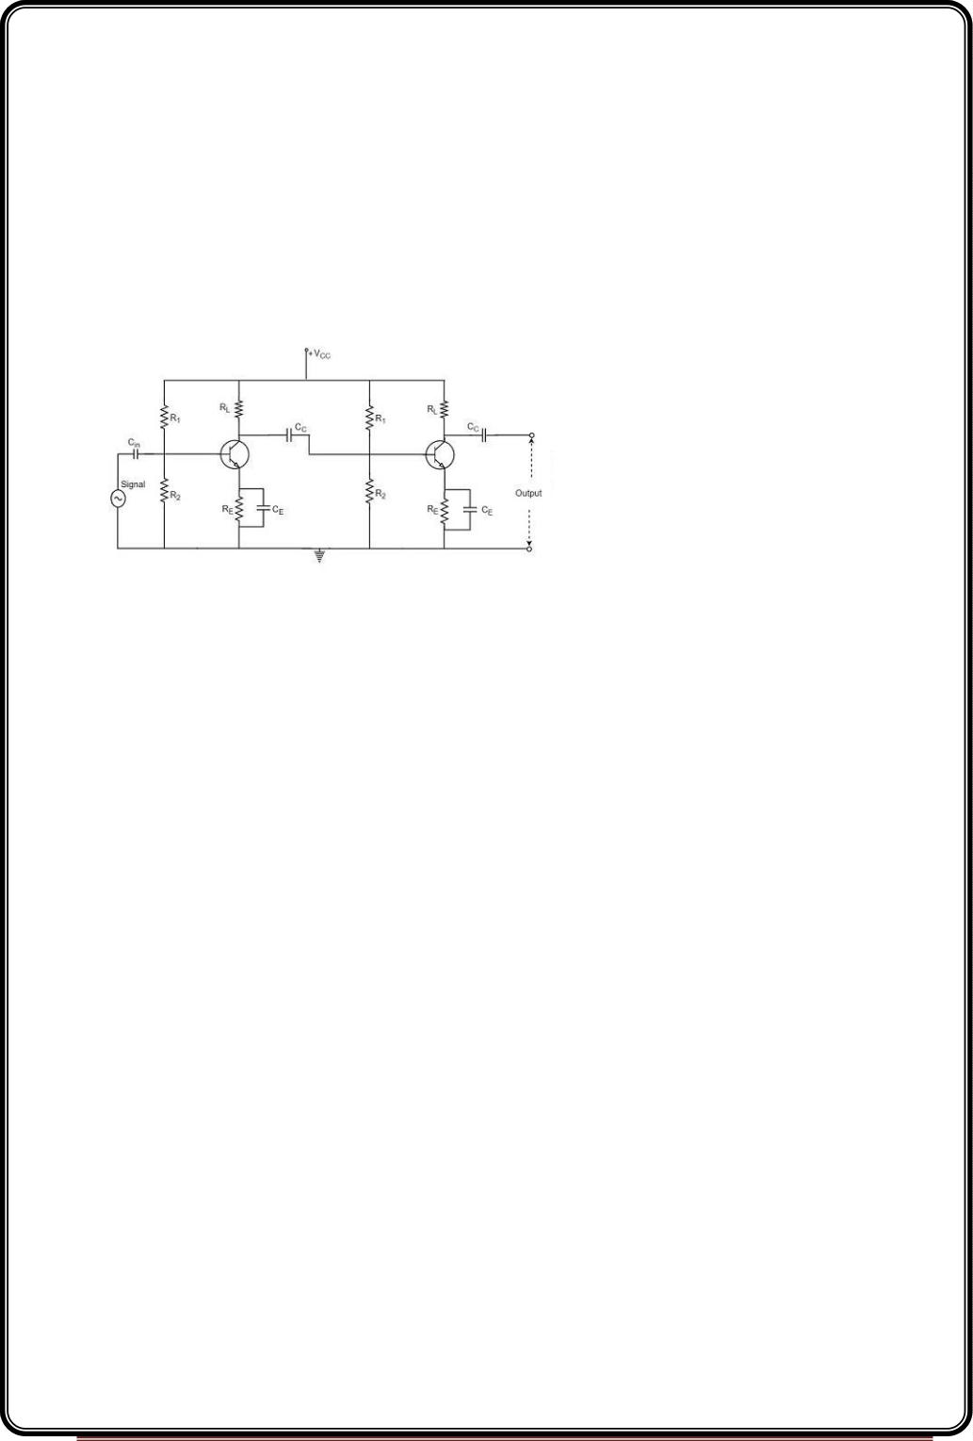
Coupling Schemes
Two-stage RC Coupled Amplifier
The resistance-capacitance coupling is, in short termed as RC coupling. This is the mostly
used coupling technique in amplifiers.
Construction of a Two-stage RC Coupled Amplifier
The constructional details of a two-stage RC coupled transistor amplifier circuit are as
follows. The two stage amplifier circuit has two transistors, connected in CE configuration
and a common power supply V is used. The potential divider network R and R and the
CC
1
2
resistor Re form the biasing and stabilization network. The emitter by-pass capacitor
Ce offers a low reactance path to the signal.
The resistor R is used as a load impedance. The input capacitor C present at the initial
L
in
stage of the amplifier couples AC signal to the base of the transistor. The capacitor CC is the
coupling capacitor that connects two stages and prevents DC interference between the
stages and controls the shift of operating point. The figure below shows the circuit diagram
of RC coupled amplifier.
Operation of RC Coupled Amplifier
When an AC input signal is applied to the base of first transistor, it gets amplified and
appears at the collector load R which is then passed through the coupling capacitor C to
L
C
the next stage. This becomes the input of the next stage, whose amplified output again
appears across its collector load. Thus the signal is amplified in stage by stage action.
The important point that has to be noted here is that the total gain is less than the product
of the gains of individual stages. This is because when a second stage is made to follow the
first stage, the effective load resistance of the first stage is reduced due to the shunting
Page 15

Slide 16
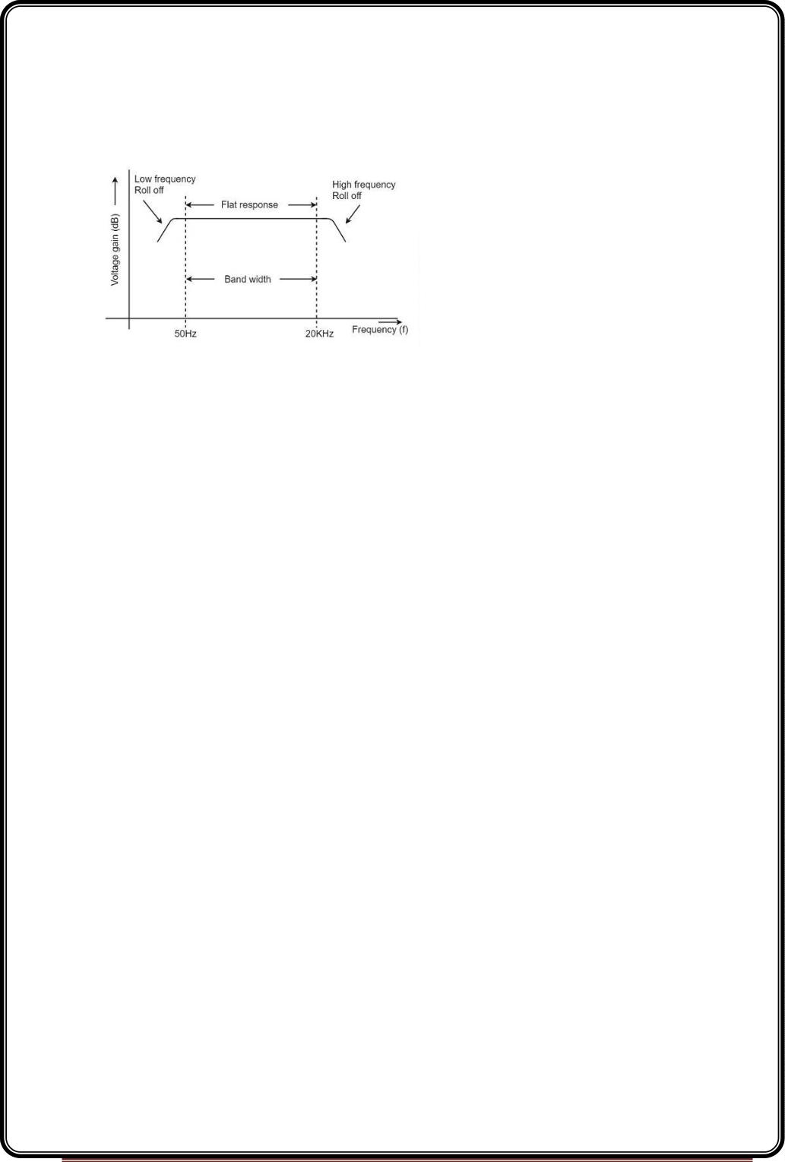
effect of the input resistance of the second stage. Hence, in a multistage amplifier, only the
gain of the last stage remains unchanged.
As we consider a two stage amplifier here, the output phase is same as input. Because the
phase reversal is done two times by the two stage CE configured amplifier circuit.
Frequency Response of RC Coupled Amplifier
Frequency response curve is a graph that indicates the relationship between voltage gain
and function of frequency. The frequency response of a RC coupled amplifier is as shown in
the following graph.
From the above graph, it is understood that the frequency rolls off or decreases for the
frequencies below 50Hz and for the frequencies above 20 KHz. whereas the voltage gain
for the range of frequencies between 50Hz and 20 KHz is constant.
We know that,
XC=1/2πfc
It means that the capacitive reactance is inversely proportional to the frequency.
At Low frequencies (i.e. below 50 Hz)
The capacitive reactance is inversely proportional to the frequency. At low frequencies, the
reactance is quite high. The reactance of input capacitor Cin and the coupling capacitor
CC are so high that only small part of the input signal is allowed. The reactance of the
emitter by pass capacitor CE is also very high during low frequencies. Hence it cannot shunt
the emitter resistance effectively. With all these factors, the voltage gain rolls off at low
frequencies.
At High frequencies (i.e. above 20 KHz):Again considering the same point, we know that
the capacitive reactance is low at high frequencies. So, a capacitor behaves as a short
Page 16

Slide 17
circuit, at high frequencies. As a result of this, the loading effect of the next stage increases,
which reduces the voltage gain. Along with this, as the capacitance of emitter diode
decreases, it increases the base current of the transistor due to which the current gain (β)
reduces. Hence the voltage gain rolls off at high frequencies.
At Mid-frequencies (i.e. 50 Hz to 20 KHz)
The voltage gain of the capacitors is maintained constant in this range of frequencies, as
shown in figure. If the frequency increases, the reactance of the capacitor CC decreases
which tends to increase the gain. But this lower capacitance reactive increases the loading
effect of the next stage by which there is a reduction in gain.
Due to these two factors, the gain is maintained constant.
Advantages of RC Coupled Amplifier
The following are the advantages of RC coupled amplifier.
•
•
•
The frequency response of RC amplifier provides constant gain over a wide
frequency range, hence most suitable for audio applications.
The circuit is simple and has lower cost because it employs resistors and capacitors
which are cheap.
It becomes more compact with the upgrading technology.
Disadvantages of RC Coupled Amplifier
The following are the disadvantages of RC coupled amplifier.
•
•
•
The voltage and power gain are low because of the effective load resistance.
They become noisy with age.
Due to poor impedance matching, power transfer will be low.
Applications of RC Coupled Amplifier
The following are the applications of RC coupled amplifier.
•
•
•
They have excellent audio fidelity over a wide range of frequency.
Widely used as Voltage amplifiers
Due to poor impedance matching, RC coupling is rarely used in the final stages.
Page 17

Slide 18
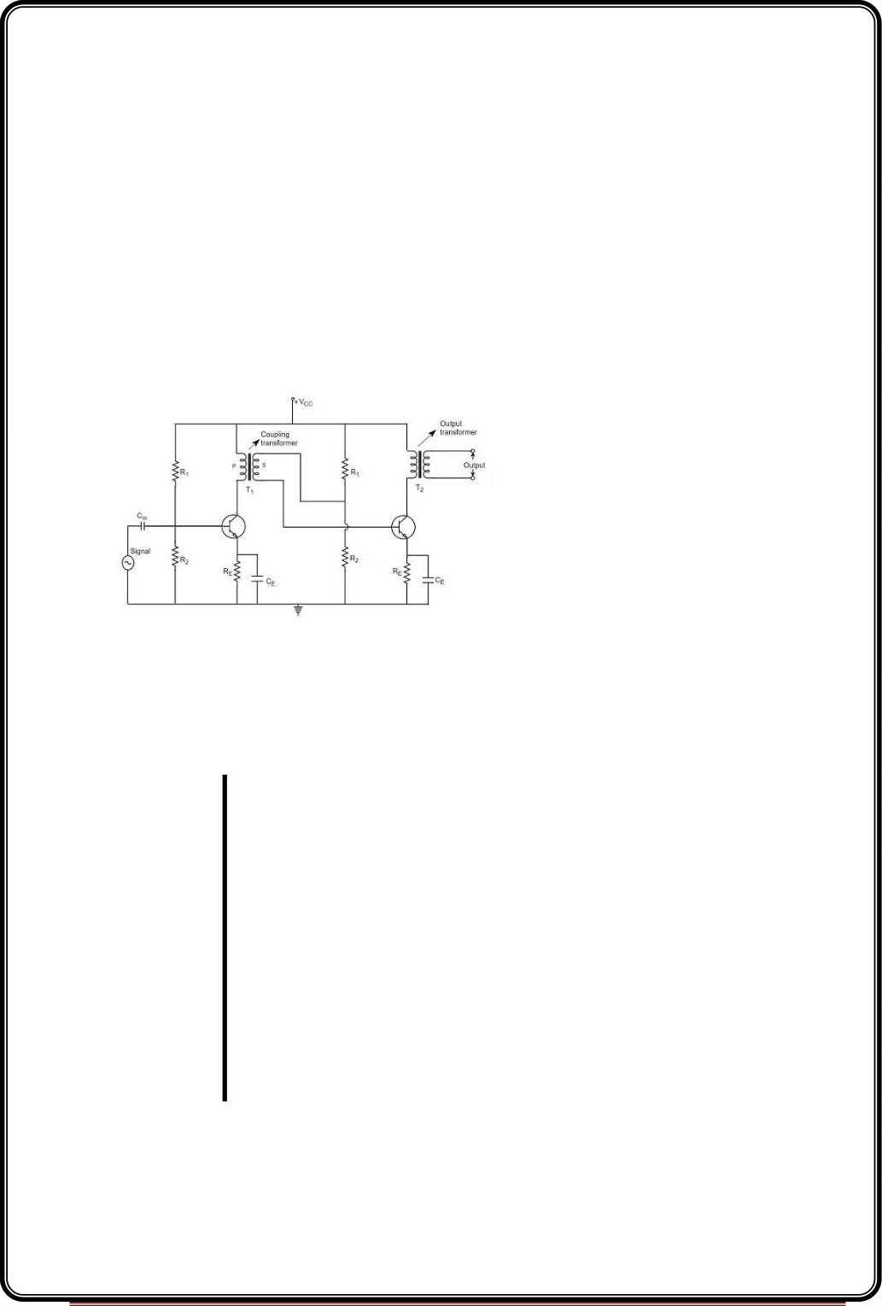
We have observed that the main drawback of RC coupled amplifier is that the effective
load resistance gets reduced. This is because, the input impedance of an amplifier is low,
while its output impedance is high.
When they are coupled to make a multistage amplifier, the high output impedance of one
stage comes in parallel with the low input impedance of next stage. Hence, effective load
resistance is decreased. This problem can be overcome by a transformer coupled
amplifier.
In a transformer-coupled amplifier, the stages of amplifier are coupled using a transformer.
Let us go into the constructional and operational details of a transformer coupled amplifier.
Construction of Transformer Coupled Amplifier
The amplifier circuit in which, the previous stage is connected to the next stage using a
coupling transformer, is called as Transformer coupled amplifier.
The coupling transformer T1 is used to feed the output of 1ststage to the input of 2nd stage.
The collector load is replaced by the primary winding of the transformer. The secondary
winding is connected between the potential divider and the base of 2ndstage, which
provides the input to the 2nd stage. Instead of coupling capacitor like in RC coupled
amplifier, a transformer is used for coupling any two stages, in the transformer coupled
amplifier circuit.
The figure below shows the circuit diagram of transformer coupled amplifier.
The potential divider network R and R and the resistor R together form the biasing and
1
2
e
stabilization network. The emitter by-pass capacitor Ce offers a low reactance path to the
signal. The resistor R is used as a load impedance. The input capacitor C present at the
L
in
initial stage of the amplifier couples AC signal to the base of the transistor. The capacitor
Page 18

Slide 19
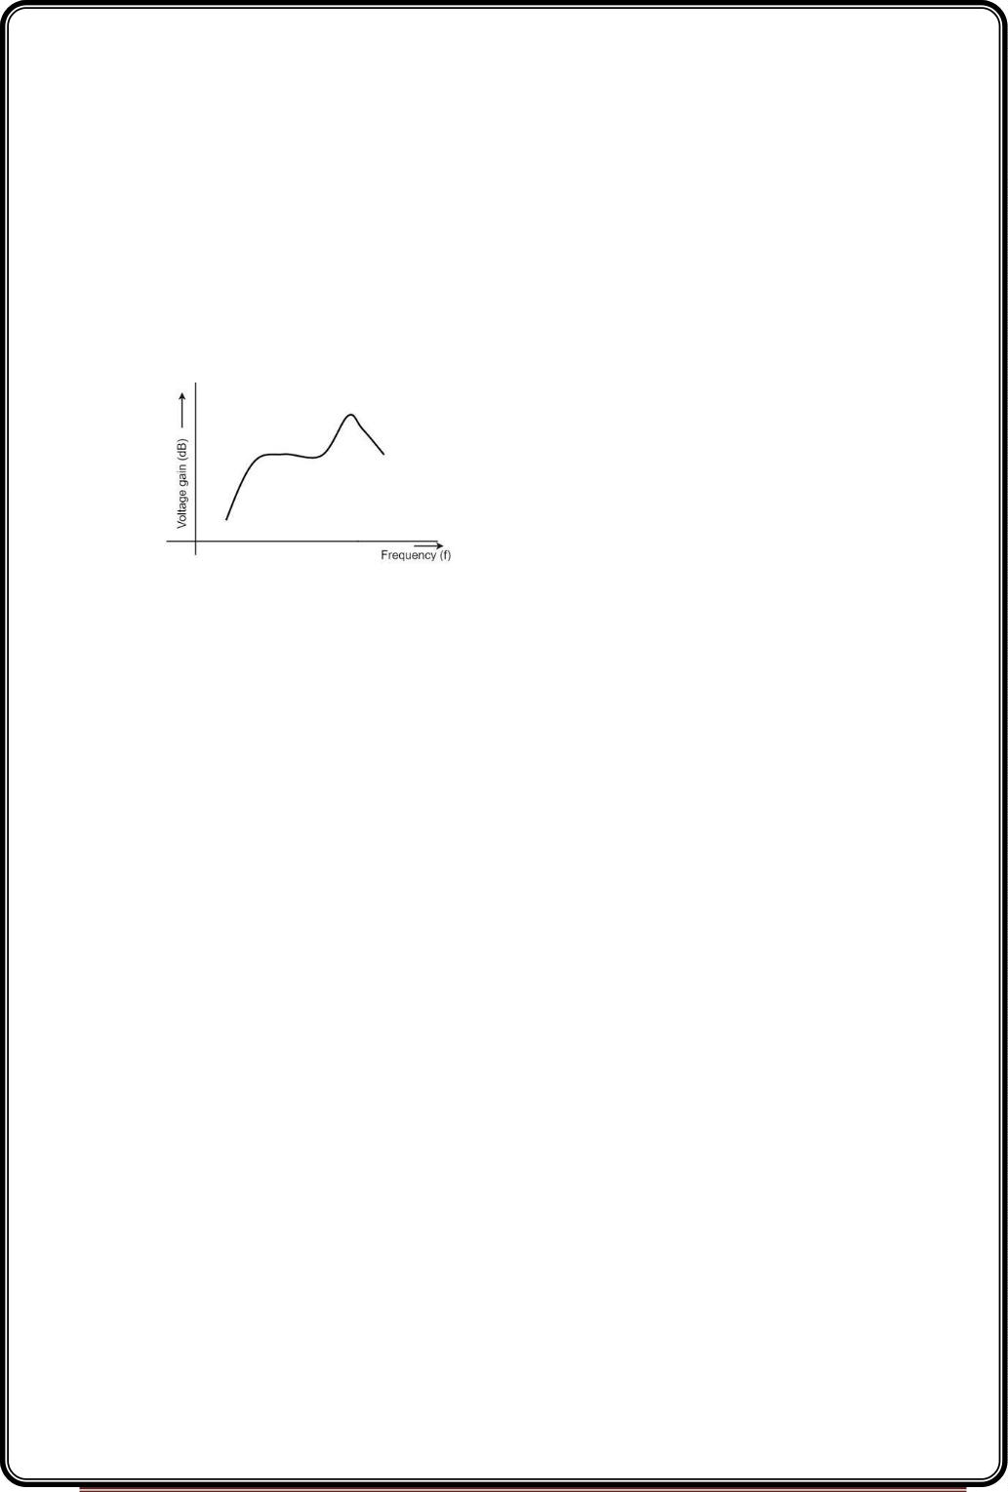
CC is the coupling capacitor that connects two stages and prevents DC interference
between the stages and controls the shift of operating point.
Operation of Transformer Coupled Amplifier
When an AC signal is applied to the input of the base of the first transistor then it gets
amplified by the transistor and appears at the collector to which the primary of the
transformer is connected.
The transformer which is used as a coupling device in this circuit has the property of
impedance changing, which means the low resistance of a stage (or load) can be reflected
as a high load resistance to the previous stage. Hence the voltage at the primary is
transferred according to the turns ratio of the secondary winding of the transformer.
This transformer coupling provides good impedance matching between the stages of
amplifier. The transformer coupled amplifier is generally used for power amplification.
Frequency Response of Transformer Coupled Amplifier
The figure below shows the frequency response of a transformer coupled amplifier. The
gain of the amplifier is constant only for a small range of frequencies. The output voltage is
equal to the collector current multiplied by the reactance of primary.
At low frequencies, the reactance of primary begins to fall, resulting in decreased gain. At
high frequencies, the capacitance between turns of windings acts as a bypass condenser to
reduce the output voltage and hence gain.
So, the amplification of audio signals will not be proportionate and some distortion will also
get introduced, which is called as Frequency distortion.
Advantages of Transformer Coupled Amplifier
•
•
•
•
An excellent impedance matching is provided.
Gain achieved is higher.
There will be no power loss in collector and base resistors.
Efficient in operation.
Page 19

Slide 20
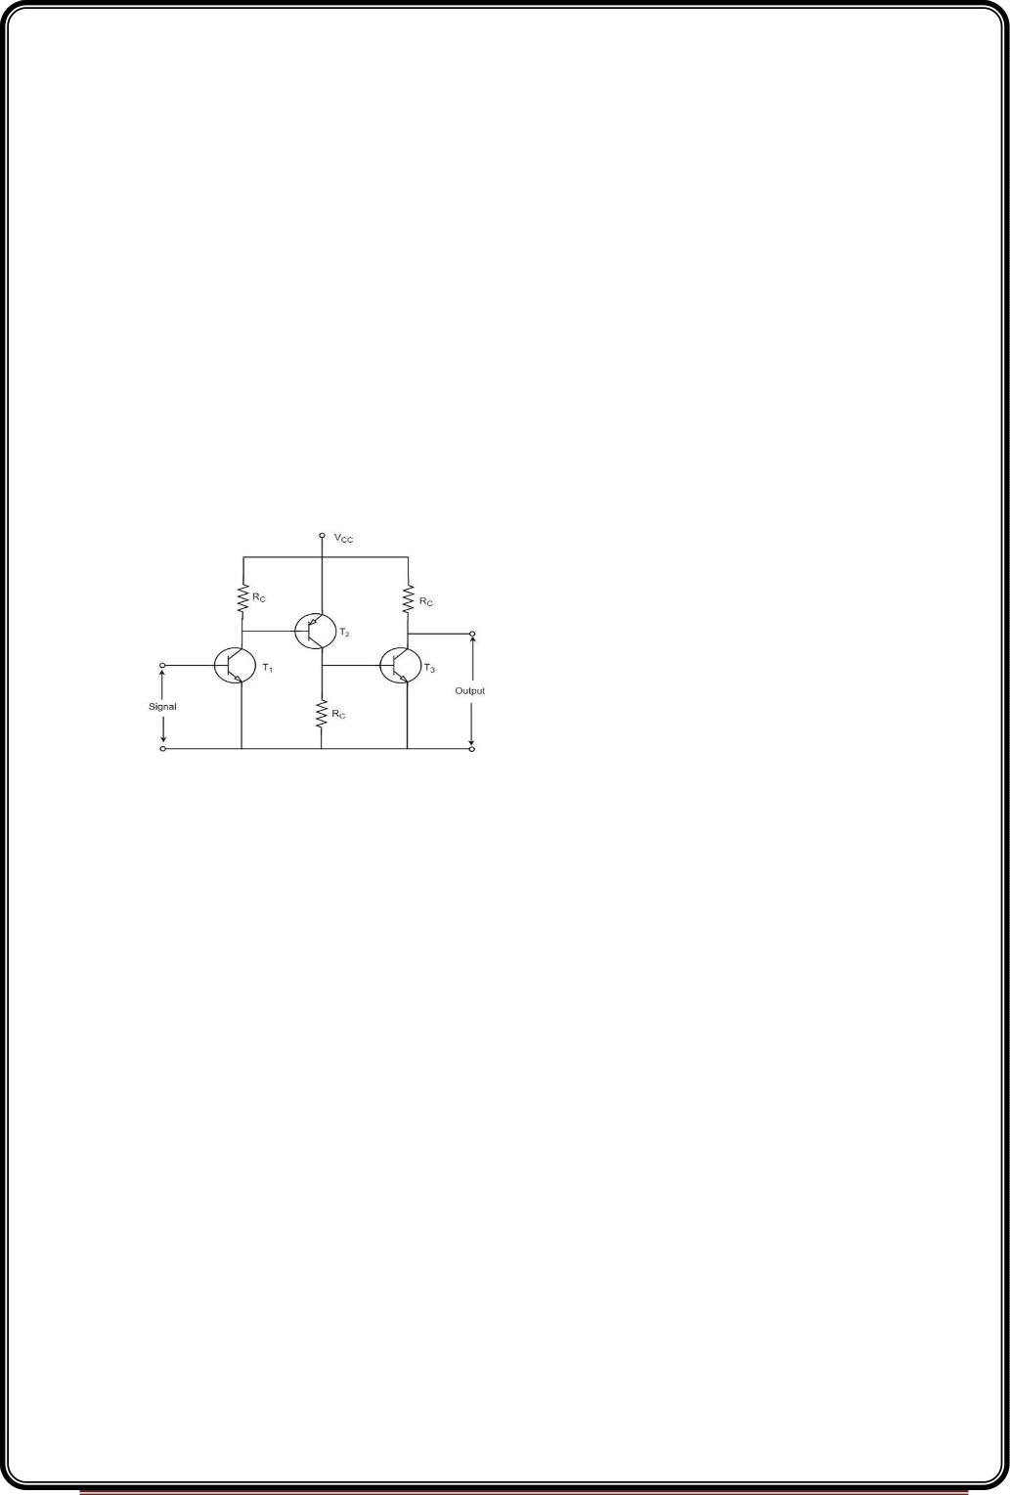
Disadvantages of Transformer Coupled Amplifier
The following are the disadvantages of a transformer coupled amplifier −
•
Though the gain is high, it varies considerably with frequency. Hence a poor
frequency response.
•
•
•
Frequency distortion is higher.
Transformers tend to produce hum noise.
Transformers are bulky and costly.
Applications
The following are the applications of a transformer coupled amplifier −
•
•
•
Mostly used for impedance matching purposes.
Used for Power amplification.
Used in applications where maximum power transfer is needed.
The other type of coupling amplifier is the direct coupled amplifier, which is especially used
to amplify lower frequencies, such as amplifying photo-electric current or thermo-couple
current or so.
Direct Coupled Amplifier
As no coupling devices are used, the coupling of the amplifier stages is done directly and
hence called as Direct coupled amplifier.
Construction
The figure below indicates the three stage direct coupled transistor amplifier. The output
of first stage transistor T is connected to the input of second stage transistor T .
1
2
Page 20

Slide 21

The transistor in the first stage will be an NPN transistor, while the transistor in the next
stage will be a PNP transistor and so on. This is because; the variations in one transistor
tend to cancel the variations in the other. The rise in the collector current and the variation
in β of one transistor gets cancelled by the decrease in the other.
Operation
The input signal when applied at the base of transistor T1, it gets amplified due to the
transistor action and the amplified output appears at the collector resistor Rc of transistor
T . This output is applied to the base of transistor T which further amplifies the signal. In
1
2
this way, a signal is amplified in a direct coupled amplifier circuit.
Advantages
The advantages of direct coupled amplifier are as follows.
•
•
The circuit arrangement is simple because of minimum use of resistors.
The circuit is of low cost because of the absence of expensive coupling devices.
Disadvantages
The disadvantages of direct coupled amplifier are as follows.
•
•
It cannot be used for amplifying high frequencies.
The operating point is shifted due to temperature variations.
Applications
•
•
Low frequency amplifications.
Low current amplifications.
Comparisons
S.No Particular
RC Coupling
Transformer
Direct Coupling
Best
1
2
3
4
5
Frequency
Cost
Excellent in audio Poor
Less
More
Least
Space
and Less
More
Least
Impedance
Use
Not good
For
Excellent
Good
voltage For
Power For
amplifying
Page 21

Slide 22
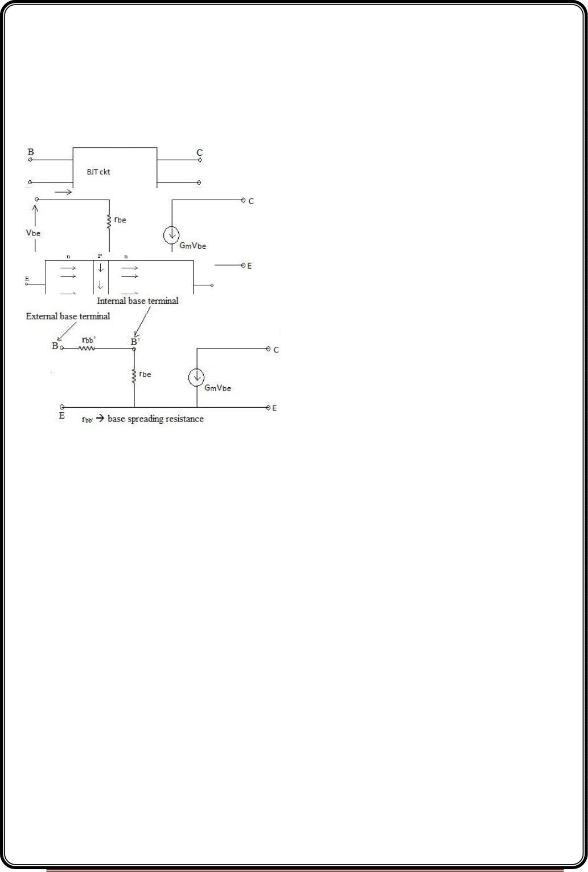
UNIT-II
BJT Amplifiers- Frequency Response
Under reverse bias condition the capacitance at the junction is called transition or space
charge capacitance.
Under forward bias condition the capacitance is called diffusion or storage capacitance.
At high frequencies, BJT cannot be analysed by h-parameters.
Giacolleto model - hybrid π equivalent ckt
Desirable fractures of hybrid π equivalent circuit (ckt)
(1)
(2)
The value of components in the equivalent ckt. are independent of frequencies.
The values of all the resistive components in the equivalent ckt. can be determined
from the known or Specified values of h-parameters at low frequencies.
(3)
The results obtained by using this equivalent ckt. Agrees with the experimental
result.
The components of the equivalent ckt. exist in the form of π hence the name.
For small signal behaviour the transistor at its input port behaves as a resistor.
The output port is a dependent current source.
Because the base (B) is lightly doped all the depletion region lies entirely in the Base region.
So, when the collector.
voltage is increased the depletion region in the base increases.
Page 22

Slide 23
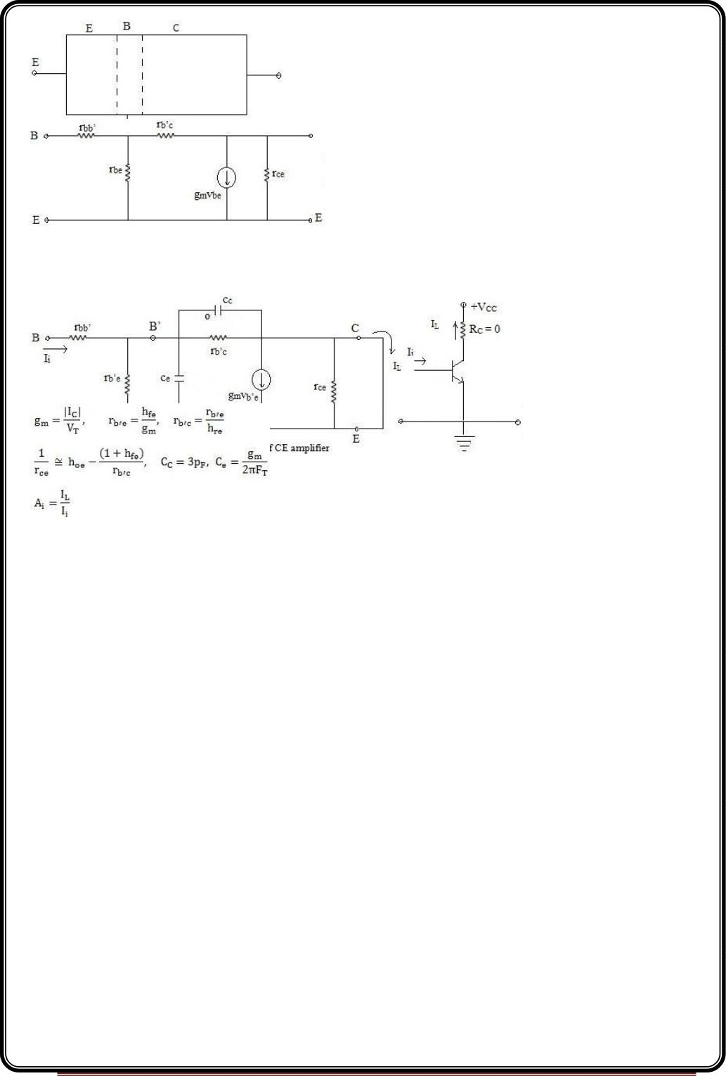
r --> This resistance is added to compensate for the change in I due to change in V .
ce
C
CE
The High frequency model parameters of a BJT in terms of low frequency hybrid parameters
is given below
Transconductance g = I /V
m
c
t
Internal Base node to emitter resistance rb’e = h / g = (h * V )/ I
c
fe
m
fe
t
Internal Base node to collector resistance rb’e = (hre* rb’c) / (1- hre) assuming hre << 1 it
reduces to rb’e = (hre* rb’c)
Base spreading resistance rbb’ = hie – rb’e = hie – (hfe* Vt )/ Ic
Collector to emitter resistance rce = 1 / ( hoe – (1+ hfe)/rb’c)
The C short circuit current gain (A )
E
i
(1)
is in shunt with short circuit and behaves as open circuit and hence is removed from
the equivalent circuit.
(2) rb’e | | rb’c rb’e
Page 23

Slide 24
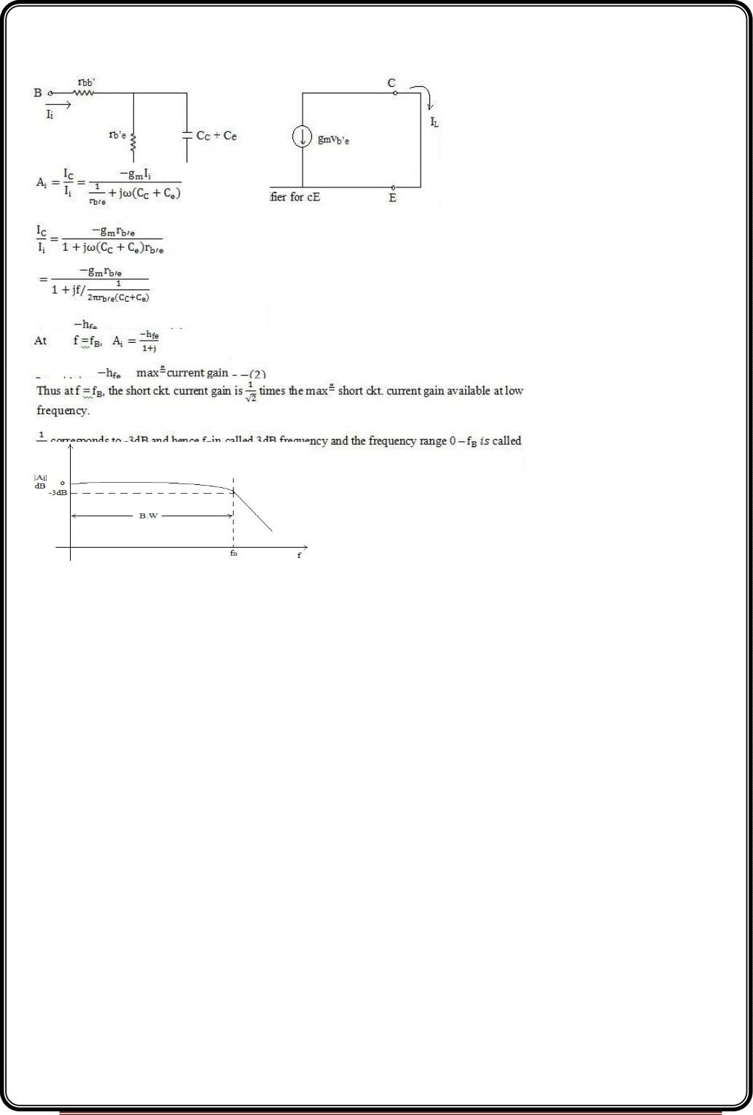
C || C = C + C
e
(3)
C
e
C
Current delivered directly to the output from input though r & C is negligibly small
b’c
C
compared to dependent
current source gmVb’e
Under these assumptions the simplified hybrid model of CE amplifier.
At
f = 0, Ai = - hfe
Page 24

Slide 25
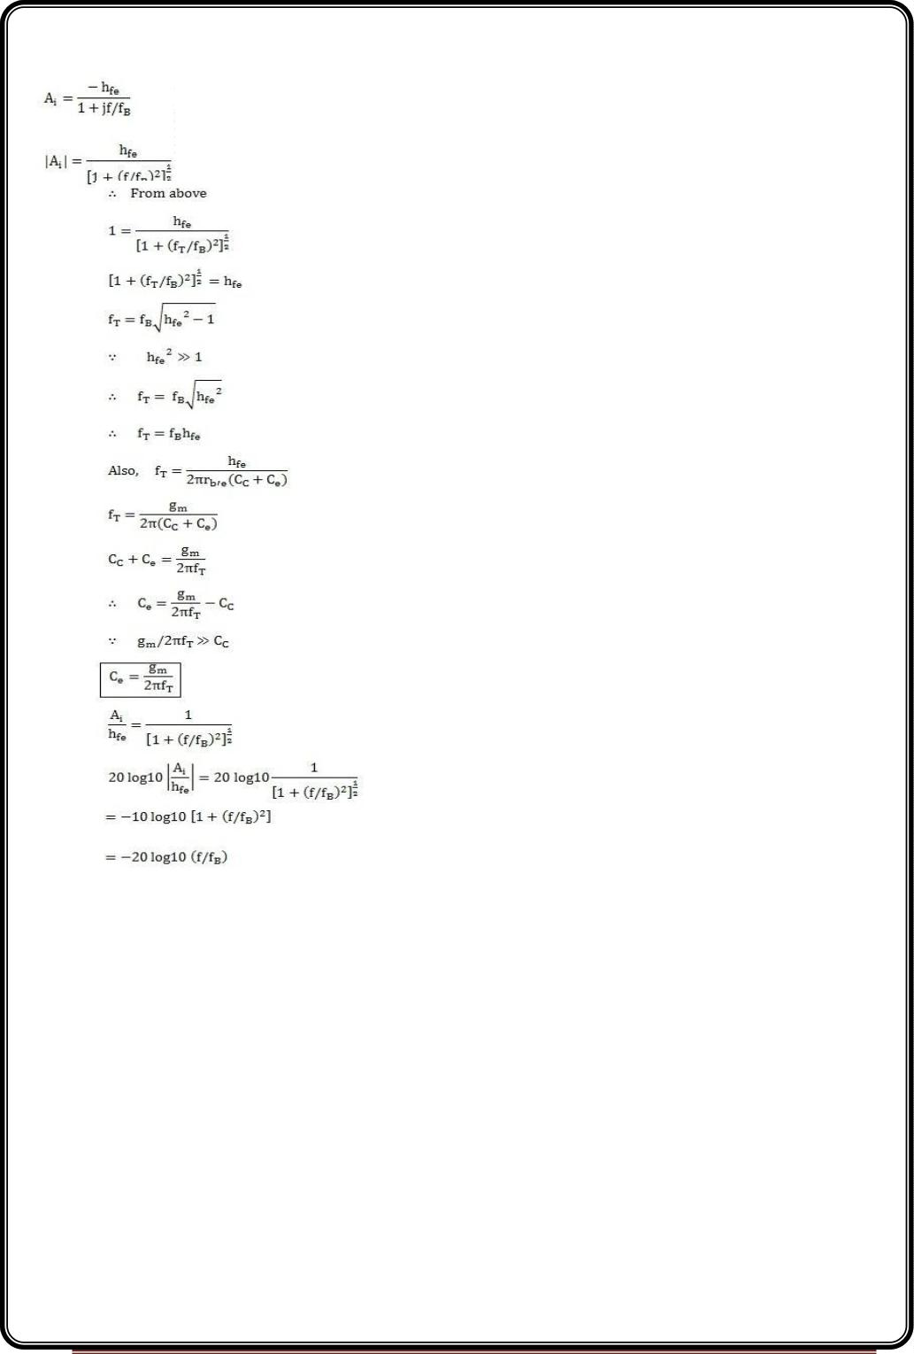
The parameter fT: The frequency at which the magnitude short ckt. current gain of
CE amplifier reduces to unity is
defined as frequency fT
fT --> Gain bandwidth product of an amplifier.
|Ai| = at f = fT
Page 25

Slide 26
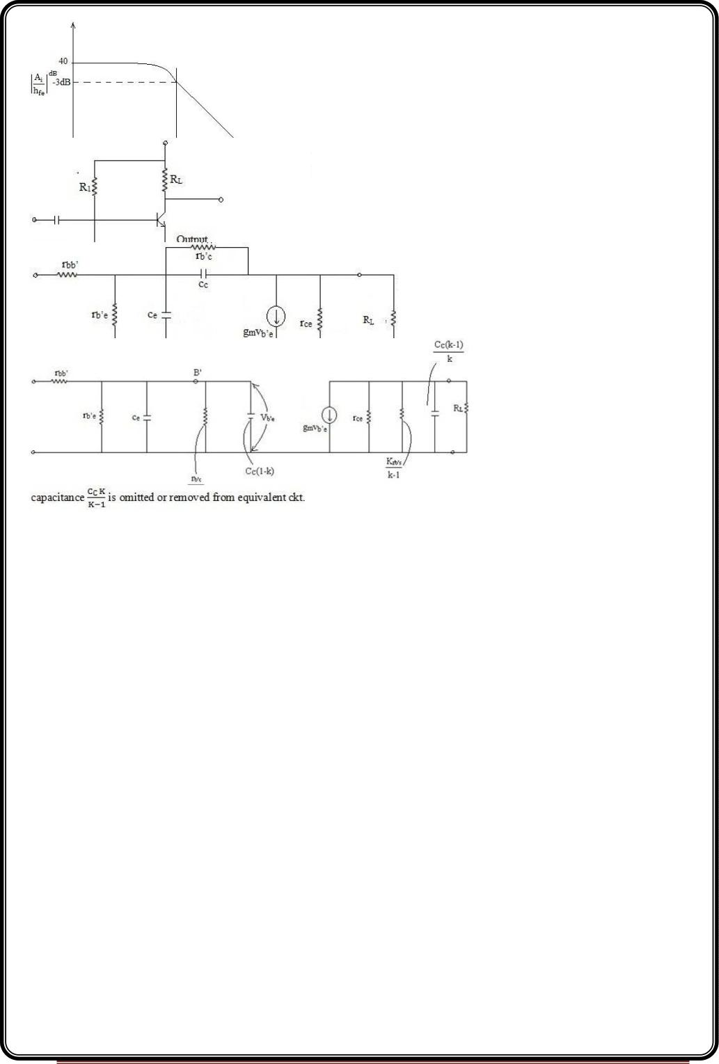
Current gain of CE amplifier with Resistive Load
Assumptions :
1)
Both input and output loop contain R ckt. the R product of input loop is larger than
C
C
that of output loop and
determines the bandwidth of (3dB frequency) of the amplifier. Consequently the
Page 26

Slide 27
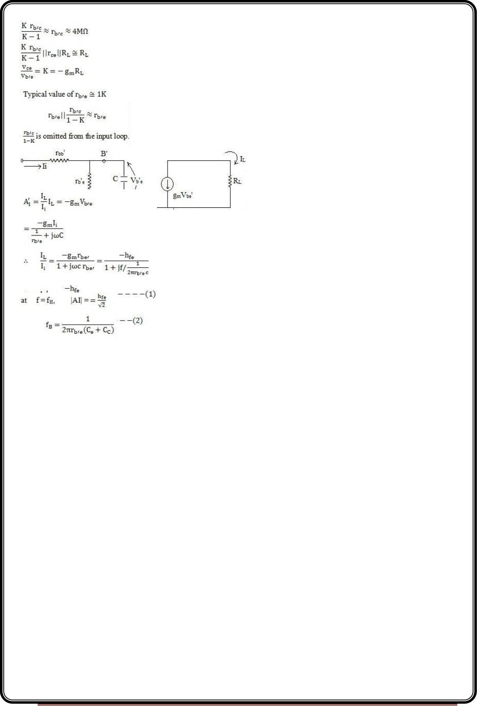
(2)
For practical amplifier RL< 2KΩ
rce = 80K
(3)
V = -g V RL
ce b’e
m
Typical value of g = 50mA/V & R = 2KΩ. Putting these value K = -100.
In the input loop
m
L
(4)
C = C + C (1-K)
e
C
= C + C (1 + g )
e
C
m
Final equivalent ckt.
At f = 0,
AI = -hfe
Page 27

Slide 28
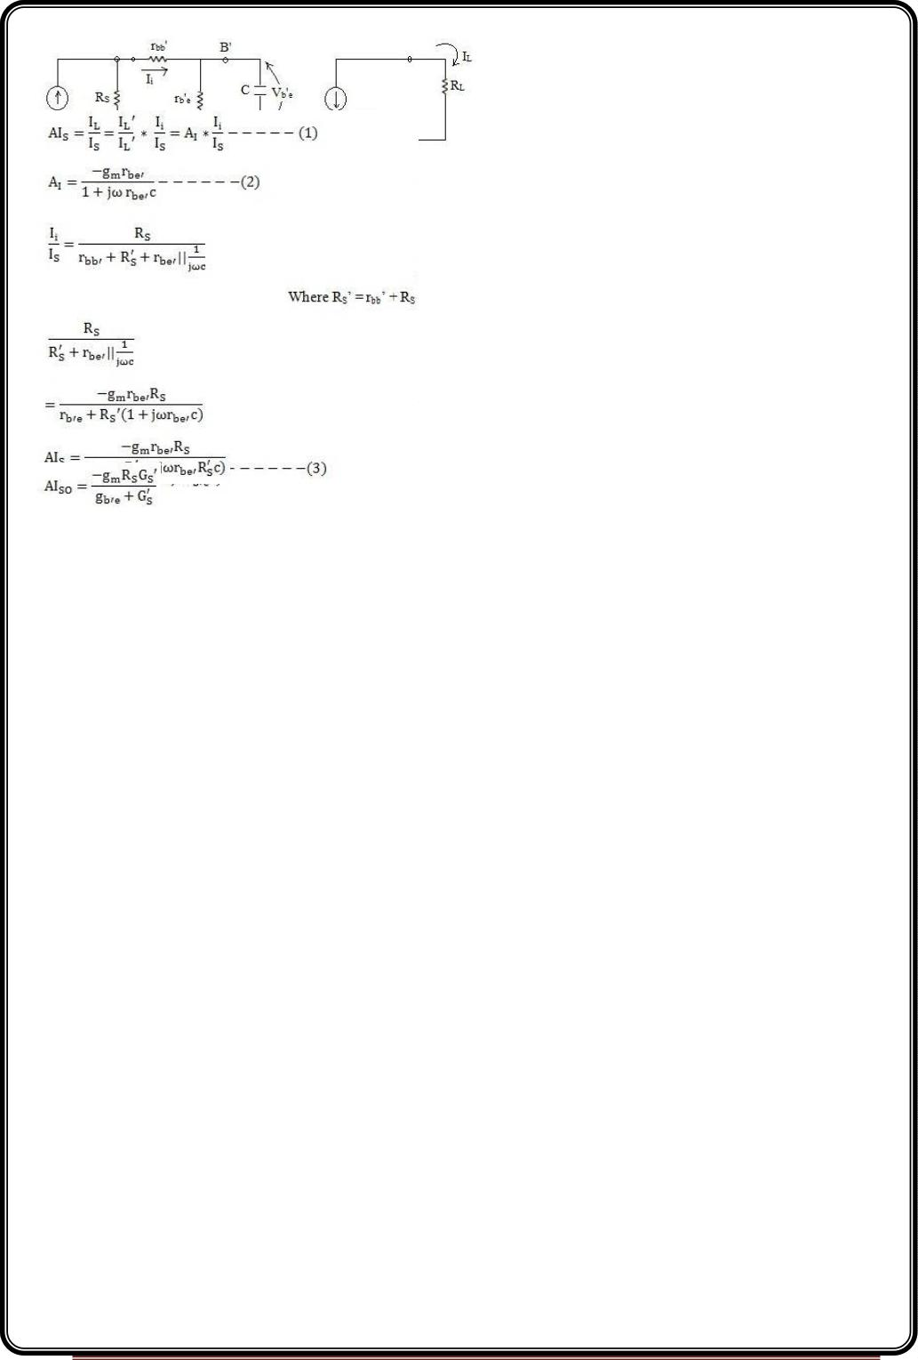
Current gain of CE amplifier taking source resistance into account
AIS= (1) * (2)
For f = 0, jωc
AI = -g R
s
where gb'e<< G'S
SO
m
From (4)
Page 28

Slide 29
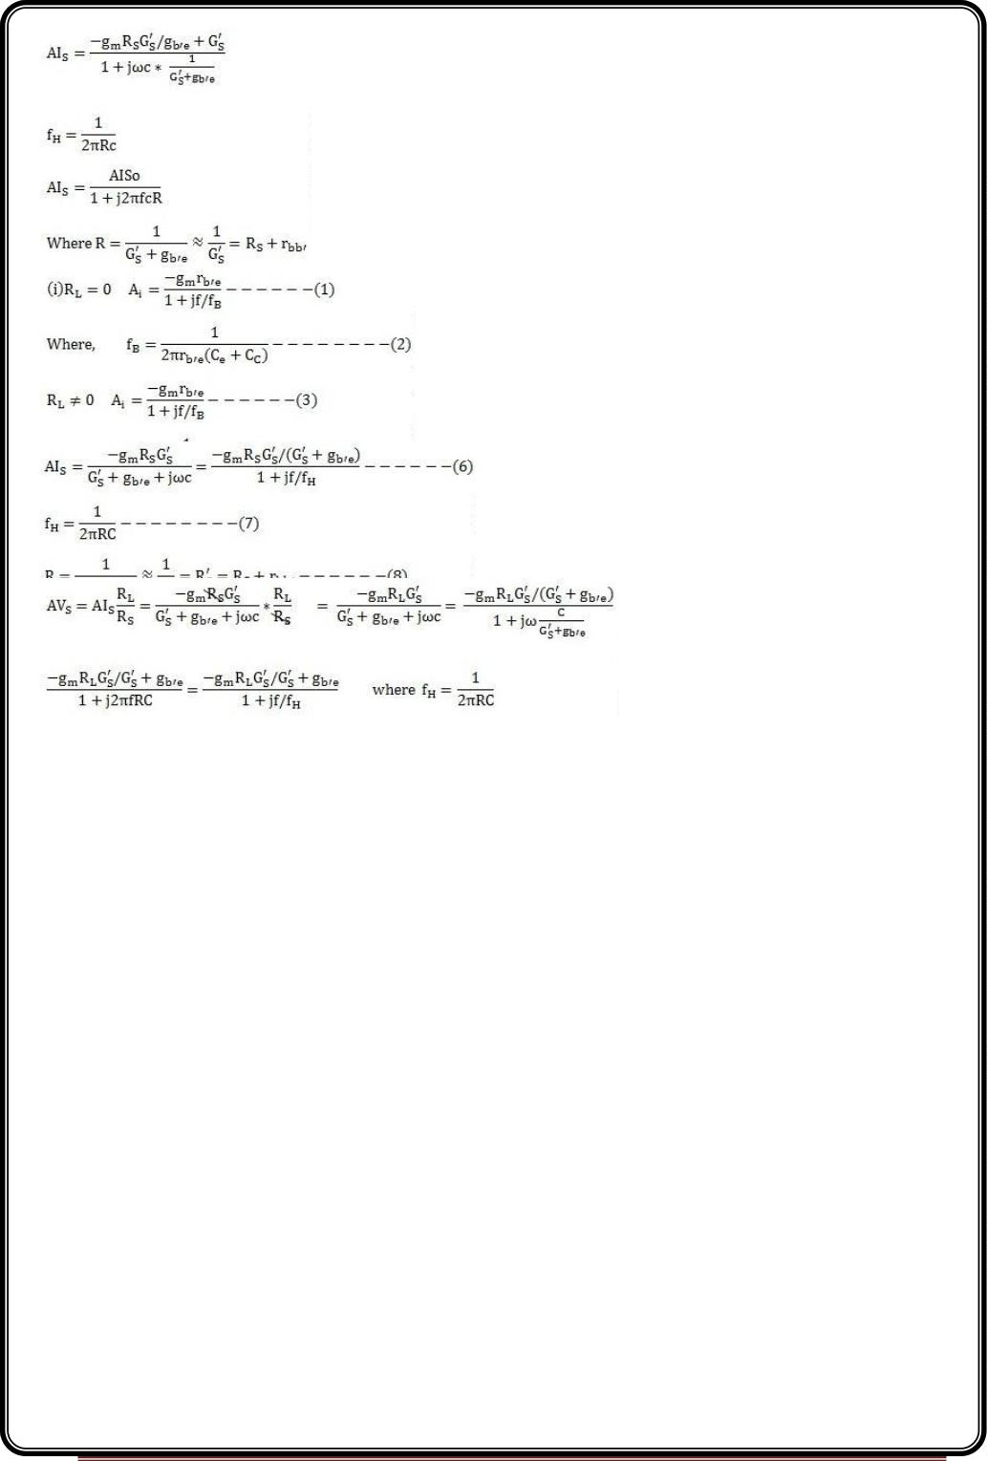
So, to summarize
C = C + C (1 + g R ) -------------(5)
(b)
e
C
m
L
Taking source resistance into account
C = C + C (1 + g R ) --------(9)
e
C
m
L
Voltage gain taking source resistance into consideration
R =R + r ' C = C + C (1 + g R )
S
bb
e
C
m
L
Page 29

Slide 30
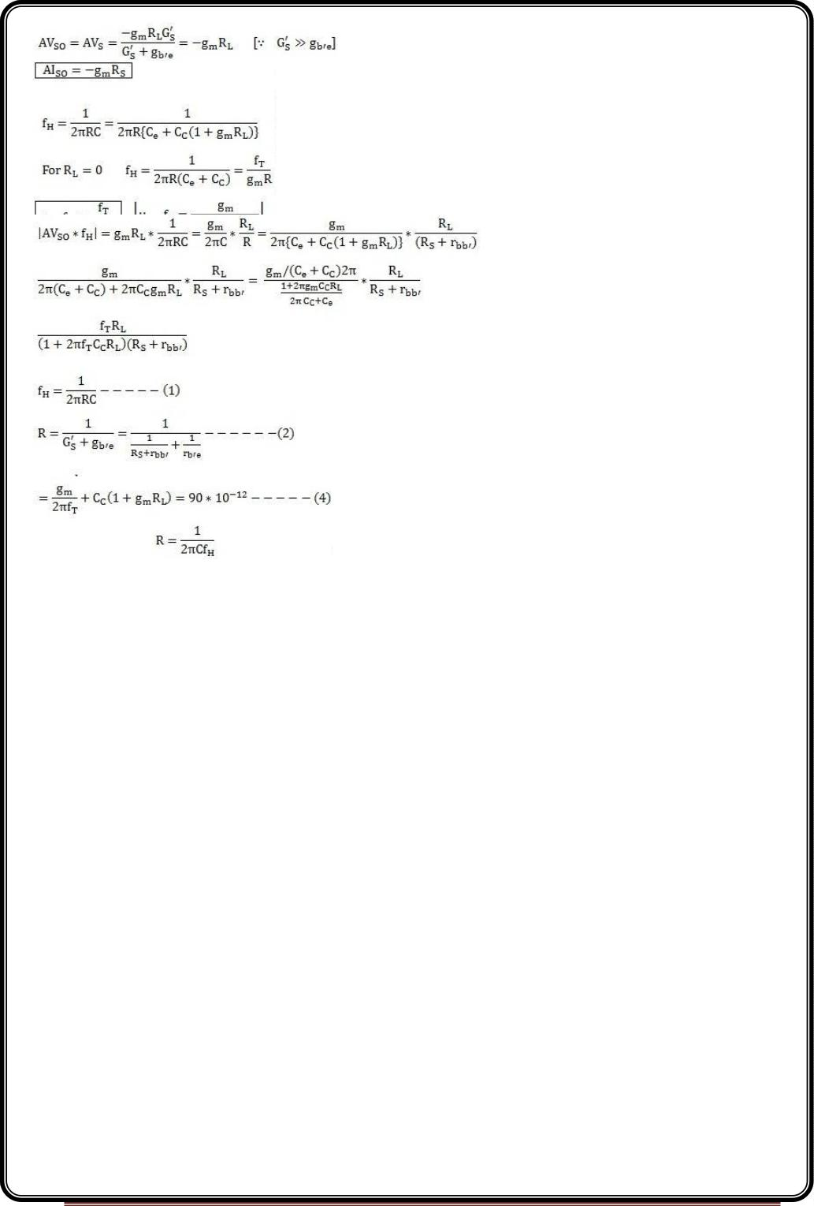
Where f = 0
Voltage Gain Bandwidth Product
Problem -
f = 400MHz, find R = ?
= f = 50 * 10⁶Hz, R = 500Ω, h = 100, g = 100mA/V, r ’ = 100Ω, C = 1PF,
T
H
L
fe
m
bb
C
S
C = C + C (1 + g R )
e
C
m
L
RS = 449 Ω
Page 30

Slide 31
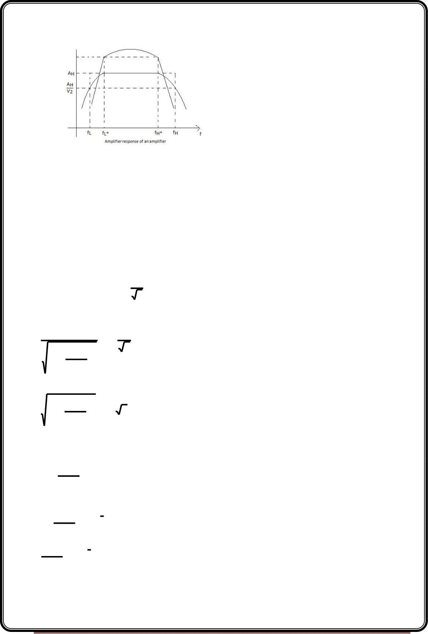
Bandwidth of a multistage amplifier
The range of frequencies which are amplified without much variation in gain is called
bandwidth
of
amplifiers.
Human ears are insensitive to the variation of power gain of about 3dB. Hence, frequency
range from lower 3dB to upper 3dB is considered as bandwidth of single stage amplifier.
Bandwidth of single stage amplifier.
Bandwidth (BW) = f – f ~ f
H
H
L
Lower 3dB frequency of multistage amplifier
The lower 3db frequency of n identical cascaded stages as fL(n).It is the frequency for which
the overall gain falls to
1
(3 db) of its midband value.
n
2





1

1

 
2

2

^{f}L


 1 
f_{L} n
 



 
^{n}

2

^{f}L


 
 
 2
1 

   

f n
L

Squaring on both sides we get

n


2
1 
f


L
   2


 f n 

L

Taking n^{th} root on both sides
1 
2
^{f}L

1
 fL n
  2^{n}

2
1

f

L
  2 1
  
n

f n
L

Taking square root on both sides
Page 31

Slide 32
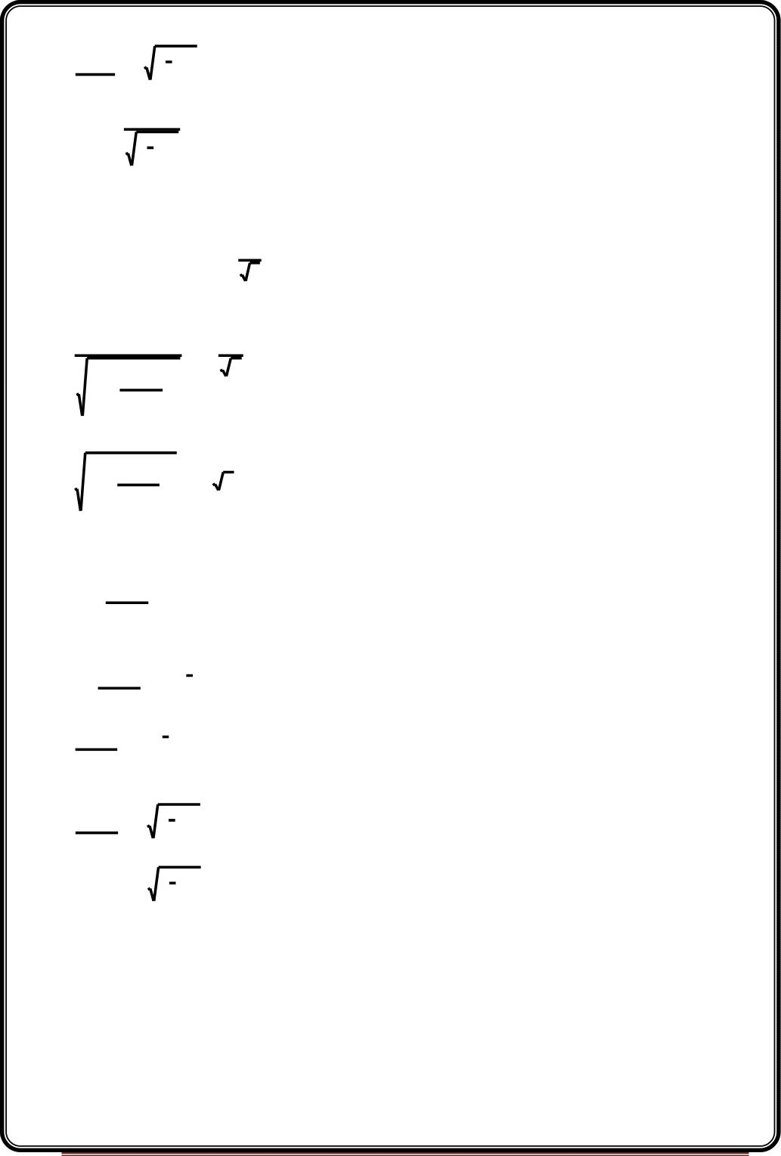

f

1

L
  2 1
  
n

f n
L

f_{L} n 
^{f}L
1
2
1
n
Higher 3dB frequency of multistage amplifier
The lower 3db frequency of n identical cascaded stages as fH(n).It is the frequency for which
the overall gain falls to
1
(3 db) of its midband value.
n
2





1

1

 
2

2

^{f}H ^{n}

 1 


^{f}H
 

 

  ²
^{n}

 
f n
 
 2

1 
H



^{f}H
 

Squaring on both sides we get

n
1 
  ² 
f n

H
   2


 f  

H

Taking n^{th} root on both sides
^{f}H ^{n}
 fH
2
1 

1
  2^{n}

  ²
1

f n
  2 1

H

n

^{f}H

Taking square root on both sides
  
1

f n
  2 1

H

n

^{f}H

1
f_{H} n f_{H} 2^{n} 1
Page 32

Slide 33
UNIT-III
Feedback Amplifier & Oscillator
Feedback Amplifier
A practical amplifier has a gain of nearly one million i.e. its output is one million
times the input. Consequently, even a casual disturbance at the input will appear in the
amplified form in the output. There is a strong tendency in amplifiers to introduce hum due
to sudden temperature changes or stray electric and magnetic fields. Therefore, every high
gain amplifier tends to give noise along with signal in its output. The noise in the output of
an amplifier is undesirable and must be kept to as small a level as possible. The noise level in
amplifiers can be reduced considerably by the use of negative feedback i.e. by injecting a
fraction of output in phase opposition to the input signal. The object of this chapter is to
consider the effects and methods of providing negative feedback in transistor amplifiers.
Ideally an amplifier should reproduce the input signal, with change in
magnitude and with or without change in phase. But some of the short comings of the
amplifier circuit are
1 . Change in the value of the gain due to variation in supplying voltage, temperature
or due to components.
2. Distortion in wave-form due to non linearities in the operating characters
of the Amplifying device.
3. The amplifier may introduce noise (undesired signals)
The above drawbacks can be minimizing if we introduce feedback
CLASSIFICATION OF AMPLIFIERS
Amplifiers can be classified broadly as,
1. Voltage amplifiers.
2. Current amplifiers.
3. Transconductance amplifiers.
4. Transresistance amplifiers.
Page 33

Slide 34
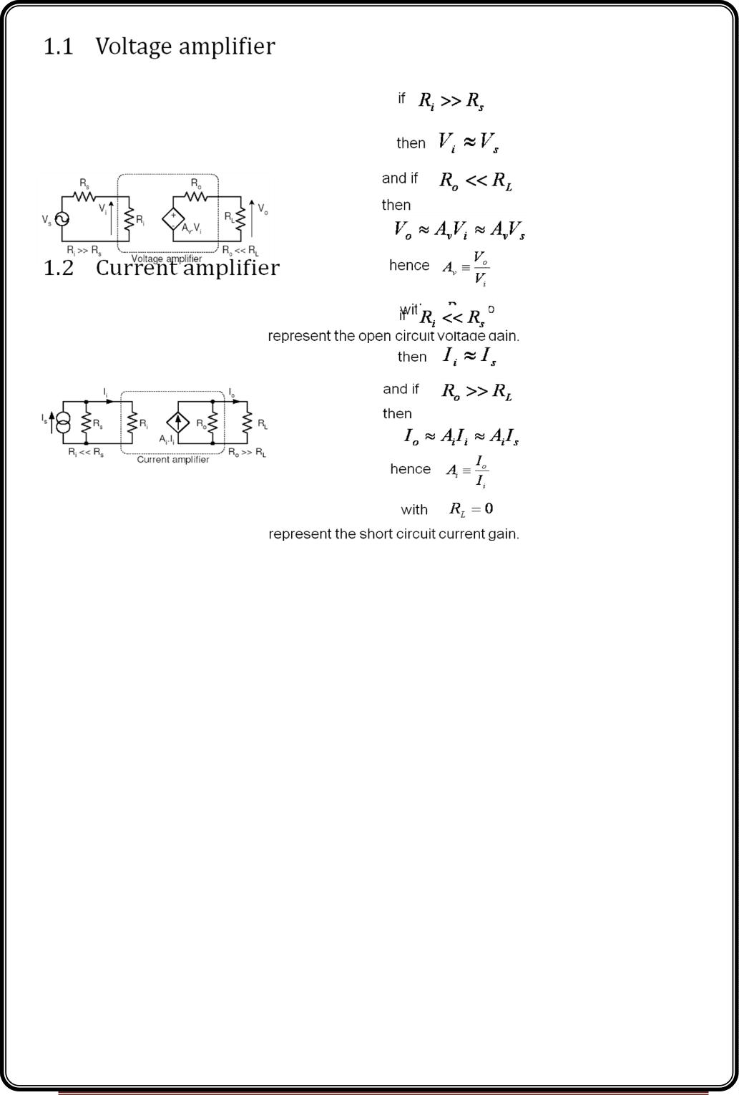
Page 34

Slide 35
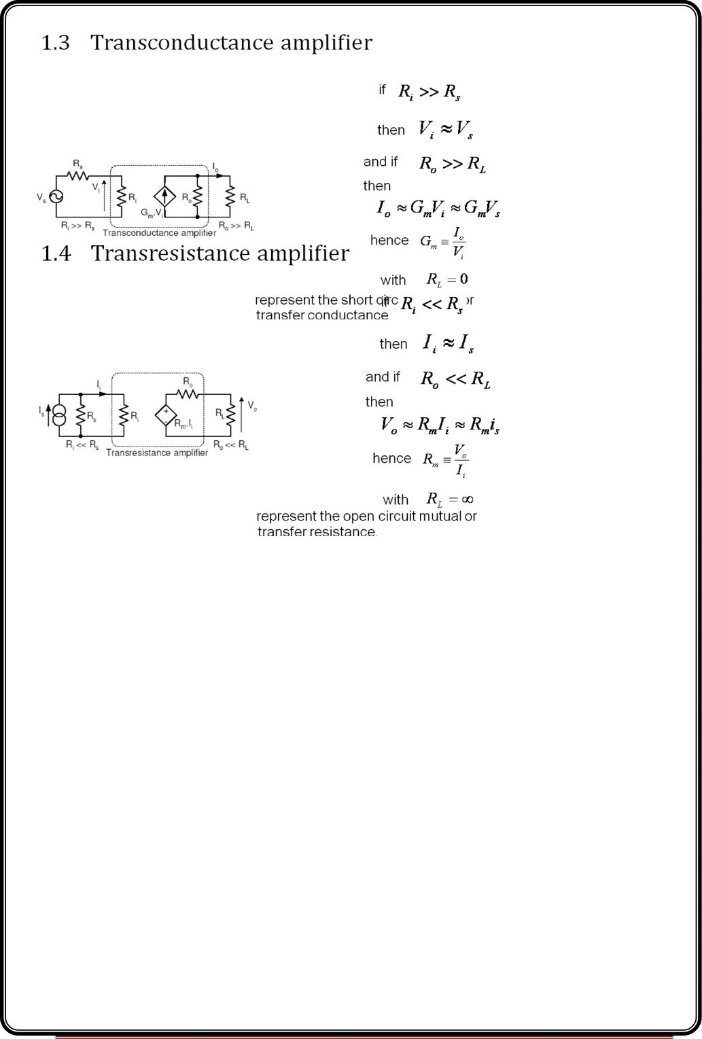
Page 35

Slide 36
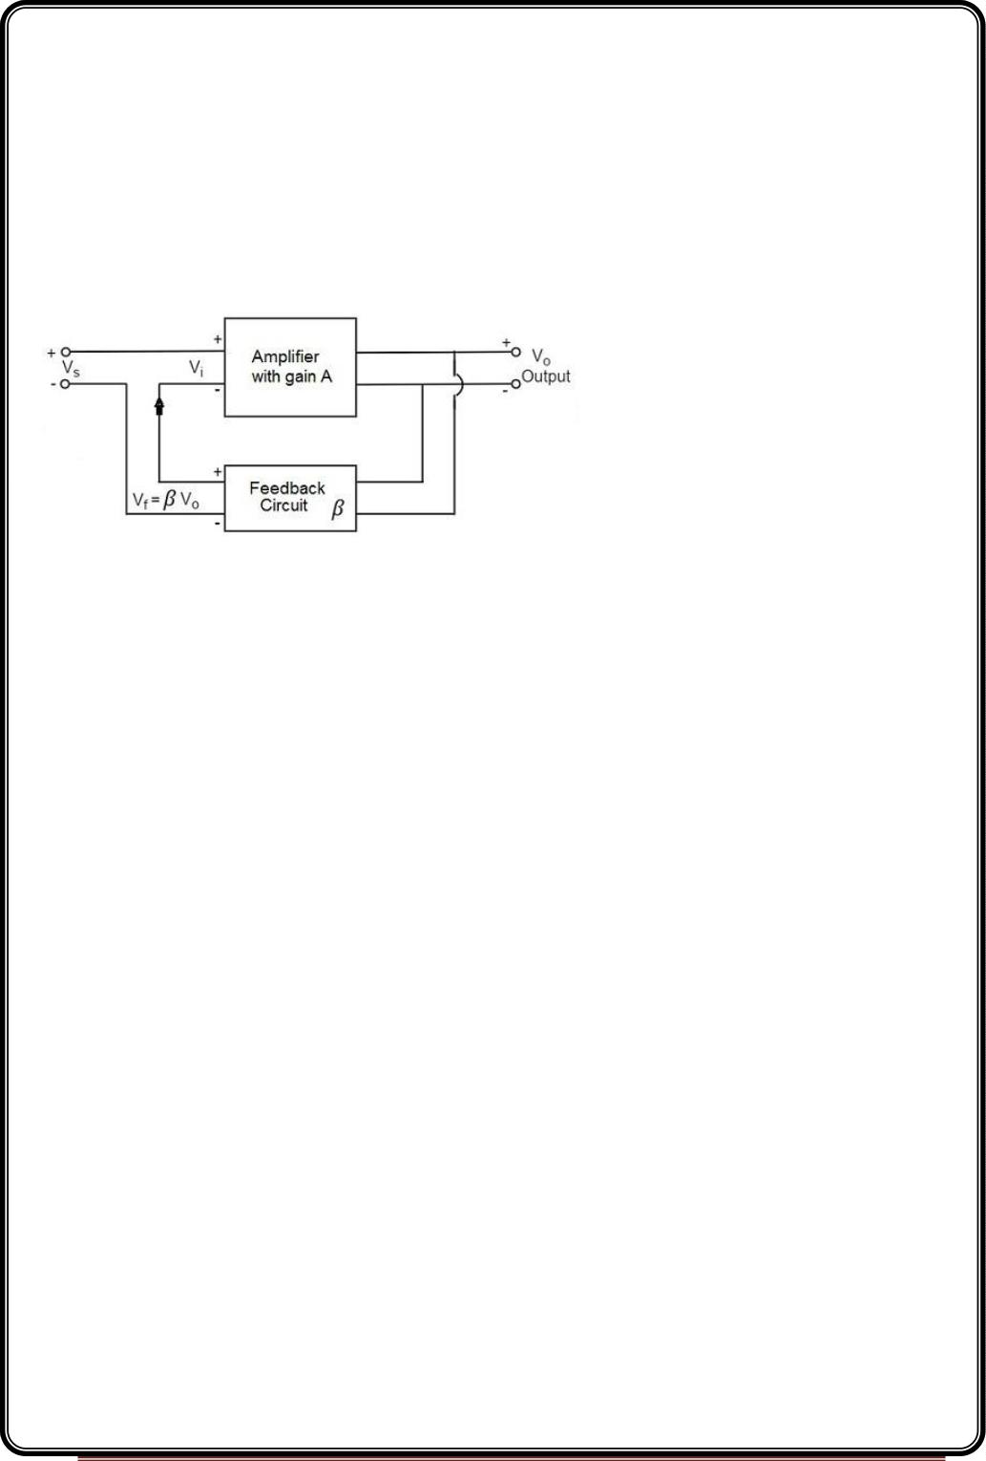
Concept of Feedback
An amplifier circuit simply increases the signal strength. But while amplifying, it just
increases the strength of its input signal whether it contains information or some noise
along with information. This noise or some disturbance is introduced in the amplifiers
because of their strong tendency to introduce hum due to sudden temperature changes or
stray electric and magnetic fields. Therefore, every high gain amplifier tends to give noise
along with signal in its output, which is very undesirable.
The noise level in the amplifier circuits can be considerably reduced by using negative
feedback done by injecting a fraction of output in phase opposition to the input signal.
Principle of Feedback Amplifier
A feedback amplifier generally consists of two parts. They are theamplifier and
the feedback circuit. The feedback circuit usually consists of resistors. The concept of
feedback amplifier can be understood from the following figure.
From the above figure, the gain of the amplifier is represented as A. the gain of the
amplifier is the ratio of output voltage V to the input voltage V . the feedback network
o
i
extracts a voltage V = β V from the output V of the amplifier.
f
o
o
This voltage is added for positive feedback and subtracted for negative feedback, from the
signal voltage Vs. Now,
Vi=Vs+Vf=Vs+βVo
Vi=Vs−Vf=Vs−βVo
The quantity β = V /V is called as feedback ratio or feedback fraction.
f
o
Let us consider the case of negative feedback. The output Vomust be equal to the input
voltage (V - βV ) multiplied by the gain A of the amplifier.
s
o
Page 36

Slide 37
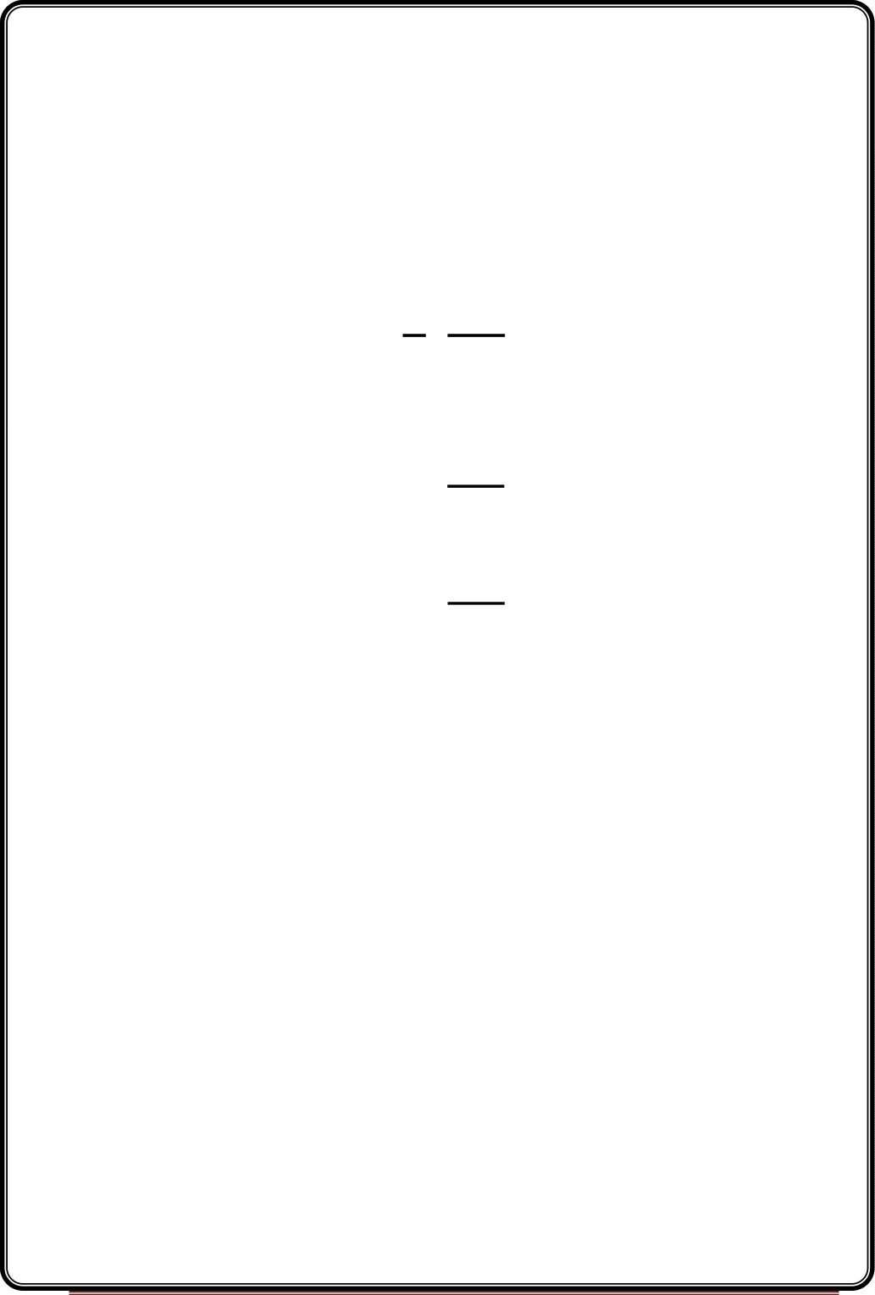
Hence,
(V −βV )A=V
s
o
o
Or
AV −AβV =V
s
Or
o
o
AV =V (1+Aβ)
s
o
Therefore,
Vo

A
Vs 1 A
Let Af be the overall gain (gain with the feedback) of the amplifier. This is defined as the
ratio of output voltage V to the applied signal voltage V , i.e.,
o
s
Af 
A
1 A
The equation of gain of the feedback amplifier, with positive feedback is given by
Af 
A
1 A
These are the standard equations to calculate the gain of feedback amplifiers.
Types of Feedbacks
The process of injecting a fraction of output energy of some device back to the input is
known as Feedback. It has been found that feedback is very useful in reducing noise and
making the amplifier operation stable.
Depending upon whether the feedback signal aids or opposes the input signal, there are
two types of feedbacks used.
Positive Feedback
The feedback in which the feedback energy i.e., either voltage or current is in phase with
the input signal and thus aids it is called asPositive feedback.
Both the input signal and feedback signal introduces a phase shift of 180º thus making a
360º resultant phase shift around the loop, to be finally in phase with the input signal.
Though the positive feedback increases the gain of the amplifier, it has the disadvantages
such as
Page 37

Slide 38
•
•
Increasing distortion
Instability
It is because of these disadvantages the positive feedback is not recommended for the
amplifiers. If the positive feedback is sufficiently large, it leads to oscillations, by which
oscillator circuits are formed.
Negative Feedback
The feedback in which the feedback energy i.e., either voltage or current is out of phase
with the input and thus opposes it, is called as negative feedback.
In negative feedback, the amplifier introduces a phase shift of 180º into the circuit while
the feedback network is so designed that it produces no phase shift or zero phase shift.
Thus the resultant feedback voltage V is 180º out of phase with the input signal V .
f
in
Though the gain of negative feedback amplifier is reduced, there are many advantages of
negative feedback such as
•
•
•
•
•
•
Stability of gain is improved
Reduction in distortion
Reduction in noise
Increase in input impedance
Decrease in output impedance
Increase in the range of uniform application
It is because of these advantages negative feedback is frequently employed in amplifiers.
Negative feedback in an amplifier is the method of feeding a portion of the amplified
output to the input but in opposite phase. The phase opposition occurs as the amplifier
provides 180º phase shift whereas the feedback network doesn’t.
While the output energy is being applied to the input, for the voltage energy to be taken as
feedback, the output is taken in shunt connection and for the current energy to be taken as
feedback, the output is taken in series connection.
There are two main types of negative feedback circuits. They are −
•
•
Negative Voltage Feedback
Negative Current Feedback
Page 38

Slide 39
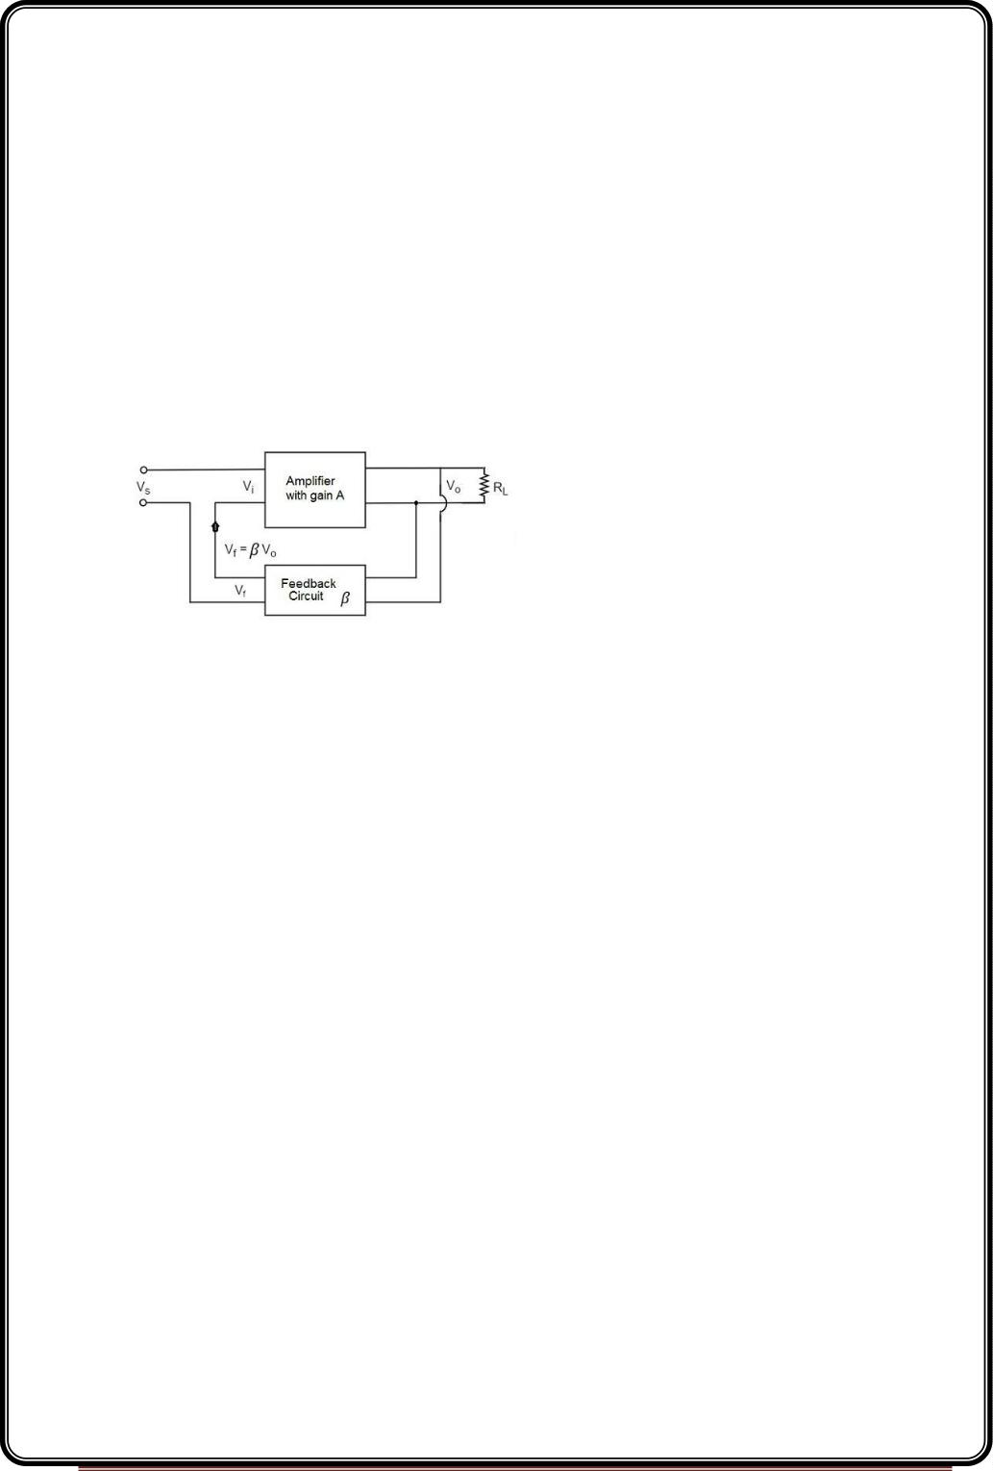
NegativeVoltageFeedback
In this method, the voltage feedback to the input of amplifier is proportional to the output
voltage. This is further classified into two types −
•
•
Voltage-series feedback
Voltage-shunt feedback
Negative Current Feedback
In this method, the voltage feedback to the input of amplifier is proportional to the output
current. This is further classified into two types.
•
•
Current-series feedback
Current-shunt feedback
Let us have a brief idea on all of them.
Voltage-SeriesFeedback
In the voltage series feedback circuit, a fraction of the output voltage is applied in series
with the input voltage through the feedback circuit. This is also known as shunt-driven
series-fed feedback, i.e., a parallel-series circuit.
The following figure shows the block diagram of voltage series feedback, by which it is
evident that the feedback circuit is placed in shunt with the output but in series with the
input.
As the feedback circuit is connected in shunt with the output, the output impedance is
decreased and due to the series connection with the input, the input impedance is
increased.
Page 39

Slide 40
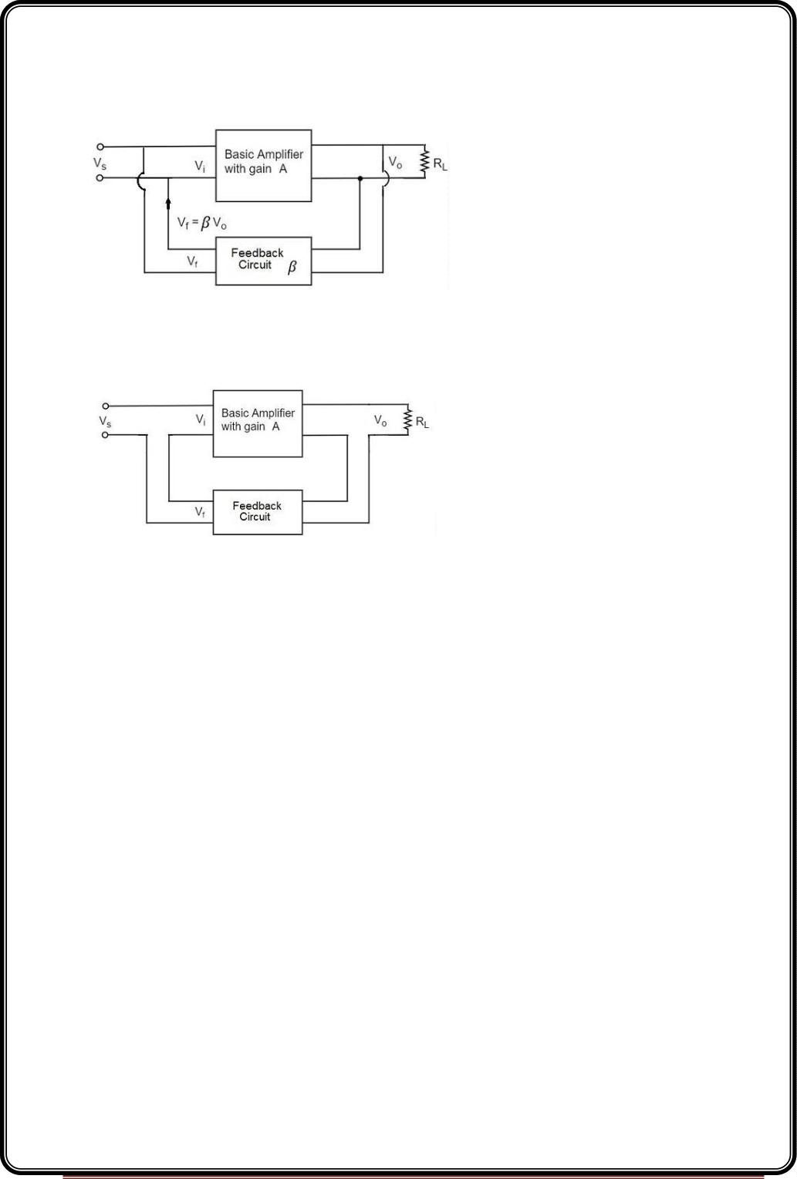
Voltage-ShuntFeedback
In the voltage shunt feedback circuit, a fraction of the output voltage is applied in parallel
with the input voltage through the feedback network. This is also known as shunt-driven
shunt-fed feedback i.e., a parallel-parallel proto type.
The below figure shows the block diagram of voltage shunt feedback, by which it is evident
that the feedback circuit is placed in shunt with the output and also with the input.
As the feedback circuit is connected in shunt with the output and the input as well, both
the output impedance and the input impedance are decreased.
Current-SeriesFeedback
In the current series feedback circuit, a fraction of the output voltage is applied in series
with the input voltage through the feedback circuit. This is also known as series-driven
series-fed feedback i.e., a series-series circuit.
The following figure shows the block diagram of current series feedback, by which it is
evident that the feedback circuit is placed in series with the output and also with the input.
As the feedback circuit is connected in series with the output and the input as well, both
the output impedance and the input impedance are increased.
Page 40

Slide 41
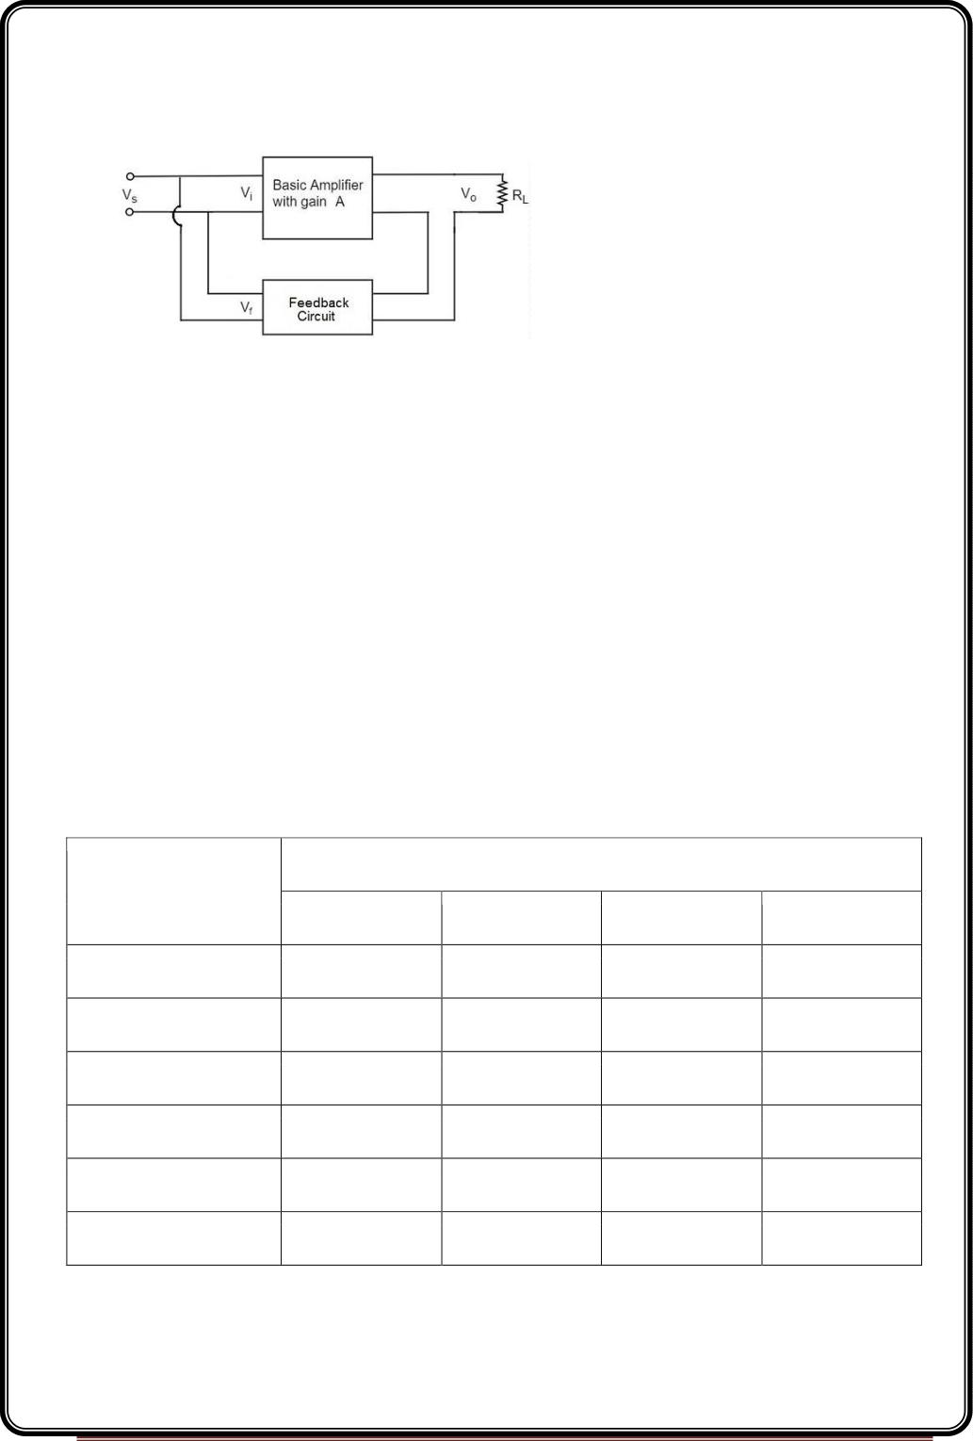
Current-ShuntFeedback
In the current shunt feedback circuit, a fraction of the output voltage is applied in series
with the input voltage through the feedback circuit. This is also known as series-driven
shunt-fed feedback i.e., a series-parallel circuit.
The below figure shows the block diagram of current shunt feedback, by which it is evident
that the feedback circuit is placed in series with the output but in parallel with the input.
As the feedback circuit is connected in series with the output, the output impedance is
increased and due to the parallel connection with the input, the input impedance is
decreased.
Let us now tabulate the amplifier characteristics that get affected by different types of
negative feedbacks.
Characteristics
Types of Feedback
Voltage-Series Voltage-Shunt Current-Series Current-Shunt
Voltage Gain
Decreases
Increases
Increases
Decreases
Decreases
Increases
Decreases
Decreases
Decreases
Decreases
Decreases
Increases
Increases
Increases
Decreases
Decreases
Decreases
Increases
Decreases
Increases
Decreases
Decreases
Bandwidth
Input resistance
Output resistance
Harmonic distortion Decreases
Noise Decreases
Page 41

Slide 42
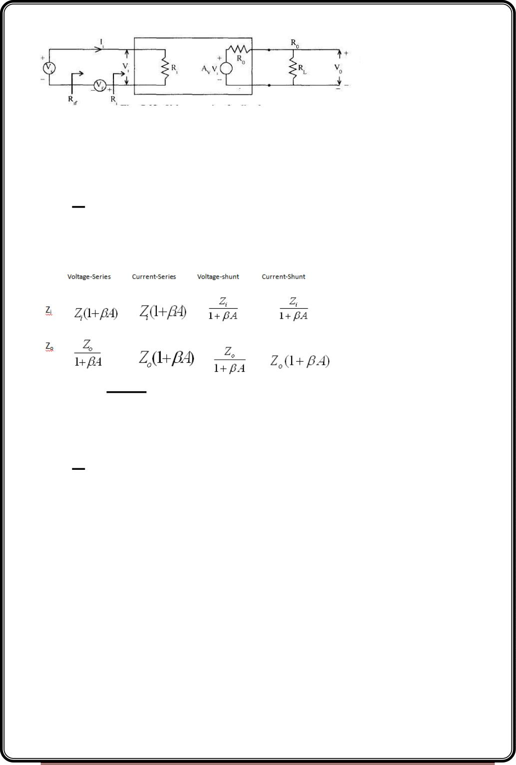
EXPRESSION FOR INPUT RESISTANCE RI WITH VOLTAGE SERIES FEEDBACK
In this circuit Av represents the open circuit voltage gain taking Rs into account
Voltage series feedback
R_{if} 
^{V}S
I_{i}
Apply KVL to the input side circuit
V -I R -V =0
s
i
i
f
V =I R +V =I R +βV
o
s
i
i
f
i
i
The output voltage Vo is given as
V_{o} 
AV R
 A I R  A V
v
i
L
V
i
i
V
i

R R
o
L
^{A}V ^{R}
Where A

L
V
R_{o}  R_{L}
Av represents the open circuit voltage gain without feedback
A represents the open circuit voltage gain without feedback taking the load R into account.
V
L
V =I R +βA I R
s
i
i
v i
i
R_{if} 
V
=R_{i}+βAvRi
S
I_{i}
R =R (1+βA )
if
i
v
Similarly we can find
Page 42

Slide 43
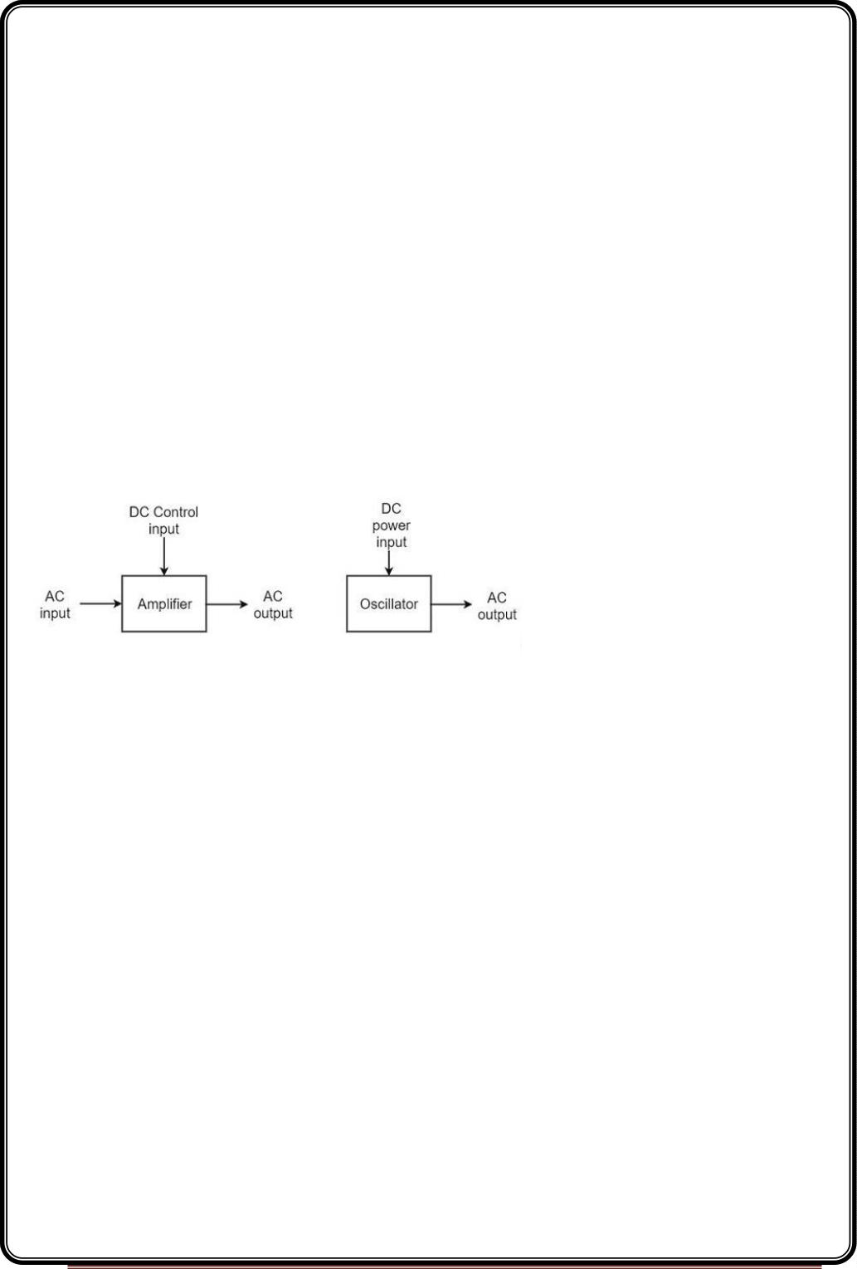
Advantages of Negative Feedback
1. Stabilization of gain
– make the gain less sensitive to changes in circuit components e.g. due to
changes in temperature.
2. Reduce non-linear distortion
– make the output proportional to the input, keeping the gain constant,
independent of signal level.
3. Reduce the effect of noise
– minimize the contribution to the output of unwanted signals generated in
circuit components or extraneous interference.
4. Extend the bandwidth of the amplifier
– Reduce the gain and increase the bandwidth
5. Modification the input and output impedances
– raise or lower the input and output impedances by selection of the
appropriate feedback topology.
Oscillators
An oscillator generates output without any ac input signal. An electronic oscillator is a
circuit which converts dc energy into ac at a very high frequency. An amplifier with a
positive feedback can be understood as an oscillator.
Amplifier vs. Oscillator
An amplifier increases the signal strength of the input signal applied, whereas
an oscillator generates a signal without that input signal, but it requires dc for its
operation. This is the main difference between an amplifier and an oscillator.
Take a look at the following illustration. It clearly shows how an amplifier takes energy
from d.c. power source and converts it into a.c. energy at signal frequency. An oscillator
produces an oscillating a.c. signal on its own.
Page 43

Slide 44
The frequency, waveform, and magnitude of a.c. power generated by an amplifier, is
controlled by the a.c. signal voltage applied at the input, whereas those for an oscillator are
controlled by the components in the circuit itself, which means no external controlling
voltage is required.
Alternator vs. Oscillator
An alternator is a mechanical device that produces sinusoidal waves without any input.
This a.c. generating machine is used to generate frequencies up to 1000Hz. The output
frequency depends on the number of poles and the speed of rotation of the armature.
The following points highlight the differences between an alternator and an oscillator −
•
An alternator converts mechanical energy to a.c. energy, whereas the oscillator
converts d.c. energy into a.c. energy.
•
An oscillator can produce higher frequencies of several MHz whereas an alternator
cannot.
•
•
An alternator has rotating parts, whereas an electronic oscillator doesn’t.
It is easy to change the frequency of oscillations in an oscillator than in an
alternator.
Oscillators can also be considered as opposite to rectifiers that convert a.c. to d.c. as these
convert d.c. to a.c.
ClassificationofOscillators
Electronic oscillators are classified mainly into the following two categories −
•
•
Sinusoidal Oscillators − The oscillators that produce an output having a sine
waveform are called sinusoidal or harmonic oscillators. Such oscillators can provide
output at frequencies ranging from 20 Hz to 1 GHz.
Non-sinusoidal Oscillators − The oscillators that produce an output having a square,
rectangular or saw-tooth waveform are called non-sinusoidal or relaxation
oscillators. Such oscillators can provide output at frequencies ranging from 0 Hz to
20 MHz.
SinusoidalOscillators
Sinusoidal oscillators can be classified in the following categories −
Page 44

Slide 45
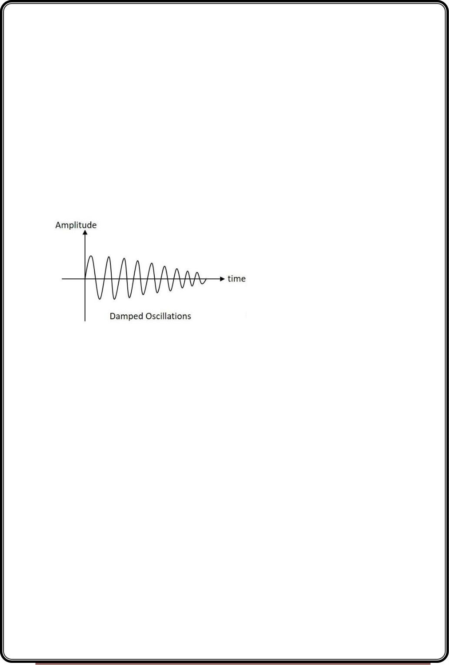
•
•
Tuned Circuit Oscillators − These oscillators use a tuned-circuit consisting of
inductors (L) and capacitors (C) and are used to generate high-frequency signals.
Thus they are also known as radio frequency R.F. oscillators. Such oscillators are
Hartley, Colpitts, Clapp-oscillators etc.
RC Oscillators − There oscillators use resistors and capacitors and are used to
generate low or audio-frequency signals. Thus they are also known as audio-
frequency (A.F.) oscillators. Such oscillators are Phase –shift and Wein-bridge
oscillators.
•
•
Crystal Oscillators − These oscillators use quartz crystals and are used to generate
highly stabilized output signal with frequencies up to 10 MHz. The Piezo oscillator is
an example of a crystal oscillator.
Negative-resistance Oscillator − These oscillators use negative-resistance
characteristic of the devices such as tunnel devices. A tuned diode oscillator is an
example of a negative-resistance oscillator.
Nature of Sinusoidal Oscillations
The nature of oscillations in a sinusoidal wave is generally of two types. They
are damped and undamped oscillations.
Damped Oscillations
The electrical oscillations whose amplitude goes on decreasing with time are called
as Damped Oscillations. The frequency of the damped oscillations may remain constant
depending upon the circuit parameters.
Damped oscillations are generally produced by the oscillatory circuits that produce power
losses and doesn’t compensate if required.
Page 45

Slide 46
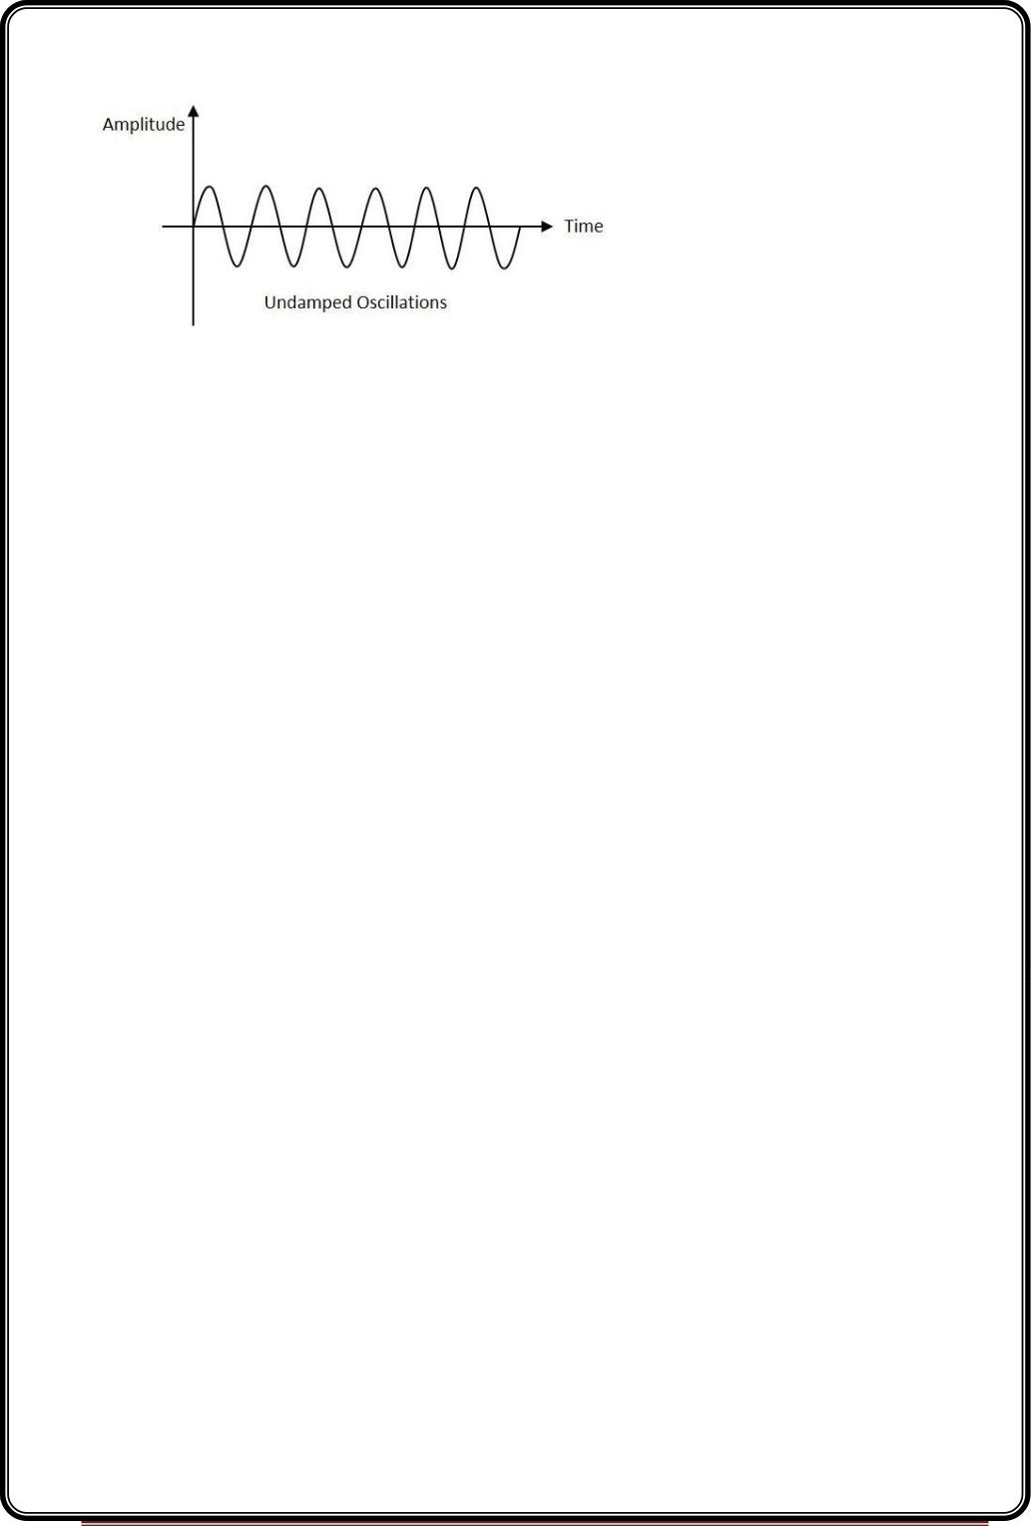
Undamped Oscillations
The electrical oscillations whose amplitude remains constant with time are called
as Undamped Oscillations. The frequency of the Undamped oscillations remains constant.
Undamped oscillations are generally produced by the oscillatory circuits that produce no
power losses and follow compensation techniques if any power losses occur.
An amplifier with positive feedback produces its output to be in phase with the input and
increases the strength of the signal. Positive feedback is also called as degenerative
feedback ordirect feedback. This kind of feedback makes a feedback amplifier, an
oscillator.
The use of positive feedback results in a feedback amplifier having closed-loop gain greater
than the open-loop gain. It results in instability and operates as an oscillatory circuit. An
oscillatory circuit provides a constantly varying amplified output signal of any desired
frequency.
The Barkhausen Criterion
With the knowledge we have till now, we understood that a practical oscillator circuit
consists of a tank circuit, a transistor amplifier circuit and a feedback circuit. so, let us now
try to brush up the concept of feedback amplifiers, to derive the gain of the feedback
amplifiers.
Principle of Feedback Amplifier
A feedback amplifier generally consists of two parts. They are theamplifier and
the feedback circuit. The feedback circuit usually consists of resistors. The concept of
feedback amplifier can be understood from the following figure below.
Page 46

Slide 47
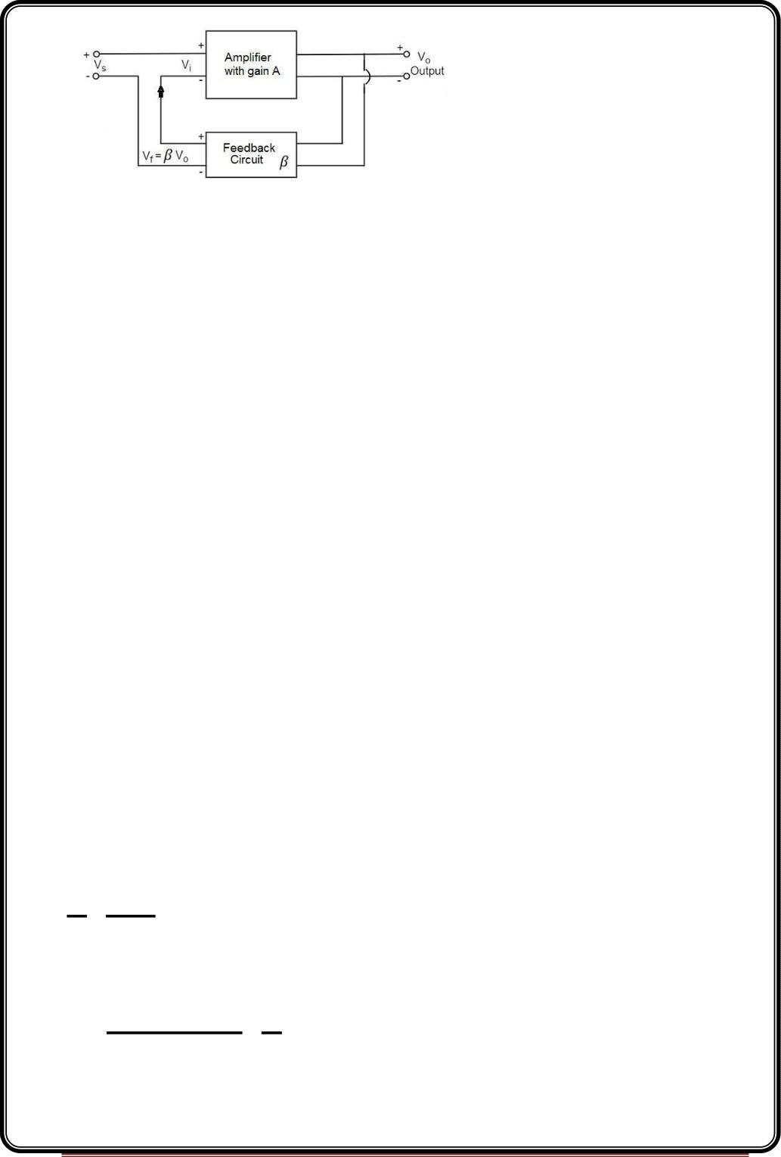
From the above figure, the gain of the amplifier is represented as A. The gain of the
amplifier is the ratio of output voltage Vo to the input voltage Vi. The feedback network
extracts a voltage V = β V from the output V of the amplifier.
f
o
o
This voltage is added for positive feedback and subtracted for negative feedback, from the
signal voltage Vs.
So, for a positive feedback,
V = V + V = V + β V
o
i
s
f
s
The quantity β = V /V is called as feedback ratio or feedback fraction.
f
o
The output V must be equal to the input voltage (V + βV ) multiplied by the gain A of the
amplifier.
o
s
o
Hence,
(Vs+βVo)A=Vo
Or
AVs+AβVo=Vo
Or
AVs=Vo(1−Aβ)
Therefore
Vo

A
Vs 1 A
Let Af be the overall gain (gain with the feedback) of the amplifier. This is defined as the
ratio of output voltage V to the applied signal voltage V , i.e.,
Af 
outputvoltage
o
Vo
s

inputsignalvoltage Vs
Page 47

Slide 48
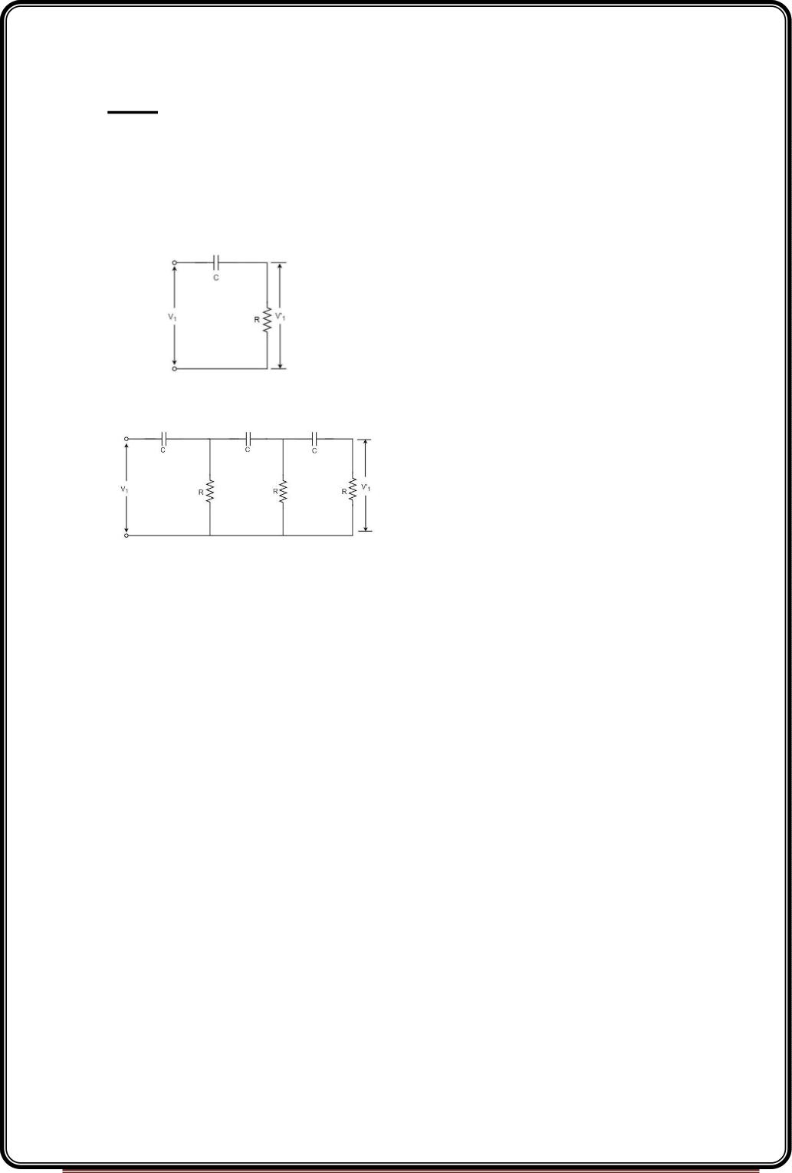
Rrom the above two equations, we can understand that, the equation of gain of the
feedback amplifier with positive feedback is given by
Af 
A
1 A
Where Aβ is the feedback factor or the loop gain.
If Aβ = 1, Af = ∞. Thus the gain becomes infinity, i.e., there is output without any input. In
another words, the amplifier works as an Oscillator.
The condition Aβ = 1 is called as Barkhausen Criterion of oscillations. This is a very
important factor to be always kept in mind, in the concept of Oscillators
RC-Phase–shift Oscillators
Principle of Phase-shift oscillators
We know that the output voltage of an RC circuit for a sinewave input leads the input
voltage. The phase angle by which it leads is determined by the value of RC components
used in the circuit. The following circuit diagram shows a single section of an RC network.
The output voltage V ’ across the resistor R leads the input voltage applied input V by
1
1
some phase angle ɸº. If R were reduced to zero, V ’ will lead the V by 90º i.e., ɸº = 90º.
1
1
However, adjusting R to zero would be impracticable, because it would lead to no voltage
across R. Therefore, in practice, R is varied to such a value that makes V ’ to lead V by 60º.
1
1
The following circuit diagram shows the three sections of the RC network.
Each section produces a phase shift of 60º. Consequently, a total phase shift of 180º is
produced, i.e., voltage V leads the voltage V by 180º.
2
1
Page 48

Slide 49
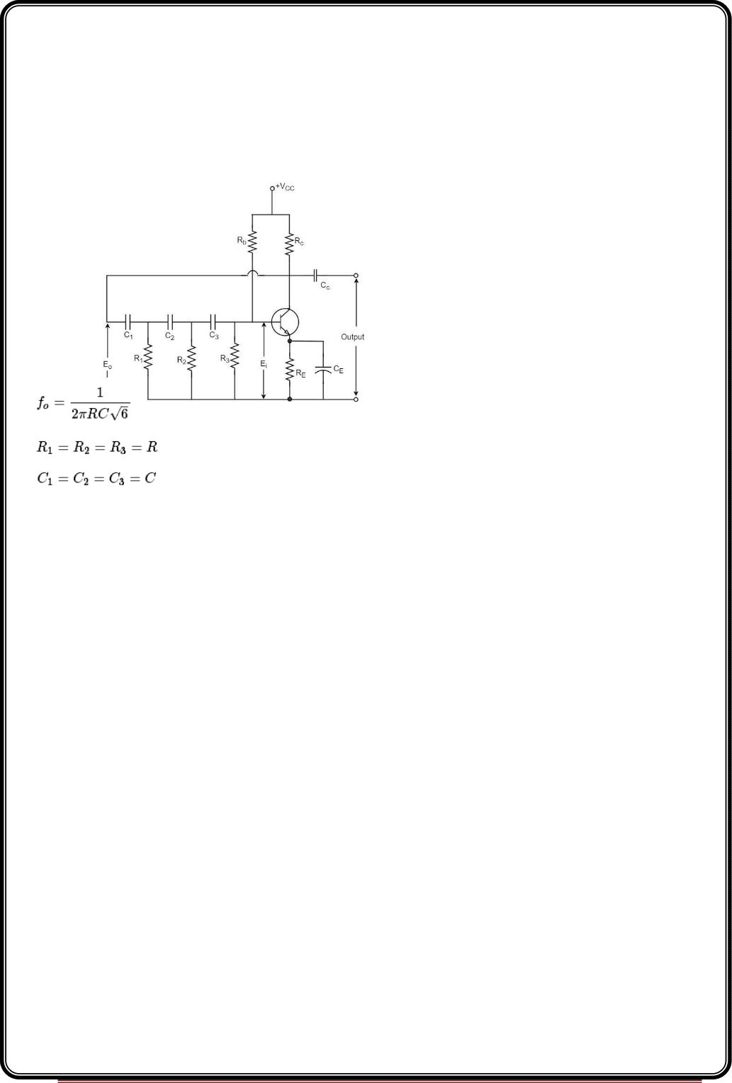
Phase-shiftOscillatorCircuit
The oscillator circuit that produces a sine wave using a phase-shift network is called as a
Phase-shift oscillator circuit. The constructional details and operation of a phase-shift
oscillator circuit are as given below.
Construction
The phase-shift oscillator circuit consists of a single transistor amplifier section and a RC
phase-shift network. The phase shift network in this circuit, consists of three RC sections.
At the resonant frequency fo, the phase shift in each RC section is 60º so that the total
phase shift produced by RC network is 180º.
The following circuit diagram shows the arrangement of an RC phase-shift oscillator.
The frequency of oscillations is given by
Where
Page 49

Slide 50
Operation
The circuit when switched ON oscillates at the resonant frequency f . The output E of the
o
o
amplifier is fed back to RC feedback network. This network produces a phase shift of
180º and a voltage Ei appears at its output. This voltage is applied to the transistor
amplifier.
The feedback applied will be
m=Ei/Eo
The feedback is in correct phase, whereas the transistor amplifier, which is in CE
configuration, produces a 180º phase shift. The phase shift produced by network and the
transistor add to form a phase shift around the entire loop which is 360º.
Advantages
The advantages of RC phase shift oscillator are as follows −
•
•
•
It does not require transformers or inductors.
It can be used to produce very low frequencies.
The circuit provides good frequency stability.
Disadvantages
The disadvantages of RC phase shift oscillator are as follows −
•
•
Starting the oscillations is difficult as the feedback is small.
The output produced is small.
Another type of popular audio frequency oscillator is the Wien bridge oscillator circuit.
This is mostly used because of its important features. This circuit is free from the circuit
fluctuations and the ambient temperature.
The main advantage of this oscillator is that the frequency can be varied in the range of
10Hz to about 1MHz whereas in RC oscillators, the frequency is not varied.
Wien bridge oscillator
Construction
The circuit construction of Wien bridge oscillator can be explained as below. It is a two-
stage amplifier with RC bridge circuit. The bridge circuit has the arms R C , R , R C and the
1
1
3
2
2
tungsten lamp L . Resistance R and the lamp L are used to stabilize the amplitude of the
output.
p
3
p
Page 50

Slide 51
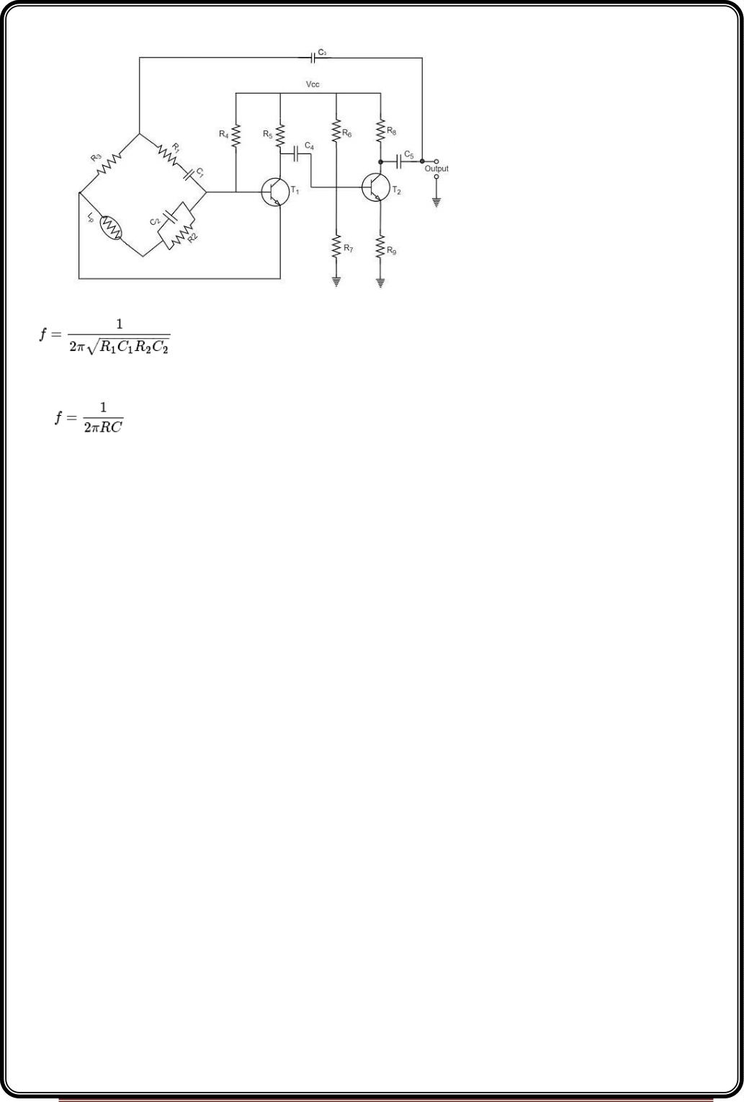
The following circuit diagram shows the arrangement of a Wien bridge oscillator.
The transistor T serves as an oscillator and an amplifier while the other transistor T serves
1
2
as an inverter. The inverter operation provides a phase shift of 180º. This circuit provides
positive feedback through R C , C R to the transistor T and negative feedback through the
1
1
2
2
1
voltage divider to the input of transistor T2.
The frequency of oscillations is determined by the series element R C and parallel element
R C of the bridge.
1
1
2
2
If R = R and C = C = C
1
2
1
2
Then,
Page 51

Slide 52
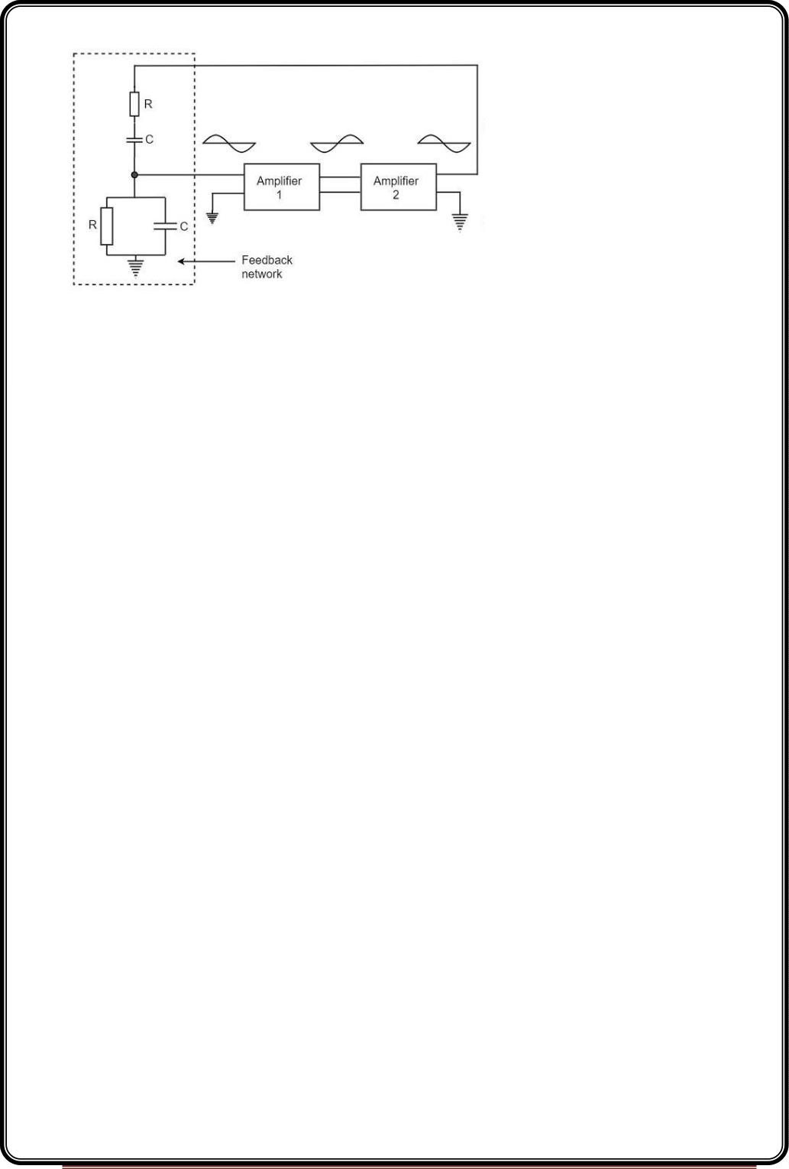
Now, we can simplify the above circuit as follows −
The oscillator consists of two stages of RC coupled amplifier and a feedback network. The
voltage across the parallel combination of R and C is fed to the input of amplifier 1. The net
phase shift through the two amplifiers is zero.
The usual idea of connecting the output of amplifier 2 to amplifier 1 to provide signal
regeneration for oscillator is not applicable here as the amplifier 1 will amplify signals over
a wide range of frequencies and hence direct coupling would result in poor frequency
stability. By adding Wien bridge feedback network, the oscillator becomes sensitive to a
particular frequency and hence frequency stability is achieved.
Operation
When the circuit is switched ON, the bridge circuit produces oscillations of the frequency
stated above. The two transistors produce a total phase shift of 360º so that proper
positive feedback is ensured. The negative feedback in the circuit ensures constant output.
This is achieved by temperature sensitive tungsten lamp Lp. Its resistance increases with
current.
If the amplitude of the output increases, more current is produced and more negative
feedback is achieved. Due to this, the output would return to the original value. Whereas, if
the output tends to decrease, reverse action would take place.
Advantages
The advantages of Wien bridge oscillator are as follows −
•
The circuit provides good frequency stability.
Page 52

Slide 53
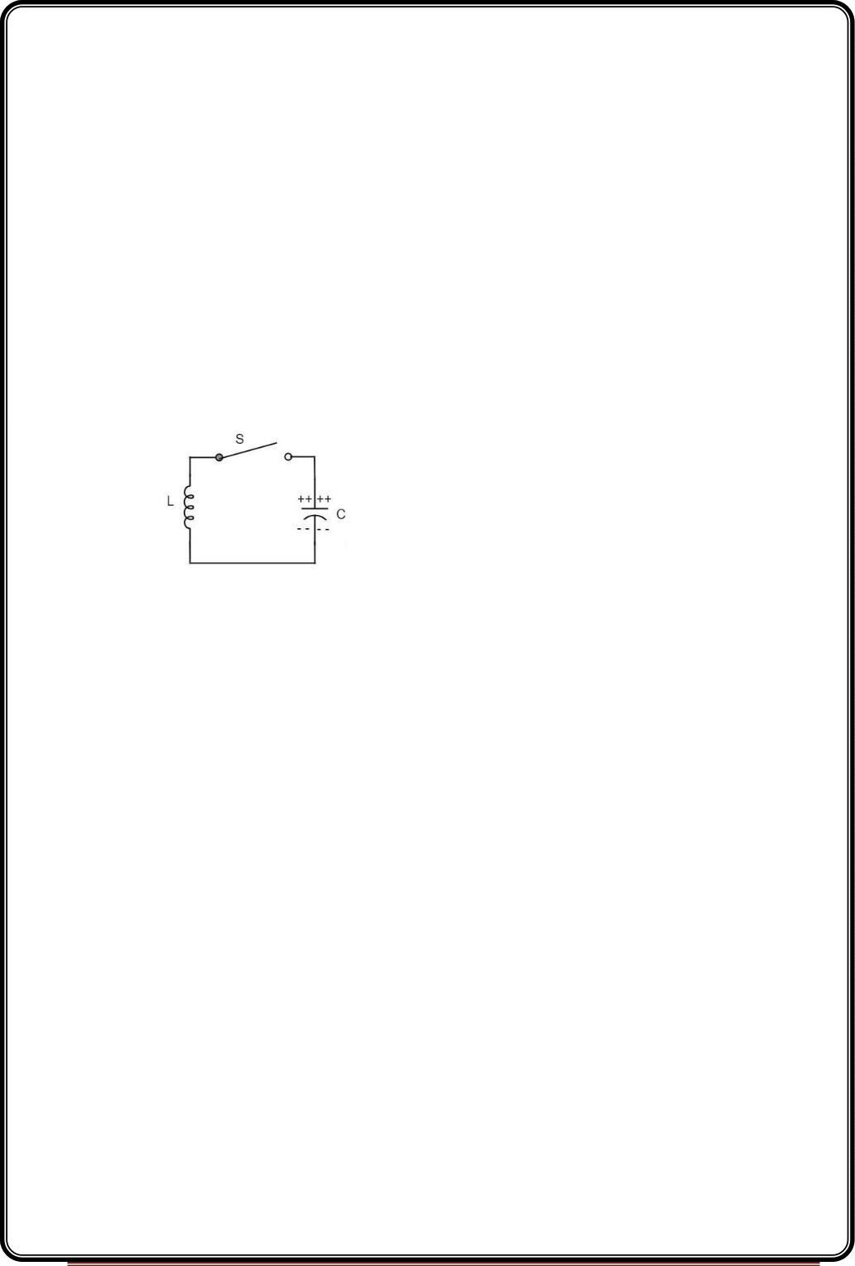
•
•
•
•
•
It provides constant output.
The operation of circuit is quite easy.
The overall gain is high because of two transistors.
The frequency of oscillations can be changed easily.
The amplitude stability of the output voltage can be maintained more accurately, by
replacing R2 with a thermistor.
Disadvantages
The disadvantages of Wien bridge oscillator are as follows −
•
•
The circuit cannot generate very high frequencies.
Two transistors and number of components are required for the circuit construction.
LC Oscillators
An oscillatory circuit produces electrical oscillations of a desired frequency. They are also
known as tank circuits.
A simple tank circuit comprises of an inductor L and a capacitor C both of which together
determine the oscillatory frequency of the circuit.
To understand the concept of oscillatory circuit, let us consider the following circuit. The
capacitor in this circuit is already charged using a dc source. In this situation, the upper
plate of the capacitor has excess of electrons whereas the lower plate has deficit of
electrons. The capacitor holds some electrostatic energy and there is a voltage across the
capacitor.
When the switch S is closed, the capacitor discharges and the current flows through the
inductor. Due to the inductive effect, the current builds up slowly towards a maximum
value. Once the capacitor discharges completely, the magnetic field around the coil is
maximum.
Page 53

Slide 54
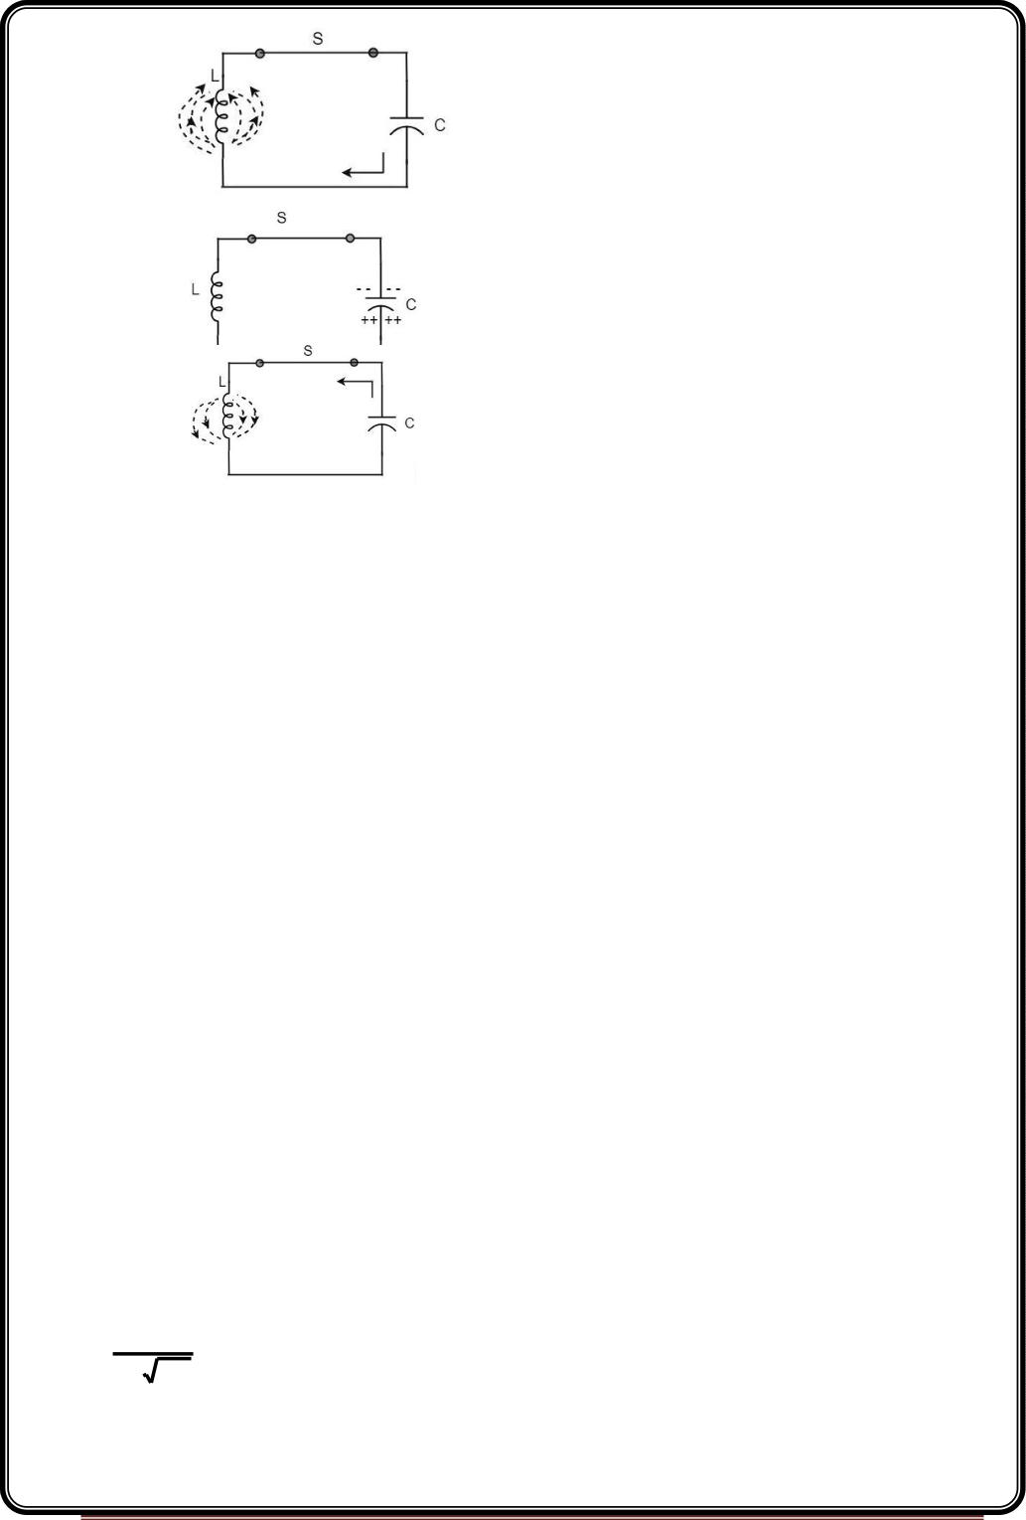
Now, let us move on to the next stage. Once the capacitor is discharged completely, the
magnetic field begins to collapse and produces a counter EMF according to Lenz’s law. The
capacitor is now charged with positive charge on the upper plate and negative charge on
the lower plate.
Once the capacitor is fully charged, it starts to discharge to build up a magnetic field around
the coil, as shown in the following circuit diagram.
This continuation of charging and discharging results in alternating motion of electrons or
an oscillatory current. The interchange of energy between L and C produce
continuous oscillations.
In an ideal circuit, where there are no losses, the oscillations would continue indefinitely. In
a practical tank circuit, there occur losses such as resistive and radiation losses in the coil
and dielectric losses in the capacitor. These losses result in damped oscillations.
Frequency of Oscillations
The frequency of the oscillations produced by the tank circuit are determined by the
components of the tank circuit, the L and the C. The actual frequency of oscillations is
the resonant frequency(or natural frequency) of the tank circuit which is given by
1
fr=
2 LC
Capacitance of the capacitor
Page 54

Slide 55
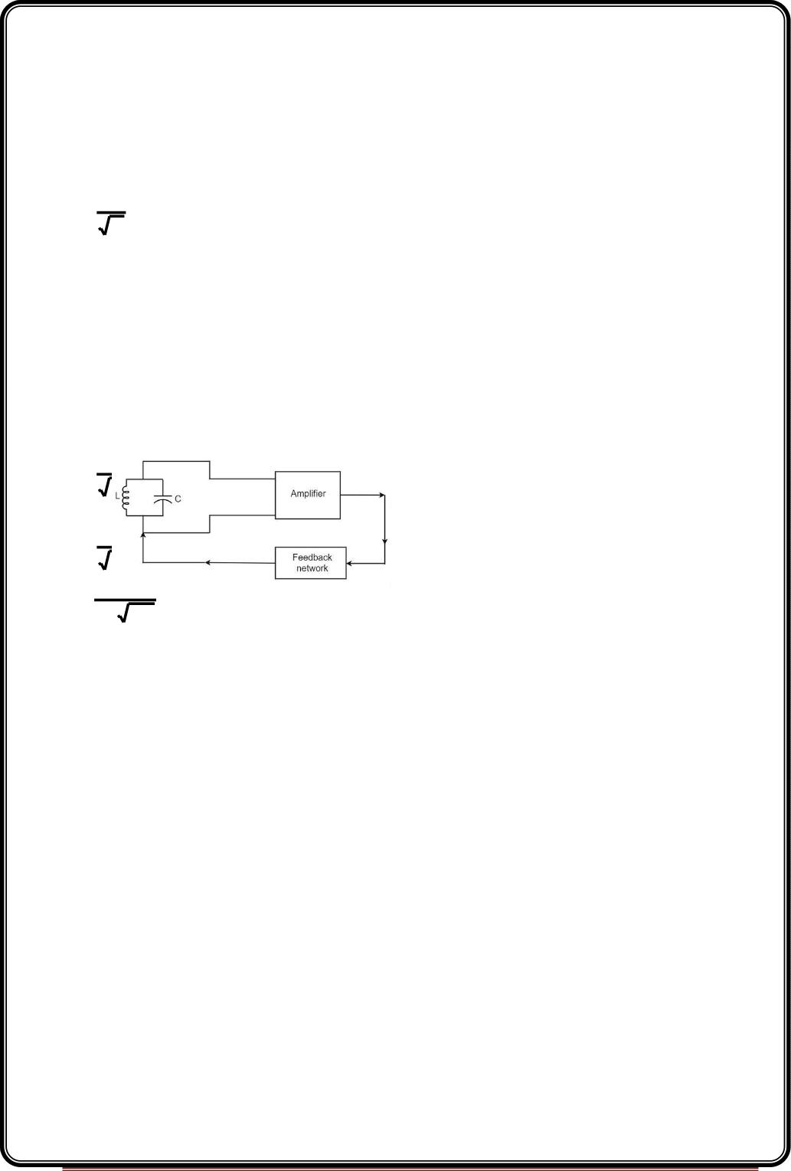
The frequency of oscillation fo is inversely proportional to the square root of the
capacitance of a capacitor. So, if the value of the capacitor used is large, the charge and
discharge time periods will be large. Hence the frequency will be lower.
Mathematically, the frequency,
fo 
1
C
Self-Inductance of the coil
The frequency of the oscillation fo is proportional to the square root of the self-inductance
of the coil. If the value of the inductance is large, the opposition to change of current flow
is greater and hence the time required to complete each cycle will be longer, which means
time period will be longer and frequency will be lower.
Mathematically, the frequency,
fo 
1
L
ombining both the above equations,
fo 
1
LC
f 
o
1
2 LC
The above equation, though indicates the output frequency, matches the natural
frequency or resonance frequency of the tank circuit.
An Oscillator circuit is a complete set of all the parts of circuit which helps to produce the
oscillations. These oscillations should sustain and should be Undamped as just discussed
before. Let us try to analyze a practical Oscillator circuit to have a better understanding on
how an Oscillator circuit works.
Practical Oscillator Circuit
A Practical Oscillator circuit consists of a tank circuit, a transistor amplifier, and a feedback
circuit. The following circuit diagram shows the arrangement of a practical oscillator.
Page 55

Slide 56
Let us now discuss the parts of this practical oscillator circuit.
Tank Circuit − The tank circuit consists of an inductance L connected in parallel with
capacitor C. The values of these two components determine the frequency of the oscillator
circuit and hence this is called as Frequency determining circuit.
•
Transistor Amplifier − The output of the tank circuit is connected to the amplifier
circuit so that the oscillations produced by the tank circuit are amplified here.
Hence the output of these oscillations are increased by the amplifier.
•
Feedback Circuit − The function of feedback circuit is to transfer a part of the output
energy to LC circuit in proper phase. This feedback is positive in oscillators while
negative in amplifiers.
Frequency Stability of an Oscillator
The frequency stability of an oscillator is a measure of its ability to maintain a constant
frequency, over a long time interval. When operated over a longer period of time, the
oscillator frequency may have a drift from the previously set value either by increasing or
by decreasing.
The change in oscillator frequency may arise due to the following factors −
•
•
•
•
•
Operating point of the active device such as BJT or FET used should lie in the linear
region of the amplifier. Its deviation will affect the oscillator frequency.
The temperature dependency of the performance of circuit components affect the
oscillator frequency.
The changes in d.c. supply voltage applied to the active device, shift the oscillator
frequency. This can be avoided if a regulated power supply is used.
A change in output load may cause a change in the Q-factor of the tank circuit,
thereby causing a change in oscillator output frequency.
The presence of inter element capacitances and stray capacitances affect the
oscillator output frequency and thus frequency stability.
Tuned circuit oscillators are the circuits that produce oscillations with the help of tuning
circuits. The tuning circuits consists of an inductance L and a capacitor C. These are also
known as LC oscillators, resonant circuit oscillators or tank circuit oscillators.
Page 56

Slide 57
The tuned circuit oscillators are used to produce an output with frequencies ranging from 1
MHz to 500 MHz Hence these are also known as R.F. Oscillators. A BJT or a FET is used as
an amplifier with tuned circuit oscillators. With an amplifier and an LC tank circuit, we can
feedback a signal with right amplitude and phase to maintain oscillations.
Types of Tuned Circuit Oscillators
Most of the oscillators used in radio transmitters and receivers are of LC oscillators type.
Depending upon the way the feedback is used in the circuit, the LC oscillators are divided
as the following types.
•
•
•
Hartley Oscillator − It uses inductive feedback.
Colpitts Oscillator − It uses capacitive feedback.
Clapp Oscillator − It uses capacitive feedback.
Hartley Oscillator
A very popular local oscillator circuit that is mostly used in radio receivers is the Hartley
Oscillator circuit. The constructional details and operation of a Hartley oscillator are as
discussed below.
Construction
In the circuit diagram of a Hartley oscillator shown below, the resistors R , R and R provide
1
2
e
necessary bias condition for the circuit. The capacitor Ce provides a.c. ground thereby
providing any signal degeneration. This also provides temperature stabilization.
The capacitors C and C are employed to block d.c. and to provide an a.c. path. The radio
c
b
frequency choke (R.F.C) offers very high impedance to high frequency currents which
means it shorts for d.c. and opens for a.c. Hence it provides d.c. load for collector and keeps
a.c. currents out of d.c. supply source
Tank Circuit
The frequency determining network is a parallel resonant circuit which consists of the
inductors L and L along with a variable capacitor C. The junction of L and L are earthed.
1
2
1
2
The coil L has its one end connected to base via C and the other to emitter via C . So, L is
1
c
e
2
in the output circuit. Both the coils L and L are inductively coupled and together form
an Auto-transformer.
1
2
The following circuit diagram shows the arrangement of a Hartley oscillator. The tank circuit
is shunt fed in this circuit. It can also be a series-fed.
Page 57

Slide 58
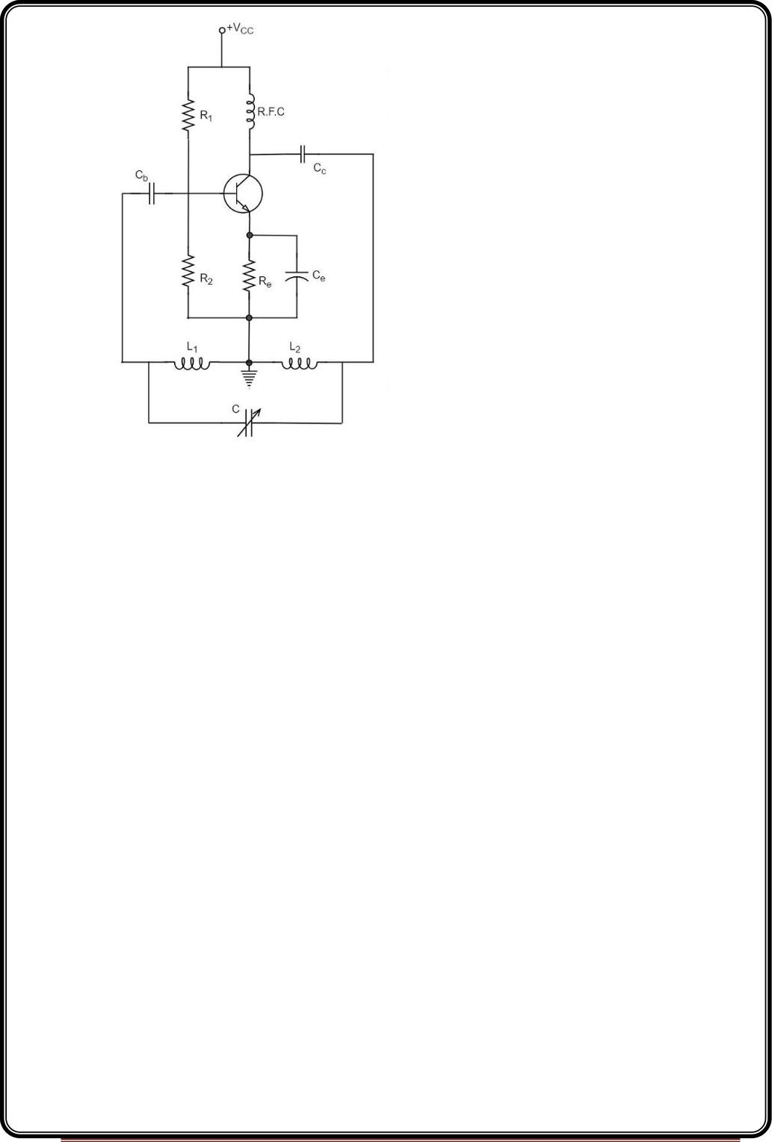
Operation
When the collector supply is given, a transient current is produced in the oscillatory or tank
circuit. The oscillatory current in the tank circuit produces a.c. voltage across L1.
The auto-transformer made by the inductive coupling of L and L helps in determining the
1
2
frequency and establishes the feedback. As the CE configured transistor provides
180º phase shift, another 180º phase shift is provided by the transformer, which makes
360º phase shift between the input and output voltages.
This makes the feedback positive which is essential for the condition of oscillations. When
the loop gain |βA| of the amplifier is greater than one, oscillations are sustained in the
circuit.
Frequency
The equation for frequency of Hartley oscillator is given as
Page 58

Slide 59
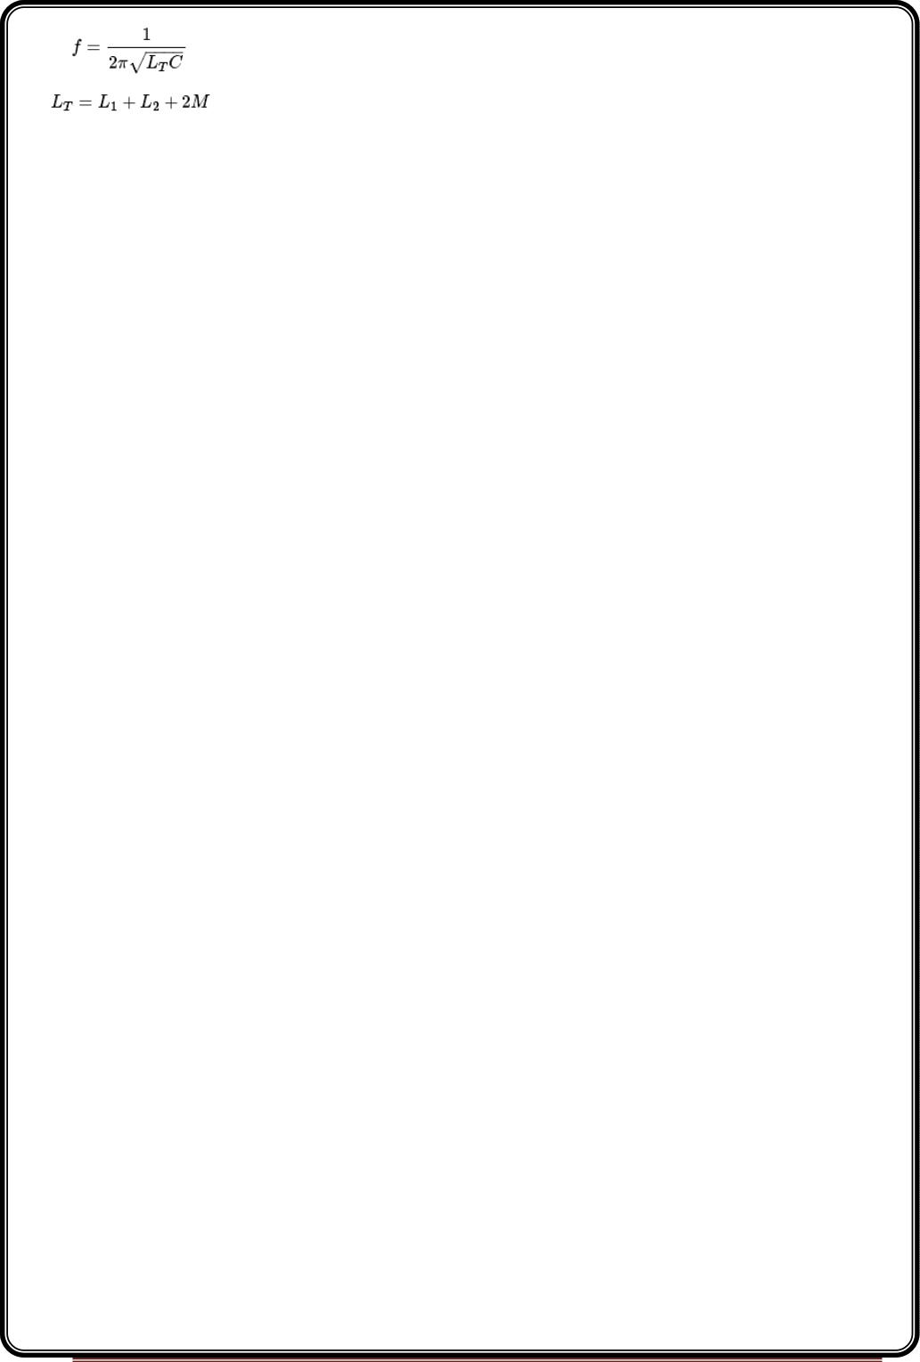
Here, L is the total cumulatively coupled inductance; L and L represent inductances of
T
1
2
1st and 2nd coils; and M represents mutual inductance.
Mutual inductance is calculated when two windings are considered.
Advantages
The advantages of Hartley oscillator are
•
•
Instead of using a large transformer, a single coil can be used as an auto-
transformer.
Frequency can be varied by employing either a variable capacitor or a variable
inductor.
•
•
Less number of components are sufficient.
The amplitude of the output remains constant over a fixed frequency range.
Disadvantages
The disadvantages of Hartley oscillator are
•
•
It cannot be a low frequency oscillator.
Harmonic distortions are present.
Applications
The applications of Hartley oscillator are
•
•
•
It is used to produce a sinewave of desired frequency.
Mostly used as a local oscillator in radio receivers.
It is also used as R.F. Oscillator.
Colpitts oscillator
A Colpitts oscillator looks just like the Hartley oscillator but the inductors and capacitors are
replaced with each other in the tank circuit. The constructional details and operation of a
colpitts oscillator are as discussed below.
Page 59

Slide 60
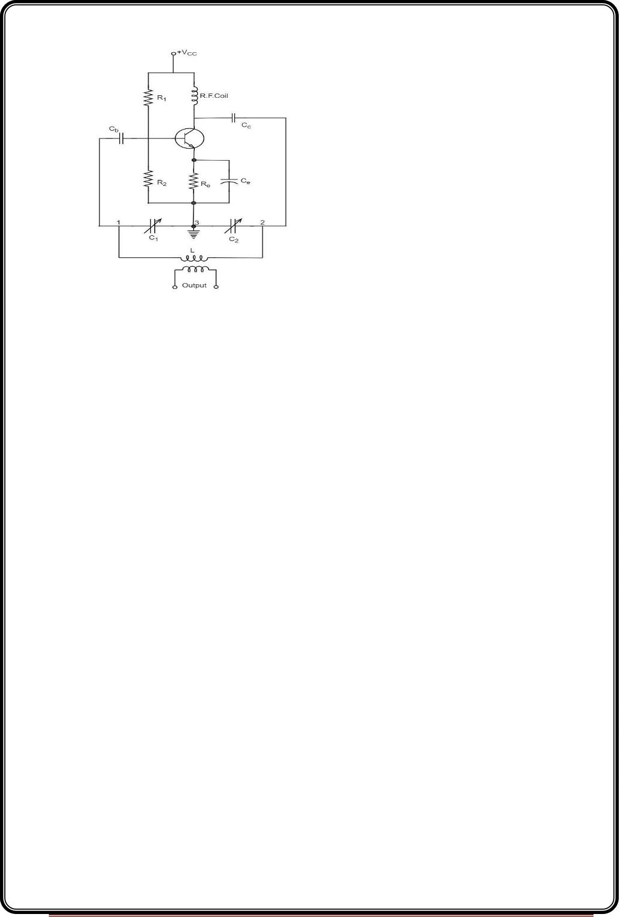
Construction
Let us first take a look at the circuit diagram of a Colpitts oscillator.
The resistors R , R and R provide necessary bias condition for the circuit. The capacitor
1
2
e
Ce provides a.c. ground thereby providing any signal degeneration. This also provides
temperature stabilization.
The capacitors C and C are employed to block d.c. and to provide an a.c. path. The radio
c
b
frequency choke (R.F.C) offers very high impedance to high frequency currents which
means it shorts for d.c. and opens for a.c. Hence it provides d.c. load for collector and
keeps a.c. currents out of d.c. supply source.
Tank Circuit
The frequency determining network is a parallel resonant circuit which consists of variable
capacitors C and C along with an inductor L. The junction of C and C are earthed. The
1
2
1
2
capacitor C has its one end connected to base via C and the other to emitter via C . the
1
c
e
voltage developed across C1 provides the regenerative feedback required for the sustained
oscillations.
Operation
When the collector supply is given, a transient current is produced in the oscillatory or tank
circuit. The oscillatory current in the tank circuit produces a.c. voltage across C1 which are
Page 60

Slide 61
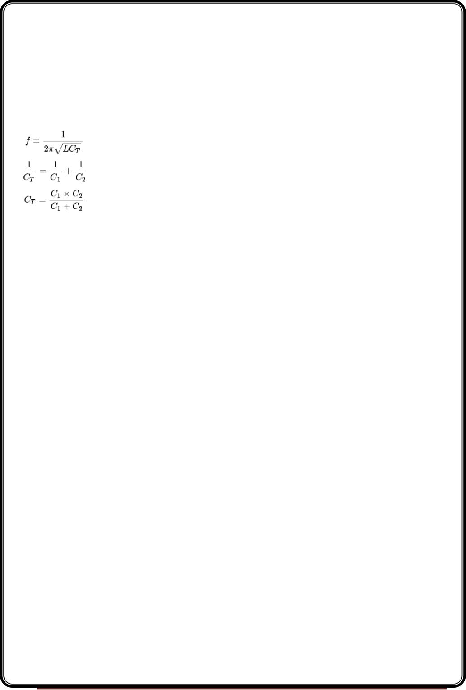
applied to the base emitter junction and appear in the amplified form in the collector
circuit and supply losses to the tank circuit.
If terminal 1 is at positive potential with respect to terminal 3 at any instant, then terminal
2 will be at negative potential with respect to 3 at that instant because terminal 3 is
grounded. Therefore, points 1 and 2 are out of phase by 180º.
As the CE configured transistor provides 180º phase shift, it makes 360º phase shift
between the input and output voltages. Hence, feedback is properly phased to produce
continuous Undamped oscillations. When the loop gain |βA| of the amplifier is greater
than one, oscillations are sustained in the circuit.
Frequency
The equation for frequency of Colpitts oscillator is given as
C is the total capacitance of C and C connected in series.
T
1
2
Advantages
The advantages of Colpitts oscillator are as follows −
•
•
•
•
•
•
Colpitts oscillator can generate sinusoidal signals of very high frequencies.
It can withstand high and low temperatures.
The frequency stability is high.
Frequency can be varied by using both the variable capacitors.
Less number of components are sufficient.
The amplitude of the output remains constant over a fixed frequency range.
The Colpitts oscillator is designed to eliminate the disadvantages of Hartley oscillator and is
known to have no specific disadvantages. Hence there are many applications of a colpitts
oscillator.
Applications
Page 61

Slide 62
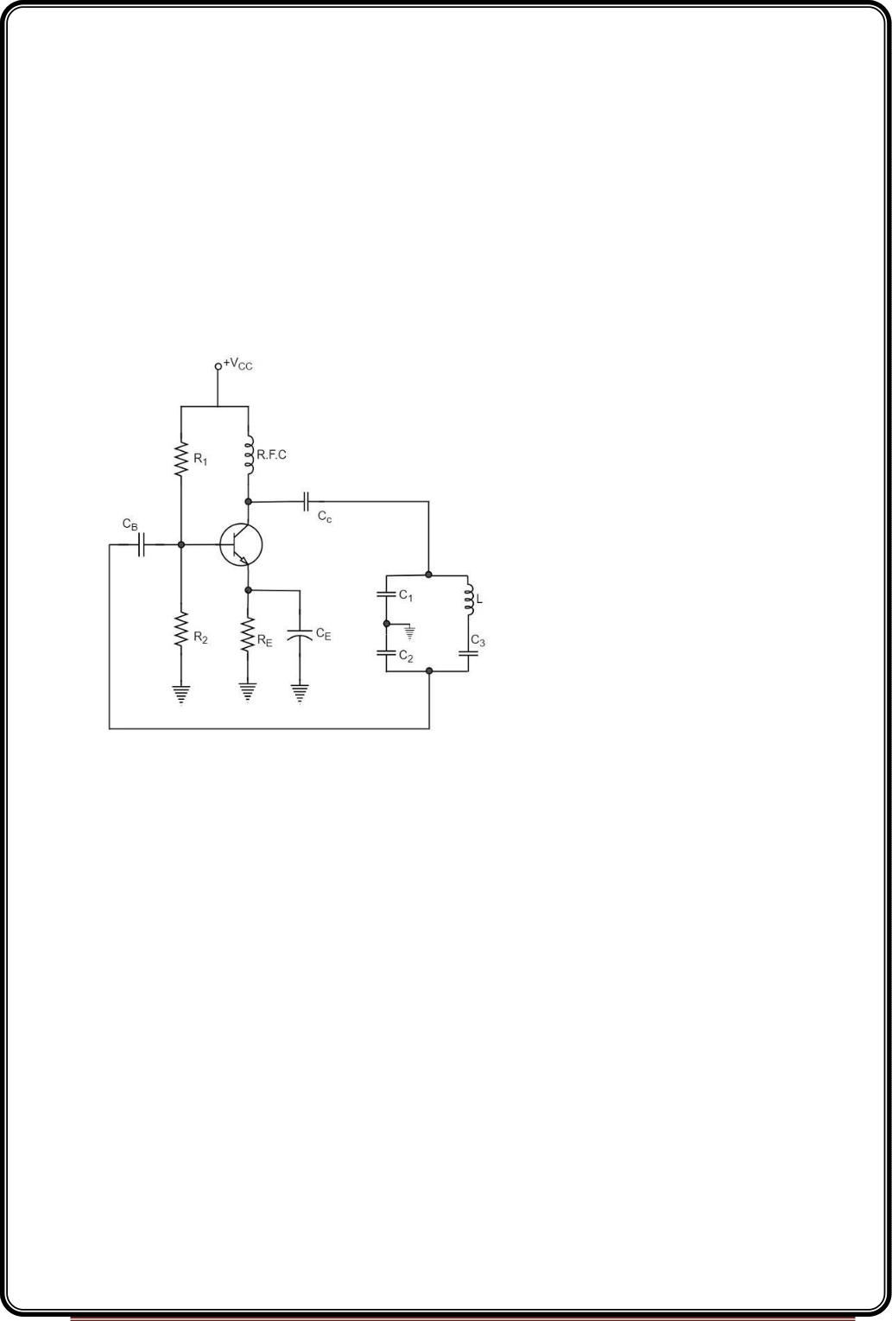
The applications of Colpitts oscillator are as follows −
•
•
•
•
•
•
Colpitts oscillator can be used as High frequency sinewave generator.
This can be used as a temperature sensor with some associated circuitry.
Mostly used as a local oscillator in radio receivers.
It is also used as R.F. Oscillator.
It is also used in Mobile applications.
It has got many other commercial applications.
Clapp Oscillator
Another oscillator which is an advanced version of Colpitts oscillator is the Clapp Oscillator.
This circuit is designed by making a few changes to the Colpitts oscillator.
The circuit differs from the Colpitts oscillator only in one respect; it contains one additional
capacitor (C ) connected in series with the inductor. The addition of capacitor (C ) improves
3
3
the frequency stability and eliminates the effect of transistor parameters and stray
capacitances.
The following circuit diagram shows the arrangement of atransistor Clapp oscillator.
Page 62

Slide 63

The operation of Clapp oscillator circuit is in the same way as that of Colpitts oscillator. The
frequency of oscillator is given by the relation,
Where
Usually, the value of C is much smaller than C and C . As a result of this, C is approximately
3
1
2
equal to C3. Therefore, the frequency of oscillation,
It is understood that the Clapp oscillator is similar to the Colpitts oscillator, however they
differ in the way the inductances and capacitances are arranged. The frequency stability
though is good, can be variable in a Clapp oscillator.
A Clapp oscillator is sometimes preferred over a Colpitts oscillator for constructing a
variable frequency oscillator. The Clapp oscillators are used in receiver tuning circuits as a
frequency oscillator.
One of the important features of an oscillator is that the feedback energy applied should be
in correct phase to the tank circuit. The oscillator circuits discussed so far has employed
inductor (L) and capacitor (C) combination, in the tank circuit or frequency determining
circuit.
We have observed that the LC combination in oscillators provide 180º phase shift and
transistor in CE configuration provide 180° phase shift to make a total of 360º phase shift
so that it would make a zero difference in phase.
Drawbacks of LC circuits
Though they have few applications, the LC circuits have fewdrawbacks such as
•
•
•
•
Frequency instability
Waveform is poor
Cannot be used for low frequencies
Inductors are bulky and expensive
Page 63

Slide 64
Whenever an oscillator is under continuous operation, itsfrequency stability gets affected.
There occur changes in its frequency. The main factors that affect the frequency of an
oscillator are
•
•
•
Power supply variations
Changes in temperature
Changes in load or output resistance
In RC and LC oscillators the values of resistance, capacitance and inductance vary with
temperature and hence the frequency gets affected. In order to avoid this problem, the
piezo electric crystals are being used in oscillators.
Crystal Oscillators
The use of piezo electric crystals in parallel resonant circuits provide high frequency
stability in oscillators. Such oscillators are called as Crystal Oscillators.
CrystalOscillators
The principle of crystal oscillators depends upon the Piezo electric effect. The natural
shape of a crystal is hexagonal. When a crystal wafer is cur perpendicular to X-axis, it is
called as X-cut and when it is cut along Y-axis, it is called as Y-cut.
The crystal used in crystal oscillator exhibits a property called as Piezo electric property. So,
let us have an idea on piezo electric effect.
Piezo Electric Effect
The crystal exhibits the property that when a mechanical stress is applied across one of the
faces of the crystal, a potential difference is developed across the opposite faces of the
crystal. Conversely, when a potential difference is applied across one of the faces, a
mechanical stress is produced along the other faces. This is known as Piezo electric effect.
Certain crystalline materials like Rochelle salt, quartz and tourmaline exhibit piezo electric
effect and such materials are called as Piezo electric crystals. Quartz is the most commonly
used piezo electric crystal because it is inexpensive and readily available in nature.
When a piezo electric crystal is subjected to a proper alternating potential, it vibrates
mechanically. The amplitude of mechanical vibrations becomes maximum when the
frequency of alternating voltage is equal to the natural frequency of the crystal.
Page 64

Slide 65

Working of a Quartz Crystal
In order to make a crystal work in an electronic circuit, the crystal is placed between two
metal plates in the form of a capacitor.Quartz is the mostly used type of crystal because of
its availability and strong nature while being inexpensive. The ac voltage is applied in
parallel to the crystal.
The circuit arrangement of a Quartz Crystal will be as shown below −
If an AC voltage is applied, the crystal starts vibrating at the frequency of the applied
voltage. However, if the frequency of the applied voltage is made equal to the natural
frequency of the crystal, resonance takes place and crystal vibrations reach a maximum
value. This natural frequency is almost constant.
Equivalent circuit of a Crystal
If we try to represent the crystal with an equivalent electric circuit, we have to consider
two cases, i.e., when it vibrates and when it doesn’t. The figures below represent the
symbol and electrical equivalent circuit of a crystal respectively.
The above equivalent circuit consists of a series R-L-C circuit in parallel with a capacitance
Cm. When the crystal mounted across the AC source is not vibrating, it is equivalent to the
capacitance Cm. When the crystal vibrates, it acts like a tuned R-L-C circuit.
Page 65

Slide 66

Frequency response
The frequency response of a crystal is as shown below. The graph shows the reactance
(X or X ) versus frequency (f). It is evident that the crystal has two closely spaced resonant
L
C
frequencies.
The first one is the series resonant frequency (fs), which occurs when reactance of the
inductance (L) is equal to the reactance of the capacitance C. In that case, the impedance of
the equivalent circuit is equal to the resistance R and the frequency of oscillation is given
by the relation,
The second one is the parallel resonant frequency (fp), which occurs when the reactance of
R-L-C branch is equal to the reactance of capacitor Cm. At this frequency, the crystal offers a
very high impedance to the external circuit and the frequency of oscillation is given by the
relation.
Where
The value of C is usually very large as compared to C. Therefore, the value of C is
m
T
approximately equal to C and hence the series resonant frequency is approximately equal
to the parallel resonant frequency (i.e., f = f ).
s
p
Page 66

Slide 67

Crystal Oscillator Circuit
pierce crystal oscillator
A crystal oscillator circuit can be constructed in a number of ways like a Crystal controlled
tuned collector oscillator, a Colpitts crystal oscillator, a Clap crystal oscillator etc. But
the transistor pierce crystal oscillator is the most commonly used one. This is the circuit
which is normally referred as a crystal oscillator circuit.
The following circuit diagram shows the arrangement of a transistor pierce crystal
oscillator.
In this circuit, the crystal is connected as a series element in the feedback path from
collector to the base. The resistors R , R and R provide a voltage-divider stabilized d.c.
1
2
E
bias circuit. The capacitor CE provides a.c. bypass of the emitter resistor and RFC (radio
frequency choke) coil provides for d.c. bias while decoupling any a.c. signal on the power
lines from affecting the output signal. The coupling capacitor C has negligible impedance at
the circuit operating frequency. But it blocks any d.c. between collector and base.
The circuit frequency of oscillation is set by the series resonant frequency of the crystal and
its value is given by the relation,
It may be noted that the changes in supply voltage, transistor device parameters etc. have
no effect on the circuit operating frequency, which is held stabilized by the crystal.
Page 67

Slide 68
Advantages
The advantages of crystal oscillator are as follows −
•
•
They have a high order of frequency stability.
The quality factor (Q) of the crystal is very high.
Disadvantages
The disadvantages of crystal oscillator are as follows −
•
•
They are fragile and can be used in low power circuits.
The frequency of oscillations cannot be changed appreciably.
Frequency Stability of an Oscillator
An Oscillator is expected to maintain its frequency for a longer duration without any
variations, so as to have a smoother clear sinewave output for the circuit operation. Hence
the term frequency stability really matters a lot, when it comes to oscillators, whether
sinusoidal or non-sinusoidal.
The frequency stability of an oscillator is defined as the ability of the oscillator to maintain
the required frequency constant over a long time interval as possible. Let us try to discuss
the factors that affect this frequency stability.
Change in operating point
We have already come across the transistor parameters and learnt how important an
operating point is. The stability of this operating point for the transistor being used in the
circuit for amplification (BJT or FET), is of higher consideration.
The operating of the active device used is adjusted to be in the linear portion of its
characteristics. This point is shifted due to temperature variations and hence the stability is
affected.
Variation in temperature
The tank circuit in the oscillator circuit, contains various frequency determining
components such as resistors, capacitors and inductors. All of their parameters are
temperature dependent. Due to the change in temperature, their values get affected. This
brings the change in frequency of the oscillator circuit.
Page 68

Slide 69
Due to power supply
The variations in the supplied power will also affect the frequency. The power supply
variations lead to the variations in Vcc. This will affect the frequency of the oscillations
produced.
In order to avoid this, the regulated power supply system is implemented. This is in short
called as RPS.
Change in output load
The variations in output resistance or output load also affects the frequency of the
oscillator. When a load is connected, the effective resistance of the tank circuit is changed.
As a result, the Q-factor of LC tuned circuit is changed. This results a change in output
frequency of oscillator.
Changes in inter-element capacitances
Inter-element capacitances are the capacitances that develop in PN junction materials such
as diodes and transistors. These are developed due to the charge present in them during
their operation.
The inter element capacitors undergo change due to various reasons as temperature,
voltage etc. This problem can be solved by connecting swamping capacitor across offending
inter-element capacitor.
Value of Q
The value of Q (Quality factor) must be high in oscillators. The value of Q in tuned
oscillators determine the selectivity. As this Q is directly proportional to the frequency
stability of a tuned circuit, the value of Q should be maintained high.
Frequency stability can be mathematically represented as,
Sw=dθ/dw
Where dθ is the phase shift introduced for a small frequency change in nominal frequency
fr. The circuit giving the larger value of (dθ/dw) has more stable oscillatory frequency.
Page 69

Slide 70

UNIT-IV
Power Amplifiers
In practice, any amplifier consists of few stages of amplification. If we consider audio
amplification, it has several stages of amplification, depending upon our requirement.
Power Amplifier
After the audio signal is converted into electrical signal, it has several voltage
amplifications done, after which the power amplification of the amplified signal is done just
before the loud speaker stage. This is clearly shown in the below figure.
While the voltage amplifier raises the voltage level of the signal, the power amplifier
raises the power level of the signal. Besides raising the power level, it can also be said that a
power amplifier is a device which converts DC power to AC power and whose action is
controlled by the input signal.
The DC power is distributed according to the relation,
DC power input = AC power output + losses
Power Transistor
For such Power amplification, a normal transistor would not do. A transistor that is
manufactured to suit the purpose of power amplification is called as a Power transistor.
A Power transistor differs from the other transistors, in the following factors.
•
It is larger in size, in order to handle large powers.
•
The collector region of the transistor is made large and a heat sink is placed at the
collector-base junction in order to minimize heat generated.
The emitter and base regions of a power transistor are heavily doped.
Due to the low input resistance, it requires low input power.
•
•
Hence there is a lot of difference in voltage amplification and power amplification. So,
let us now try to get into the details to understand the differences between a voltage
amplifier and a power amplifier.
Difference between Voltage and Power Amplifiers:Let us try to differentiate between
voltage and power amplifier.
Voltage Amplifier
The function of a voltage amplifier is to raise the voltage level of the signal. A voltage
amplifier is designed to achieve maximum voltage amplification.
The voltage gain of an amplifier is given by
Av=β(Rc/Rin)
The characteristics of a voltage amplifier are as follows −
•
The base of the transistor should be thin and hence the value of β should be greater
than 100.
Page 70

Slide 71

•
•
•
The resistance of the input resistor Rin should be low when compared to collector
load RC.
The collector load RC should be relatively high. To permit high collector load, the
voltage amplifiers are always operated at low collector current.
The voltage amplifiers are used for small signal voltages.
Power Amplifier
The function of a power amplifier is to raise the power level of input signal. It is required to
deliver a large amount of power and has to handle large current.
The characteristics of a power amplifier are as follows −
•
The base of transistor is made thicken to handle large currents. The value of β being
(β > 100) high.
•
The size of the transistor is made larger, in order to dissipate more heat, which is
produced during transistor operation.
•
•
Transformer coupling is used for impedance matching.
Collector resistance is made low.
The comparison between voltage and power amplifiers is given below in a tabular form.
S.No Particular Voltage Amplifier Power Amplifier
1
2
3
4
5
6
7
β
High (>100)
Low (5 to 20)
RC
High (4-10 KΩ)
Low (5 to 20 Ω)
Coupling
Input voltage
Collector current
Power output
Usually R-C coupling Invariably transformer coupling
Low (a few m V)
Low (≈ 1 mA)
Low
High (2-4 V)
High (> 100 mA)
High
Output impendence High (≈ 12 K Ω)
Low (200 Ω
The Power amplifiers amplify the power level of the signal. This amplification is done
in the last stage in audio applications. The applications related to radio frequencies employ
radio power amplifiers. But the operating point of a transistor plays a very important role
in determining the efficiency of the amplifier. The main classification is done based on this
mode of operation.
The classification is done based on their frequencies and also based on their mode
of operation.
Classification Based on Frequencies
Power amplifiers are divided into two categories, based on the frequencies they
handle. They are as follows.
•
Audio Power Amplifiers − The audio power amplifiers raise the power level of
signals that have audio frequency range (20 Hz to 20 KHz). They are also known
as Small signal power amplifiers.
•
Radio Power Amplifiers − Radio Power Amplifiers or tuned power amplifiers raise
the power level of signals that have radio frequency range (3 KHz to 300 GHz). They
are also known as large signal power amplifiers.
Page 71

Slide 72
Classification Based on Mode of Operation
On the basis of the mode of operation, i.e., the portion of the input cycle during which
collector current flows, the power amplifiers may be classified as follows.
•
Class A Power amplifier − When the collector current flows at all times during the
full cycle of signal, the power amplifier is known as class A power amplifier.
•
Class B Power amplifier − When the collector current flows only during the positive
half cycle of the input signal, the power amplifier is known as class B power
amplifier.
•
Class C Power amplifier − When the collector current flows for less than half cycle of
the input signal, the power amplifier is known as class C power amplifier.
There forms another amplifier called Class AB amplifier, if we combine the class A and
class B amplifiers so as to utilize the advantages of both. Before going into the details of
these amplifiers, let us have a look at the important terms that have to be considered to
determine the efficiency of an amplifier.
Terms Considering Performance
The primary objective of a power amplifier is to obtain maximum output power. In
order to achieve this, the important factors to be considered are collector efficiency, power
dissipation capability and distortion. Let us go through them in detail.
Collector Efficiency
This explains how well an amplifier converts DC power to AC power. When the DC
supply is given by the battery but no AC signal input is given, the collector output at such a
condition is observed as collector efficiency.
The collector efficiency is defined as
η=average a.c poweroutput / average d.c powerinputtotransisto
The main aim of a power amplifier is to obtain maximum collector efficiency. Hence the
higher the value of collector efficiency, the efficient the amplifier will be.
Power Dissipation Capacity
Every transistor gets heated up during its operation. As a power transistor handles large
currents, it gets more heated up. This heat increases the temperature of the transistor,
which alters the operating point of the transistor. So, in order to maintain the operating
point stability, the temperature of the transistor has to be kept in permissible limits. For
this, the heat produced has to be dissipated. Such a capacity is called as Power dissipation
capability.
Power dissipation capability can be defined as the ability of a power transistor to dissipate
the heat developed in it. Metal cases called heat sinks are used in order to dissipate the
heat produced in power transistors.
Distortion
A transistor is a non-linear device. When compared with the input, there occur few
variations in the output. In voltage amplifiers, this problem is not pre-dominant as small
Page 72

Slide 73

currents are used. But in power amplifiers, as large currents are in use, the problem of
distortion certainly arises.
Distortion is defined as the change of output wave shape from the input wave shape of the
amplifier. An amplifier that has lesser distortion, produces a better output and hence
considered efficient.
We have already come across the details of transistor biasing, which is very
important for the operation of a transistor as an amplifier. Hence to achieve faithful
amplification, the biasing of the transistor has to be done such that the amplifier operates
over the linear region.
A Class A power amplifier is one in which the output current flows for the entire
cycle of the AC input supply. Hence the complete signal present at the input is amplified at
the output. The following figure shows the circuit diagram for Class A Power amplifier.
From the above figure, it can be observed that the transformer is present at the collector as
a load. The use of transformer permits the impedance matching, resulting in the
transference of maximum power to the load e.g. loud speaker.
Page 73

Slide 74

The operating point of this amplifier is present in the linear region. It is so selected
that the current flows for the entire ac input cycle. The below figure explains the selection
of operating point.
The output characteristics with operating point Q is shown in the figure above. Here
(I ) and (V ) represent no signal collector current and voltage between collector and
c Q
ce Q
emitter respectively. When signal is applied, the Q-point shifts to Q and Q . The output
1
2
current increases to (Ic)max and decreases to (Ic)min. Similarly, the collector-emitter voltage
increases to (Vce)max and decreases to (V )
.
ce min
D.C. Power drawn from collector battery Vcc is given by
Pin=voltage×current=VCC(I )
C Q
This power is used in the following two parts −
•
Power dissipated in the collector load as heat is given by
P =(current)²×resistance=(IC)² R
RC
Q
C
•
Power given to transistor is given by
P =P −P =V −(I ) R
tr
in
RC
CC
C 2Q
C
When signal is applied, the power given to transistor is used in the following two parts −
•
A.C. Power developed across load resistors RC which constitutes the a.c. power
output.
(P )ac=I²R =V² / R =(V /√2 ) /R =V2m/2R
C
O
C
C
m
C
•
•
Where I is the R.M.S. value of a.c. output current through load, V is the R.M.S. value
of a.c. voltage, and Vm is the maximum value of V.
The D.C. power dissipated by the transistor (collector region) in the form of heat, i.e.,
(P )
C dc
We have represented the whole power flow in the following diagram.
Page 74

Slide 75

This class A power amplifier can amplify small signals with least distortion and the output
will be an exact replica of the input with increased strength.
Let us now try to draw some expressions to represent efficiencies.
Advantages of Class A Amplifiers
The advantages of Class A power amplifier are as follows −
•
•
•
•
The current flows for complete input cycle
It can amplify small signals
The output is same as input
No distortion is present
Disadvantages of Class A Amplifiers
The advantages of Class A power amplifier are as follows −
•
Low power output
•
Low collector efficiency
The class A power amplifier as discussed in the previous chapter, is the circuit in which
the output current flows for the entire cycle of the AC input supply. We also have learnt
about the disadvantages it has such as low output power and efficiency. In order to
Page 75

Slide 76

minimize those effects, the transformer coupled class A power amplifier has been
introduced.
The construction of class A power amplifier can be understood with the help of below
figure. This is similar to the normal amplifier circuit but connected with a transformer in the
collector load.
Here R and R provide potential divider arrangement. The resistor Re provides
1
2
stabilization, C is the bypass capacitor and R to prevent a.c. voltage. The transformer used
e
e
here is a step-down transformer.The high impedance primary of the transformer is
connected to the high impedance collector circuit. The low impedance secondary is
connected to the load (generally loud speaker).
Transformer Action:
The transformer used in the collector circuit is for impedance matching. RL is the load
connected in the secondary of a transformer. RL’ is the reflected load in the primary of the
transformer.
The number of turns in the primary are n and the secondary are n . Let V and V be
1
2
1
2
the primary and secondary voltages and I and I be the primary and secondary currents
1
2
respectively. The below figure shows the transformer clearly.
Page 76

Slide 77

A power amplifier may be matched by taking proper turn ratio in step down transformer.
Circuit Operation
If the peak value of the collector current due to signal is equal to zero signal collector
current, then the maximum a.c. power output is obtained. So, in order to achieve complete
amplification, the operating point should lie at the center of the load line.
The operating point obviously varies when the signal is applied. The collector voltage varies
in opposite phase to the collector current. The variation of collector voltage appears across
the primary of the transformer.
Page 77

Slide 78

Circuit Analysis
The power loss in the primary is assumed to be negligible, as its resistance is very
small.
The input power under dc condition will be
The efficiency of a class A power amplifier is nearly than 30% whereas it has got
improved to 50% by using the transformer coupled class A power amplifier.
Advantages
The advantages of transformer coupled class A power amplifier are as follows.
•
•
•
•
No loss of signal power in the base or collector resistors.
Excellent impedance matching is achieved.
Gain is high.
DC isolation is provided.
Disadvantages
The disadvantages of transformer coupled class A power amplifier are as follows.
•
Low frequency signals are less amplified comparatively.
Page 78

Slide 79

•
•
•
Hum noise is introduced by transformers.
Transformers are bulky and costly.
Poor frequency response.
Applications
The applications of transformer coupled class A power amplifier are as follows.
This circuit is where impedance matching is the main criterion.
These are used as driver amplifiers and sometimes as output amplifiers.
When the collector current flows only during the positive half cycle of the input signal, the
power amplifier is known as class B power amplifier.
Class B Operation
The biasing of the transistor in class B operation is in such a way that at zero signal
condition, there will be no collector current. The operating point is selected to be at
collector cut off voltage. So, when the signal is applied, only the positive half cycle is
amplified at the output.
The figure below shows the input and output waveforms during class B operation.
When the signal is applied, the circuit is forward biased for the positive half cycle of
the input and hence the collector current flows. But during the negative half cycle of the
input, the circuit is reverse biased and the collector current will be absent. Hence only the
positive half cycle is amplified at the output.
As the negative half cycle is completely absent, the signal distortion will be high.
Also, when the applied signal increases, the power dissipation will be more. But when
compared to class A power amplifier, the output efficiency is increased.Well, in order to
minimize the disadvantages and achieve low distortion, high efficiency and high output
power, the push-pull configuration is used in this class B amplifier.
Page 79

Slide 80

Class B Push-Pull Amplifier
Though the efficiency of class B power amplifier is higher than class A, as only one
half cycle of the input is used, the distortion is high. Also, the input power is not completely
utilized. In order to compensate these problems, the push-pull configuration is introduced in
class B amplifier.
Construction:
The circuit of a push-pull class B power amplifier consists of two identical transistors
T and T whose bases are connected to the secondary of the center-tapped input
1
2
transformer Tr1. The emitters are shorted and the collectors are given the VCC supply
through the primary of the output transformer Tr2.
The circuit arrangement of class B push-pull amplifier, is same as that of class A push-pull
amplifier except that the transistors are biased at cut off, instead of using the biasing
resistors. The figure below gives the detailing of the construction of a push-pull class B
power amplifier.
The circuit operation of class B push pull amplifier is detailed below.
Operation
The circuit of class B push-pull amplifier shown in the above figure clears that both
the transformers are center-tapped. When no signal is applied at the input, the transistors
T and T are in cut off condition and hence no collector currents flow. As no current is
1
2
drawn from VCC, no power is wasted.
When input signal is given, it is applied to the input transformer Tr1 which splits the
signal into two signals that are 180º out of phase with each other. These two signals are
given to the two identical transistors T and T . For the positive half cycle, the base of the
1
2
transistor T1 becomes positive and collector current flows. At the same time, the transistor
T has negative half cycle, which throws the transistor T into cutoff condition and hence no
2
2
collector current flows. The waveform is produced as shown in the following figure.
Page 80

Slide 81

For the next half cycle, the transistor T1 gets into cut off condition and the transistor
T2 gets into conduction, to contribute the output. Hence for both the cycles, each transistor
conducts alternately. The output transformer Tr3 serves to join the two currents producing
an almost undistorted output waveform.
Power Efficiency of Class B Push-Pull Amplifier
The current in each transistor is the average value of half sine loop.
For half sine loop, Idc is given by
Page 81

Slide 82

The collector efficiency would be the same.
Hence the class B push-pull amplifier improves the efficiency than the class A push-pull
amplifier.
Complementary Symmetry Push-Pull Class B Amplifier
The push pull amplifier which was just discussed improves efficiency but the usage of
center-tapped transformers makes the circuit bulky, heavy and costly. To make the circuit
simple and to improve the efficiency, the transistors used can be complemented, as shown
in the following circuit diagram.
The above circuit employs a NPN transistor and a PNP transistor connected in push
pull configuration. When the input signal is applied, during the positive half cycle of the
input signal, the NPN transistor conducts and the PNP transistor cuts off. During the
negative half cycle, the NPN transistor cuts off and the PNP transistor conducts.
In this way, the NPN transistor amplifies during positive half cycle of the input, while
PNP transistor amplifies during negative half cycle of the input. As the transistors are both
complement to each other, yet act symmetrically while being connected in push pull
configuration of class B, this circuit is termed as Complementary symmetry push pull class B
amplifier.
Advantages
The advantages of Complementary symmetry push pull class B amplifier are as follows.
•
•
As there is no need of center tapped transformers, the weight and cost are reduced.
Equal and opposite input signal voltages are not required.
Disadvantages
The disadvantages of Complementary symmetry push pull class B amplifier are as follows.
Page 82

Slide 83

•
•
It is difficult to get a pair of transistors (NPN and PNP) that have similar
characteristics.
We require both positive and negative supply voltages.
The class A and class B amplifier so far discussed has got few limitations. Let us now try to
combine these two to get a new circuit which would have all the advantages of both class A
and class B amplifier without their inefficiencies. Before that, let us also go through another
important problem, called as Cross over distortion, the output of class B encounters with.
Cross-over Distortion:
In the push-pull configuration, the two identical transistors get into conduction, one
after the other and the output produced will be the combination of both.
When the signal changes or crosses over from one transistor to the other at the zero
voltage point, it produces an amount of distortion to the output wave shape. For a
transistor in order to conduct, the base emitter junction should cross 0.7v, the cut off
voltage. The time taken for a transistor to get ON from OFF or to get OFF from ON state is
called the transition period.
At the zero voltage point, the transition period of switching over the transistors from
one to the other, has its effect which leads to the instances where both the transistors are
OFF at a time. Such instances can be called as Flat spot or Dead band on the output wave
shape.
The above figure clearly shows the cross over distortion which is prominent in the output
waveform. This is the main disadvantage. This cross over distortion effect also reduces the
overall peak to peak value of the output waveform which in turn reduces the maximum
power output. This can be more clearly understood through the non-linear characteristic of
the waveform as shown below.
Page 83

Slide 84

It is understood that this cross-over distortion is less pronounced for large input
signals, where as it causes severe disturbance for small input signals. This cross over
distortion can be eliminated if the conduction of the amplifier is more than one half cycle,
so that both the transistors won’t be OFF at the same time.
This idea leads to the invention of class AB amplifier, which is the combination of
both class A and class B amplifiers, as discussed below.
Class AB Power Amplifier
As the name implies, class AB is a combination of class A and class B type of
amplifiers. As class A has the problem of low efficiency and class B has distortion problem,
this class AB is emerged to eliminate these two problems, by utilizing the advantages of
both the classes.
The cross over distortion is the problem that occurs when both the transistors are
OFF at the same instant, during the transition period. In order to eliminate this, the
condition has to be chosen for more than one half cycle. Hence, the other transistor gets
into conduction, before the operating transistor switches to cut off state. This is achieved
only by using class AB configuration, as shown in the following circuit diagram.
Page 84

Slide 85

Therefore, in class AB amplifier design, each of the push-pull transistors is
conducting for slightly more than the half cycle of conduction in class B, but much less than
the full cycle of conduction of class A.
The conduction angle of class AB amplifier is somewhere between 180º to 360º
depending upon the operating point selected. This is understood with the help of below
figure.
The small bias voltage given using diodes D and D , as shown in the above figure,
1
2
helps the operating point to be above the cutoff point. Hence the output waveform of class
AB results as seen in the above figure. The crossover distortion created by class B is
overcome by this class AB, as well the inefficiencies of class A and B don’t affect the circuit.
So, the class AB is a good compromise between class A and class B in terms of
efficiency and linearity having the efficiency reaching about 50% to 60%. The class A, B and
AB amplifiers are called as linear amplifiers because the output signal amplitude and phase
are linearly related to the input signal amplitude and phase.
Page 85

Slide 86

Class C Power Amplifier
When the collector current flows for less than half cycle of the input signal, the
power amplifier is known as class C power amplifier. The efficiency of class C amplifier is
high while linearity is poor. The conduction angle for class C is less than 180º. It is generally
around 90º, which means the transistor remains idle for more than half of the input signal.
So, the output current will be delivered for less time compared to the application of input
signal.
The following figure shows the operating point and output of a class C amplifier.
This kind of biasing gives a much improved efficiency of around 80% to the amplifier,
but introduces heavy distortion in the output signal. Using the class C amplifier, the pulses
produced at its output can be converted to complete sine wave of a particular frequency by
using LC circuits in its collector circuit.
The types of amplifiers that we have discussed so far cannot work effectively at radio
frequencies, even though they are good at audio frequencies. Also, the gain of these
amplifiers is such that it will not vary according to the frequency of the signal, over a wide
range. This allows the amplification of the signal equally well over a range of frequencies
and does not permit the selection of particular desired frequency while rejecting the other
frequencies.
Page 86

Slide 87

UNIT-V
TUNED AMPLIFIER
Tuned amplifiers are the amplifiers that are employed for the purpose of tuning.
Tuning means selecting. Among a set of frequencies available, if there occurs a need to
select a particular frequency, while rejecting all other frequencies, such a process is called
Selection. This selection is done by using a circuit called as Tuned circuit.
When an amplifier circuit has its load replaced by a tuned circuit, such an amplifier can be
called as a Tuned amplifier circuit. The basic tuned amplifier circuit looks as shown below.
The tuner circuit is nothing but a LC circuit which is also called as resonant or tank circuit. It
selects the frequency. A tuned circuit is capable of amplifying a signal over a narrow band of
frequencies that are centered at resonant frequency.
When the reactance of the inductor balances the reactance of the capacitor, in the tuned
circuit at some frequency, such a frequency can be called as resonant frequency. It is
denoted by fr.
The formula for resonance is
Page 87

Slide 88

Types of Tuned Circuits
A tuned circuit can be Series tuned circuit (Series resonant circuit) or Parallel tuned circuit
(parallel resonant circuit) according to the type of its connection to the main circuit.
Series Tuned Circuit
The inductor and capacitor connected in series make a series tuned circuit, as shown in the
following circuit diagram.
At resonant frequency, a series resonant circuit offers low impedance which allows
high current through it. A series resonant circuit offers increasingly high impedance to the
frequencies far from the resonant frequency.
Parallel Tuned Circuit
The inductor and capacitor connected in parallel make a parallel tuned circuit, as
shown in the below figure.
At resonant frequency, a parallel resonant circuit offers high impedance which does
not allow high current through it. A parallel resonant circuit offers increasingly low
impedance to the frequencies far from the resonant frequency.
Characteristics of a Parallel Tuned Circuit
The frequency at which parallel resonance occurs (i.e. reactive component of circuit
current becomes zero) is called the resonant frequency fr. The main characteristics of a
tuned circuit are as follows.
Impedance
The ratio of supply voltage to the line current is the impedance of the tuned circuit.
Impedance offered by LC circuit is given by
Supply voltage / Lineequation=V / I
At resonance, the line current increases while the impedance decreases.
The below figure represents the impedance curve of a parallel resonance circuit.
Page 88

Slide 89

Impedance of the circuit decreases for the values above and below the resonant
frequency fr. Hence the selection of a particular frequency and rejection of other
frequencies is possible.
To obtain an equation for the circuit impedance, let us consider
Line Current I=ILcosϕ
V/Zr=V/ZL×R/ZL
1/Zr=R/Z²L
1/Zr =CR/L
Since, Z2L=L/C
Therefore, circuit impedance Zr is obtained as
ZR=L/CR
Thus at parallel resonance, the circuit impedance is equal to L/CR.
Circuit Current
At parallel resonance, the circuit or line current I is given by the applied voltage
divided by the circuit impedance Zr i.e.,
Line Current I=VZr
Where Zr=L/CR
Because Zr is very high, the line current I will be very small.
Quality Factor
For a parallel resonance circuit, the sharpness of the resonance curve determines the
selectivity. The smaller the resistance of the coil, the sharper the resonant curve will be.
Hence the inductive reactance and resistance of the coil determine the quality of the tuned
circuit.
The ratio of inductive reactance of the coil at resonance to its resistance is known as Quality
factor. It is denoted by Q.
Q=XL/R=2πfrLR
The higher the value of Q, the sharper the resonance curve and the better the selectivity will
be.
Page 89

Slide 90

Advantages of Tuned Amplifiers
The following are the advantages of tuned amplifiers.
•
•
•
The usage of reactive components like L and C, minimizes the power loss, which
makes the tuned amplifiers efficient.
The selectivity and amplification of desired frequency is high, by providing higher
impedance at resonant frequency.
A smaller collector supply VCC would do, because of its little resistance in parallel
tuned circuit.
It is important to remember that these advantages are not applicable when there is a high
resistive collector load.
Frequency Response of Tuned Amplifier
For an amplifier to be efficient, its gain should be high. This voltage gain depends
upon β, input impedance and collector load. The collector load in a tuned amplifier is a
tuned circuit.
The voltage gain of such an amplifier is given by
Voltage gain = Βzc/Zin
Where Z = effective collector load and Z = input impedance of the amplifier.
C
in
The value of Z depends upon the frequency of the tuned amplifier. As Z is maximum at
C
C
resonant frequency, the gain of the amplifier is maximum at this resonant frequency.
Bandwidth
The range of frequencies at which the voltage gain of the tuned amplifier falls to
70.7% of the maximum gain is called its Bandwidth. The range of frequencies between f1
and f2 is called as bandwidth of the tuned amplifier. The bandwidth of a tuned amplifier
depends upon the Q of the LC circuit i.e., upon the sharpness of the frequency response.
The value of Q and the bandwidth are inversely proportional.
The figure below details the bandwidth and frequency response of the tuned amplifier.
Relation between Q and Bandwidth
The quality factor Q of the bandwidth is defined as the ratio of resonant frequency
to bandwidth, i.e.,
Q=fr / BW
Page 90

Slide 91

In general, a practical circuit has its Q value greater than 10.
Under this condition, the resonant frequency at parallel resonance is given by
fr=1/√2πLC
There are two main types of tuned amplifiers. They are −
•
Single tuned amplifier
•
Double tuned amplifier
Single Tuned Amplifier
An amplifier circuit with a single tuner section being at the collector of the amplifier circuit is
called as Single tuner amplifier circuit.
Construction
A simple transistor amplifier circuit consisting of a parallel tuned circuit in its
collector load, makes a single tuned amplifier circuit. The values of capacitance and
inductance of the tuned circuit are selected such that its resonant frequency is equal to the
frequency to be amplified.
The following circuit diagram shows a single tuned amplifier circuit.
The output can be obtained from the coupling capacitor CC as shown above or from a
secondary winding placed at L.
Operation
The high frequency signal that has to be amplified is applied at the input of the
amplifier. The resonant frequency of the parallel tuned circuit is made equal to the
frequency of the signal applied by altering the capacitance value of the capacitor C, in the
tuned circuit.At this stage, the tuned circuit offers high impedance to the signal frequency,
which helps to offer high output across the tuned circuit. As high impedance is offered only
for the tuned frequency, all the other frequencies which get lower impedance are rejected
Page 91

Slide 92

by the tuned circuit. Hence the tuned amplifier selects and amplifies the desired frequency
signal.
Frequency Response
The parallel resonance occurs at resonant frequency fr when the circuit has a high Q. the
resonant frequency fr is given by
fr=1/√2πLC
The following graph shows the frequency response of a single tuned amplifier circuit.
At resonant frequency fr the impedance of parallel tuned circuit is very high and is
purely resistive. The voltage across RL is therefore maximum, when the circuit is tuned to
resonant frequency. Hence the voltage gain is maximum at resonant frequency and drops
off above and below it. The higher the Q, the narrower will the curve be.
Double Tuned Amplifier
An amplifier circuit with a double tuner section being at the collector of the amplifier circuit
is called as Double tuner amplifier circuit.
Construction
The construction of double tuned amplifier is understood by having a look at the
following figure. This circuit consists of two tuned circuits L C and L C in the collector
1
1
2
2
section of the amplifier. The signal at the output of the tuned circuit L C is coupled to the
1
1
other tuned circuit L C through mutual coupling method. The remaining circuit details are
2
2
same as in the single tuned amplifier circuit, as shown in the following circuit diagram.
Page 92

Slide 93

Operation
The high frequency signal which has to be amplified is given to the input of the
amplifier. The tuning circuit L C is tuned to the input signal frequency. At this condition, the
1
1
tuned circuit offers high reactance to the signal frequency. Consequently, large output
appears at the output of the tuned circuit L C which is then coupled to the other tuned
1
1
circuit L C through mutual induction. These double tuned circuits are extensively used for
2
2
coupling various circuits of radio and television receivers.
Frequency Response of Double Tuned Amplifier
The double tuned amplifier has the special feature of coupling which is important in
determining the frequency response of the amplifier. The amount of mutual inductance
between the two tuned circuits states the degree of coupling, which determines the
frequency response of the circuit.
In order to have an idea on the mutual inductance property, let us go through the basic
principle.
Mutual Inductance
As the current carrying coil produces some magnetic field around it, if another coil is
brought near this coil, such that it is in the magnetic flux region of the primary, then the
varying magnetic flux induces an EMF in the second coil. If this first coil is called as Primary
coil, the second one can be called as a Secondary coil. When the EMF is induced in the
secondary coil due to the varying magnetic field of the primary coil, then such phenomenon
is called as the
.
Page 93

Slide 94

Mutual Inductance.
The figure below gives an idea about this.
The current is in the figure indicate the source current while iind indicates the induced
current. The flux represents the magnetic flux created around the coil. This spreads to the
secondary coil also. With the application of voltage, the current is flows and flux gets
created. When the current is varies the flux gets varied, producing iind in the secondary coil,
due to the Mutual inductance property.
Coupling
Under the concept of mutual inductance coupling will be as shown in the figure below.
When the coils are spaced apart, the flux linkages of primary coil L1 will not link the
secondary coil L2. At this condition, the coils are said to have Loose coupling. The resistance
reflected from the secondary coil at this condition is small and the resonance curve will be
sharp and the circuit Q is high as shown in the figure below.
Page 94

Slide 95
On the contrary, when the primary and secondary coils are brought close together,
they have Tight coupling. Under such conditions, the reflected resistance will be large and
the circuit Q is lower. Two positions of gain maxima, one above and the other below the
resonant frequency are obtained.
Bandwidth of Double Tuned Circuit
The above figure clearly states that the bandwidth increases with the degree of coupling.
The determining factor in a double tuned circuit is not Q but the coupling. We understood
that, for a given frequency, the tighter the coupling the greater the bandwidth will be.
The equation for bandwidth is given as
BWdt=kfr
Where BWdt = bandwidth for double tuned circuit, K = coefficient of coupling, and fr =
resonant frequency.
Page 95

