Slide 1
UNIT - I
Antenna Basics & Dipole antennas:Introduction, Basic antenna parameters- patterns,
Beam Area, Radiation Intensity, Beam Efficiency, Directivity-Gain-Resolution, Antenna
Apertures, Effective height, Fields from oscillating dipole, Field Zones, Shape-
Impedance considerations, Polarization – Linear, Elliptical, & Circular polarizations,
Antenna temperature, Antenna impedance, Front–to-back ratio, Antenna theorems,
Radiation – Basic Maxwell‟s equations, Retarded potential-Helmholtz Theorem,
Radiation from Small Electric Dipole, Quarter wave Monopole and Half wave Dipole –
Current Distributions, Field Components, Radiated power, Radiation Resistance, Beam
width, Natural current distributions, far fields and patterns of Thin Linear Center-fed
Antennas of different lengths, Illustrative problems.
UNIT- II
VHF, UHF and Microwave Antennas - I:Loop Antennas - Introduction, Small Loop,
Comparison of far fields of small loop and short dipole, Radiation Resistances and
Directives of small and large loops (Qualitative Treatment), Arrays with Parasitic
Elements - Yagi - Uda Arrays, Folded Dipoles & their characteristics. Helical Antennas-
UNIT - III
VHF, UHF and Microwave Antennas - II: Micro strip Antennas- Introduction, features,
advantages and limitations, Rectangular patch antennas- Geometry and parameters,
characteristics of Micro strip antennas, Impact of different parameters on
characteristics, reflector antennas - Introduction, Flat sheet and corner reflectors,
parabola reflectors- geometry, pattern characteristics, Feed Methods, Reflector Types -
Related Features, Lens Antennas - Geometry of Non-metallic Dielectric Lenses, Zoning
, Tolerances, Applications, Illustrative Problems.
UNIT- IV
Antenna Arrays: Point sources - Definition, Patterns, arrays of 2 Isotropic sources-
Different cases, Principle of Pattern Multiplication, Uniform Linear Arrays – Broadside
Arrays, Endfire Arrays, EFA with Increased Directivity, Derivation of their characteristics
and comparison, BSA with Non-uniform Amplitude Distributions
considerations and Bionomial Arrays, Illustrative problems.
Antenna Measurements: Introduction, Concepts- Reciprocity, Near and Far Fields,
Coordination system, sources of errors, Patterns to be Measured, Pattern Measurement
Arrangement, Directivity Measurement , Gain Measurements (by comparison, Absolute
and 3-Antenna Methods
UNIT – V
Wave Propagation: Introduction, Definitions, Characterizations and general
classifications, different modes of wave propagation, Ray/Mode concepts, Ground wave
propagation (Qualitative treatment) - Introduction, Plane earth reflections, Space and
surface waves, wave tilt, curved earth reflections, Space wave propagation -
Introduction, field strength variation with distance and height, effect of earth‟s curvature,
absorption, Super refraction, M-curves and duct propagation, scattering phenomena,
tropospheric propagation, fading and path loss calculations, Sky wave propagation -
Introduction, structure of Ionosphere, refraction and reflection of sky waves by
Ionosphere, Ray path, Critical frequency, MUF, LUF, OF, Virtual height and Skip
distance, Relation between MUF and Skip distance, Multi-HOP propagation, Energy
loss in Ionosphere, Summary of Wave Characteristics in different frequency ranges,
Illustrative problems.

Slide 2
UNIT- I
Antenna Characteristics: Radiation mechanism and current distribution, radiation pattern,
directivity, gain, Input impedance, polarization, bandwidth, HPBW. Reciprocity, equivalence of
radiation and receive patterns, equivalence of impedances, effective aperture, vector effective
length, antenna temperature, Friis transmission formula, problem solving.
Learning Outcomes:
At the end of this unit, the student will be able to
x
x
Understand radiation mechanism and basic antenna characteristics. (L1)
Compute radiation intensity, gain and directivity of antennas. (L2)
UNIT- II
Wire and Antenna Arrays: Wire and antenna arrays: Radiation resistance and directivity and
other characteristics of short dipole, monopole, half-wave dipole, small loop antenna.
Linear array and pattern multiplication, two-element array, uniform array, binomial array,
broadside and end-fire arrays.
Rhombic antennas, Yagi-Uda array, Turnstile Antenna, Helical antenna - axial and normal
modes, log-periodic Array, spiral antenna.
Learning Outcomes:
At the end of this unit, the student will be able to
UNIT- I
Antenna Characteristics: Radiation mechanism and current distribution, radiation pattern,
directivity, gain, Input impedance, polarization, bandwidth, HPBW. Reciprocity, equivalence of
radiation and receive patterns, equivalence of impedances, effective aperture, vector effective
length, antenna temperature, Friis transmission formula, problem solving.
Learning Outcomes:
At the end of this unit, the student will be able to
Understand radiation mechanism and basic antenna characteristics. (L1)
Compute radiation intensity, gain and directivity of antennas. (L2)
UNIT- II
Wire and Antenna Arrays: Wire and antenna arrays: Radiation resistance and directivity and
other characteristics of short dipole, monopole, half-wave dipole, small loop antenna.
Linear array and pattern multiplication, two-element array, uniform array, binomial array,
broadside and end-fire arrays.
Rhombic antennas, Yagi-Uda array, Turnstile Antenna, Helical antenna - axial and normal
modes, log-periodic Array, spiral antenna.
Learning Outcomes:
At the end of this unit, the student will be able to
Identify layers in ionosphere and their ionization densities (L1

Slide 3
x
x
x
Derive expressions for radiation resistance, directivity of wire antennas. (L3)
Obtain radiation pattern of various array antennas using pattern multiplication. (L3)
Compare radiation pattern and other antenna parameters of broadside and endfire array
antennas. (L5)
x
To know the design aspects of antenna arrays. (L4)
UNIT- III
Aperture Antennas and Lens Antennas: Aperture Antennas and Lens Antennas: Slot antenna,
pyramidal and conical horn antennas, reflector Antenna: flat plate, corner and parabolic
reflectors - common curved reflector shapes, Feed mechanisms.
Lens Antennas - Introduction, Geometry of Non-metallic Dielectric Lenses, Zoning, Tolerances,
Applications.
UNIT- IV
Micro-Strip Antennas And Antenna Measurements: Micro-strip Antennas and Antenna
Measurements: Basic characteristics, feeding methods, methods of analysis - Design of
Rectangular and Circular Patch Antennas, Introduction to Smart Antennas - Concept of adaptive
beam forming, Measurement of Antenna Parameters, basic setup, radiation pattern measurement,
gain, directivity.
UNIT- V
Wave Propagation - I: Introduction, Definitions, Categorizations and General Classifications,
Different Modes of Wave Propagation, Ray/Mode Concepts, Ground Wave Propagation
(Quantitative Treatment) - Introduction, Plane Earth Reflections, Space and Surface Waves,
Wave Tilt, Curved Earth Reflections, Space Wave Propagation - Introduction, Field Strength
Learning Outcomes:
Variation with Distance and Height, Effect of Earth's Curvature, Absorption, Super retraction,
M- Curves and Duct Propagation, Scattering Phenomena, Tropospheric Propagation.
Wave Propagation - II: Sky Wave Propagation - Introduction, Structure of Ionosphere,
Refraction and Reflection of Sky Waves by Ionosphere, Ray Path, Critical Frequency, MUF,
LUF, OF, Virtual Height and Skip Distance, Relation between MUF and skip Distance, Multi-
hop Propagation, illustrative problems
At the end of this unit, the student will be able to
Understand effects of earth’s magnetic field on wave propagation (L1)
Apply the concepts to solve problems related to wave propagation(L2)
Analyze tropospheric propagation and derive the expression for received field strength
(L3)

Slide 4
Course Outcomes:
Understand various antenna parameters, principle of operation of various antennas viz.
wired, aperture, micro strip antennas.
Discuss various EM wave propagation methods in ionosphere and troposphere
Analyze mathematical aspects of wave propagation, Derive expressions related to
radiation mechanisms for antennas
Design various antennas namely array, micro strip, horn, lens and aperture antennas, etc.,
for a given application.
Compare performance of various antennas.
Unit – 1
Antenna Basics: Introduction, basic Antenna parameters, patterns, beam
area, radiation intensity, beam efficiency, directivity and gain, antenna
apertures, effective height, bandwidth, radiation efficiency, antenna
temperature and antenna field zones.
Introduction:-
It is a source or radiator of EM waves, or a sensor of EM waves. It is a
transition device or transducer between a guided wave and a free space wave
or vice versa. It is an electrical conductor or system of conductors that
radiates EM energy into or collects EM energy from free space. is an
impedance matching device, coupling EM waves between Transmission
line and free space or vice versa.
Some Antenna Types
Wire Antennas- dipoles, loops and Helical
Aperture Antennas-Horns and reflectors
Array Antennas-Yagi, Log periodic
Patch Antennas- Microstrips, PIFAs
Principle- Under time varying conditions , Maxwell’s equations predict the
radiation of EM energy from current source(or accelerated charge). This
happens at all frequencies , but is insignificant as long as the size of the
source region is not comparable to the wavelength. While transmission.lines
are designed to minimize this radiation loss, radiation into free space
becomes main purpose in case of Antennas . For steady state harmonic
variation, usually we focus on time changing current For transients or pulses
,we focus on accelerated charge The radiation is perpendicular to the
acceleration. The radiated power is proportional to the square of
I L or Q V
Where
I = Time changing current in Amps/sec
L = Length of the current element in meters
Q= Charge in Coulombs

Slide 5
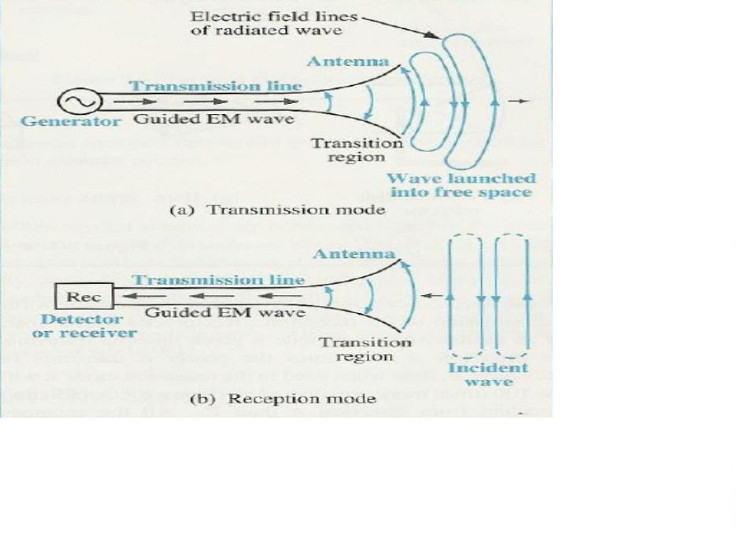
V= Time changing velocity
Transmission line opened out in a Tapered fashion as Antenna:
a) As Transmitting Antenna: –Here the Transmission Line is connected to
source or generator at one end. Along the uniform part of the line energy is
guided as Plane TEM wave with little loss. Spacing between line is a small
fraction of λ. As the line is opened out and the separation b/n the two lines
becomes comparable to λ, it acts like an antenna and launches a free space
wave since currents on the transmission Line flow out on the antenna but
fields associated with them keep on going. From the circuit point of view the
antennas appear to the tr. lines As a resistance R_{r}, called Radiation resistance
b) As Receiving Antenna –Active radiation by other Antenna or Passive
radiation from distant objects raises the apparent temperature of R_{r .}This has
nothing to do with the physical temperature of the antenna itself but is
2

Slide 6
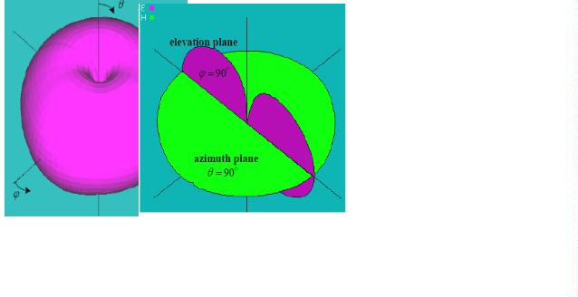
related to the temperature of distant objects that the antenna is looking at. R_{r}
may be thought of as virtual resistance that does not exist physically but is a
quantity coupling the antenna to distant regions of space via a virtual
transmission .line
Reciprocity-An antenna exhibits identical impedance during Transmission
or Reception, same directional patterns during Transmission or Reception,
same effective height while transmitting or receiving . Transmission and
reception antennas can be used interchangeably. Medium must be linear,
passive and isotropic(physical properties are the same in different
directions.) Antennas are usually optimised for reception or transmission,
not both.
Patterns
The radiation pattern or antenna pattern is the graphical representation of
the radiation properties of the antenna as a function of space. That is, the
antenna's pattern describes how the antenna radiates energy out into space
(or how it receives energy. It is important to state that an antenna can radiate
energy in all directions, so the antenna pattern is actually three-dimensional.
It is common, however, to describe this 3D pattern with two planar patterns,
called the principal plane patterns. These principal plane patterns can be
obtained by making two slices through the 3D pattern ,through the
maximum value of the pattern . It is these principal plane patterns that are
commonly referred to as the antenna patterns
3

Slide 7
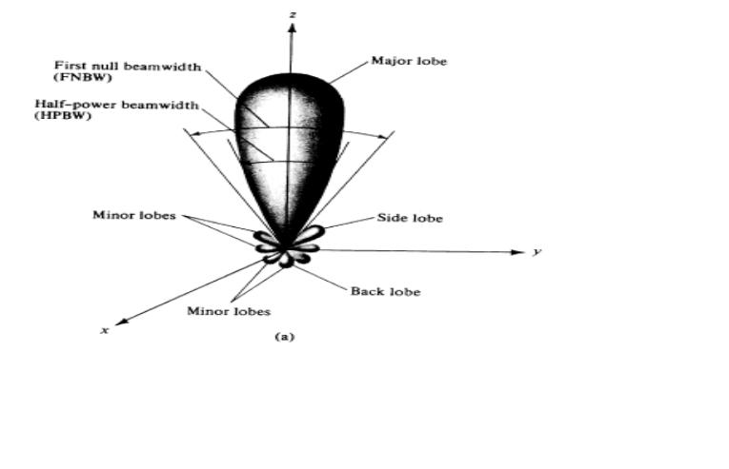
Radiation pattern or Antenna pattern is defined as the spatial
distribution of a ‘quantity’ that characterizes the EM field generated by an
antenna.
The ‘quantity’ may be Power, Radiation Intensity, Field amplitude, Relative
Phase etc.
Normalized patterns
It is customary to divide the field or power component by it’s maximum
value and plot the normalized function.Normalized quantities are
dimensionless and are quantities with maximum value of unity
E_{θ} (θ,φ)
Normalized Field Pattern =^{θ}
E (θ,φ)
=
n
^{E}θ ^{(θ,φ)}max
Half power level occurs at those angles (θ,Φ)for which E (θ,Φ) =0.707
θ
n
At distance d>>λ and d>> size of the antenna, the shape of the field pattern
is independent of the distance
Normalized Power Pattern =
P (θ,φ) =
n
S(θ,φ)
n
S(θ,φ)_{max}
where
[E (θ,φ) + E (θ,φ)]
S(θ,φ) =
2
θ
2
φ
W m²
Z₀
is the poynting vector. Half power level occurs at those angles (θ,Φ)for
which P(θ,Φ)_{n} =0.5
Pattern lobes and beam widths
4

Slide 8
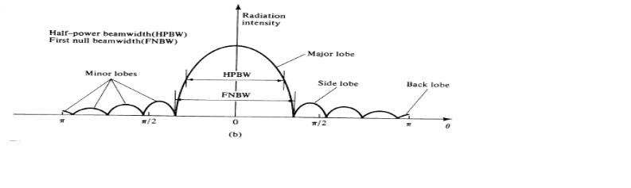
Pattern in spherical co-ordinate system
Beamwidth is associated with the lobes in the antenna pattern. It is defined
as the angular separation between two identical points on the opposite sides
of the main lobe. The most common type of beamwidth is the half-power (3
dB) beamwidth (HPBW). To find HPBW, in the equation, defining the
radiation pattern, we set power equal to 0.5 and solve it for angles. Another
frequently used measure of beamwidth is the first-null beamwidth (FNBW),
which is the angular separation between the first nulls on either sides of the
main lobe.
Pattern in Cartesian co-ordinate system
Beamwidth defines the resolution capability of the antenna: i.e., the ability
of the system to separate two adjacent targets
5

Slide 9
Examples :
1.An antenna has a field pattern given by E(θ)=cos^{2θ} for 0^{o ≤ θ ≤} 90^{o .} Find
the Half power beamwidth(HPBW)
E(θ) at half power=0.707
Therefore, cos^{2θ}= 0.707 at Halfpower point
-1
1/2
o
i.e., θ =cos [(0.707) ]=33
HPBW=2θ=66º
2.Calculate the beamwidths in x-y and y-z planes of an antenna, the power

pattern of which is given by
sin² θ sinφ;0 ≤θ ≤ π,0 ≤ φ ≤ π
U(θ,φ) =

0;π ≤θ ≤ 2π,π ≤ φ ≤ 2π
soln: In the x-y plane,θ=π/2 and power pattern is given by U(π/2,Φ)=sinΦ
• Therefore half power points are at sinΦ=0.5, i.e., at Φ=30º and Φ=
150º
• Hence 3dB beamwidth in x-y plane is (150-30)=120º
• In the y-z plane,Φ =π/2 and power pattern is given by U(θ,π/2)=sin²θ
• Therefore half power points are at sin²θ =0.5, i.e., at θ =45º and θ
=135º
• Hence 3dB beamwidth in y-z plane is (135-45)= 90º
Beam area or Beam solid angle Ω_{A}
Radian and Steradian:Radian is plane angle with it’s vertex a the centre of
a circle of radius r and is subtended by an arc whose length is equal to r.
Circumference of the circle is 2πr Therefore total angle of the circle is 2π
radians.
Steradian is solid angle with it’s vertex at the centre of a sphere of radius r,
which is subtended by a spherical surface area equal to the area of a square
with side length r
Area of the sphere is 4πr². Therefore the total solid angle of the sphere is 4π
steradians
6

Slide 10
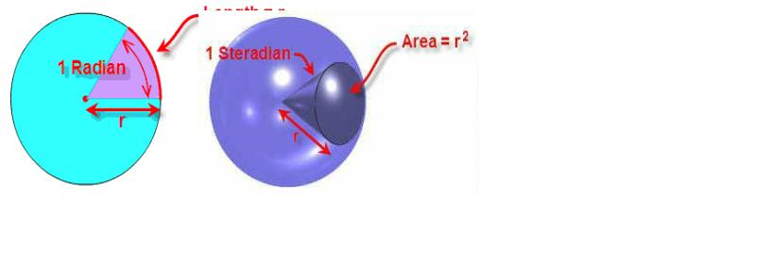
1stersteadian= (1radian)²
= (180 / π)²
=
3282.8 Square degrees
The infinitesimal area ds on a surface of a sphere of radius r in spherical
coordinates(with θ as vertical angle and Φ as azimuth angle) is
ds r2 sinθdθdφ
=
By defnition of solid angle_{ds = r}2_{dΩ}
∴dΩ = sinθdθdφ
Beam area is the solid angle Ω_{A} for an antenna, is given by the integral of
the normalized power pattern over a sphere(4π steradians)
i.e.,
2ΠΠ
Ω_{Α} =
∫∫
0 0
P_{n} (θ,φ)dΩ
dΩ = Sinθdθdφ
Beam area is the solid angle through which all of the power radiated by the
antenna would stream if P(θ,Φ) maintained it’s maximum value over Ω_{A} and
was zero elsewhere.
i.e., Power radiated= P(θ,Φ) Ω_{A} watts
Beam area is the solid angle Ω_{A} is often approximated in terms of the
angles subtended by the Half Power points of the main lobe in the two
principal planes(Minor lobes are neglected)
Ω ≈θ φ
Α
HP HP
7

Slide 11
Example
An antenna has a field pattern given by E(θ)=cos^{2θ} for 0^{o ≤ θ ≤} 90^{o .} Find
the Beam area of the pattern. Also find Approximate beam area using Half
Power Beamwidths
2ΠΠ
Ω_{Α} =
∫∫
0 0
P_{n} (θ,φ)dΩ
dΩ = Sinθdθdφ
2ΠΠ
Ω_{Α} =
∫∫
0 0
cos ( )Sinθdθdφ
4
θ
 1
π

2π
5
Ω = −2π
Α
5
cos ( )
2

θ
 =
^{=1.26}Sr


0
25
Radiation Intensity
Definition: The power radiated from an Antenna per unit solid angle is
called the Radiation Intensity. U Units: Watts/Steradians
Poyting vector or power density is dependant on distance from the antenna
while Radiation intensity is independent of the distance
Beam efficiency
The total beam area Ω consists of Main beam area Ω and minor lobe area
Ω_{m}
A
M
∴Ω = Ω + Ω
A
M
m
^{Ω}M
‘Beam efficiency’ is defined by
ε =
M
Ω
A
And ‘stray factor’ is
^{ε}m ⁼
^{Ω}m
Ω
A
∴ε +ε =1
M
m
8

Slide 12
Directivity and Gain
From the field point of view, the most important quantitative information on
the antenna is the directivity, which is a measure of the concentration of
radiated power in a particular direction. It is defined as the ratio of the
radiation intensity in a given direction from the antenna to the radiation
intensity averaged over all directions. The average radiation intensity is
equal to the total radiated power divided by 4π. If the direction is not
specified, the direction of maximum radiation is implied. Mathematically,
the directivity (dimensionless) can be written as
D =
^{U(θ,φ)}max
U(θ,φ)_{average}
The directivity is a dimensionless quantity. The maximum directivity is
always ≥ 1
Directivity and Beam area
1
2ΠΠ
P(θ,φ)_{Av} =
4Π
∫∫
0 0
P(θ,φ)Sinθdθdφ
1
2ΠΠ
=
4Π
∫∫
0 0
P(θ,φ)dΩ
∴D =
^{P(θ,φ)}max
2ΠΠ
1
∫∫
0 0
P(θ,φ)dΩ
4Π
D =
2ΠΠ
1
1
∫∫
0 0
P_{n} (θ,φ)dΩ
4Π
i.e., D =
4Π
Ω_{Α}
9

Slide 13
Directivity is the ratio of total solid angle of the sphere to beam solid angle.
For antennas with rotationally symmetric lobes, the directivity D can be
approximated as
D ≈
4π
θ φ
HP
H
• Directivity of isotropic
a
P
nt
antenna Beam area ΩA =4π
enna is equal to unity , for an isotropic
• Directivity indicates how well an antenna radiates in a particular
direction in comparison with an isotropic antenna radiating same
amount of power
• Smaller the beam area, larger is the directivity
Gain:Any physical Antenna has losses associated with it. Depending on
structure both ohmic and dielectric losses can be present. Input power P_{in} is
the sum of the Radiated power P_{rad} and losses P_{loss}
P = P + P
loss
in
rad
The Gain G of an Antenna is an actual or realized quantity which is less than
Directivity D due to ohmic losses in the antenna. Mismatch in feeding the
antenna also reduces gain
The ratio of Gain to Directivity is the Antenna efficiency factor
k(dimensionless)
∴G = kD
0 ≤ k ≤1
In practice, the total input power to an antenna can be obtained easily, but
the total radiated power by an antenna is actually hard to get. The gain of an
antenna is introduced to solve this problem. This is defined as the ratio of
the radiation intensity in a given direction from the antenna to the total input
power accepted by the antenna divided by 4π. If the direction is not
specified, the direction of maximum radiation is implied. Mathematically,
the gain (dimensionless) can be written as
G = 4πU
Pin
10

Slide 14
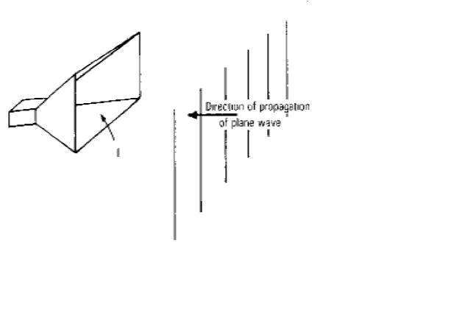
Directivity and Gain: Directivity and Gain of an antenna represent the
ability to focus it’s beam in a particular direction
Directivity is a parameter dependant only on the shape of radiation pattern
while gain takes ohmic and other losses into account
Effective Aperture
Aperture Concept: Aperture of an Antenna is the area through which the
power is radiated or received. Concept of Apertures is most simply
introduced by considering a Receiving Antenna. Let receiving antenna be a
rectangular Horn immersed in the field of uniform plane wave as shown
Let the poynting vector or power density of the plane wave be S watts/sq –m
and let the area or physical aperture be A_{p} sq-m.If the Horn extracts all the
power from the Wave over it’s entire physical Aperture A_{p}, Power
absorbed is given by
2
P=SA = (E /Z)A Watts,
p
S is poynting vector ,
p
Z is intrinsic impedance of medium,
E is rms value of electric field
But the Field response of Horn is not uniform across A_{p} because E at
sidewalls must equal zero. Thus effective Aperture Ae of the Horn is less
than Ap
Aperture efficiency is defined as
ε =
ap
^{A}e
A_{p}
11

Slide 15
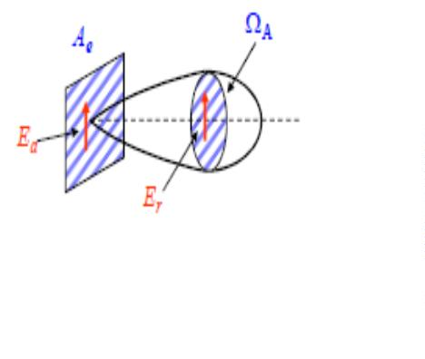
The effective antenna aperture is the ratio of the available power at the
terminals of the antenna to the power flux density of a plane wave incident
upon the antenna, which is matched to the antenna in terms of polarization.
If no direction is specified, the direction of maximum radiation is implied.
Effective Aperture (Ae) describes the effectiveness of an Antenna in
receiving mode, It is the ratio of power delivered to receiver to incident
power density
It is the area that captures energy from a passing EM wave
An Antenna with large aperture (Ae) has more gain than one with smaller
aperture(Ae) since it captures more energy from a passing radio wave and
can radiate more in that direction while transmitting
Effective Aperture and Beam area: Consider an Antenna with an effective
Aperture A_{e} which radiates all of it’s power in a conical pattern of beam area
Ω , assuming uniform field E over the aperture, power radiated is
A
a
2
P =
^{E}a
A_{e}
z₀
Assuming a uniform field E_{r} in far field at a distance r, Power Radiated is
also given by
2
P =
^{E}r
²Ω_{Α}
z
r
0
Equating the two and noting that E =E A /rλ we get Aperture –Beam area
relation
r
a
e
λ
2
= A_{e}Ω_{Α}
At a given wavelength if Effective Aperture is known, Beam area can be
determined or vice- versa
Directivity in terms of beam area is given by
D =
4Π
Ω_{Α}
12

Slide 16
Aperture and beam area are related by
λ
2
= A_{e}Ω_{Α}
Directivity can be written as
Other antenna equivalent areas :
D =
4Π
A_{e}
λ
2
Scattering area : It is the area, which when multiplied with the incident
wave power density, produces the re-radiated (scattered) power
Loss area : It is the area, which when multiplied by the incident wave power
density, produces the dissipated (as heat) power of the antenna
Capture area: It is the area, which when multiplied with the incident wave
power density, produces the total power intercepted by the antenna.
Effective height
The effective height is another parameer related to the apertures.
Multiplying the effective height, h_{e}(meters), times the magnitudeof the
incident electric field E (V/m) yields the voltage V induced. Thus
V=h E or h V/ E (m). Effective height provides an indication as to how
e
e=
much of the antenna is involved in radiating (or receiving. To demonstrate
this, consider the current distributions a dipole antenna for two different
lengths.
If the current distribution of the dipole were uniform, it’s effective height
would be l Here the current distribution is nearly sinusoidal with average
value 2/π=0.64(of the maximum) so that it’s effective height is 0.64l .It is
assumed that antenna is oriented for maximum response.
If the same dipole is used at longer wavelength so that it is only 0.1λ long,
the current tapers almost linearly from the central feed point to zero at the
ends in a triangular distribution. The average current is now 0.5 & effective
height is 0.5l
13

Slide 17
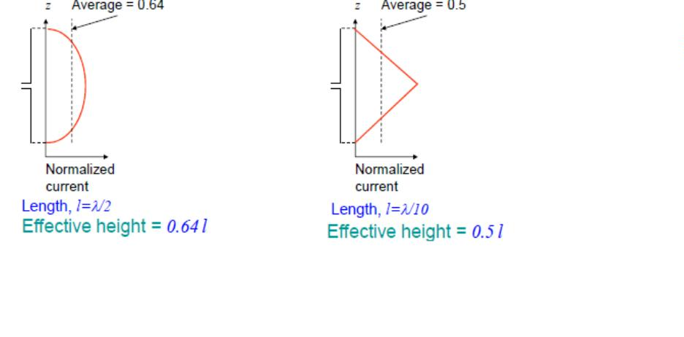
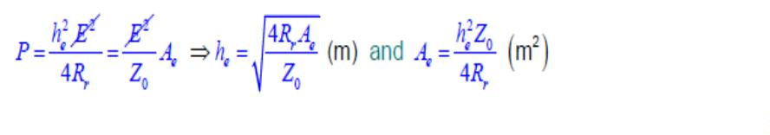
For an antenna of radiation resistance R_{r} matched to it’d load , power
2
delivered to load is P=V /(4R ), voltage is given by V=h E.
2
Therefore P=(h E) /(4R )
r
e
e
In terms of Effective aperture the same power is given by
r
2
P=SA = (E /Z )A
e
e
Equating the two,
0
Notes: the above calculations assume that the electric field is constant over
the antenna Z₀ is the intrinsic impedance of free space = 120π Ω or 377 Ω
Bandwidth or frequency bandwidth
This is the range of frequencies, within which the antenna characteristics
(input impedance, pattern) conform to certain specifications . Antenna
characteristics, which should conform to certain requirements, might be:
input impedance, radiation pattern, beamwidth, polarization, side-lobe level,
gain, beam direction and width, radiation efficiency. Separate bandwidths
may be introduced: impedance bandwidth, pattern bandwidth, etc.
14

Slide 18

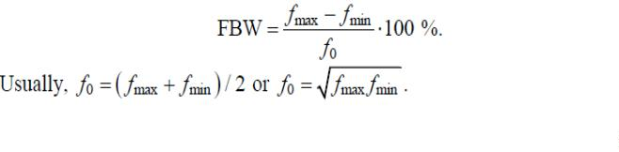
The FBW of broadband antennas is expressed as the ratio of the upper to the
lower frequencies, where the antenna performance is acceptable.
Based on Bandwidth antennas can be classified as
1. Broad band antennas-BW expressed as ratio of upper to lower
frequencies of acceptable operation eg: 10:1 BW means f_{H} is 10 times
greater than f_{L}
2. Narrow band antennas-BW is expressed as percentage of frequency
difference over centre frequency eg:5% means (f f ) /f is .05.
H – L
o
Bandwdth can be considered to be the range of frequencies on either
sides of a centre frequency(usually resonant freq. for a dipole)
The FBW of broadband antennas is expressed as the ratio of the upper to the
lower frequencies, where the antenna performance is acceptable
Broadband antennas with FBW as large as 40:1 have been designed. Such
antennas are referred to as frequency independent antennas.
For narrowband antennas, the FBW is expressed as a percentage of the
frequency difference over the center frequency
The characteristics such as Zi, G, Polarization etc of antenna does not
necessarily vary in the same manner. Some times they are critically affected
by frequency Usually there is a distinction made between pattern and input
impedance variations. Accordingly pattern bandwidth or impedance
bandwidth are used .pattern bandwidth is associated with characteristics
such as Gain, Side lobe level, Polarization, Beam area.
(large antennas)
Impedance bandwidth is associated with characteristics such as input
impedance, radiation efficiency(Short dipole)
Intermediate length antennas BW may be limited either by pattern or
impedance variations depending on application
If BW is Very large (like 40:1 or greater), Antenna can be considered
frequency independent.
15

Slide 19


Radiation Efficiency
Total antenna resistance is the sum of 5 components
Rr+Rg+Ri+Rc+Rw
Rr is Radiation resistance
Rg is ground resistance
Ri is equivalent insulation loss
Rc is resistance of tuning inductance
Rw is resistance equivalent of conductor loss
Radiation efficiency=Rr/( Rr+Rg+Ri+Rc+Rw). It is the ratio of power
radiated from the antenna to the total power supplied to the antenna
Antenna temperature
The antenna noise can be divided into two types according to its physical
source:
- noise due to the loss resistance of the antenna itself; and
- noise, which the antenna picks up from the surrounding environment
The noise power per unit bandwidth is proportional to the object’s
temperature and is given by Nyquist’s relation
where
T_{P} is the physical temperature of the object in K (Kelvin degrees); and
k is Boltzmann’s constant (1.38x10⁻²³ J/K
A resistor is a thermal noise source. The noise voltage(rms value) generated
by a resistor R, kept at a temperature T, is given by
V_{n} = 4kTBR
Where
k is Boltzmann’s constant (1.38x10⁻²³ J/K). And
B is the bandwidth in Hz
Often, we assume that heat energy is evenly distributed in the frequency
band ∆f . Then, the associated heat power in ∆f is
16

Slide 20

For a temperature distribution T( θ,Φ ) and radiation pattern R( θ,Φ ) of the
antenna ,
Then noise temperature T_{A} is given by
1
2π
π
T_{A} =
∫ ∫
R(θ,φ).T(θ,φ)sinθdθdφ
4π
0
0
The noise power P received from an antenna at temperature T can be
TA
A
expressed in terms of Bandwidth B over which the antenna(and it’s
Receiver) is operating as
P =kT B
TA
A
The receiver also has a temperature T_{R} associated with it and the total
system noise temperature (i.e., Antenna + Receiver) has combined
temperature given by
T = T + T
sys
A
R
And total noise power in the system is P_{Total} = kT_{sys} B
Antenna Field Zones
The space surrounding the antenna is divided into three regions according to
the predominant field behaviour. The boundaries between the regions are not
distinct and the field behaviour changes gradually as these boundaries are
crossed. In this course, we are mostly concerned with the far-field
characteristics of the antennas .
17

Slide 21
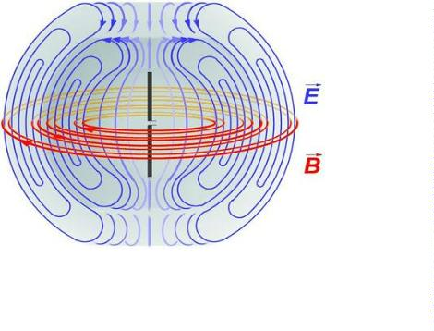
Fig: Radiation from a dipole
1.Reactive near-field region: This is the region immediately surrounding
the antenna, where the reactive field dominates. For most antennas, it is
assumed that this region is a sphere with the antenna at its centre
2. Radiating near-field (Fresnel) region :This is an intermediate region
between the reactive near-field region and the far-field region, where the
radiation field is more significant but the angular field distribution is still
dependent on the distance from the antenna.
3. Far-field (Fraunhofer) region :Here r >> D and r >> λ
The angular field distribution does not depend on the distance from the
source any more, i.e., the far-field pattern is already well established.
------X------X------X---------
18

Slide 22
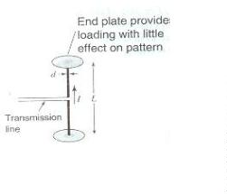

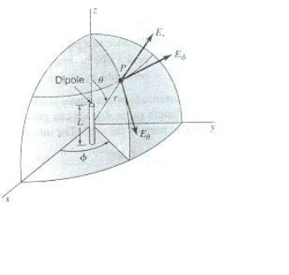
The Electric Dipoles and Thin Linear Antennas
Short Electric dipole:
Any linear antenna may be considered as consisting of a large number of
very short conductors connecter in series. A short linear conductor is often
called a ‘short dipole’. A short dipole is always of finite length even though
it may be very short. If the dipole is vanishingly short it is an infinite single
dipole.
Fig 3.1: A short dipole antenna
dipole antenna
Fig 3.2: Equivalent of short
Consider a short dipole as shown in figure 3.1, the length L is very short
compared to the wavelength [L<< λ]. The current I along the entire length is
assumed to be uniform. The diameter d of the dipole is small compare to its
length [d<<L]. Thus the equivalent of short dipole is as shown in figure (b).
It consists of a thin conductor of length L with uniform current I and point
charges at the ends. The current and charge are related by
-------------------------------(3.1)
The fields of a short dipole:
Fig3.3: Relation of dipole to co-ordinates
Consider a dipole of length ‘L’ placed coincident with the z-axis with its
center at the origin. The electric and magnetic fields due to the dipoles can

Slide 23

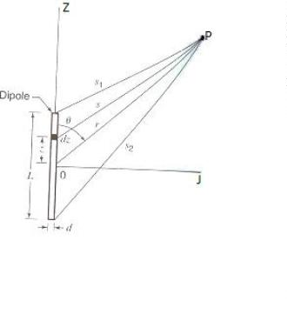


be expressed in terms of vector and scalar potentials. The relation of electric
field Electric field Er, Eθ and Eϕ is as shown in figure3.3. It is assumed that
the medium surrounding the dipole is air.
Retardation effect:
In dealing with antennas, the propagation time is a matter of great important.
Thus if a current is flowing in the short dipole. The effect of the current is
not felt instantaneously at the point P, but only after an interval equal to the
time required for the disturbance to propagate over the distance ‘r’. This is
known as retardation effect.
When retardation effect is considered instead of writing current I as
which implies instantaneous propagation of the effect of the
current, we introduce propagation time as
Where [I] is called retarded current
c - Velocity of propagation
Fig3.3: Geometry for short dipole
For a dipole as shown in the above figure the retarded vector potential of the
electric current has only one component namely A₃ and it is given by
[I] is the retarded current given by
Z= distance to a point on the conductor
I₀= peak value in the time of current
µ = permeability of free space = 4π x 10 Hm
0
-7
-1

Slide 24







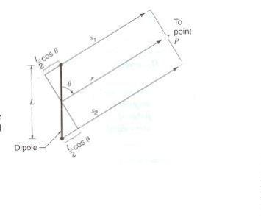
If the distance from the dipole is large compare to its length (r>>L) and
wavelength is large compare to the length (λ>>L), we can put s=r and
neglect the phase difference of the field contributions from different parts of
the wire. The integrand in (2) can then be regarded as a constant. So that (2)
becomes
The retarded scaled potential V of a charge distributed is
Where [ρ] is the retarded charge density given by
dτ= infinitesimal volume element
= permittivity of free space [= 8.854 x 10 Fm ]
-10
-1
Since the region of charge in the case of the dipole being considered is
confined to the points at the ends as in figure 3.2 equation 3.5 reduce to
But,
Substituting equation (3.7) in (3.6)
Referring the figure
Fig 3.4: Relation for short dipole when r>>L
When r>>L, the lines connecting the ends of the dipole and the point ‘p’
may be consider as parallel so that

Slide 25
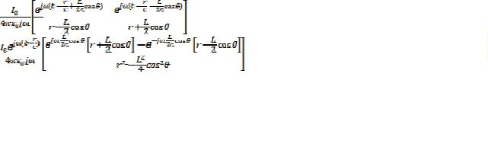























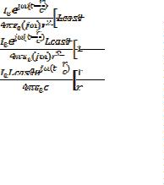





Sub S and S in the equation 3.8
1
2
The term
is negligible compare to r² assuming r>>L
If the wavelength is much greater than the length of dipole (λ>>L) then,
Thus the above expression reduce to
Equation 3.4 and 3.9 express the vector and scalar potentials everywhere due
to a short dipole. The only restrictions are r>>L and λ>>L

Slide 26
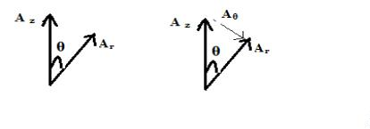
These equations gives the vector and scalar potentials at a point P in terms of
the distance ‘r ‘to the point from the center of the dipole, the angle θ , the
length of the dipole L the current on the dipole and some constants.
Fig 3.5: resolution of Vector potential into A and A components
θ
r
Knowing the vector potential A and the scalar potential V the electric and
magnetic field may then be obtained from the relations
It will be desirable to obtain E x H components in polar coordinates. The
polar coordinate components for the vector potential are
Since the vector potential for the dipole has only ‘z’ components Aϕ=0 and
Ar and Aθ are given by
In polar coordinates the gradient of V is
Expressing E in its polar coordinates components is
Sub Eqn. (3.11) (3.12)and (3.13) in (3.10)
Equating the respective component on either side we get
Since Aϕ=0 and = 0 Eϕ = 0 substituting Ar and A_{ϴ} from (3.12)

Slide 27
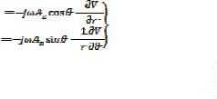

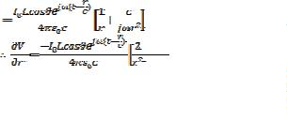





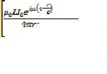














We have,
Substituting these values in equation (3.15)
st
the 1 and 3 term are one and the same
Expressing
rd
with opposite sign therefore
And
Sub
in the first term we get
Magnetic Field Component: To find magnetic field component we use the
relation
For Spherical Coordinate system
is given by

Slide 28












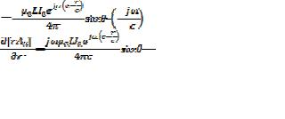







Since A has only two components ie A and A which are given by
θ
z
r
A = A cosθ
r
z
A = -A Sinθ
θ
z
A has no components in A direction therefore
&
and substituting these
z
two values rsinθ A&=0
Substituting these two values
Here A_{z} is independent of θ
Substitute for A_{z} value
Substituting equations (3.22) and (3.23) in the equation (3.21)

Slide 29











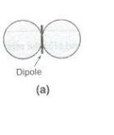
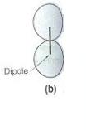
The above two equation represents the total electric and magnetic fields due
to short dipoles
When r is very large the terms
[Er is also negligible]
and
becomes negligible compare to
[As H = H =0]
θ
Taking the ratio of E and H as in the above equation
r
Intrinsic impedance of free space [pure resistance]
Relation between E , E and H
r
θ
&
Fig 3.6 (a): Near and far field pattern of E and H components for short
&
dipole. (b): Near field component, E_{r}
θ
From the equation (3.26) and (3.27), it is clear that E and H components
&
θ
are in phase in the field. The field pattern of both is proportional to sinθ. The
pattern is independent of & so that the space pattern is doughnut shaped.
When we consider near field ( and is not neglected) for a small r, the
electric field has two components E and E , which are both in time phase
θ
quadrature with the magnetic field.
r

Slide 30





















i.e.,
At intermediate distance E and E can approach time phase quadrature. So
θ
r
that total electric field vector rotates in a plane parallel to the direction of
propagation thus referred as cross field.
For E and H components the near field patterns are same as the far field
θ
&
pattern [which is proportional to sinθ]
The near field pattern of E is proportional to cosθ [far field E =0]
r
r
Quasi stationary or dc case:
It refers to low frequency of operation
The retarded current is given by
E and E can be written as [equations (3.28) (3.29) and (3.30)]
θ
r
And magnetic field
At low frequency fꢀ 0 or wꢀ0, so that

Slide 31
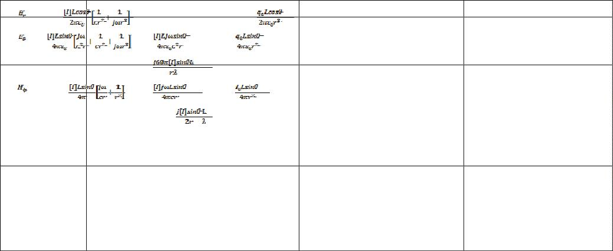





Table:
Fields of Short Dipole:-
Component
General Expression
Far Field
0
Quasi Stationary
or
Or
Alternative Expression for field E:
In case of far field [ is negligible ] , the maximum value of Electric field
is given by
Substitute
Substitute
But

Slide 32











Expression for power: From pointing theorem
Radiation resistance of short dipole:
Let, I = RMS value of current
P_{T}= Total power radiated.
R_{r}= Radiating resistance
The average pointing vector is given by
since
The total power radiated is
Substitute E from equation (3.32)
we get
2
But total power radiated =I R
------- (3.35)
From Equations (3.34) and (3.35)
0
r
This gives the radiation resistance of short dipole

Slide 33

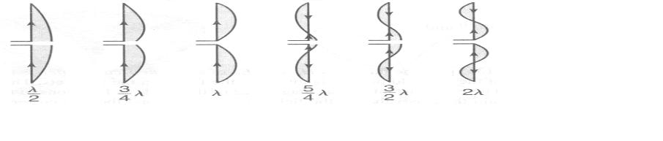
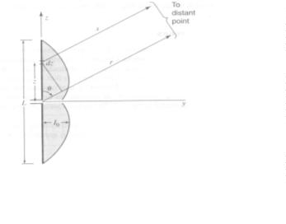


Field due to a thin linear antenna:
Thin antenna means its diameter is small compared to its wave length,
i.e
Where d= diameter of the antenna and λ= wavelength
Antenna is fed at the center by a balanced two wire transmission line and
assuming sinusoidal current distribution along various length of line as
shown in figure 3.7
Figure 3.7: Approximate natural current distribution for thin linear center fed
antenna of various length.
Fig 3.8: Relation for symmetrical thin linear center-fed antenna of length L.
Relation for symmetrical thin linear center-fed antenna of length L is as
shown in figure 3.8.
The magnitude of current at any point on the antenna is given by
The retarded current is given by
The expression
is used when z<0 [-ve z]
is used when z>0 [+ve z]
The total radiation field due to the antenna is obtained by considering the
antenna as made up of a series of infinitesimal dipoles of length dz and
integrating the field due to elementary dipole over the entire length. The far
field
at a distance ‘S’ from the infinitesimal dipole d_{z} are

Slide 34



















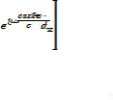



And
Since
. Thus either
calculate is enough
The value of the magnetic field
the length of the antenna
for the entire antenna is the integral of
over
Thus
Substitute the value of
from equation (3.40) we get
substituting [I] from equation (3.38)
At far distance the difference between s and r can be neglected for magnitude but
can be considered for phase
[ s=r – zcosθ for phase s = r for magnitude]
Since
the above equation can be written as

Slide 35
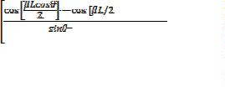

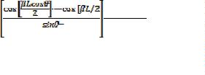




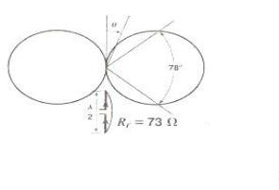
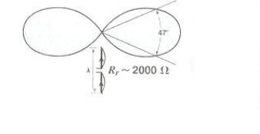
The integral is in the form
For 1st integral
For 2nd integral
and
,
, and
Multiplying
Where
by η=120π
retarded current
Case 1: If the length of antenna is λ/2
L= λ/2, the magnitude of current distribution is given by
When z=0
When
[i.e., The maximum value of current at the center]
[i.e., The minimum current at the end of
,
dipole]
When L = λ/2, the pattern factor becomes
The pattern is as shown in figure 3.9(a), it is slightly more directional
than the pattern of infinitesimal of short dipole [which is given by sinθ].
The beam width between half power points of λ/2 antenna is 78⁰ as
compared to 90⁰ for a short dipole
Fig 3.9: (a)Far field pattern of λ/2 antenna b) Far field pattern of full
wave antenna

Slide 36


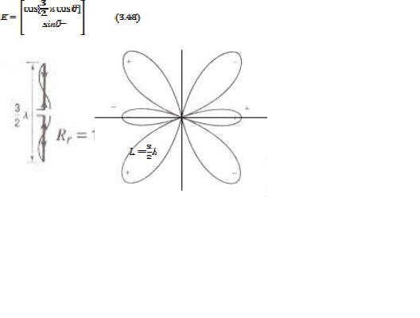

Case 2: If the length of antenna is λ
For full wave antenna [L = λ , the magnitude of current is given by
When z=0, Imag =0 current minimum at the center.
Imag =0 (again zero)
Maximum current at
The pattern factor is given by
The pattern is as shown in figure3.8(b) The half power beam width is
47⁰
Case 3: If the length of antenna is 3λ/2
The pattern factor is
Fig 3.9: Far field pattern of
antenna
The pattern is as shown in figure3.9 and 3.10 It has been observed that
increasing the length up to L=λ increases the directivity in the H plane. For
length L>λ tne H field strength decreases and the major part of the radiated
energy is directed at some angle to the horizontal. For L< λ the radiation
pattern has no side lobes. This is key point in the design of directional array.

Slide 37
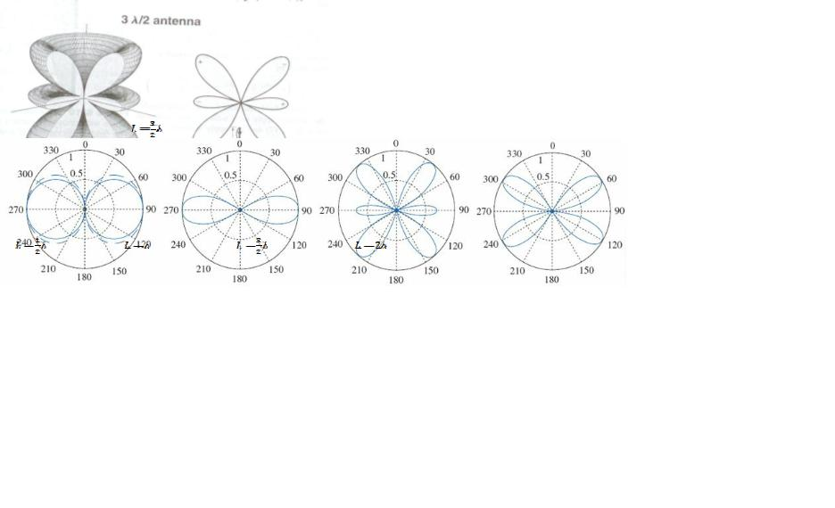
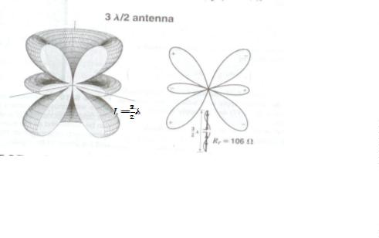
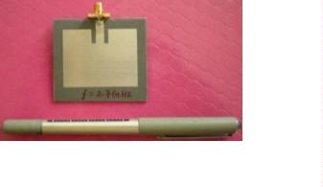
Fig 3.10: Far field pattern of
antenna
Fig 3.11: The E-plane radiation patterns for dipoles of different lengths
The E-plane radiation patterns for dipoles of different lengths, [length
varies from λ/2 to 2λ] is as shown in Fig 3.11
Microstrip antenna:
Fig 3.12: Single Microstrip antenna
It is also called “patch antennas” as shown in figure3.12
ꢁ One of the most useful antennas at microwave frequencies
(f > 1 GHz).
ꢁ It consists of a metal “patch” on top of a grounded dielectric substrate.
The patch may be in a variety of shapes, but rectangular and circular are the
most common

Slide 38
Advantages of Microstrip Antennas:
The advantages of microstrip antenna are
ꢂ Easy to fabricate (use etching and photolithography).
ꢂ Easy to feed (coaxial cable, Microstrip line, etc.) .
ꢂ Easy to use in an array or incorporate with other Microstrip circuit
elements.
ꢂ Patterns are somewhat hemispherical, with a moderate directivity
(about 6-8 dB is typical).
ꢂ Light weight, smaller size and lesser volume
Disadvantages of Microstrip Antennas:
ꢂ Low bandwidth
ꢂ Low efficiency
ꢂ Low gain
Long wire antenna
A linear wire antenna, many wavelengths long may be regarded as an array
of λ/2 length but connected in a continuous linear fashion.
The long antennas are
1 V antenna
2 Rhombic antenna
3 Beverage antenna
V antenna:
• It is a type of transmitting or receiving antenna for providing a low
angle beam for fixed frequency working in the HF band.`
• It consists of two wires in the form of V fed at the apex.
• Length of the extending from 2λ to 8λ. The main lobe of radiation lies
along the axis of the wire.
• The beam width of the main lobe is approximately equal to angle
between wires.
• Due to reflection at the far end [as there is no load] a similar backward
beam is also produced. This is minimized and the forward gain is
increased by placing a similar V antenna in the plane of first V at an
odd number of quarter wavelength behind the first V antenna.
ANTENNA & PROPAGATION (06EC64)-Unit 3
Dr. H V Kumaraswamy, Professor, RVCE, Bangalore-59
Page 17

Slide 39
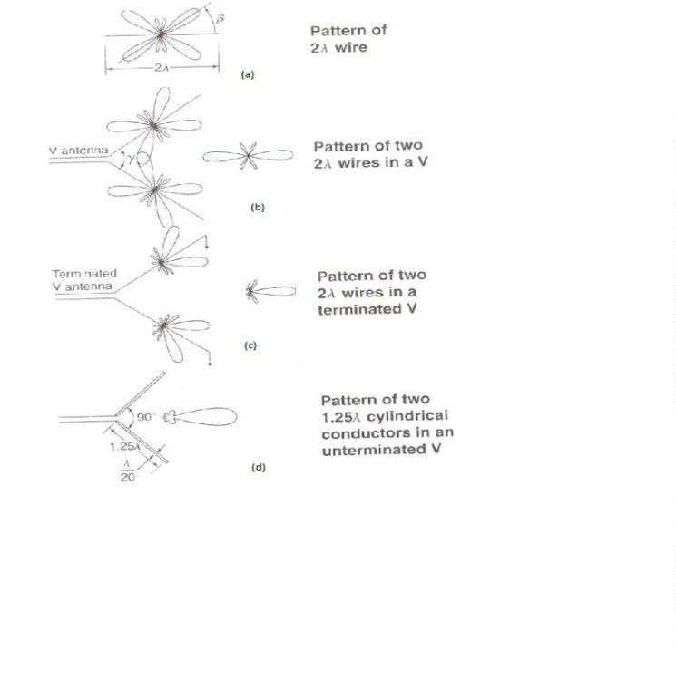
Fig 3.13: a)Calculated pattern of 2λ wire with standing wave, (b) v antenna of two
such wres, c) terminated V antenna with legs 2λ long and d) V antenna of
cylindrical conductors 1.25λ long with measured pattern.
Rhombic antenna
The rhombic antenna is as shown in fig 3.14. It consists of four wires in the
form of a parallelogram in the horizontal plane above the earth the length of
the wire is 2λ to 10λ.
For transmission purpose the radio frequency energy is fed through a
balanced line at one end and the resistor at the other end. In free space the
maximum gain is along the main axis and the polarization horizontal.
The antenna could be used for both transmission and reception. Because of
its simplicity it is a very popular antenna for HF transmission.
Each wire produces a main beam of radiation and a number of side lobes.
The design of rhombic antenna consists of the determination of the three
factors, the length L, the tilt angle ϕ and the height h.

Slide 40
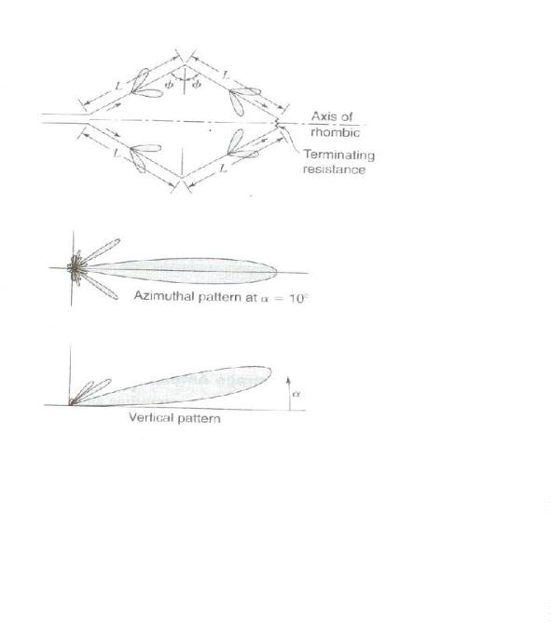
The earth serves to deflect the main beam upward at some angle of
elevation. Combining with the earth plane the antenna produces a vertical
pattern with an angle of elevation α.
Figure 3.14: Rhombic antenna
Advantages
• It is a wideband antenna.
• It is a high gain antenna and the required angle of equation of main
lobe be obtained.
• Design and structure are simple.
• Input impedance is constant for a range of frequency.
Disadvantages
• As terminating resistance is used efficiency is less.
• The width of the main lobe changes with frequency.

Slide 41
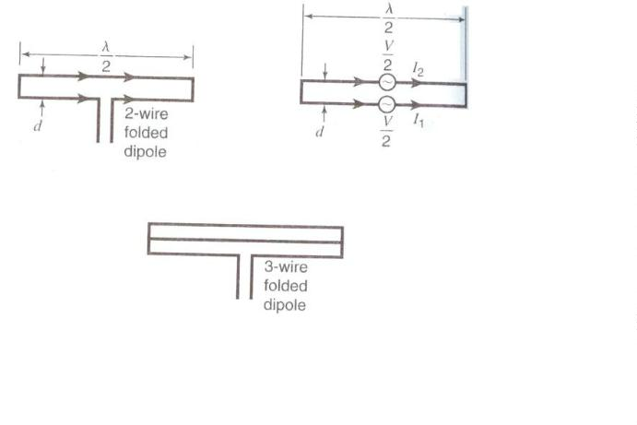
Folded dipole
A folded dipole antenna is formed by joining two half wave dipole at both
ends and splitting one of them in the middle. The spilt dipole is fed at the
center by a balanced transmission line as shown in figure.15.
This configuration is essentially two dipoles in parallel and therefore has the
same voltages at the ends. The radiation pattern is same as that of a single
dipole, but the input impedance is higher. Since the circuit in the two dipoles
is half of that in a single dipole antenna and the radiated power is the same,
it follows that the input impedance is four times that of a single dipole.
The input impedance [radiation resistance] for a dipole is around 73Ω, hence
for the folded dipole with 2 arms the radiation resistance will be
4 X 73 Ω=292 Ω.
Fig 3.15: Folded dipole
If 3 arms are used the resistance will be 3 X 73 = 657 .
2
Ω
For impedance which is not a multiple of 73 Ω (of a single dipole) the radii
of the arms is made unequal. By doing so, the thicker dipole carries more
circuit compared to the other one. A transformation ratio of 1.5 to 25 can be
achieved with only two dipoles.
The folded dipole may be considered as two short circuited quarter wave
transmission lines connected together and fed in series.
At the resonant frequency, the impedance presented at the fed point is very
high (ideally ) and hence does not affect the total impedance seen by the

Slide 42
feeder on either side of their frequency, the impedance falls and is reactive,
but since the Q is low. The fall is not steep and the antenna works
satisfactorily over a broad-band of frequencies.
It is used for television reception along with same parasitic elements. The
antenna than is referred as Yagi-Uda antenna

Slide 43
G.PULLAIAH COLLEGE OF ENGINEERING AND
TECHNOLOGY, KURNOOL
Department of ECE
Course: Antennas & Wave Propagation
Unit-2

Slide 44
1. Introduction
Loop antennas feature simplicity, low cost and versatility. They may have
various shapes: circular, triangular, square, elliptical, etc. They are widely used
in communication links up to the microwave bands (up to ≈ 3 GHz). They are
also used as electromagnetic (EM) field probes in the microwave bands.
Loop antennas are usually classified as electrically small (C < 0.1λ ) and
electrically large (C  λ ). Here, C denotes the loop’s circumference.
Electrically small loops of a single turn have very small radiation resistance
(comparable to their loss resistance). Their radiation resistance can be
substantially improved by adding more turns. Multi-turn loops have better
radiation resistance although their efficiency is still poor. That is why they are
used mostly as receiving antennas provided losses are not important. The
radiation characteristics of a small loop antenna can be additionally improved
by inserting a ferromagnetic core. Radio receivers of AM broadcast are usually
equipped with ferrite-loop antennas. Such antennas are used in pagers, too.
The small loops, regardless of their shape, have a far-field pattern very
similar to that of a small electric dipole normal to the plane of the loop. This is
expected because they are equivalent to a magnetic dipole. Note, however, that
the field polarization is orthogonal to that of the electric dipole.
As the circumference of the loop increases, the pattern maximum shifts
towards the loop’s normal, and when C ≈ λ, the maximum of the pattern is
along the loop’s normal.
2. Radiation Characteristics of a Small Loop
A small loop is by definition a loop of constant current. Its radius satisfies
a <
λ
6π
,
(12.1)
or, equivalently, C < λ / 3. The limit (12.1) is mathematically derived later in
this Lecture from the first-order approximation of the Bessel function of the
1

Slide 45
first order J₁(x) in the general solution for a loop of constant current. Actually,
to make sure that the current has near-constant distribution along the loop, a
tighter limit must be imposed:
a < 0.03λ ,
(12.2)
or, C < λ / 5. A good approximate model of a small loop is provided by the
infinitesimal loop (or the infinitesimal magnetic dipole).
The expressions for the field components of an infinitesimal loop of electric
current of area A were already derived in Lecture 3. Here, we give only the far-
field components of the loop the axis of which is along the z:
E_{j} =ηβ ² ⋅(IA)⋅
e− jβr
⋅sinθ ,
(12.3)
(12.4)
4πr
e− jβr
4πr
H_{θ} = −β ² ⋅(IA)⋅
⋅sinθ .
It is obvious that the far-field pattern,
E_{j} (θ) = sinθ ,
(12.5)
is identical to that of a z-directed infinitesimal electric dipole although the
polarization is orthogonal. The power pattern is identical to that of the
infinitesimal electric dipole:
F(θ) = sin² θ .
(12.6)
Radiated power:
1
2η
Π =
∫∫
| E |² ⋅r² sinθdθdj
j
,

ds
Π =
1
12π
⁴ IA
ηβ ( )² .
(12.7)
Radiation resistance:
8


A
λ²
²
 .
R =η π ³ 
(12.8)
(12.9)
r
3

In free space, η =120π Ω, and
R_{r} ≈ 31171(A / λ² )² .
2

Slide 46
Equation (12.9) gives the radiation resistance of a single loop. If the loop
antenna has N turns, then the radiation resistance increases with a factor of N ²
(because the radiated power increases as I²):
8


A
λ²
²
 .
R =η π ³  N
(12.10)
r
3

The relation in (12.10) provides a handy mechanism to increase R_{r} and the
radiated power Π. Unfortunately, the losses of the loop antenna also increase
(although only as  N ) and this results in low efficiency.
The directivity is the same as that of an infinitesimal dipole:
U
Π
= π ^{max} =1.5.
(12.11)
D 4
0
rad
3. Circular Loop of Constant Current – General Solution
So far, we have assumed that the loop is of infinitesimal radius a, which
allows the use of the expressions for the infinitesimal magnetic dipole. Now,
we derive the far field of a circular loop, which might not be necessarily very
small, but still has constant current distribution. This derivation illustrates the
general loop-antenna analysis as the approach is used in the solutions to circular
loop problems of nonuniform distributions, too.
The circular loop can be divided into an infinite number of infinitesimal
current elements. With reference to the figure below, the position of a current
element in the xy plane is characterized by 0□ ≤ j′ < 360 and
θ′ =
□
90□ . The
position of the observation point P is defined by (θ,j).
The far-field approximations are
R ≈ r − acosψ , for the phase term,
1 1
(12.12)
≈ , for the amplitude term.
R r
In general, the solution for A does not depend on j because of the cylindrical
symmetry of the problem. Here, we set j = 0. The angle between the position
vector of the source point Q and that of the observation point P is determined as
cosψ = rˆ ⋅rˆ′ = (xˆ sinθ cosj ˆ sinθ sinj ˆ cosθ) (ˆ cosj ˆ sinj′),
+ y
+ z
⋅ x
′ + y
3

Slide 47
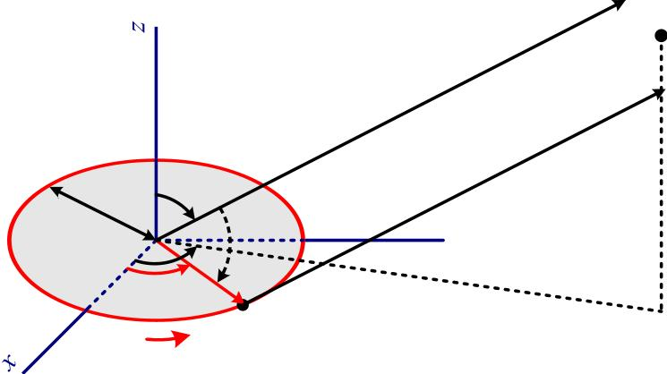
P
r
θ
R
a
ψ
j
r′
y
j′
Q
I₀
⇒
cosψ = sinθ cosj′.
(12.13)
Now the vector potential integral can be solved for the far zone:
A(r,θ,j) =
µ
4π
∫
e− jβ (r−asinθ cosj′)
(12.14)
I₀
r
dl
C
where dl = φˆ′adj′ is the linear element of the loop contour. The current
element changes its direction along the loop and its contribution depends on the
angle between its direction and the respective A component. Since all current
elements are directed along φˆ , we conclude that the vector potential has only
A component, i.e., A = A φˆ , where
j
j
µ
4π
e− jβ r
2π
A (r,θ,j) ˆ (r,θ,j)
∫
(φˆ ⋅φˆ′)e ^{jβ asinθ cosj} dj
′. (12.15)
j
= φ⋅A
=
(I₀a)
r
′
0
Since
φˆ ⋅φˆ′ = (xˆ cosj + yˆ sinj)⋅(xˆ cosj′ + yˆ sinj′) =
=
=
cosj cosj′ + sinj sinj′ =
(12.16)
cos(j − j′)
j=0
=
cosj′,
the vector potential is
4

Slide 48
µ
4π
e− jβr
2π
∫
cosj′⋅e ^{jβasinθ cosj} dj
A_{j} (θ,0)
=
(I₀a)
r
′
′,
(12.17)
0
µ
4π
e− jβr
^{π}
2π

∫
∫
A_{j} (θ)
=
cosj′⋅e ^{jβasinθ cosj} dj
′ +
cosj′⋅e ^{jβasinθ cosj} dj
′ .
(I₀a)

′
′
r 
π

0
We apply the following substitution in the second integral: j′ = j′′ +π . Then,
µI₀a e− jβr
4π
^{π}
π

∫
∫
cos e ^{jβasinθ cosj} d
j′⋅ ′ j′−
cos e ^{jβasinθ cosj} d
′′ j′′. (12.18)
θ =
A ( )
j

j ′′⋅ −
r 

0
0
The integrals in (12.18) can be expressed in terms of Bessel functions, which
are defined as
π
∫
cos(nj)e ^{jzcosj} dj = π j^{n} J_{n} (z).
(12.19)
0
Here, J_{n} (z) is the Bessel function of the first kind of order n. From (12.18) and
(12.19), it follows that
θ =
A ( )
j
µ
4π
(I₀a)
e− jβr
j J₁ asin
π  (β
θ )− (−β
θ ). (12.20)
asin 
J
r
1
Since
J (−z) = (−1)^{n} J (z),
(12.21)
(12.22)
n
n
equation (12.20) reduces to
µ
e− jβr
A (θ) = j (I a)
J₁(βasinθ).
j
2
0
r
5

Slide 49
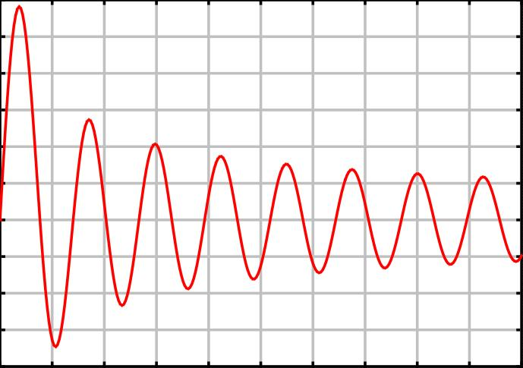
0.6
0.5
0.4
0.3
0.2
0.1
0
-0.1
-0.2
-0.3
^{-0.4}0
5 10 15 20 25 30 35 40 45 50
x
The far-zone fields are derived as
E (θ) = βη(I a)
e− jβr
J₁(βasinθ),
j
0
2r
E_{j}
η
e− jβr
(12.23)
H_{θ} (θ) = −
= −β(I₀a)
2r
J₁(βasinθ).
The patterns of constant-current loops obtained from (12.23) are shown below:
6

Slide 50
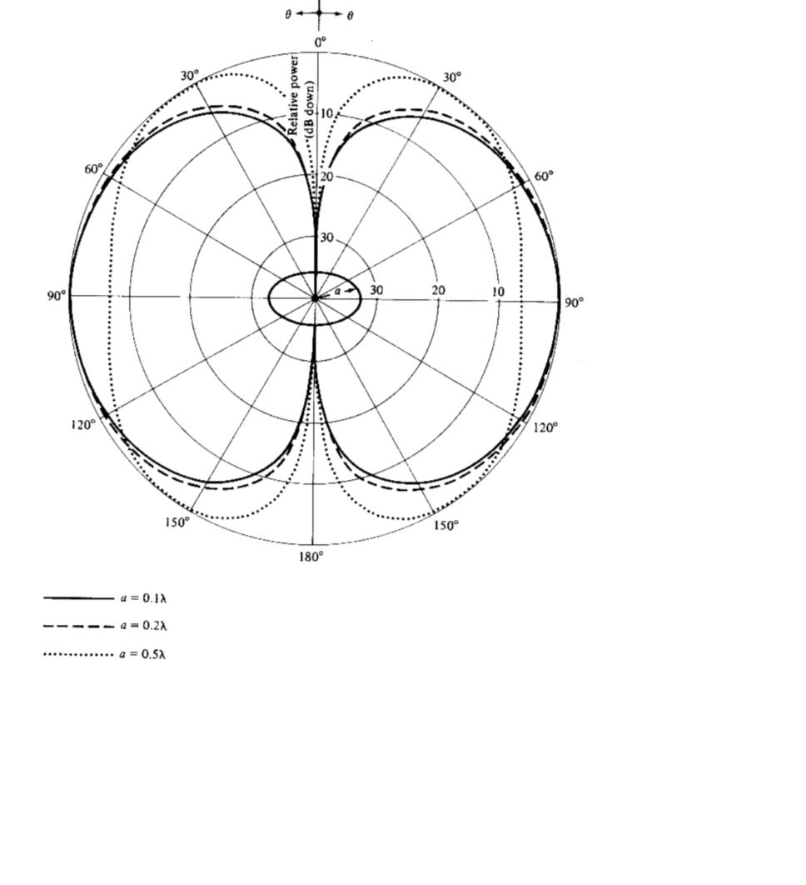
[Balanis]
The small-loop field solution in (12.3)-(12.4) is actually a first-order
approximation of the solution in (12.23). This becomes obvious when the
Bessel function is expanded in series as
1
1
J (βasinθ) = (βasinθ) − (βasinθ)³ +☹.
(12.24)
1
2
16
7

Slide 51
For small values of the argument (βa <1/ 3), the first-order approximation is
acceptable, i.e.,
1
J (βasinθ) ≈ (βasinθ).
(12.25)
1
2
The substitution of (12.25) in (12.23) yields (12.3)-(12.4).
It can be shown that the maximum of the pattern given by (12.23) is in the
direction θ = 90□ for all loops, which have circumference C <1.84λ .
Radiated power and radiation resistance
We substitute the E_{j} expression (12.23) in
1
2η
Π =
∫∫
| E |² ⋅r² sinθdθdj
j
,

which yields
ds
(ωµ)²
π
∫
Π =
(I² A)⋅ J ² (βasinθ) sinθdθ .
(12.26)
4η
0
0
1
Here, A = πa² is the loop’s area. The integral in (12.26) does not have a closed
form solution. Often, the following transformation is applied:
π
1
βa
2βa
∫
J₁² (βasinθ) sinθdθ =
∫
J₂ (x)dx.
(12.27)
0
0
The second integral in (12.27) does not have a closed form solution either but it
can be approximated with a highly convergent series:
2βa
∞
∫
∑
J₂ (x)dx = 2 J_{2m+3}(2βa).
(12.28)
0
m=0
The radiation resistance is obtained as
2Π
(ωµ)²
π
∫
R_{r} =
=
A⋅ J ² (βasinθ) sinθdθ .
(12.29)
I ²
0
2η
0
1
The radiation resistance of small loops is very small. For example, for
λ / 100 < a < λ / 30 the radiation resistance increases from ≈ 3×10−³ Ω up to
8

Slide 52

≈ 0.5 Ω. This is often less than the loss resistance of the loop. That is why
small loop antennas are constructed with multiple turns and on ferromagnetic
cores. Such loop antennas have large inductive reactance, which is
compensated by a capacitor. This is convenient in narrowband receivers, where
the antenna itself is a very efficient filter (together with the tuning capacitor),
which can be tuned for different frequency bands.
4. Circular Loop of Nonuniform Current
When the loop radius becomes larger than 0.2λ , the constant-current
assumption does not hold. A common assumption is the cosine distribution.^{1,2}
Lindsay, Jr.,³ considers the circular loop to be a deformation of a shorted
parallel-wire line. If I is the current magnitude at the “shorted” end, i.e., the
s
′ =
point opposite to the feed point where j π , then
I(a) = I_{s} cosh(γ aa)
(12.30)
where a = π −j′ is the angle with respect to the shorted end, γ is the line
propagation constant and a is the loop radius. If we assume loss-free
transmission-line model, then γ = jβ and cosh(γ aa) = cos(βaa). For a loop in
open space, β is assumed to be the free-space wave number (β = ω µ₀ε₀ ).
The cosine distribution is not very accurate, especially close to the
terminals, and this has a negative impact on the accuracy of the computed input
impedance. That is why the current is often represented by a Fourier series:^{4,5}
N
∑
I(j′) = I + 2 I cos(nj ).
0
n
′
(12.31)
n=1
Here, j′ is measured from the feed point. This way, the derivative of the
j′ = π
current distribution with respect to j′ at
(the point diametrically
opposite to the feed point) is always zero. This imposes the requirement for a
symmetrical current distribution on both sides of the diameter from j′ = 0 to
j′ = π . The complete analysis of this general case will be left out, and only
¹ E.A. Wolff, Antenna Analysis, Wiley, New York, 1966.
² A. Richtscheid, “Calculation of the radiation resistance of loop antennas with sinusoidal current distribution,” IEEE Trans.
Antennas Propagat., Nov. 1976, pp. 889-891.
³ J. E. Lindsay, Jr., “A circular loop antenna with non-uniform current distribution,” IRE Trans. Antennas Propagat., vol. AP-8,
No. 4, July 1960, pp. 439-441.
⁴ H. C. Pocklington, “Electrical oscillations in wire,” in Cambridge Phil. Soc. Proc., vol. 9, 1897, pp. 324–332.
⁵ J. E. Storer, “Input impedance of circular loop antennas,” Am. Inst. Electr. Eng. Trans., vol. 75, Nov. 1956.
9

Slide 53
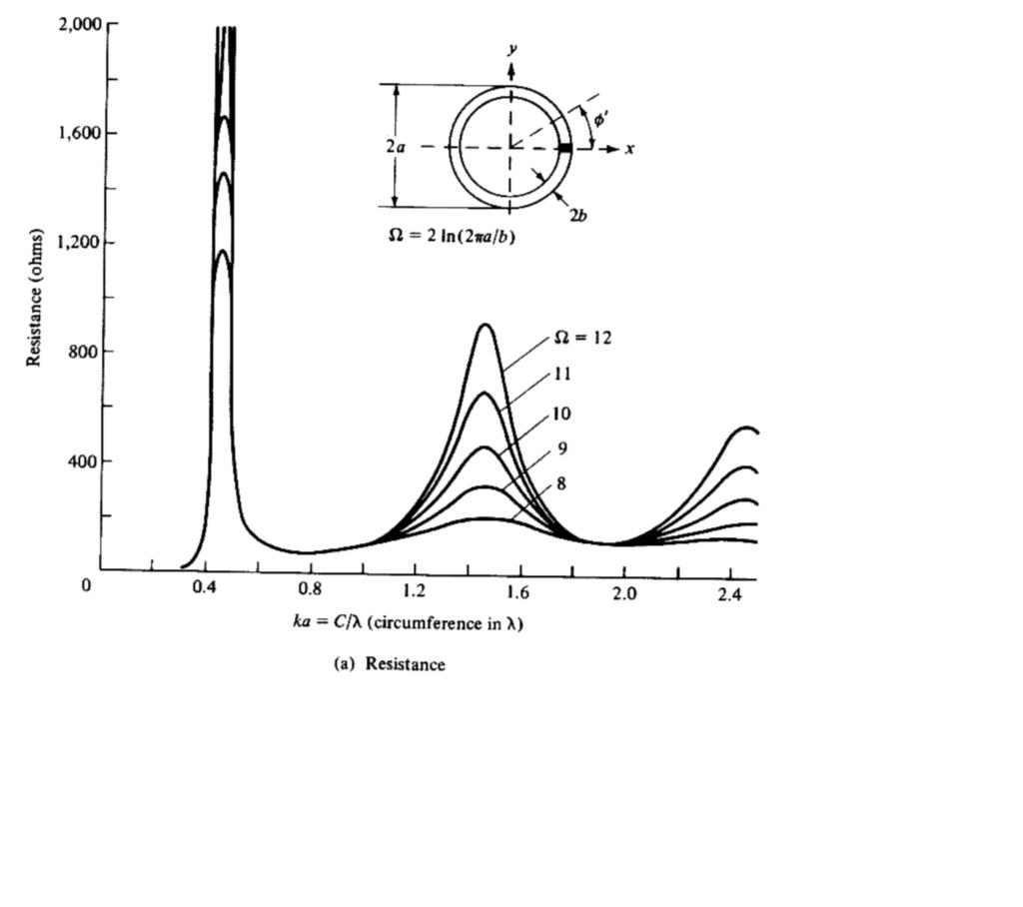
some important results will be given. When the circumference of the loop
approaches λ , the maximum of the radiation pattern shifts exactly along the
loop’s normal. Then, the input resistance of the antenna is also good (about 50
to 70 Ω). The maximum directivity occurs when C ≈1.4λ but then the input
impedance is too large. The input resistance and reactance of the large circular
loop are given below.
10

Slide 54
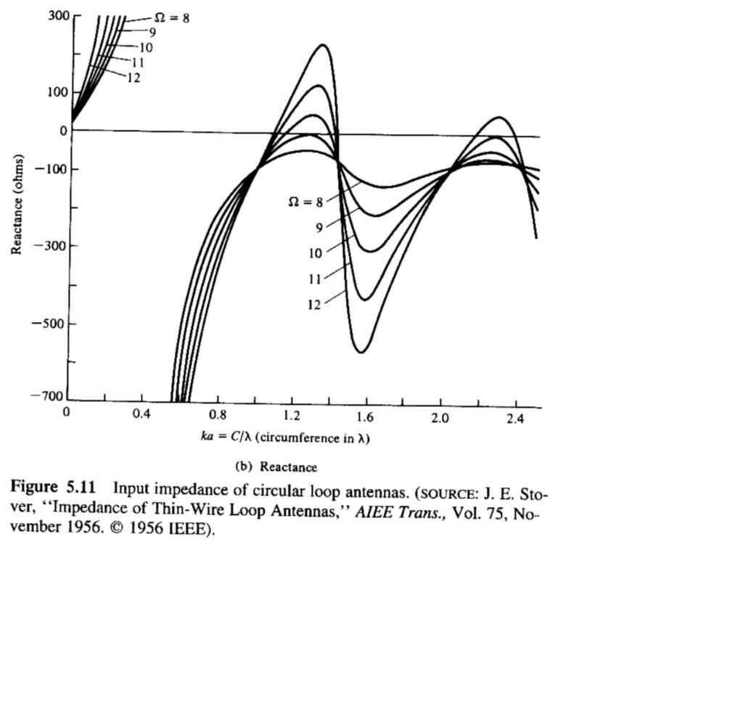
(Note: typo in author’s name, read as J. E. Storer)
11

Slide 55

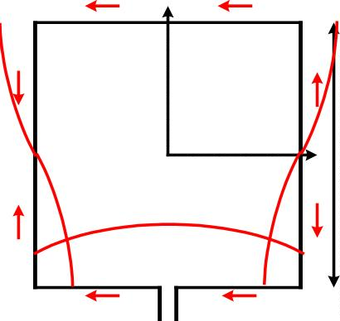
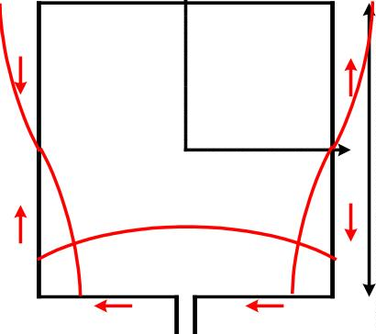
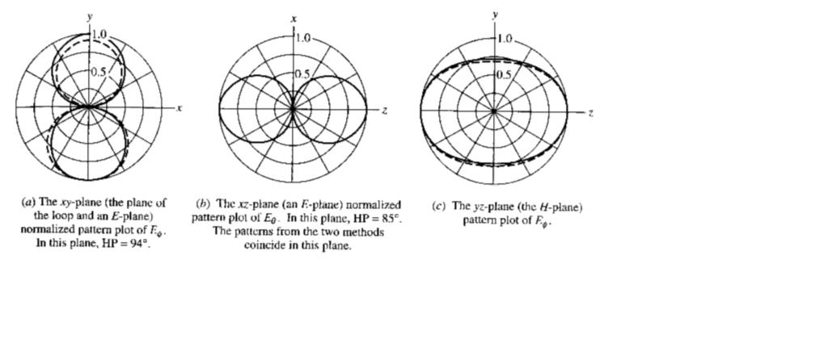
The large circular loop is very similar in its performance to the large square
loop. An approximate solution of very good accuracy for the square-loop
antenna can be found in
W.L. Stutzman and G.A. Thiele, Antenna Theory and Design, 2nd Ed., John
Wiley & Sons, New York, 1998.
There, it is assumed that the total antenna loop is exactly one wavelength and
has a cosine current distribution along the loop’s wire.
y
λ
x
4
The principal plane patterns obtained through the cosine-current assumption
(solid line) and using numerical methods (dash line) are shown below:
12

Slide 56
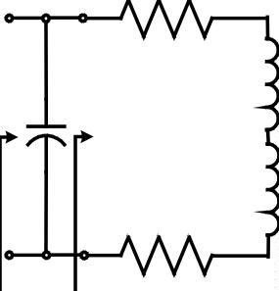

5. Equivalent Circuit of a Loop Antenna
R_{r}
C_{r}
^{L}A
L_{i}
′
R_{l}
Z
Z_{in}
in
C_{r}
R_{l}
- resonance capacitor
- loss resistance of the loop antenna
- radiation resistance
R_{r}
L_{A}
L_{i}
- inductance of the loop
- inductance of the loop conductor (wire)
(a) Loss resistance
Usually, it is assumed that the loss resistance of loosely wound loop equals
the high-frequency loss resistance of a straight wire of the same length as the
loop and of the same current distribution. In the case of a uniform current
distribution, the high-frequency resistance is calculated as
l
π f µ
R = R , R =
, Ω
(12.32)
hf
p
s
s
s
where l is the length of the wire, and p is the perimeter of the wire’s cross-
section. We are not concerned with the current distribution now because it can
be always taken into account in the same way as it is done for the
dipole/monopole antennas. However, another important phenomenon has to be
taken into account, namely the proximity effect.
13

Slide 57
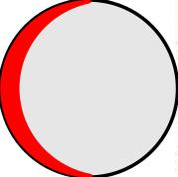
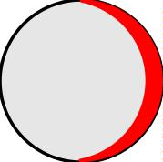

⊗J
J₂ ⊗
1
When the spacing between the wound wires is very small, the loss resistance
due to the proximity effect might be larger than that due to the skin effect. The
following formula is used to calculate exactly the loss resistance of a loop with
N turns, wire radius b, and loop separation 2c:
R_{l} =
Na  R_{p}
R 

b
s
+1
(12.33)
 R

0
where
R_{s} , Ω, is the surface resistance (see (12.32)),
R_{p} , Ω / m, is the ohmic resistance per unit length due to the proximity
effect,
^{NR}s
2πb
effect.
R₀
=
,
Ω
/ m, is the ohmic resistance per unit length due to the skin
2a
2c
2b
14

Slide 58

The ratio R / R has been calculated for different relative spacings c / b, for
p
0
loops with 2 ≤ N ≤ 8 in:
G.N. Smith, “The proximity effect in systems of parallel conductors,” J.
Appl. Phys., vol. 43, No. 5, May 1972, pp. 2196-2203.
The results are shown below:
(b) Loop inductance
The inductance of a single circular loop of radius a made of wire of radius b
is
  8a 


L = µaln  − 2.
(12.34)
15
A
1
b

 

Slide 59
The inductance of a square loop with sides a and wire radius b is calculated as
a   a 
^{sq} = µ

L
2
ln
  −
0.774 .
(12.35)
A
π   
1
b

The inductance of a multi-turn coil is obtained from the inductance of a single-
turn loop multiplied by N² , where N is the number of turns.
The inductance of the wire itself is very small and is often neglected. It can
be shown that the DC self-inductance of a straight wire of length l is
µ
8π
L_{i}
=
⁰ ⋅ .
(12.36)
l
For a single loop, l = 2πa.
(c) Tuning capacitor
The susceptance of the capacitor B_{r} must be chosen to eliminate the
susceptance of the loop. Assume that the equivalent admittance of the loop is
Y =
in
1
=
1
(12.37)
^{Z}in
R_{in} + jX_{in}
where
R = R + R ,
in
r
l
X = jω(L + L ).
in
A
i
The following transformation holds:
Y = G + jB
(12.38)
(12.39)
in
in
in
where
G_{in}
B_{in}
=
=
^{R}in
R_{i}²_{n} + X ²
^{−X}in
R_{i}²_{n} + X ²
,
in
.
in
The susceptance of the capacitor is
B = ωC .
r
r
(12.40)
16

Slide 60
For resonance to occur at f = ω / (2π ) when the capacitor is in parallel with
the loop, the condition
0
0
B_{r} = −B_{in}
(12.41)
must be fulfilled. Therefore,
π
=
^{X}in
2 f C
,
(12.42)
(12.43)
0
r
R_{i}²_{n} + X ²
in
^{X}in
⇒
C_{r}
=
1
.
(
)
2π f R² + X ²
in
in
′
Under resonance, the input impedance Z becomes
in
^{R}i²n ^{+ X 2}
in
Z
′ = ′ =
1
=
1
=
,
(12.44)
(12.45)
in
R
in
′
G
G_{in}
R_{in}
in
⇒ ′ =
X ²
R
Z
R_{in}
+
in Ω.
in
,
in
5. The Small Loop as a Receiving Antenna
The small loop antennas have the following features:
1) high radiation resistance provided multi-turn ferrite-core constructions
are used;
2) high losses, therefore, low radiation efficiency;
3) simple construction, small size and weight.
Small loops are usually not used as transmitting antennas due to their low
efficiency e_{cd} . However, they are much preferred as receiving antennas in AM
radio-receivers because of their high signal-to-noise ratio (they can be easily
tuned to form a very high-Q resonant circuit), their small size and low cost.
Loops are constructed as magnetic field probes to measure magnetic flux
densities. At higher frequencies (UHF and microwave), loops are used to
measure the EM field intensity. In this case, ferrite rods are not used.
Since the loop is a typical linearly polarized antenna, it has to be oriented
properly to optimize reception. The optimal case is a linearly polarized wave
with the H-field aligned with the loop’s axis.
17

Slide 61


ψ
H^{i}
a
θ_{i}
E^{i}
optimal
0
y
incidence
j_{i}
^{V}oc
The open-circuit voltage at the loop terminals is induced by the time-varying
magnetic flux through the loop:
V = jωΨ = jωB⋅s = jωµH ⋅πa² ,
(12.46)
(12.47)
oc
m
z
H = H^{i} cosψ sinθ .
z
i
Here,
Ψ_{m} is the magnetic flux, Wb;
(θ j )
are the angles specifying the direction of incidence;
,
i
i
ψ is the angle between the H^{i} vector and the plane of incidence.
Finally, the open-circuit voltage can be expressed as
V = jωµSH^{i} cosψ sinθ = jβ SE^{i} cosψ sinθ .
(12.48)
oc
i
i
Here, S = πa² denotes the area of the loop, and β = ω µε is the phase
constant. V is maximum for θ = 90□ and ψ = 0□ .
oc
i
18

Slide 62

6. Ferrite Loops
The radiation resistance and radiation efficiency can be raised by inserting a
ferrite core, which has high magnetic permeability in the operating frequency
band. Large magnetic permeability µ = µ µ means large magnetic flux Ψ ,
0
r
m
and therefore large induced voltage V_{oc} . The radiation resistance of a small loop
was already derived in (12.10) to include the number of turns, and it was shown
that it increases as  N² . Now the magnetic properties of the loop will be
included in the expression for R_{r} .
The magnetic properties of a ferrite core depend not only on the relative
magnetic permeability µ_{r} of the material it is made of but also on its geometry.
The increase in the magnetic flux is then more realistically represented by the
effective relative permeability (effective magnetic constant) µ . We show
r
eff
next that the radiation resistance of a ferrite-core loop is (µ )² times larger
r
eff
than the radiation resistance of the air-core loop of the same geometry. When
we calculated the far fields of a small loop, we used the equivalence between an
electric current loop and a magnetic current element:
jωµ(IA) = I_{m}l .
(12.49)
From (12.49) it is obvious that the equivalent magnetic current is proportional
to µ . The field magnitudes are proportional to I , and therefore they are
m
proportional to µ as well. This means that the radiated power Π
rad
is
proportional to µ² , and therefore the radiation resistance increases as  (µ )² .
Finally, we can express the radiation resistance as
r
eff
8


A
^{eff} λ²
²

R =η π ³  Nµ
 .
(12.50)
r
0
3
r
Here, A = πa² is the loop area, and η = µ / ε is the intrinsic impedance of
vacuum.
0
0
0
Some notes are made below with regard to the properties of ferrite cores:
• The effective magnetic constant of a ferrite core is always less than the
magnetic constant of the ferromagnetic material it is made of, i.e.,
µ < µ . Toroidal cores have the highest µ , and ferrite-stick cores
r
r
r
eff
eff
have the lowest µ .
r
eff
19

Slide 63
• The effective magnetic constant is frequency dependent. One has to be
careful when picking the right core for the application at hand.
• The magnetic losses of ferromagnetic materials increase with frequency.
At very high (microwave) frequencies, the magnetic losses are very high.
They have to be calculated and represented in the equivalent circuit of the
antenna as a shunt conductance G_{m} .
20

Slide 64



Helical Antenna
Helical Antenna consists of a conducting wire wound in the form of a screw thread forming a
helix as shown in figure 6.1. In the most cases the helix is used with a ground plane. The helix is
usually connected to the center conductor of a co-axial transmission line and the outer conductor of the
line is attached to the ground plane
.
Fig 6.1: Helical Antenna
The helix parameters are related by
(πD)² =L² − S
2
Let
S = Spacing between each turns
N= No. of Turns
D= Diameter of the helix
L’=A=Ns=Total length of the antenna
L= Length of the wire between each turn = (πD)² + s²
L_{n}= LN = Total length of the wire
C =πD= Circumference of the helix
α = Pitch angle formed by a line tangent to the helix wire and a plane perpendicular to the helix
axis.

Slide 65

−1
s
−1
s
α = tan
= tan
πD
c
- (6.1)
The radiation characteristics of the antenna can be varied by controlling the size of its
geometrical properties compared to the wavelength.
Mode of Operation
o Normal Mode
o Axial Mode
Normal Mode:-
If the circumference, pitch and length of the helix are small compared to the wavelength, so that
the current is approximately uniform in magnitude and phase in all parts of the helix, the normal mode
of radiation is excited.
In normal mode as shown in fig 6.2 the radiation is maximum in the plane normal to the helix
axis. The radiation may be elliptically or circularly polarized depending upon helix dimensions.
Disadvantages:
o Narrow Bandwidth
o Poor Efficiency
The radiation pattern in this mode is a combination of the equivalent radiation form a short
dipole positioned along the axis of the helix and a small co-axial loop.

Slide 66


The radiation pattern of these two equivalent radiators is the same with the polarization at right
angles and the phase angle at a given point in space is at 90⁰ apart. Therefore the radiation is either
elliptically polarized or circularly polarized depending upon the field strength ratio of the two
components. This depends on the pitch angleα
When ‘α ’ is very small, the loop type of radiation predominates, when it becomes very large, the helix
becomes essentially a short dipole. In these two limiting cases the polarization is linear. For intermediate
value of the polarization is elliptical and at a particular value of ‘α ’ the polarization is circular
Analysis of normal mode
Field due to short dipole is given by
j60πIssinθ
E_{θ} (θ )=
λr
---------------------------------------------- (6.2)
Field of a small loop
E_{φ} (θ )=
j60π IAsinθ
2
2_{r}
λ
--------------------------------------------- (6.3)
Magnitude of E (θ )and E (θ ) ratio defines axial ratio
θ
φ
Eθ
sλ
s
=
Eφ 2πA βA
Axial ratio =
=
-------------------------------------------- (6.4)
The field is circularly polarized if S = βA
∴s =
2π πD² (πD)²
λ
4
=
2λ


2


2s
πD
2
From figure 6.1 L -s = ( D)


2
π
2
λ
=
λ
 ²  ²

2

L
s
πD
2s
   

 =
∴
−
=
 λ   λ   λ 
λ
 ²
 ²


2
L
2s
s


s
1+   =1+ +   = 1+ 
   
λ
λ
λ
λ

Slide 67




2
s
 
L
1+ = 1+  
λ
 
λ
 
2
s
 
L
  = −1+ 1+  
---------------------------------------------------- (6.5)
 
λ
 
λ
This is the condition for circular polarization
The pitch angle is given by
tanα =
s
but s =
(πD)²
πD
2λ
tanα =
(πD)² πD
=
2λπD 2λ
------------------------------------------------------- (6.6)
Axial Mode:-
If the dimensions of the helix are such that the circumference of one turn is approximately λ, the
antenna radiates in the axial mode, which is as shown in fig 6.3.
Advantages:
Large Bandwidth and Good Efficiency
The Radiation is circularly polarized and has a max value in the direction of helix axis. The
directivity increase linearly with the length of the helix. It also referred as “helix beam antenna”.
It acts like end fire array. The far field pattern of the helix can be developed by assuming that
the helix consists of an array of N identical turns with an uniform spacing ‘s’ between them.
52
λ
3
The 3db bandwidth is given by f_{3db}
=
C
NS
deg
----------------- (6.7)

Slide 68
2
15N S C
Directivity is given by D_{max}
=
λ³
---------------------------- (6.8)
N= Number of turns
C= Circumference
S=Spacing between turns
λ=Wavelength
Applications:-
Used in space telemetry application at the ground end of the telemetry link for satellite and space probes
at HF and VHF.
Low Frequency, Medium Frequency and High Frequency Antennas:
The choice of an antenna for a particular frequency depends on following factors.
• Radiation Efficiency to ensure proper utilization of power.
• Antenna gain and Radiation Pattern
• Knowledge of antenna impendence for efficient matching of the feeder.
• Frequency characteristics and Bandwidth
• Structural consideration
Yagi uda array:
Yagi-Uda or Yagi is named after the inventors Prof. S.Uda and Prof. H.Yagi around 1928.
The basic element used in a Yagi is λ/2 dipole placed horizontally known as driven element or
active element. In order to convert bidirectional dipole into unidirectional system, the passive elements
are used which include reflector and director. The passive or parasitic elements are placed parallel to
driven element, collinearly placed close together as shown in fig 6.4.
The Parasitic element placed in front of driven element is called director whose length is 5% less
than the drive element. The element placed at the back of driven element is called reflector whose
length is 5% more than that of driver element. The space between the element ranges between 0.1λ to
0.3λ.

Slide 69

Fig 6.4: Seven segment yagi-uda antenna
For a three element system,
Reflector length = 500/f (MHz) feet
Driven element length = 475/f (MHz) feet
Director length = 455/f (MHz) feet.
The above relations are given for elements with length to diameter ratio between 200 to 400 and
spacing between 0.1 λ to 0.2 λ.
With parasitic elements the impedance reduces less than 73 Ω and may be even less than 25 Ω.
A folded λ/2 dipole is used to increase the impedance.
System may be constructed with more than one director. Addition of each director increases the
gain by nearly 3 dB. Number of elements in a yagi is limited to 11.
Basic Operation:
The phases of the current in the parasitic element depends upon the length and the distance
between the elements. Parasitic antenna in the vicinity of radiating antenna is used either to reflect or to
direct the radiated energy so that a compact directional system is obtained.
A parasitic element of length greater than λ/2 is inductive which lags and of length less than λ/2
is capacitive which leads the current due to induced voltage. Properly spaced elements of length less
than λ/2 act as director and add the fields of driven element. Each director will excite the next. The
reflector adds the fields of driven element in the direction from reflector towards the driven element.
The greater the distance between driven and director elements, the greater the capacitive
reactance needed to provide correct phasing of parasitic elements. Hence the length of element is
tapered-off to achieve reactance.

Slide 70
A Yagi system has the following characteristics.
1. The three element array (reflector, active and director) is generally referred as “beam antenna”
2. It has unidirectional beam of moderate directivity with light weight, low cost and simplicity in
design.
3. The band width increases between 2% when the space between elements ranges between 0.1λ to
0.15 λ.
4. It provides a gain of 8 dB and a front-to-back ratio of 20dB.
5. Yagi is also known as super-directive or super gain antenna since the system results a high gain.
6. If greater directivity is to be obtained, more directors are used. Array up to 40 elements can be
used.
7. Arrays can be stacked to increase the directivity.
8. Yagi is essentially a fixed frequency device. Frequency sensitivity and bandwidth of about 3% is
achievable.
9. To increase the directivity Yagi’s can be staked one above the other or one by side of the other.

Slide 71

HORN ANTENNAS
Flared waveguides that produce a nearly uniform phase front larger than the waveguide itself.
Constructed in a variety of shapes such as sectoral E-plane, sectoral H-plane, pyramidal, conical,
etc. as shown in figure 4.4.
Figure:4.4: Different types of Horn antenna
Horn Antennas -Application Areas
ꢀ
ꢀ
ꢀ
ꢀ
Used as a feed element for large radio astronomy, satellite tracking and communication dishes
A common element of phased arrays
Used in the calibration, other high-gain antennas
Used for making electromagnetic interference measurements
Rectangular Horn antenna:
A rectangular horn antenna is as shown in figure 4.6. This is an extension of rectangular wave guide.
TE₁₀ mode is preferred for rectangular horns.

Slide 72

Fig 4.6: Rectangular Horn antenna
Consider a rectangular horn as in figure 4.6(b). from figure
_{cos}θ
=
L
2
L +δ
a
θ
=
sin
tan
2(L +δ )
2
θ
2
=
a
Where
2L
L= length of the horn
side length=L+δ
A=Aperture
θ=Flare angle
From the geometry, we have also that
2
a
(δ << L)
L=
8δ
and
θ = 2 tan−¹
a
= 2 cos⁻¹
L
2L
L +δ
Optimum horn dimensions
δ₀ =
L
− L = optimum δ
cos(θ / 2)

Slide 73


L=
^{δ}0 ^{cos(θ / 2)}
= optimum length
1−cos(θ / 2)
Table:
Problem:
a) Determine the length L, H-Plane aperture and flare angles θ and θ ( in the E and H planes,
E
H
respectively) of a pyramidal horn for which the
E-plane aperture aE = 10λ. The horn is fed by
a rectangular waveguide with TE10 mode. Let δ = 0.2λ in the E plane and 0.375λ in the H plane.
b) What are the beam widths?
c) What is the directivity?
Solution:
Taking δ = λ/5 in the E plane, the required horn length
2
100λ
a
L=
8δ
=
8
5
= 62.5λ
and the flare angle in the E plane
−1
a
−1
10
_{9.1}0
θ_{E} =2 tan
=
=
2L
2 tan
125
Taking δ = 3λ/8 in the H plane, the flare angle in the H plane

Slide 74
−1
L
=2 cos−1
62.5
_{12.52}0
θ_{H} = 2 cos
L +δ
62.5 + 0.375
=
=
and the H-plane aperture
−1
θ
0
a =2 L tan
H
H
= 2×62.5λ tan 6.26
13.7λ
2
HPBW (EPlane) =
56⁰
=
56⁰
10
=
_{5.6}0
a_{Eλ}
0
0
HPBW (HPlane) =
67
=
67
=
_{4.9}0
a_{Hλ}
13.7
D ≅ 10 log
 7.5 A 
p

 λ²
=10 log(7.5×10×13.5)=30.1dBi

Problems:
The radius of a circular loop Antenna is 0.02λ. How many turns of the antenna will give a radiation
resistance of 35 Ω.
A =π (0.02λ)²
2
A <
λ
or
A
<0.01
2
A
100
λ
2
=π (0.02)² =0.001256<0.01
λ


2


=31200
An
 =
35
'
R
r
_{λ}2
Problem:
hence n =27
The impedance of an infinitesimally thin λ/2 antenna is 73+j42.5 Ω Find the terminal
impedance of
infinitesimally thin λ/2 slot antenna.
(L =0.5λ and L/ D= ∞)
(L =0.5λ and L/ w= ∞)
35,476
Z₁ =
73+ j 42.5
=363− j211Ω

Slide 75
Problem:
The impedance of an thin cylindrical antenna is resistive and equal to 67 Ω. Find the terminal impedance
of complementary slot antenna
(L =0.475λ and L/ D=100)
(w =2D=2L /100= 0.01λ)
35.476
Z₁ =
67
= 530+ j0Ω

Slide 76

G.PULLAIAH COLLEGE OF ENGINEERING AND
TECHNOLOGY, KURNOOL
DEPARTMENT OF ECE
COURSE: ANTENNAS & WAVE PROPAGATION
UNIT-III

Slide 77

UNIT-3
MICROSTRIP ANTENNAS
REFLECTOR ANTENNAS
LENS ANTENNAS
Microstrip antenna:
Fig 3.12: Single Microstrip antenna
It is also called “patch antennas” as shown in figure3.12
ꢀ One of the most useful antennas at microwave frequencies
(f > 1 GHz).
ꢀ It consists of a metal “patch” on top of a grounded dielectric substrate.
The patch may be in a variety of shapes, but rectangular and circular are the
most common

Slide 78

Advantages of Microstrip Antennas:
The advantages of microstrip antenna are
ꢁ Easy to fabricate (use etching and photolithography).
ꢁ Easy to feed (coaxial cable, Microstrip line, etc.) .
ꢁ Easy to use in an array or incorporate with other Microstrip circuit
elements.
ꢁ Patterns are somewhat hemispherical, with a moderate directivity
(about 6-8 dB is typical).
ꢁ Light weight, smaller size and lesser volume
Disadvantages of Microstrip Antennas:
ꢁ Low bandwidth
ꢁ Low efficiency
ꢁ Low gain

Slide 79


REFLECTOR ANTENNAS IS A COMBINATION OF A REFLECTOR AND AN
ANTENNA. REFLECTOR ANTENNAS ARE USED TO MODIFY THE
RADIATION PATTERN OF AN ANTENNA.
TYPES OF REFLECTOR ANTENNAS:
Depending on the shape of reflector, the following are the types:
Flat Sheet Reflectors
Corner Reflectors
Parabolic Reflectors
Circular Reflectors
Elliptical Reflectors
Semi Circula`r Reflectors
Corner reflector
Fig 6.5: Square Corner reflector with images used in the analysis
Two flat reflecting sheets intersecting at an angle or corner as in figure 6.5 form an effective
directional antenna. When the corner angle α=90⁰, the sheets intersect at right angles, forming a square-
corner reflector. Corner angles both greater or less than 90⁰ can be used although there are practical
disadvantages to angles much less than 90. A corner reflector with α=180⁰ is equivalent to a flat sheet
reflector and may be considered as limiting case of the corner reflector.
Assuming perfectly conducting reflecting sheets infinite extent, the method of images can be
applied to analyze the corner reflector antenna for angle α = 180°/n, where n is any positive integer. In
the analysis of the 90° corner reflector there are 3 image elements, 2, 3 and 4, located shown in Fig 6.5.
The driven antenna 1the 3 images have currents of equal magnitude. The phase of the currents in I and 4
is same. The phase of the currents in 2 and 3 is the same but 180° out of phase with respect the currents
in 1and 4. All elements are assumed to be λ/2 long.

Slide 80



At the point P at a large distance D from the antenna. The field intensity is
E(φ) = 2kI [cos(S cosφ)− cos(S sinφ)]
1
r
r
----------------------------------------------------- (6.9)
Where
I₁= current in each element
S_{r} = spacing of each element from the corner, rad
=2πS/λ
K=constant involving the distance D,
For arbitrary corner angles, analysis involves integrations of cylindrical functions. The emf Vt at
the terminals at the center of the driven element is
V =I Z +I R +I Z - 2I Z
12
1
1
11
1
1L
1
14
1
Where
Z₁₁= Self-Impedance of driven element
R_{1L}=Equivalent loss resistance of driven element
Z₁₂=Mutual impedance of element 1 and 2
Z₁₄=Mutual impedance of element 1 and 4
If ‘P’ is the power delivered to the driven element, then from symmetry
I₁ =
P
R + R + R − 2R
11
1L
14
12
--------------------------------------------- (6.10)
E(φ)= 2k
P
[cos(S cosφ)− cos(S sinφ)]
R + R + R − 2R
11
r
r
1L
14
12
------------- (6.11)
The Field Intensity at ‘P’ with reflector removed
E_{HW} (φ)= 2k
P
^{R}11 ^{+ R}1L
----------------------------------------------------------- (6.12)
The Gain in the field intensity of a square corner reflector antenna over a single λ/2 antenna
^{G}f ^{(φ)=}
E(φ)
^{E}HW
(φ)

Slide 81



G_{f} (φ)= 2
^{R}11 ^{+ R}1L
[cos(S cosφ)− cos(S sinφ)]
R + R + R − 2R
11
r
r
1L
14
12
-------------------(6.13)
Where the expression in brackets is the pattern factor and the expression included under the
radical sign is the coupling factor. The pattern shape is a function of both the angle &, and the antenna-
to-corner spacing S. For the 60° corner the analysis requires a total of 6 elements, 1 actual antenna and 5
images as in Fig.6.6
Fig 6.6 : A 60 deg corner reflector with images used in analysis
Parabolic reflectors
Suppose that we have a point source and that we wish to produce a plane-wave front over a large
aperture by means of a sheet reflector. Referring to Fig. 6.7(a), it is then required that the distance from
the source to the plane-wave front via path 1 and 2 be equal or
The parabola-general properties
2L = R(1+ cosθ)
--------------------------------------------------------------- (6.14)
R =
2L
1+ cosθ
------------------------------------------------------------------------ (6.15)

Slide 82

Referring to Fig. 6.7(b), the parabolic curve may be defined as follows. The distance from any
point P on a parabolic curve to a fixed point F, called the focus, is equal to the perpendicular distance to
a fixed line called the directrix. Thus, in Fig.6.7(b), PF = PQ. Referring now to Fig.6.7(c), let AA’ be a
line normal to the axis at an arbitrary distance QS from the directrix. Since PS = QS — PQ and PF =
PQ, it follows that the distance from the focus to S is
PF+PS=PF+QS-PQ=QS
Thus, a property of a parabolic reflector is that waves from an isotropic source at the focus that
are reflected from the parabola arrive at a line AA’ with equal phase. The “image” of the focus is the
directrix and the reflected field along the Jine A A’ appears as though it originated at the directrix as a
plane wave. The plane BB’ (Fig. 6.7c) at which a reflector is cut off is called the aperture plane.
A cylindrical parabola converts a cylindrical wave radiated by an in-phase line source at the focus, as in
Fig. 6.7a, into a plane wave at the aperture, or a paraboloid-of-revolution converts a spherical wave from
an isotropic source at the focus, as in Fig. 6.7b, into a uniform plane wave at the aperture. Confining our
attention to a single ray or wave path, the paraboloid has the property of directing or collimating
radiation from the focus into a beam parallel to the axis.
The presence of the primary antenna in the path of the reflected wave, as in the above examples,
has two principle disadvantages. These are, first, that waves reflected from the parabola back to the
primary antenna produce interaction and mismatching. Second, the primary antenna acts as an
obstruction, blocking out the central portion of the aperture and increasing the minor lobes. To avoid
both effects, a portion of the paraboloid can be used and the primary antenna displaced as in Fig. 6.8.
This is called an offset feed.
Fig 6.8 : Parabolic reflector with Offset feed

Slide 83

Fig 6.9 : Cross Sections of cylinderical parabola (a) and of paraboloid of revolution (b)
Let us next develop an expression for the field distribution across the aperture of a parabolic reflector.
Since the development is simpler for a cylindrical parabola, this case is treated first, as an introduction to
the case for a paraboloid. Consider a cylindrical parabolic reflector with line source as in Fig. 6.9a. The
line source is isotropic in a plane perpendicular to its axis (plane of page). For a unit distance in the z
direction (normal to page in Fig. 6.9a) the power P in a strip of width dy is
P = dyS
y
------------------------------------------------------------------------ (6.16)
Where S_{y}= the power density ay y, W m-2
P = U ′dθ
------------------------------------------------------------------------ (6.17)
U’=the power per unit angle per unit length in the direction
S_{y} dy = U ′dθ
S
1
y
=
U′ (d / dθ )(Rsinθ)
R =
2L
1+ cosθ
S_{y} =
1+ cosθ
U ′
2L

Slide 84

The ratio of the power density
S_{θ} 1+ cosθ
S₀
=
2
------------------------------------------------------------------------ (6.18)
The field intensity ratio in the aperture plane is equal to the square root of the power ratio
E_{θ}
E₀
=
1+ cosθ
2
------------------------------------------------------------------------ (6.19)
------------------------------------------------------------------------ (6.20)
------------------------------------------------------------------------ (6.21)
P = 2πρdρSρ
P = 2π sinθdθU
Equating Equations 6.20 and 6.21
ρdρSρ = sinθdθU
S
sinθ
ρ
=
ρ(dρ dθ)
U
------------------------------------------------------------------------ (6.22)
S_{ρ} =
(1+ cosθ )²
U
4L²
^{S}θ
=
(1+ cosθ )²
S₀
4
------------------------------------------------------------------------ (6.23)
------------------------------------------------------------------------ (6.24)
E_{θ} 1+ cosθ
E₀
=
2
The Log periodic antenna
This is a frequency independent antenna for which the impedance and radiation pattern (and hence the directivity)
remains constant as a function of frequency. But in this antenna, the electrical properties like impedance are a
logarithmically periodic function of the frequency. i.e. if a graph of ‘z’ is plotted v/s log f a repetitive variation
will be obtained.
One of the design for a log periodic antenna is as shown in fig. 6.10

Slide 85

Lens antenna
Like parabolic reflectors, lens is used to convert circular or spherical wave fronts into planar wave fronts, versa
as a receiver. Lens is a medium through which the waves are transmitted or e decelerating medium and
accelerating medium. In decelerating system, the velocity with in the medium is less than that of free space
velocity. Pure dielectrics like Lucite or polysterene,

Slide 86




impure dielectrics or H-plane metal plates can be used as decelerating mediums. Accelerating system is the one
in which the velocity within the medium is more than that of free space velocity. E-plane metal plates are the
examples for accelerating types. Lens Antenna with different refractive index are as shown in fig.6.12 and
6.13.
Fig 6.12 : Lens Antenna
Fig 6.13 : Lens Antenna with different refractive index
Dielectric Lens Antenna
The dielectric material used should have a refractive index more than 1 w.r.t. free space having minimum
dielectric losses. Lucite and polystyrene can be used having a refractive index a=1.5. The system is constructed

Slide 87

in the form of plane-convex lens. The source or primary antenna is placed at the focus point ‘O’ having focal
length L.
Fig 6.14 : Dielectric Lens Antenna
Planar wave fronts can be obtained at the aperture when the electrical path OQ’ and OP remains same
OP OQ QQ'
λ₀
=
λ₀
+
λ_{d}
------------------------------------------------------------------------ (6.27)
R
=
L
+
Rcosθ − L ----------------------------------------------------------------------(6.28)
λ₀ λ₀
λ_{d}
Multiplying by λ₀,
^{λ}0
R= L+ (Rcosθ − L)
λ_{d}
Refractive Index
a=
^{v}0
=
^{λ}0
(>1)
v_{d} λ_{d}
Hence,
R=L+a(Rcosθ − L)
R=
L(1−a)
or
R=
L(a−1)
1−acosθ
acosθ −1
------------------------------------------------------------ (6.29)
The above equation is also known as an equation for a hyperbola with a greater than one. The lens is
plano-convex with the convex curvature as hyperbolic.

Slide 88


Fig 6.15 : Lens Analysis
Consider the dielectric lens with a primary source at the focus point O as shown in fig.6.15. Let P is the
power density and U is radiation intensity at a distance y from the axis. Assuming P and U remain constant
within the elemental aperture subtended by dθ or dy, the power radiated through elemental aperture is
dW =2πy.dy.P
---------------------------- (6.30)
∫∫
Where W = U.dΩ
2πθ + dθ
W =
∫ ∫U sinθ dθ dφ
0
θ
θ + dθ
∫
W =U 2π sinθ dθ
θ
W = 2π U sinθ dθ
---------------------------- (6.31)
Equating Equations 6.29 and 6.30
2πy.dy.P =2π U sinθ dθ
------------------------ ( 6.32)
---------------- (6.33)
P sinθ dθ sinθ
sinθ
=
=
dy
=
d
U
y dy
y
y (y)
dθ
dθ

Slide 89

From the geometry,
y=R sinθ
y =
L(a−1)sinθ
acosθ −1
-------------------------------------- (6.34)
Substituting above equation in equation 6.33
P
=
sinθ

U
L(a−1) sinθ d L(a−1) sinθ





acosθ −1 dθ  acosθ −1 
P =U
(acosθ −1)³
L a− a−
( 1)² ( cosθ)
----------------------------------------------------------- (6.35)
2
The power density along the axis is obtained at θ= 0.
P₀ =
U
L²
The relative power density is
P
=
(acosθ −1)³
P
0
(a−1)² (a−cosθ)
----------------------------------------------------------- (6.36)
The relative electric field is
E
=
(acosθ −1)³
E₀
(a−1)² (a−cosθ)
----------------------------------------------------------- (6.37)

Slide 90



when
θ =0,
E
=1
E₀
θ =20,
E
E₀
E
=0.7
=0.14
θ =40,
E₀
Relative electric field:
Relative Electric field is as shown in fig.6.16
Fig 6.16 : Relative Electric Field
E-Plane Metal Plate Lens
The velocity in between E-Plane Metal Plate is more than the Free space velocity v₀
Fig 6.17 : E-Plane Metal Plate Lens

Slide 91
Advantages of Lens Antenna
ꢀ Can be used as Wide band Antenna since its shape is independent of frequency.
ꢀ Provides good collimation.
ꢀ Internal dissipation losses are low, with dielectric materials having low loss tangent.
ꢀ Easily accommodate large band width required by high data rate systems.
Quite in-expensive and have good fabrication tolerance
Disadvantages of Lens Antenna
ꢀ Bulky and Heavy
ꢀ Complicated Design
ꢀ Refraction at the boundaries of the lens

Slide 92
G.PULLAIAH COLLEGE OF ENGINEERING AND
TECHNOLOGY, KURNOOL
DEPARTMENT OF ECE
COURSE: ANTENNAS & WAVE PROPAGATION
UNIT-IV

Slide 93

Radiation pattern:
The radiation pattern of antenna is a representation (pictorial or
mathematical) of the distribution of the power out-flowing (radiated)
from the antenna (in the case of transmitting antenna), or inflowing
(received) to the antenna (in the case of receiving antenna) as a function
of direction angles from the antenna
Antenna radiation pattern (antenna pattern): It is defined for large
distances from the antenna, where the spatial (angular) distribution of the
radiated power does not depend on the distance from the radiation source
is independent on the power flow direction
It is clear in Figures a and b that in some very specific directions there
are zeros, or nulls, in the pattern indicating no radiation.
The protuberances between the nulls are referred to as lobes, and the
main, or major, lobe is in the direction of maximum radiation.
There are also side lobes and back lobes. These other lobes divert power
away from the main beam and are desired as small as possible.
Pattern lobe is a portion of the radiation pattern with a local maximum
Lobes are classified as: major, minor, side lobes, back lobes

Slide 94


Point sources and Arrays
Pattern lobes and beam widths
Normalized pattern:
Usually, the pattern describes the normalized field (power) values with
respect to the maximum value.
Note: The power pattern and the amplitude field pattern are the same
when computed and when plotted in dB.

Slide 95


Point sources and Arrays
Fig: 3-D pattern
Antenna radiation pattern is 3-dimensional. The 3-D plot of antenna
pattern assumes both angles θ and φ varying.
Fig:2-D pattern
Usually the antenna pattern is presented as a 2-D plot, with only one
of the direction angles, θ or φ varies.
It is an intersection of the 3-D one with a given plane .Usually it is a θ
= const plane or a φ = const plane that contains the pattern’s
maximum.

Slide 96


Point sources and Arrays
RADIATION INTENSITY
The radiation intensity is total power radiated per unit solid angle and
is denoted by U and it is expressed as U= P/4π.
First figure shows radiation intensity of a source and second figure is
relative radiation intensity of that source.
POINT SOURCE
A point source is a radiator that has dimensions of a point in space.

Slide 97



Point sources and Arrays
POWER PATTERN
The directional property of the antenna is often described in the form of a
power pattern. The power pattern is simply the effective area
normalized to be unity at the maximum.
Fig: Power pattern for isotropic source
Power pattern and relative power patterns of a source
Figure (a) shows power pattern of a source. Figure(b) shows relative
power pattern of a same source. Both Patterns have the same shape. The
relative power pattern is normalized to a maximum of unity

Slide 98

Point sources and Arrays
The radiated energy streams from the source in radial lines.
Time rate of Energy flow/unit area is called as Poynting vector (Power
Density)
It is expressed as ……….watts / square meters.
For a Point source Poynting vector has only radial component Sr
S component in Θ and φ directions are zero.
Magnitude of S = Sr
Source radiating uniformly in all directions – Isotropic Source.
It is independent of Θ and φ .
Graph of Sr at a constant radius as a function of angle is POWER
PATTERN
Field pattern
A pattern showing variation of the electric field intensity at a constant
radius r as a function of angle(θ , φ) is called “field pattern”
Fig: Relation of poynting vector s and 2 electric field components of a far
field
The power pattern and the field patterns are inter-related:
P(θ, φ) = (1/η)*|E(θ, φ )|2 = η*|H(θ, φ)|2
P = power
E = electrical field component vector
H = magnetic field component vector
η = 377 ohm (free-space impedance)

Slide 99
Point sources and Arrays
The power pattern is the measured (calculated) and plotted received
power: |P(θ, φ)| at a constant (large) distance from the antenna
The amplitude field pattern is the measured (calculated) and plotted
electric (magnetic) field intensity, |E(θ, φ)| or |H(θ, φ)| at a constant
(large) distance from the antenna s
Antenna Arrays
Antennas with a given radiation pattern may be arranged in a pattern
line, circle, plane, etc.) to yield a different radiation pattern.
Antenna array - a configuration of multiple antennas (elements)
arranged to achieve a given radiation pattern.
Simple antennas can be combined to achieve desired directional
effects.Individual antennas are called elements and the combination is
an array
Types of Arrays
1. Linear array - antenna elements arranged along a straight line.
2. Circular array - antenna elements arranged around a circular
ring.
3. Planar array - antenna elements arranged over some planar
surface (example - rectangular array).
4. Conformal array - antenna elements arranged to conform two
some non-planar surface (such as an aircraft skin).
Design Principles of Arrays
There are several array design variables which can be changed to
achieve the overall array pattern design.
Array Design Variables
1. General array shape (linear, circular,planar)
2. Element spacing.
3. Element excitation amplitude.
4. Element excitation phase.
5. Patterns of array elements.
Types of Arrays
• Broadside: maximum radiation at right angles to main axis of
antenna
• End-fire: maximum radiation along the main axis of antenna
• Phased: all elements connected to source
• Parasitic: some elements not connected to source
– They re-radiate power from other elements

Slide 100
Point sources and Arrays
Yagi-Uda Array
• Often called Yagi array
• Parasitic, end-fire, unidirectional
• One driven element: dipole or folded dipole
• One reflector behind driven element and slightly longer
• One or more directors in front of driven element and slightly
shorter
Log-Periodic Dipole Array
• Multiple driven elements (dipoles) of varying lengths
• Phased array
• Unidirectional end-fire
• Noted for wide bandwidth
• Often used for TV antennas
Monopole Array
• Vertical monopoles can be combined to achieve a variety of
horizontal patterns
• Patterns can be changed by adjusting amplitude and phase of signal
applied to each element
• Not necessary to move elements
– Useful for AM broadcasting
Collinear Array
• All elements along same axis
• Used to provide an omnidirectional horizontal pattern from a
vertical antenna
• Concentrates radiation in horizontal plane
Broadside Array
• Bidirectional Array
• Uses Dipoles fed in phase and separated by 1/2 wavelength
End-Fire Array
• Similar to broadside array except dipoles are fed 180 degrees out of
phase
• Radiation max. off the ends

Slide 101

Point sources and Arrays
Application of Arrays
An array of antennas may be used in a variety of ways to improve the
performance of a communications system. Perhaps most important is its
capability to cancel co channel interferences. An array works on the
premise that the desired signal and unwanted co channel interferences
arrive from different directions. The beam pattern of the array is adjusted
to suit the requirements by combining signals from different antennas
with appropriate weighting. An array of antennas mounted on vehicles,
ships, aircraft, satellites, and base stations is expected to play an
important role in fulfilling the increased demand of channel requirement
for these services
ARRAY OF POINT SOURCES
ARRAY is an assembly of antennas in an electrical and geometrical of
such a nature that the radiation from each element add up to give a
maximum field intensity in a particular direction& cancels in other
directions. An important characteristic of an array is the change of its
radiation pattern in response to different excitations of its antenna
elements.
CASE1:
2 isotropic point sources of same amplitude and phase
• Phase difference =βd/2*cosθ=2π/λ*d/2*cosθ
β = propagation constant

Slide 102


Point sources and Arrays
and d_{r}= βd=2π/λ*d = Path difference
E = E exp(j*Ψ/2)
2
0
E = E exp(-j*Ψ/2)
1
0
The total field strength at a large distance r in the direction θ is :
E =E + E = E [exp(j*Ψ/2 +exp(-j*Ψ/2)]
1
2
0
Therefore: E = 2E₀cosΨ/2 ............ (1)
Ψ= phase difference between E1 & E2
& Ψ/2= dr/2*cosθ
E₀ =amplitude of the field at a distance by single isotropic antenna
Substituting for Ψ in (1) & normalizing
E=2E₀ COS(2π/λ*d/2*cosθ)
E_{nor}=COS(dr/2*cosθ)
for d= λ/2
E=COS(π/2*cosθ)
At θ=π/2
At θ=0
E=1...
E=0...
Point of maxima= π/2(or) 3π/2
Point of minima= 0 (or) π
At θ=±π/3
E=1/√2 3db bandwidth point= ±π/3
CASE2:
2 isotropic point sources of same amplitude but opposite
phase
The total field strength at a large distance r in the direction θ is :
E =E + E =E [exp(j*Ψ/2 -exp(-j*Ψ/2)]
1
2
0

Slide 103

Point sources and Arrays
Therefore: E = 2jE₀SIN(Ψ/2) ...............(2)
Ψ= phase difference between E₁&E₂
Ψ /2=dr/2*cosθ
E₀ =amplitude of the field at a distance by single isotropic antenna
At k=0
E=1 Point of maxima= 0(or) π
E=0 Point of minima= π/2(or)-π/2
E=1/√2 3db bandwidth point= ±π/3
At k=0,θ=π/2
At θ=±π/3
END FIRE ARRAY PATTERN

Slide 104

Point sources and Arrays
Pattern multiplication:
The total far-field radiation pattern |E| of array (array pattern) consists of
the original radiation pattern of a single array element multiplying with
the magnitude of the array factor |AF|. This is a general property of
antenna arrays and is called the principle of pattern multiplication.
Uniformly excited equally spaced linear arrays
Linear arrays of N-isotropic point sources of equal amplitude and
spacing:
An array is said to be linear if the individual elements of the array are
spaced equally along a line and uniform if the same are fed with currents
of equal amplitude and having a uniform phase shift along the line
The total field E at distance point in the direction of is given by
℮ ^{j(n-1)ψ}
(1)
E=1+℮ +
^{jψ} ℮ ^{j2ψ} ℮ ^{j2ψ}
+
+...................................+
Where Ψ= total phase difference between adjacent source
Ψ =dr*cos +δ =2π/λ*d*cosφ +δ
δ = phase difference of adjacent source
multipliying equation (1) by ℮^{jφ}
jψ ℮ ^{jψ} ℮ ^{j2ψ} ℮^{j3ψ}
℮ ^{jnψ}
E ℮ =
(1)-(3)
+
+
+.................................+
(3)
jψ
℮ ^{jnψ}
E(1- ℮ ) = (1-
)
E=1-℮ ^{jnψ}/1-
℮ ^{jψ}
{sin(n /2)) /sin( /2) }
j(n-1)ψ/2
Ψ
If the phase is referred to the centre point of the array, then E reduces to
E = ℮
Ψ
E=(sin(nΨ/2)) /sin(Ψ/2)
when Ψ=0
E=lim (sin(nΨ/2)) /sin(Ψ/2)
ψ
0

Slide 105
Point sources and Arrays
E =n=Emax
Ψ=0 E=Emax= n ………. normalizing
Enorm =E/Emax =(1/n)(sin(nΨ/2)) /sin(Ψ/2)
CASE 1: LINEAR BROAD SIDE ARRAY
An array is said to be broadside if the phase angle is such that it makes
maximum radiation perpendicular to the line of array i.e. 90⁰&270⁰
For broad side array
Therefore Ψ =dr*cosϕ +δ=βdcosϕ+0=0
Ψ=0 & δ=0
ϕ= ±90⁰
therefore ϕ = 90 &270
max
0
0
Broadside array example for n=4 and d=λ/2
By previous results we have ϕmax = 90⁰&270⁰
Direction of pattern maxima:
E=(1/n)(sin(nΨ/2)) /sin(Ψ/2)
This is maximum when numerator is maximum i.e. sin(nΨ/2)=1
nΨ/2= ±(2k+1)π/2
where k=0,1,2.........
K=0
K=1
major lobe maxima
nΨ/2= ±3π/2 Ψ= ±3π/4
Therefore dr*cosϕ=2π/λ*d*Cosϕ= ±3π/4
cosϕ= ±3/4
ϕ =(ϕ_{max})_{minor lobe}= cos⁻¹ (± 3/4) = ±41.4⁰ or ±138.6⁰
At K=2
ϕ= cos⁻¹ (± 5/4) which is not possible
Direction of pattern minima or nulls
It occurs when numerator=0
i.e. sin(nΨ/2) =0
nΨ/2= ±kπ
where k=1,2,3..................................
now using condition δ=0
Ψ =±2kπ/n= ±kπ/2 dr*cosϕ= 2π/λ*d/2*cosϕ
Substituting for d and rearranging the above term
πcosϕ= ±kπ/2
cos ϕ= ±k/2
therefore ϕ_{min} =cos-1(±k/2)
ϕ_{min} =cos (±1/2)= ±60 or ±120
K=1
K=2
-1
0
0
ϕ_{min} =cos (±1) = 0 or ±180
-1
0
0

Slide 106

Point sources and Arrays
Beam width is the angle b/w first nulls
From the pattern we see that
Beamwidth between first pair of nulls =BWFN=60⁰
Half power beam width =BWFN/ 2=30⁰
CASE2: END FIRE ARRAY
An array is said to be end fire if the phase angle is such that it makes
maximum radiation in the line of array i.e. 0⁰&180⁰
For end fire array
Ψ=0 & ϕ =0⁰ &180⁰
Therefore Ψ =dr*cosϕ +δ
δ= -dr
The above result indicates that for an end fire array the phase
difference b/w sources is retarded progressively by the same amount
as spacing b/w the sources in radians.
If d= λ/2
δ= -dr = - 2π/λ x λ /2= -π
The above result indicates that source 2 lags behind source1 by π
radians.
End fire array example for n=4 and d=λ/2
Direction of maxima
Maxima occurs when sin(nΨ/2)=1
i.e.Ψ/2= ±(2k+1)π/2
where k=0,1,2.........
Ψ = ±(2k+1)π/n dr*cosϕ+δ= ±(2k+1)π/n
cosϕ= [±(2k+1)π/n –δ]/dr

Slide 107
Point sources and Arrays
Therefore ϕ_{max} =cos-1 {[±(2k+1)π/n –δ]/dr}
By definition For end fire array : δ= -dr = -2π/λ*d
Therefore ϕ_{max} =cos-1 {[±(2k+1)π/n –δ]/ (-2π/λ*d) }
For n=4, d=λ/2
equation & solving we get
Φ_{max}=cos-1 {[±(2k+1)/4 +1}
dr=π after substituting these values in above
Where k=0,1,2......
For major lobe maxima,
Ψ = 0=dr*cosϕ+ δ
=dr*cosϕ-dr
=dr(cosϕ-1)
cosϕ_{m}=1
there fore ϕ =0 or 180
0
0
m
Minor lobe maxima occurs when k=1,2,3......
K=1
(ϕmax)minor1=cos-1 {[±(3)/4 +1}
=cos-1 (7/4 or 1/4)
Since cos-1 (7/4 ) is not possible
Therefore (ϕmax)minor1=cos-1 (1/4)=75.5
K=2
=cos-1 (9/4 or -1/4)
(ϕmax)minor2=cos-1 {[±(5)/4 +1}
Since cos-1 (9/4 ) is not possible
Therefore
(ϕmax)minor1=cos-1 (-1/4)=104.4
Direction of nulls:
it occurs when numerator=0
i.e. sin(nΨ/2) =0
nΨ/2= ±kπ
where k=1,2,3..................................
Here Ψ =dr*cosϕ+ δ=dr(cosϕ-1)
dr=2π/λ*λ/2=π
Substituting for d and n
dr(cosϕ-1)= ±2kπ/n
therefore
cosϕ= ±k/2+1
ϕnull =cos-1(±k/2+1)
k=1 ,
ϕnull1 =cos-1(±1/2+1) = cos-1(3/2 or 1/2)
since cos-1(3/2) not exist ,
ϕnull1 = cos-1(1/2)= ±60
there fore
ϕnull1 = ±60
k= 2,

Slide 108

Point sources and Arrays
ϕnull2 =cos-1(±2/2+1)
= cos-1(2 or 0)
since cos-1(2) not exist ,
ϕnull2 = cos-1(0)= ±90
there fore ϕnull2 = ±900
k=3,
ϕnull3 =cos-1(±3/2+1) = cos-1(5/2 or-1/2)
since cos-1(5/2) not exist , ϕnull3 = cos-1(-1/2)= ±120 0
there fore, ϕnull3 = ±1200
ϕ_{null4} =cos (±4/2+1) = cos (3 or-1)
k=4 ,
-1
-1
since cos⁻¹(3) not exist ,
ϕ
null4
= cos⁻¹(-1)= ±180⁰
there fore ϕ_{null14}= ±180⁰
ϕ_{null5} =cos (±5/2+1) = cos (7/2 or-3/2)
-1
-1
k=5 ,
both values doesn't exists
BWFN=60+60=120⁰
END FIRE ARRAY WITH INCREASED DIRECTIVITY
HANSEN&WOODYARD CONDITION:
It states that a large directivity is obtained by increasing phase change
b/w sources so that,
δ=- (dr +π/n)
now,Ψ =dr*cosϕ+δ
=dr*cosϕ-(dr +π/n)
=dr(cosϕ-1)- π/n

Slide 109
Point sources and Arrays
End fire array with Increased directivity
Example with n= 4 &d= λ /2
dr= 2π/λ * λ /2
Ψ = π (cosϕ-1)- π/4
W.K.T major lobe occurs in the direction ϕ=0⁰ or 180⁰
at 0⁰
E=(1/n)(sin(n /2)) /sin( /2)
Ψ
Ψ
where Ψ = π (cosϕ-1)- π/4
= π (cos0-1)- π/4
=- π/4
therefore
E =(1/4) sin(- π/2)/sin(- π/8)=0.653
At 180⁰
E=(1/n)(sin(nΨ/2)) /sin(Ψ/2)
where Ψ = π (cosϕ-1)- π/4
= π (cos180-1)- π/4
=- 9π/4
therefore
E =(1/4) sin(- 9π/2)/sin(- 9π/8)
=-0.653
MAXIMA DIRECTIONS:
by definition sin(nΨ/2)=1
Where k =1,2,3..............
now, Ψ= ± (2k+1)π/n
there fore
nΨ/2= ±(2k+1)π/2
π(cosϕ-1)- π/4= ±(2k+1)π/4
cosϕ= ±(2k+1)/4+5/4
K=1
cosϕ= ±(3)/4+5/4=1/2
which implies ϕ=cos⁻¹(1/2)= ± 60⁰
there fore (ϕ )
0
max minor1
= ± 60
Now E=(1/n)(sin(nΨ/2)) /sin(Ψ/2)
where Ψ = π (cosϕ-1)- π/4
= π (cos60-1)- π/4
=- 3π/4
Now,
E =(1/4) sin(- 3π/2)/sin(- 3π/8)
=-0.27
therefore E = -0.27 at ± 60⁰
cosϕ= ±(5)/4+5/4=0 &10/4 which is not possible
K=2
which implies ϕ=cos-1(0)= ± 90⁰

Slide 110
Point sources and Arrays
there fore (ϕmax)minor2 = ± 90⁰
Now E=(1/n)(sin(nΨ/2)) /sin(Ψ/2)
where Ψ = π (cosϕ-1)- π/4
= π (cos90-1)- π/4
=- 5π/4
Now, E =(1/4) sin(-5π/2)/sin(-5π/8)=0.27
therefore E = 0.27 at ± 90⁰
K=3
cosϕ= ±(7)/4+5/4=-1/2 &12/4 which is not possible
which implies ϕ=cos-1(-1/2)= ± 120⁰
there fore (ϕmax)minor3 = ± 120⁰
Now E=(1/n)(sin(nΨ/2)) /sin(Ψ/2)
where Ψ = π (cosϕ-1)- π/4
= π (cos120-1)- π/4
=- 7π/4
Now, E =(1/4) sin(-7π/2)/sin(-7π/8)= ± 0.653
therefore E = ±0.653 at ± 120⁰
K=4
cosϕ= ±(9)/4+5/4=-1 &14/4 which is not possible
which implies ϕ=cos-1(-1)= ± 180
0
there fore (ϕmax)minor4 = ± 180⁰
Direction of nulls
(sin(nΨ/2)=0
Where k=1,2,3,4.....
now, Ψ= ±2kπ/n
nΨ/2= ±kπ
π(cosϕ-1)- π/4
there fore cosϕ= ±(2k/4)-5/4
K=1
cosϕ= ±(1)/2+5/4=3/4 &7/4 which is not possible which
implies ϕ=cos-1(3/4)= ± 41.4⁰
there fore ϕnull1 = ± 41.4⁰
K=2
cosϕ= ±(1)+5/4=1/4 &9/4 which is not possible which
implies ϕ=cos-1(1/4)= ± 75.5
0
there fore ϕnull2 = ± 75.5⁰
cosϕ= ±(6/4)+5/4=-1/4 &11/4 which is not possible which
K=3
implies ϕ=cos⁻¹(-1/4)= ± 104.4⁰
there fore ϕ_{null3} = ±104.4⁰
K=4
cosϕ= ±(8/4)+5/4=-3/4 &13/4 which is not possible which
implies ϕ=cos⁻¹(-3/4)= ±75.5
0
there fore ϕ_{null4} = ±75.50⁰
K=5
cosϕ= ±(10/4)+5/4=-5/4 &15/4

Slide 111

Point sources and Arrays
Both values are not possible

Slide 112
G.PULLAIAH COLLEGE OF ENGINEERING AND
TECHNOLOGY, KURNOOL
DEPARTMENT OF ECE
COURSE: ANTENNAS & WAVE PROPAGATION
UNIT-V

Slide 113

UNIT-5
WAVE PROPAGATION
Ground wave propagation
Space wave propagation
Sky wave propagation
Troposphere Scatter propagation
RADIO PROPAGATION
What is Radio?
Radio is a Transmitter or a Receiver. The Radio Transmitter induces electric
and magnetic fields. The electrostatic field Components is µ 1/d3, induction
field components is µ 1/d2 and radiation field components is µ 1/d.The
radiation field has E and B Component. Surface area of sphere centered at
transmitter, the field strength at distance d = E×B µ 1/d2.
Two main factors affect signal at the Receiver. One is distance (or delay)
that results in path attenuation, second is multipath that results in Phase
differences
Green signal travels 1/2λ farther than Black to reach receiver, who sees
Blue. For 2.4 GHz, λ (wavelength) =12.5cm.
Your ability to work with radio is based on 4 factors:
1. Your skill as a radio operator ( knowing your regs. etc..);
2. Your equipment and how you use it;
3. The antennas you use;
4. Understanding radio wave propagation.

Slide 114
Antennas:
The antennas are the transducers. The transmitting antenna changes the
electrical energy into electromagnetic energy or waves. The receiving
antenna changes the electromagnetic energy back into electrical energy.
These electromagnetic waves propagate at rates ranging from 150kHz to
300GHz.
POLARIZATION:
The polarization of an antenna is the orientation of the electric field with
respect to the Earth's surface and is determined by the physical structure of
the antenna and by its orientation.Radio waves from a vertical antenna will
usually be vertically polarized and that from a horizontal antenna are
usually horizontally polarized.
PROPAGATION
Propagation means how radio waves travel from one point A to another
point B. What are the events that occur in the transmission path and how
they affect the communications between the points?
Electromagnetic Waves (EM waves) are produced when the electrons in
a conductor i.e antenna wire are made to oscillate back and forth. These
waves radiate outwards from the source at the speed of light(300 million
meters per second). Electromagnetic Waves are of two types (i)Light Waves
(waves we see) (ii)Radio Waves (waves we hear).Both of these EM Waves
differ only in frequency and wavelength. EM waves travel in straight lines,
unless acted upon by some outside force. They travel faster through a
vacuum than through any other medium. As EM waves spread out from the
point of origin, they decrease in strength in what is described as an "inverse
square relationship".

Slide 115


Electric
Field, E
Direction of
Propagation
Magnetic
Field, H
The two fields are at right-angles to each other and the direction of
propagation is at right-angles to both fields. The Plane of the Electric Field
defines the Polarisation of the wave.
The radio waves can further be classified as Transverse and longitudinal.
The Transverse Waves Vibrates from side to side;i.e, at right angles to the
direction in which they travel for eg:A guitar string vibrates with transverse
motion.
EM waves are always transverse.
For Longitudinal radio waves vibrations are parallel to the direction of
propagation. Sound and pressure waves are longitudinal and oscillate back
and forth as vibrations are along or parallel to their direction of travel

Slide 116




Factors affecting the propagation of radio wave are
(i)Spherical shape of the earth:-For Free Space RW travel in straight line.
But communication on the earth surface is limited by distance to horizon
and requires change in propagation.
(ii)Atmosphere-Height of about 600km.Is divided into layers. RW near the
surface is affected by troposphere. Higher up RW is influenced by
ionosphere.
(iii)Interaction with the objects.
Atmosphere:-
Is divided into Troposphere(earth’s surface to about 6.5 mi),
Stratosphere(extends from the troposphere upwards for about 23 mi),
Ionosphere(extends from the stratosphere upwards for about 250mi) Beyond
this layer is Free Space.
The ionosphere is the uppermost part of the atmosphere and is ionized by
solar radiation. Ionization is the conversion of atoms or molecules into an
ion by light (heating up or charging) from the sun on the upper atmosphere.
Ionization also creates a horizontal set of stratum (layer) where each has a
peak density and a definable width or profile that influences radio
propagation. The ionosphere is divided into layers.

Slide 117

About 120 km to 400 km above the surface of the Earth is the F layer. It is
the top most layer of the ionosphere. Here extreme ultraviolet (UV) (10-100
nm) solar radiation ionizes atomic oxygen (O). The F region is the most
important part of the ionosphere in terms of HF communications. The F
layer combines into one layer at night, and in the presence of sunlight
(during daytime), it divides into two layers, the F1 and F2.The F layers are
responsible for most sky wave propagation of radio waves, and are thickest
and most reflective of radio on the side of the Earth facing the sun. The E
layer is the middle layer, 90 km to 120 km above the surface of the Earth.
This layer can only reflect radio waves having frequencies less than about
10 MHz. It has a negative effect on frequencies above 10 MHz due to its
partial absorption of these waves. At night the E layer begins to disappear
because the primary source of ionization is no longer present. The increase
in the height of the E layer maximum increases the range to which radio
waves can travel by reflection from the layer. The D layer is the innermost
layer, 50 km to 90 km above the surface of the Earth. when the sun is active
with 50 or more sunspots, During the night cosmic rays produce a residual
amount of ionization as a result high-frequency (HF) radio waves aren't
reflected by the D layer. The D layer is mainly responsible for absorption of
HF radio waves, particularly at 10 MHz and below, with progressively
smaller absorption as the frequency gets higher. The absorption is small at
night and greatest about midday. The layer reduces greatly after sunset. A
common example of the D layer in action is the disappearance of distant AM
broadcast band stations in the daytime.

Slide 118

Radio Propagation Modes:
RADIO
WAVES
SPACE
GROUND
SKY
REFLECTED
DIRECT
SURFACE
Ground Wave Propagation:-
Propagation of EM wave near earth surface (including
troposphere).When the Transmit and Receive antenna are on earth there
can be multiple paths for communication. If the Transmit and Receive
antenna are in line of sight (LOS) then direct path exist. The propagating
wave is called direct wave. When EM wave encounters an interface
between two dissimilar media, a part of energy will flow along the
interface Known as Surface Wave. At LF and MF this is predominant
mode of energy transfer for vertically polarized radiation. Interaction
with the objects on ground will manifest as, Reflection, Refraction,
Diffraction, Scattering. Waves are collectively called as Space Wave.
FREE SPACE:
Implies an infinite space without any medium or objects that can interact
with the EM wave. Antenna is kept in free space and radiation fields are
in the form of spherical waves with angular power distribution given by
the antenna pattern. It assumes far-field (Fraunhofer region) d >> D and
d >> λ , where D is the largest linear dimension of antenna, λ is the
carrier wavelength. With no interference and obstructions. The received
power at distance d is

Slide 119

2
P =K P / d
r
t
where Pt is the transmitter power in Watts, a constant factor K depends
on antenna gain, a system loss factor, and the carrier wavelength.
2
2
P =P G G λ / (4 R)
r
t
t
r
π
Where P =Transmit power, G =Transmit gain antenna, G =Receive gain
t
antenna
t
r
Transfer of electromagnetic energy from transmit antenna to receive
antenna take place in a straight line path such communication link is
called line of sight link.
The factor [λ / (4πR)]2 is due propagation and is called free space path
loss.It represents the attenuation of the signal due to the spreading of the
power as function of distance are ’R’.In decibel units the path loss is
expressed as:
2
P =10log (4πR/ λ) dB
L
10
Ground Reflection:
In LOS model, the assumption is that there is only one path for
propagation of EM Wave from transmit antenna to receive antenna. The
two antennas are kept in free space with no other objects intersecting
radiation from transmitter antenna. If two antennas are situated close the
ground due to discontinuity in the electrical properties at the air ground
interface any wave that falls on the ground is reflected. The amount of
reflection depending on factors like angle of incidence, Polarization of
wave, Electrical Properties of the Ground i.e conductivity and dielectric
constant, the frequency of the propagating wave. Thus, the field at any

Slide 120

point above the ground is a vector sum of the fields due to the direct and
the reflected waves.
.
Direct Wave:-
It is limited to “line-of sight” transmission distances .The limiting factors
are antenna height and curvature of earth. The Radio horizon is about 80%
greater than line of sight because of diffraction effects. A Part of the signal
from the transmitter is bounced off the ground and reflected back to the
receiving antenna. If the phase between the direct wave and the reflected
wave are not in phase can cause problems
Detune the antenna so that the reflected wave is too weak to receive
To compute the fields of a transmit antenna above an imperfect ground.
Used to design of communication links. To select the locations of the
transmit and receive antennas and their patterns. Consider a transmit
antenna located at point P at a height ht. Receive antenna located at point Q
at a height hr from the surface of the ground. Let the horizontal distance
between the two antenna be d.
The electromagnetic wave from transmit antenna can reach the receive
antenna by two possible paths (a) direct path (b) ground reflected path.
The total electric field at the field point Q is given by the vector sum of the
electric field due to the direct wave and ground reflected wave.
Assumptions:-
1. The transmit antenna and the field points are located in the y-z plane.
2. The transmit antenna is an infinitesimal dipole oriented along the x-axis.

Slide 121
The electric field is of infinitesimal dipole oriented along the x-axis is
given by
-jkR
E = -jkη(I dl/4π)(e /R)(a cos cos -a sin )
0
θ
θ
φ
φ
φ
- R is the distance from the antenna to the field point.
In the y-z plane, φ=90o . Since cos90o = 0. The θ-component of the
electric field is zero. The φ-component of the electric field at Q due to
the direct wave is given by
E1= -jkη(I₀ dl/4π)(e^{-jkR1}/R1)
The field at Q also has a contribution from the wave that travels via the
reflected path PXQ. The location of the point of reflection X depends on
h , h , and d. At X the incident and reflected rays satisfy snell’s law of
t
r
reflection (angle of incidence is equal to angle of reflection). The
incident ray PX the reflected ray XQ and the normal to the surface are all
contained in the y-z plane. The y-z plane is also known as the plane of
incidence. The incident field at X is given by
Ei= -jkη(I₀ dl/4π)(e^{-jkR'}₂/R'₂)
•
- R'2 is the distance from the transmitter to X and the incident E
field vector is perpendicular to the plane of incidence. At X the
reflection co-efficient ,Γ┴ is given by
Γ┴ =Er/Ei
= (sinψ-√ (Єr-j χ)-cos2ψ))/ sinψ+√ (Єr-j χ)-cos2ψ)
Electric field is perpendicular to the plane of incidence. At Q is given by
E = E1+E2
E = jkη I₀ dl/4π(e-jkR₁/R₁ +Γ┴ e-^{jkR}₂/R₂)
Field point Q is far away from the transmitter R2≈R1.Total electric field
E = E1+E2

Slide 122

E = jkη (I₀ dl/4π)(e-jkR₁/R₁) (1+Γ┴
-jk(R –R )
2
e
)
1
A product of the free space field and an environmental factor, F Γ given
by
F Γ= (1+Γ┴ e
-jk(R –R )
2
)
1
The total field at Q due to an infinitesimal dipole at (0, 0, ht) oriented
along the z-direction. The electric field of a z-directed infinitesimal
dipole is
-jkR
E= a jkη(I dlsinθ/4π)(e ₁/R₁)
θ
0
Electric field is parallel to the plane of incidence
The electric field is parallel to the plane of incidence and the reflection
coefficient, Γ┴ at X is given by
Γ = ((Є -j χ)sinψ-√ (Є -j χ)-cos2ψ) / ((Є -j χ)sinψ+√ (Є -j χ)-cos2ψ)
║
r
r
r
r
The total field at point Q is given by
E= jkη(I₀ dlsinθ/4π)(e-jkR₁/R₁) F
║
Where F = (1+Γ e
-jk(R –R )
2
║
║
1
)
R = √d +(h - h )² ≈ d√1+( h - h /d)
1
2
r
t
r
t
2
For d»h_{r} and d»h_{t}
Using the first two significant terms in the binomial expansion of √1+x,
√1+x≈1+x/2
for x«1;

Slide 123
2
R ≈ d[√1+1/2*( h - h /d) ]
1
r
t
2
R ≈ d[√1+1/2*( h + h /d) ]
2
r
t
The path difference R - R is given as R - R = 2 h h /d
2
1
2
1
r
t
For (h h /d)«λ;
r
t
∆θ=k(R - R )=4π h h /dλ
2
1
r
t
The path difference is small so that sinx≈x and cosx≈1 ;
-jk(R –R )
2
∆θ
=cos( )-jsin( )
e
1
∆θ
≈1-jk2 h h /d
r
t
For low angle of incidence Γ ≈ Γ ≈-1
┴
║
F=F =F ≈ jk2 h h /d
┴
║
r
t
Taking into account the ground reflection, the power received by the
receive antenna can be written as
Pr=PtGtGr λ2 / (4πR)2 │F│2
For h and h small compared to d
r
t
R₁≈d
Therefore the received power is approximately given by
2
4
P ≈P G G (h h ) /d
r
t
t
r
r
t
For large d the received power decreases as d⁴. This rate of change of
power with distance is much faster than that observed in the free space
propagation condition. Taking into account the ground reflection, the
power received by the receive antenna can be written as
P =P G G λ / (4 R)² │F│²
r
t
t
r
2
π

Slide 124
For h and h small compared to d
r
t
R₁≈d
Therefore the received power is approximately given by
P ≈P G G (h h ) /d
r
t
t
r
r
2
4
t
SURFACE WAVE
Travels directly without reflection on ground. Occurs when both antennas
are in LOS
Space wave bend near ground follows a curved path. Antennas must
display a very low angle of emission. Power radiated must be in direction
of the horizon instead of escaping in sky. A high gain and horizontally
polarized antenna is recommended.
If dipole and the field points are on the surface of the earth but separated
by a distance d, We have R = R =d and ψ=0
2
If ground has finite conductivity (typically 10-3S/m-30*10-3S/m) then
1
Γ ║= -1,
The EF due to the direct and ground reflected wave will cancel each
other. The EF due to the direct and ground reflected wave is also known
as surface wave. Surface wave constitute the primary mode of
propagation for frequencies in the range of few KHz-several MHz. In
AM broadcast application, A vertical monopole above the ground is used
to radiate power in the MW frequency band. The receivers are placed
very close to the surface of the earth and hence they receive the broadcast
signal via surface wave. Achieve Propagation over hundreds of
kilometers. Attenuation factor of the surface wave depends on
1. Distance between the transmitter and receiver.
2. The frequency of the electrical properties of the ground over which the
ground propagates. At the surface of the earth the attenuation is also
known as the ground wave attenuation factor and is designated as A_{su}
The numerical distance p=(πR/λχ)cosb, where b is the power factor
angle
b=tan-1(Є r+1/χ)

Slide 125
Where R is the distance between the transmit and receive antennas and χ
is given as
χ=σ/ωЄ₀
For χ»Єr the power factor angle is nearly zero and the ground is almost
resistive.
For a 1MHz wave propagating over a ground surface with
σ =12*10-3S/m and Є_{r}=15
the valve of χ is 215.7 and is much greater than Є_{r}.
The power factor angle is 4.25⁰ . At higher frequency 100MHz the valve
of χ is 2.157 and power factor angle becomes 82.32⁰
For large numerical distance the attenuation factor decreases by a factor
of 10 for every decade i.e 20dB/decade.Thus attenuation is inversely
proportional to p and R.
The electric field intensity due to the surface wave is proportional to the
product of Asu and e^{-jkR}/R. The EF due to the surface wave at large
distance from vertically polarized antenna is inversely propositional to
the surface of the distance or the power is inversely propositional to R⁴.
The EF of a vertically polarized wave near the surface of the earth have a
forward tilt. The magnitude of the wave tilt depends on the conductivity
and permittivity of the earth. The horizontal component is smaller than
the vertical component and they are not in phase. The EF is elliptically
polarized very close to the surface of the earth.

Slide 126
DIFFRACTION
DIFFRACTION is the bending of the wave path when the waves meet an
obstruction. The amount of diffraction depends on the wavelength of the wave.
Higher frequency waves are rarely diffracted in the normal world. Since light
waves are high frequency waves, they are rarely diffracted. However, diffraction in
sound waves can be observed by listening to music. When outdoors, behind a solid
obstruction, such as a brick wall, hear mostly low notes are heard. This is because
the higher notes, having short wave lengths, undergo little or no diffraction and
pass by or over the wall without wrapping around the wall and reaching the ears.
The low notes, having longer wavelengths, wrap around the wall and reach the
ears. This leads to the general statement that lower frequency waves tend to
diffract more than higher frequency waves. Broadcast band(AM band) radio waves
(lower frequency waves) often travel over a mountain to the opposite side from
their source because of diffraction, while higher frequency TV and FM signals
from the same source tend to be stopped by the mountain.
Diffraction, results in a change of direction of part of the wave energy from the
normal line-of-sight path making it possible to receive energy around the edges of
an obstacle. Although diffracted RF energy is usually weak, it can still be detected
by a suitable receiver. The principal effect of diffraction extends the radio range
beyond the visible horizon. In certain cases, by using high power and very low
frequencies, radio waves can be made to encircle the Earth by diffraction.
Mechanism for diffraction
Diffraction arises because of the way in which waves propagate; this is described
by the Hugyens-Fresnel Principle and the principle of superposition of waves.
The propagation of a wave can be visualized by considering every point on a
wavefront as a point source for a secondary spherical waves. The wave
displacement at any subsequent point is the sum of these secondary waves. When
waves are added together, their sum is determined by the relative phases as well as
the amplitudes of the individual waves so that the summed amplitude of the waves
can have any value between zero and the sum of the individual amplitudes. Hence,
diffraction patterns usually have a series of maxima and minima.

Slide 127


There are various analytical models which allow the diffracted field to be
calculated, including the Kirchoff-Fresnel diffraction equation which is derived
from wave equation, the Fraunofer diffraction approximation of the Kirchhoff
equation which applies to the far field and the Fresnel diffraction approximation
which applies to the near field. Most configurations cannot be solved analytically, but
can yield numerical solutions through finite element and boundary element methods.
It is possible to obtain a qualitative understanding of many diffraction phenomena
by considering how the relative phases of the individual secondary wave sources
vary, and in particular, the conditions in which the phase difference equals half a
cycle in which case waves will cancel one another out.
The simplest descriptions of diffraction are those in which the situation can be
reduced to a two-dimensional problem. For water waves, this is already the case;
water waves propagate only on the surface of the water. For light, we can often
neglect one direction if the diffracting object extends in that direction over a
distance far greater than the wavelength. In the case of light shining through small
circular holes we will have to take into account the full three dimensional nature of
the problem.
Effect of diffraction of waves:
Speed …………………………does not change
Frequency………………………. does not change
Wavelength…………………….. does not change
Amplitude ………………………decreases
If diffraction is due to mountain or a hill, Knife edge diffraction model is used to
study the properties of the diffracted ray, and if is due to a building, rounded
surface diffraction model is used.
Knife Edge diffraction model:
In EM wave propagation knife-edge effect or edge diffraction is a redirection
by diffraction of a portion of the incident radiation that strikes a well-defined
obstacle such as a mountain range or the edge of a building.
The knife-edge effect is explained by Hugyens- Fresnel principle which states that
a well-defined obstruction to an electromagnetic wave acts as a secondary source,
and creates a new wave front. This new wave front propagates into the geometric
shadow area of the obstacle.

Slide 128


TROPOSPHERIC PROPAGATION:
The lowest part of the earth’s atmosphere is called the troposphere. Typically, the
troposphere extends from the surface of the earth to an altitude of approximately 9
km at the poles and 17 km at the equator. This upper boundary is referred to as the
tropopause and is defined as the point at which the temperature in the atmosphere
begins to increase with height. Within the troposphere, the temperature is found to
decrease with altitude at a rate of approximately 7o C per km . The earth’s weather
system is confined to the troposphere and the fluctuations in weather parameters
like temperature, pressure and humidity cause the refractive index of the air in this
layer to vary from one point to another. It is in this context that the troposphere
assumes a vital role in the propagation of radio waves at VHF (30-300 MHz) and
UHF (300-3000 MHz) frequencies. The meteorological conditions therefore
influence the manner in which radio wave propagation occurs in the troposphere
both on a spatial and temporal scale.
Refractive Index, Refractivity and Modified Refractivity
[“Transhorizon Radiowave Propagation due to Evaporation Ducting, The Effect of
Tropospheric Weather Conditions on VHF and UHF Radio Paths Over the Sea”, S
D Gunashekar, D R Siddle and E M Warrington]
In general, the refractive index, n, of the troposphere decreases with altitude To
simplify the mathematics involved variations in the horizontal are neglected and
horizontal homogeneity of the refractive index of the troposphere is assumed in
most discussions on this topic. A typical value for n at sea level is 1.000350. A few
s above sea level, this might decrease to a value such as 1.000300. For all practical
purposes, at this scale, this change in the refractive index is negligibly small, with
hardly any visible deviation. However, immediately above the surface of the sea, it
is often this small (but rapid) change in the refractive index profile that facilitates
the formation of meteorological phenomena called evaporation ducts. A
convenient way of expressing these unwieldy numbers is to use the concept of
refractivity instead. Refractivity, N, is defined as follows:
N = (n–1)*10⁶
So, for example, when n = 1.000350, N = 350.

Slide 129

A well-known approximation for refractivity N is given below
where P = total atmospheric pressure (in mb);
T = atmospheric temperature (in K);
e = water vapour pressure (in mb).
All three terms, P, T and e fall with height in an exponential manner, resulting in a
corresponding decrease in N with height. A standard atmosphere, therefore is one
in which the refractivity varies with altitude according to equation. Using Snell’s
law, a radio ray projected into the atmosphere will have to travel from a denser to
rarer medium and will refract downwards towards the surface of the earth. The
curvature of the ray, however, will still be less than the earth’s curvature. The
gradient of refractivity in this case generally varies from 0 to –79 N-units per kilo.
When the refractivity gradient varies from –79 to –157 N-units per kilo, a super
refractive condition is said to prevail in the troposphere and the ray will refract
downwards at a rate greater than standard but less than the curvature of the earth .
A refractivity gradient that is even less than –157 N-units per kilo will result in a
ray that refracts towards the earth’s surface with a curvature that exceeds the
curvature of the earth. This situation is referred to as trapping and is of particular
importance in the context of evaporation ducts. Finally, if the refractivity gradient
is greater than 0 N units per kilo, a sub refractive condition exists and a radio ray
will now refract upwards, away from the surface of the earth. Depending on the
existing conditions in the troposphere, a radio wave will undergo any of the types
of refraction: sub refraction, standard refraction, super refraction or trapping.Figure
1 illustrates the four refractive conditions discussed above.

Slide 130


While dealing with radio propagation profiles, the curved radio rays are replaced
with linear rays for the purpose of geometric simplicity. To account for drawing
radio rays as straight lines, the earth radius has to be increased. The radius of this
virtual sphere is known as the effective earth radius and it is approximately equal
to four-thirds the true radius of the earth (i.e. roughly 8500 km). A more classical
form of representing n is that of modified refractivity, M. In this case, the surface
of the earth is represented by a flat plane and the radio rays are constituted by
curves that are determined by Snell’s law and the corresponding value of M at each
point along the radio link. The following is the expression for M
N + 0.157h,
where N = refractivity (in N-units), h = height above sea level (in s), a = radius of
the earth (in s).
Formation of Evaporation Ducts
The air that is in immediate contact with the sea surface is saturated with water
vapour (i.e. the relative humidity is 100%). As the height increases, the water
vapour pressure in the atmosphere rapidly decreases until it reaches an ambient
value at which it remains more or less static for a further increase in height.
Therefore, for the first few s above the surface of the sea, it is the water vapour
pressure, e, in the expression for N that dominates. This rapid decrease in e causes
a steep fall in N.

Slide 131

This is reflected in the modified refractivity, M, which also correspondingly
decreases. (The height term h, which increases, is more than offset by the rapidly
decreasing N term). This behaviour can be seen in the graph of h vs M
as that portion of the curve with a strong negative M gradient. Therefore, despite
the fact that the height h is increasing, it is the sharp fall in the water vapour
pressure, e, that contributes to the rapid decrease in M.
Once e has reached its ambient value at a given height, a further rise in altitude
does not cause a substantial change in the humidity of the troposphere. Thus, as h
increases further, N decreases more (since air pressure and temperature both
decrease with height). But this decrease in N is very small over large height
increments. Consequently, despite a decreasing N term, it is the h term that starts to
dominate in the expression for M. Thus, M now gradually increases with height,
and can be seen as the portion of the curve that has a positive M gradient.
The point at which the M gradient changes from negative to positive is referred to
as the evaporation duct height (or thickness), and is a practical and realistic
measure of the strength of the evaporation duct.
Evaporation Ducts and the Troposphere
By virtue of their nature of formation, evaporation ducts are nearly permanent
features over the sea surface. Typically, the height of an evaporation duct is of the
order of only a few s; however, this can vary considerably with geographical
location and changes in atmospheric parameters such as humidity, air pressure and
temperature. In the lower regions of the troposphere where the earth’s weather is
confined, these parameters do, in fact, fluctuate significantly. The turbulent nature
of the atmosphere contributes to its unpredictability and a variable atmosphere, in
turn, is one of the major causes of unreliable wireless communications. Depending
on their location and the prevailing climate, evaporation duct heights may vary
from a few meters to few tens of meters. Additionally, it is observed that calm sea
conditions are more conducive for the creation of ducts. As a consequence of

Slide 132
sporadic meteorological phenomena, evaporation duct heights undergo significant
spatial and temporal variations. Evaporation ducts are weather-related phenomena;
their heights cannot easily be measured directly using instruments like
refractometers and radiosondes. At best, the height of an evaporation duct can be
deduced from the bulk meteorological parameters that are representative of the
ongoing physical processes at the air-sea boundary. The dependence of evaporation
ducts on the physical structure of the troposphere signifies that changing weather
conditions can indeed result in alterations in radio wave propagation.
Evaporation Ducts and Radio wave Propagation
Over the years, much research has been undertaken to explain the mechanism of
radio wave propagation in evaporation ducts. A key reason why evaporation ducts
are so important for radio communications is because they are often associated
with enhanced signal strengths at receivers. An evaporation duct can be regarded as
a natural waveguide that steers the radio signal from the transmitter to a receiver
that may be situated well beyond the radio horizon. The drop in the refractive
index of the atmosphere within the first few meters above the surface of the sea
causes incident radio waves to be refracted towards the earth more than normal so
that their radius of curvature becomes less than or equal to that of the earth’s
surface. The sudden change in the atmosphere’s refractivity at the top of the duct
causes the radio waves to refract back into the duct, and when it comes in contact
with the surface of the sea, it gets reflected upwards again. The waves then
propagate long ranges by means of successive reflections (refractions) from the top
of the duct and the surface of the earth.
Since the top of an evaporation duct is not ‘solid’ (as in the case of an actual
waveguide), there will be a small but finite amount of energy leakage into the free
space immediately above the duct .However, despite this escape of energy, radio
waves are still capable of travelling great distances through the duct, with
relatively small attenuation and path loss. The ducting effect often results in radio
signals reaching places that are beyond the radio horizon with improved signal
strengths. This naturally has far reaching implications on practical radio
propagation patterns. For this reason, evaporation ducts and their impact on radio
wave propagation have been studied extensively over the years. Numerous
statistical models have been proposed to describe evaporation ducts and compute
the duct heights under different atmospheric conditions.
The presence of evaporation ducts might not always indicate enhanced signal
strengths. For instance, if there is an unwanted distant transmitter also located
within the duct, then there is always the possibility of the system under

Slide 133
consideration being susceptible to signal interference and interception. This is
dependent on the location of the radio paths being investigated. Another scenario
that might arise is the interference between the various propagation modes that
exist within the evaporation duct itself. Depending on the separation of the
transmitter and receiver and the prevailing atmospheric conditions, there could be
destructive interference between the direct and reflected rays, the latter of which is
comprised of the various multiple hop (one-hop, two-hop, and so on) propagation
modes. Additionally, signal degradation may also occur if there is destructive
interference between various modes that arrive at the receiver after refraction from
different heights in the troposphere. All these situations could possibly cause key
problems in the domain of cellular mobile communication systems in littoral
regions. Thus, in addition to aiding radio wave propagation, evaporation ducts
could also be principal limiting factors in beyond line of sight over-the-sea UHF
propagation.
IONOSPHERE PROPAGATION
The ionosphere is a part of the upper atmosphere, from about 85 km to 600 km
altitude, comprising portions of the mesosphere, thermosphere, and exosphere,
thermosphere and exosphere, distinguished because it is ionized by solar radiation.
It plays an important part in atmospheric electricity and forms the inner edge of
the magnetosphere. It has practical importance because, among other functions, it
influences radio wave Propagation to distant places on the earth.
In a region extending from a height of about 90 km to over thousands of kms, most
of the molecules of the atmosphere are ionized by radiation from the Sun. This
region is called the ionosphere
At greater heights- intensity of ionizing radiation is very high, few molecules are
available for ionization, ionization density is low
As height decreases- more molecules are available due to reduced atmospheric
pressure, ionization density is higher (closer to the earth)
But as height decreases further,
ionization density decreases though more
molecules are available since the energy in the ionizing radiation has been used
up to create ions.
Hence, ionization is different at different heights above the earth and is
affected by time of day and solar activity

Slide 134


Ionospheric layers.
At night the F layer is the only layer of significant ionization present, while the
ionization in the E and D layers is extremely low. During the day, the D and E
layers become much more heavily ionized, as does the F layer, which develops an
additional, weaker region of ionisation known as the F layer. The F layer persists
1
2
by day and night and is the region mainly responsible for the refraction of radio
waves.
D layer
The D layer is the innermost layer, 60 km to 90 km above the surface of the Earth.
Ionization here is due to Lyman series alpha hydrogen radiation at a of
121.5 nanometer (nm).. In addition, with high solar activity hard X rays
(wavelength < 1 nm) may ionize (N , O ). During the night cosmic rays produce a
2
2
residual amount of ionization. Recombination is high in the D layer, the net
ionization effect is low, but loss of wave energy is great due to frequent collisions
of the electrons (about ten collisions every msec). As a result high-frequency
(HF) radio waves are not reflected by the D layer but suffer loss of energy therein.
This is the main reason for absorption of HF radio waves, particularly at 10 MHz
and below, with progressively smaller absorption as the frequency gets higher. The
absorption is small at night and greatest about midday. The layer reduces greatly
after sunset; a small part remains due to galactic cosmic rays. A common example
of the D layer in action is the disappearance of distant AM broadcast band stations
in the daytime.
During solar proton events , ionization can reach unusually high levels in the D-
region over high and polar latitudes. Such very rare events are known as Polar Cap
Absorption (or PCA) events, because the increased ionization significantly
enhances the absorption of radio signals passing through the region. In fact,
absorption levels can increase by many tens of dB during intense events, which is
enough to absorb most (if not all) transpolar HF radio signal transmissions. Such
events typically last less than 24 to 48 hours.
E layer

Slide 135

The E layer is the middle layer, 90 km to 120 km above the surface of the Earth.
Ionization is due to soft X-ray (1-10 nm) and far ultraviolet (UV) solar radiation
ionization of molecular oxygen(O₂). Normally, at oblique incidence, this layer can
only reflect radio waves having frequencies lower than about 10 MHz and may
contribute a bit to absorption on frequencies above. However, during intense
Sporadic E events, the E_{s} layer can reflect frequencies up to 50 MHz and higher.
The vertical structure of the E layer is primarily determined by the competing
effects of ionization and recombination. At night the E layer rapidly disappears
because the primary source of ionization is no longer present. After sunset an
increase in the height of the E layer maximum increases the range to which radio
waves can travel by reflection from the layer.
E_{s}
The E_{s} layer (sporadic E-layer) is characterized by small, thin clouds of intense
ionization, which can support reflection of radio waves, rarely up to 225 MHz.
Sporadic-E events may last for just a few minutes to several hours. Sporadic E
propagation makes radio amateurs very excited, as propagation paths that are
generally unreachable can open up. There are multiple causes of sporadic-E that
are still being pursued by researchers. This propagation occurs most frequently
during the summer months when high signal levels may be reached. The skip
distances are generally around 1,000 km (620 mi). Distances for one hop
propagation can be as close as 900 km [500 miles] or up to 2,500 km (1,600 mi).
Double-hop reception over 3,500 km (2,200 mi) is possible.
F layer
The F layer or region, also known as the Appleton layer extends from about
200 km to more than 500 km above the surface of Earth. It is the densest point of
the ionosphere, which implies signals penetrating this layer will escape into space.
At higher altitudes the amount of oxygen ions decreases and lighter ions such as
hydrogen and helium become dominant, this layer is the topside ionosphere . Here
extreme ultraviolet (UV, 10–100 nm) solar radiation ionizes atomic oxygen. The F
layer consists of one layer at night, but during the day, a deformation often forms
in the profile that is labeled F . The F layer remains by day and night responsible
1
2
for most skywave propagation of radio waves, facilitating high frequency (HF, or
shortwave ) radio communications over long distances.

Slide 136

Day and night structure of ionosphere:
VARIATIONS IN THE IONOSPHERE [Integrated Publishing, Electrical Engineering
Training Series]
Because the existence of the ionosphere is directly related to radiations emitted
from the sun, the movement of the Earth about the sun or changes in the sun's
activity will result in variations in the ionosphere. These variations are of two
general types:
(1) those which are more or less regular and occur in cycles and, therefore, can be
predicted in advance with reasonable accuracy, and
(2) those which are irregular as a result of abnormal behavior of the sun and,
therefore, cannot be predicted in advance. Both regular and irregular variations
have important effects on radio wave propagation.
Regular Variations
The regular variations that affect the extent of ionization in the ionosphere can be
divided into four main classes: daily, seasonal, 11-year, and 27-day variations.

Slide 137
DAILY. - Daily variations in the ionosphere are a result of the 24-hour rotation of
the Earth about its axis. Daily variations of the different layers (fig. 2-14) are
summarized as follows:
The D layer reflects VLF waves; is important for long range VLF communications;
refracts lf and mf waves for short range communications; absorbs HF waves; has
little effect on vhf and above; and disappears at night. In the E layer, ionization
depends on the angle of the sun. The E layer refracts HF waves during the day up
to 20 megahertz to distances of about 1200 miles. Ionization is greatly reduced at
night. Structure and density of the F region depend on the time of day and the
angle of the sun. This region consists of one layer during the night and splits into
two layers during daylight hours.
• Ionization density of the F1 layer depends on the angle of the sun.
Its main effect is to absorb hf waves passing through to the F2 layer.
• The F2 layer is the most important layer for long distance HF
communications.
It is a very variable layer and its height and density change with time of day,
season, and sunspot activity.
SEASONAL. - Seasonal variations are the result of the Earth revolving
around the sun; the relative position of the sun moves from one
hemisphere to the other with changes in seasons. Seasonal variations of
the D, E, and F1 layers correspond to the highest angle of the sun; thus
the ionization density of these layers is greatest during the summer. The
F2 layer, however, does not follow this pattern; its ionization is greatest in
winter and least in summer, the reverse of what might be expected. As a result,
operating frequencies for F2 layer propagation are higher in the winter than in the
summer.
ELEVEN-YEAR SUN SPOT CYCLE. - One of the most notable phenomena on
the surface of the sun is the appearance and disappearance of dark, irregularly
shaped areas known as SUNSPOTS. The exact nature of sunspots is not known,
but scientists believe they are caused by violent eruptions on the sun and are
characterized by unusually strong magnetic fields. These sunspots are responsible
for variations in the ionization level of the ionosphere. Sunspots can, of course,
occur unexpectedly, and the life span of individual sunspots is variable; however, a

Slide 138
regular cycle of sunspot activity has also been observed. This cycle has both a
minimum and maximum level of sunspot activity that occur approximately every
11 years.
During periods of maximum sunspot activity, the ionization density of all layers
increases. Because of this, absorption in the D layer increases and the critical
frequencies for the E, F1, and F2 layers are higher. At these times, higher operating
frequencies must be used for long distance communications.
27-DAY SUNSPOT CYCLE. - The number of sunspots in existence at any one
time is continually subject to change as some disappear and new ones emerge. As
the sun rotates on its own axis, these sunspots are visible at 27-day intervals, the
approximate period required for the sun to make one complete rotation.
The 27-day sunspot cycle causes variations in the ionization density of the layers
on a day-to-day basis. The fluctuations in the F2 layer are greater than for any
other layer. For this reason, precise predictions on a day-to-day basis of the critical
frequency of the F2 layer are not possible. In calculating frequencies for long-
distance communications, allowances for the fluctuations of the F2 layer must be
made.
Irregular Variations
Irregular variations in ionospheric conditions also have an important effect on
radio wave propagation. Because these variations are irregular and unpredictable,
they can drastically affect communications capabilities without any warning.
The more common irregular variations are sporadic E, sudden ionospheric
disturbances, and ionospheric storms.
SPORADIC E. - Irregular cloud-like patches of unusually high ionization, called
sporadic E, often form at heights near the normal E layer. Exactly what causes this
phenomenon is not known, nor can its occurrence be predicted. It is known to vary
significantly with latitude, and in the northern latitudes, it appears to be closely
related to the aurora borealis or northern lights.
At times the sporadic E is so thin that radio waves penetrate it easily and are
returned to earth by the upper layers. At other times, it extends up to several
hundred miles and is heavily ionized.

Slide 139
These characteristics may be either harmful or helpful to radio wave propagation.
For example, sporadic E may blank out the use of higher, more favorable
ionospheric layers or cause additional absorption of the radio wave at some
frequencies. Also, it can cause additional multipath problems and delay the arrival
times of the rays of rf energy.
On the other hand, the critical frequency of the sporadic E is very high and can be
greater than double the critical frequency of the normal ionospheric layers. This
condition may permit the long distance transmission of signals at unusually high
frequencies. It may also permit short distance communications to locations that
would normally be in the skip zone.
The sporadic E can form and disappear in a short time during either the day or
night. However, it usually does not occur at the same time at all transmitting or
receiving stations.
SUDDEN IONOSPHERIC DISTURBANCES. - The most startling of the
ionospheric irregularities is known as a SUDDEN IONOSPHERIC
DISTURBANCE (SID). These disturbances may occur without warning and may
prevail for any length of time, from a few minutes to several hours. When SID
occurs, long distance propagation of hf radio waves is almost totally "blanked out."
The immediate effect is that radio operators listening on normal frequencies are
inclined to believe their receivers have gone dead.
When SID has occurred, examination of the sun has revealed a bright solar
eruption. All stations lying wholly, or in part, on the sunward side of the Earth are
affected. The solar eruption produces an unusually intense burst of ultraviolet light,
which is not absorbed by the F2, F1, and E layers, but instead causes a sudden
abnormal increase in the ionization density of the D layer. As a result, frequencies
above 1 or 2 megahertz are unable to penetrate the D layer and are usually
completely absorbed by the layer.
IONOSPHERIC STORMS. - Ionospheric storms are disturbances in the Earth's
magnetic field. They are associated, in a manner not fully understood, with both
solar eruptions and the 27-day intervals, thus corresponding to the rotation of the
sun.
Scientists believe that ionospheric storms result from particle radiation from the
sun. Particles radiated from a solar eruption have a slower velocity than ultraviolet
light waves produced by the eruption. This would account for the 18-hour or so
time difference between a sid and an ionospheric storm. An ionospheric storm that

Slide 140
is associated with sunspot activity may begin anytime from 2 days before an active
sunspot crosses the central meridian of the sun until four days after it passes the
central meridian. At times, however, active sunspots have crossed the central
region of the sun without any ionospheric storms occurring. Conversely,
ionospheric storms have occurred when there were no visible spots on the sun and
no preceding SID. As you can see, some correlation between ionospheric storms,
sid, and sunspot activity is possible, but there are no hard and fast rules.
Ionospheric storms can occur suddenly without warning.
The most prominent effects of ionospheric storms are a turbulent ionosphere and
very erratic sky wave propagation. Critical frequencies are lower than normal,
particularly for the F2 layer. Ionospheric storms affect the higher F2 layer
first, reducing its ion density. Lower layers are not appreciably affected by the
storms unless the disturbance is great. The practical effect of ionospheric storms is
that the range of frequencies that can be used for communications on a given
circuit is much smaller than normal, and communications are possible only at the
lower working frequencies.

